Slide 1
Organic agriculture in Europe 2017 - Graphs
Helga Willer and Julia Lernoud Research Institute of Organic Agriculture FiBL, Frick, Switzerland
Branchenpressekonferenz zur BIOFACH
Messezentrum Nürnberg, February 13, 2019

Slide 2
EUROPE: ORGANIC FARMLAND 2017
Europe 14.6 Million ha
Spain 2.1 Million ha
2.9% of Europe s farmland is organic (EU 7.2%)
+75% in the decade 2008-2017
Over half of Europe´s organic farmland is in 4 countries.
The country with the largest area of organic farmland is in Spain, followed by Italy and France.
Ten countries have 10% or more of their agricultural land under organic management.
In 2017 over one million hectares more were reported compared with 2016.
Spain
Liechtenstein
Italy
Austria
France
Estonia
Germany
Sweden
Russian Federation
Italy
Percentage
Distribution of organic
agricultural land by country 2017
Top 5 countries with the largest areas of organic agricultural land 2017
Top 5 countries, where more than 10 percent of the farmland is organic 2017
Growth of the organic
agricultural land 1985–2017
Source: FiBL survey 2019 www.organic-world.net

Slide 3
EUROPE: ORGANIC RETAIL SALES 2017
Europe 37.3 billion €
Germany 10 billion €
288 € are spent per person in Switzerland
13.3 % of the food market in Denmark is organic
The European Union (34.3 billion €) is the second largest single market after the US (40 billion) and China. By region, North America has the lead (43 billion €), followed by Europe and Asia.
The European countries with the largest markets for organic food are Germany, France (7.9 billion €), Italy (3.1 billion €), and Switzerland (2.4 billion €).
Switzerland has the highest per capita consumption of organic food worldwide, followed by Denmark and Sweden.
The highest organic share of the total market is in Denmark, followed by Sweden, Switzerland, Austria, and Luxembourg.
Germany
Switzerland
Denmark
France
Denmark
Sweden
Italy
Sweden
Switzerland
Switzerland
Luxembourg
Austria
Sweden
Austria
Luxembourg
Distribution of retail sales value worldwide by country 2017
The countries with the largest markets for organic food 2017
The countries with the highest
per capita consumption of organic food 2017
The countries with the highest organic shares of the total market 2017
Source: FiBL survey 2019 www.organic-world.net

Slide 4
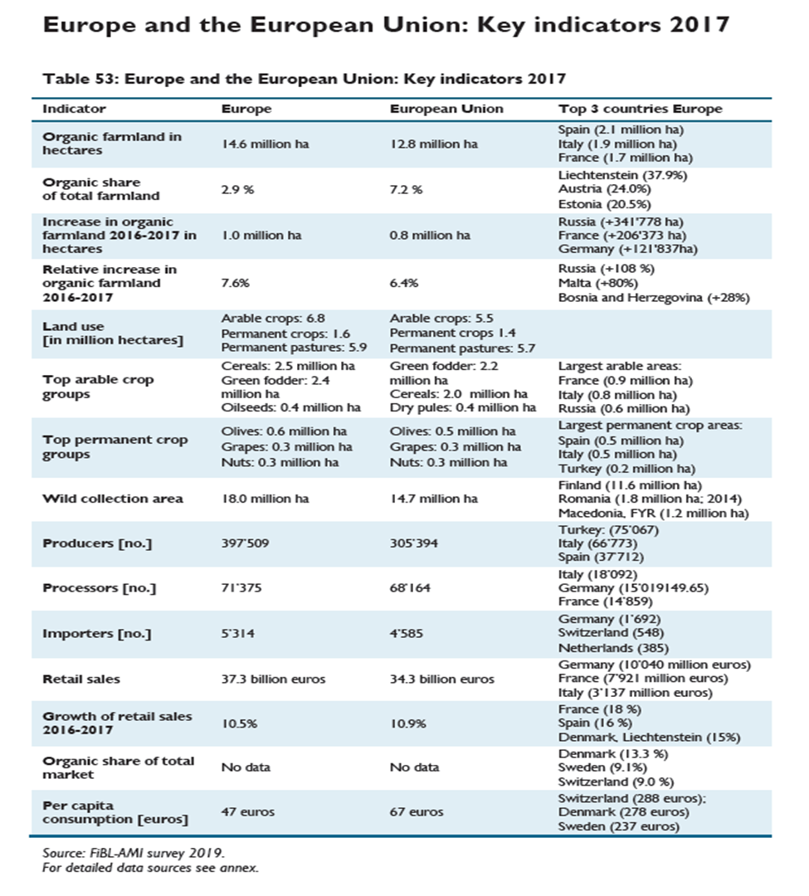

Slide 5
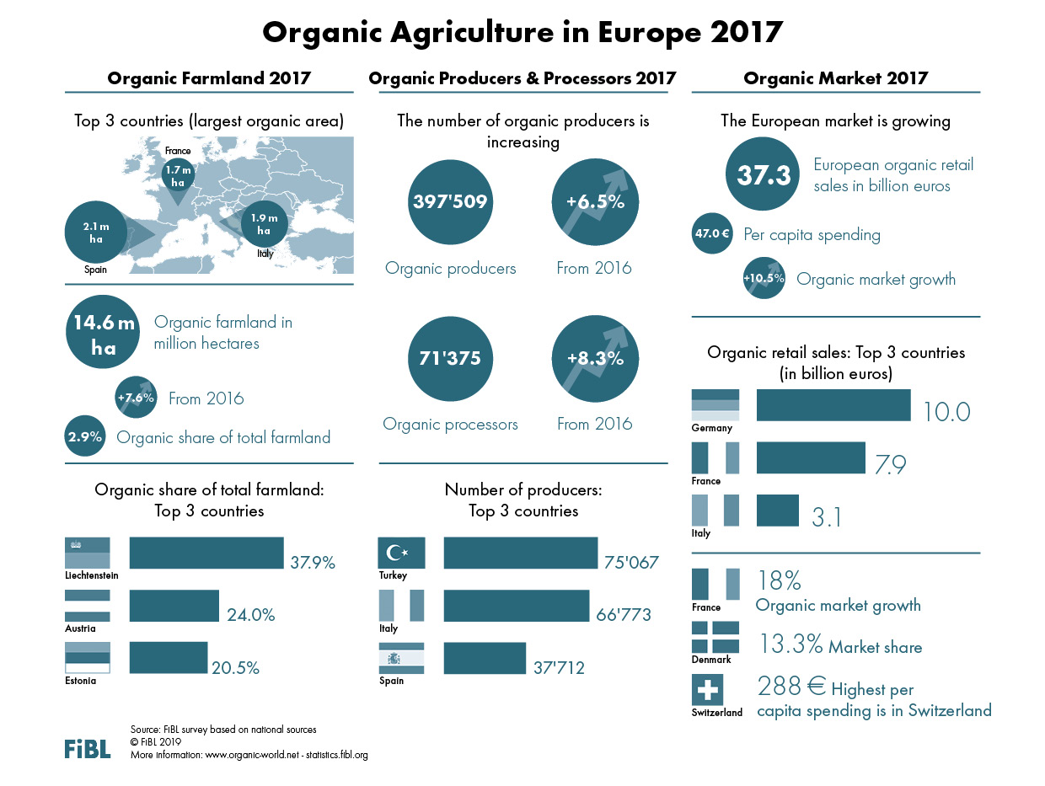

Slide 6
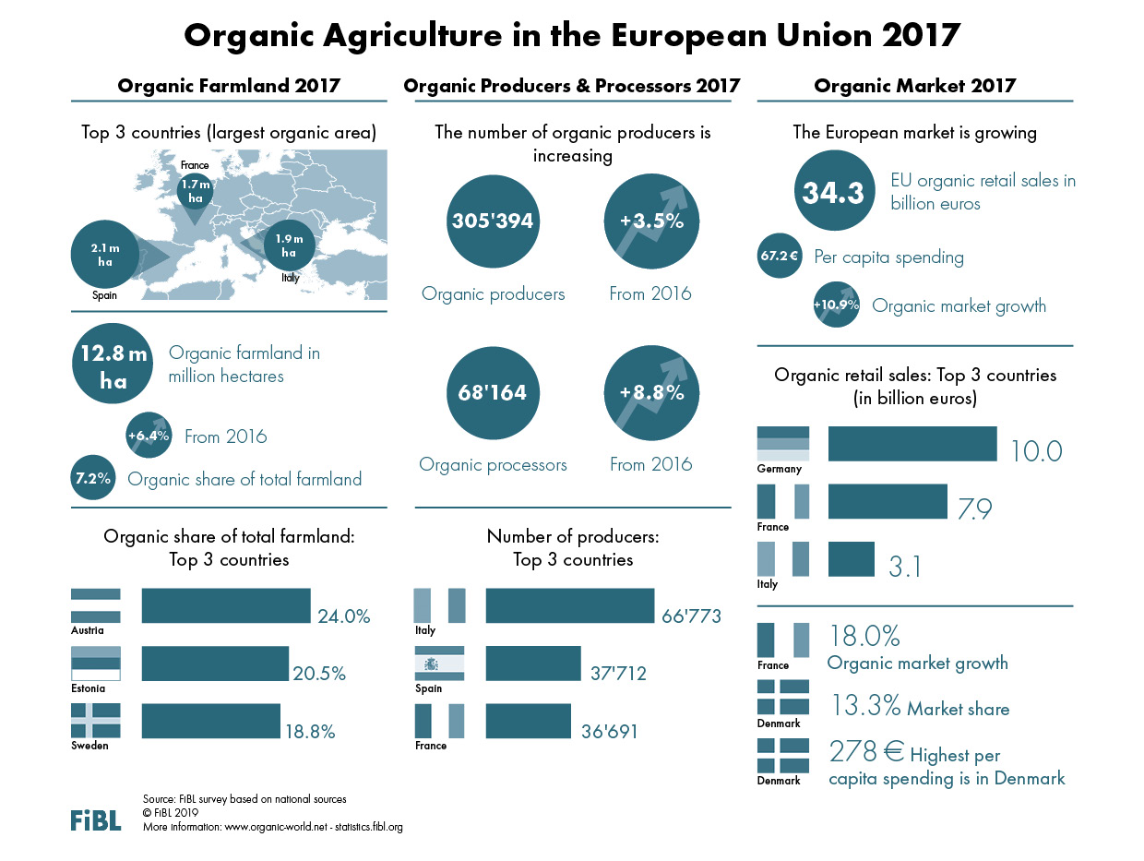

Slide 7
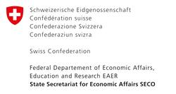
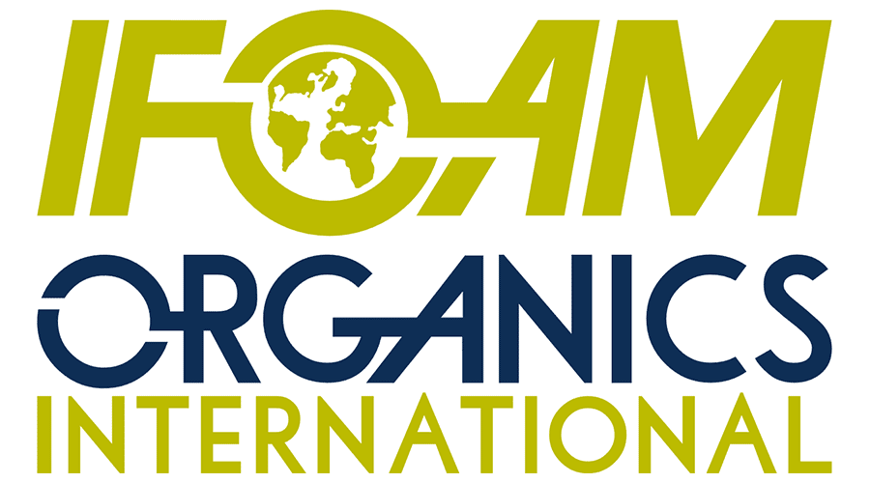
Acknowledgements
Swiss State Secretariat of Economic Affairs SECO
International Trade Centre ITC
Coop Sustainability Fund
NürnbergMesse, the organizers of BIOFACH
IFOAM – Organics International
More than 200 experts from all parts of the world contributed to the FiBL survey 2019.

Slide 8
The World of Organic Agriculture 2019 www.organic-world.net
The 20th edition of ‚The World of Organic Agriculture‘, was published by FiBL and IFOAM – Organics International in February 2019.
Data tables
Country and continent reports
Markets, standards, policy support
Get your copy at the FiBL Stand in Hall 1/553 or the stand of IFOAM - Organics International (1/451)
www.organic-world.net

Slide 9
Contact
Helga Willer and Julia Lernoud
Research Institute of Organic Agriculture (FiBL)
Ackerstrasse 113, 5070 Frick, Switzerland
Tel. +41 79 218 0626, Fax +41 62 865 7273
helga.willer@fibl.org und julia.lernoud@fibl.org
www.fibl.org, www.organic-world.net; www.fibl.stats.fibl.org
Willer, Helga and Julia Lernoud (Eds.) (2019): The World The World of Organic Agriculture. Statistics and Emerging Trends 2019. FiBL, Frick and IFOAM – Organics International, Bonn
http://www.organic-world.net/yearbook/yearbook-2019.html

