Slide 1
Organic agriculture worldwide 2017 - Graphs
Helga Willer and Julia Lernoud Research Institute of Organic Agriculture FiBL, Frick, Switzerland
Branchenpressekonferenz zur BIOFACH
Messezentrum Nürnberg, February 13, 2019

Slide 3
World: Market growth versus retail sales growth 2001-2017

Slide 4
Development of the number of countries with data on organic agriculture

Slide 5
The ten countries with the largest organic agricultural land 2013

Slide 6
Distribution of organic agricultural land by region 2013

Slide 7
The eleven countries with the highest shares of organic agricultural land 2013

Slide 8
Growth of the organic agricultural land 1999-2013

Slide 9
Growth of the organic agricultural land 1999-2013

Slide 10
Growth of the organic agricultural land by continent 1999-2013

Slide 11
Growth of the organic agricultural land by continent 2005-2013

Slide 12
Growth of the organic land by land use type 2004-2013

Slide 13
The ten countries with the largest numbers of organic producers 2013

Slide 14
Organic producers by region 2013

Slide 16
The ten countries with the largest per capita consumption for 2013

Slide 17
Global market: Distribution of total retail sales value by country (total: 56.2billion) Euros 2013

Slide 18
Global market: Distribution of total retail sales value by single markets (total: 47.8 billion) Euros 2013

Slide 19
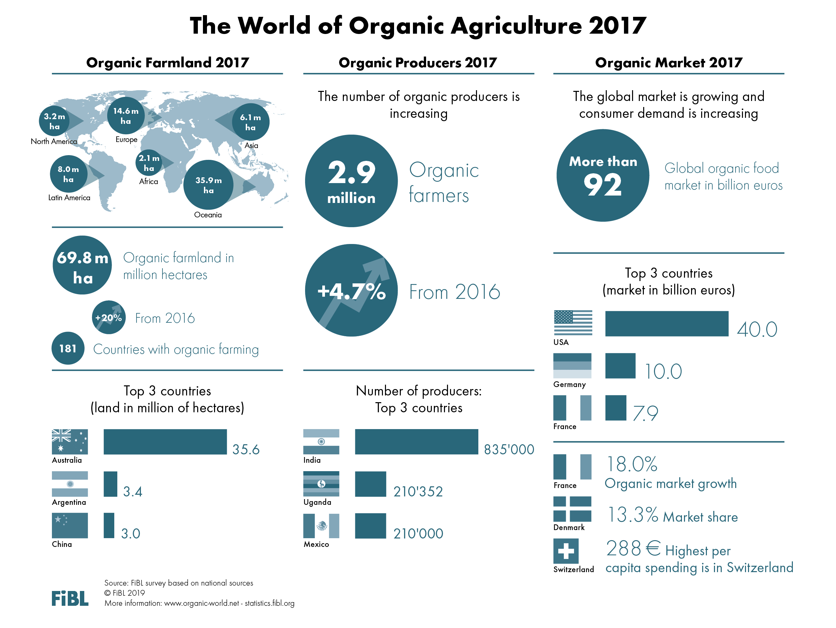

Slide 20
ORGANIC FARMLAND 2017
World 69.8 Mio ha
Australia 35.6 Mio ha
1.4% of the world’s farmland is organic
+533% since 1999
In Oceania there were 35.9 Mio ha, in Europe 14.6 Mio ha, and in Latin America 8 Mio ha.
The ten countries with the largest organic agricultural areas represent 79% of the world’s organic agricultural land.
14 countries have 10% or more of their agricultural land under organic management.
In 2017, over 11.7 million hectares more were reported compared with 2016.
Percentage
Distribution of organic
agricultural land by region 2017
The five countries with the largest areas of organic agricultural land 2017
Top 5 countries with more than 10 percent of organic agricultural land 2017
Growth of the organic
agricultural land 1999-2017
Source: FiBL survey 2019 www.organic-world.net – statistics.fibl.org

Slide 21
ORGANIC PRODUCERS 2017
World 2.9 million producers
+1ꞌ300% since 1999
40% in Asia
The country with the most organic producers is India, followed by Uganda and Mexico.
More than 84% of the producers are in Asia, Africa, and Latin America.
There has been an increase in the number of producers by almost 127’500, or over 5% since 2015.
The five countries with the largest numbers
of organic producers 2017
Distribution of organic producers by region 2017
Development of the number of organic
producers 1999-2017
Source: FiBL survey 2019 www.organic-world.net – statistics.fibl.org

Slide 22
ORGANIC RETAIL SALES 2017
World approx. 90 billion €
North America almost 42 billion €
288€ are spent per person in Switzerland
13.3% of the food market in Denmark is organic
The largest single market is the USA followed by the EU (34.3 billion €) and China. By region, North America has the lead (43 billion €), followed by Europe (37.3 billion €) and Asia.
The countries with the largest markets for organic food are the United States (40 billion €), followed by Germany (10 billion €), France (7.9 billion €) and China (7.6 billion €).
Switzerland has the highest per capita consumption worldwide, followed by Denmark and Sweden.
The highest shares the organic market of the total market is in Denmark, followed by Sweden, Switzerland, Austria, and Luxembourg.
Distribution of retail sales value
by country 2017
The five countries with the largest markets for organic food 2017
The five countries with the highest
per capita consumption 2017
The five countries with the highest organic shares of the total market 2017
Source: FiBL survey 2019 www.organic-world.net – statistics.fibl.org

Slide 23
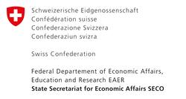
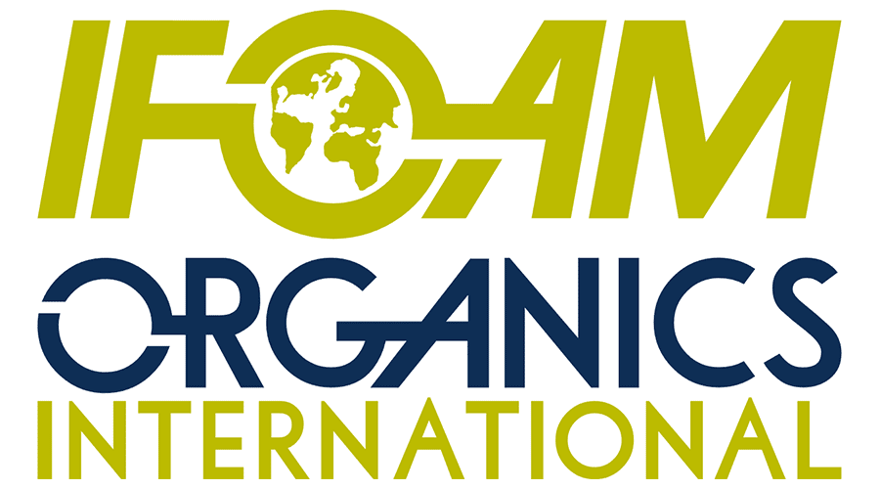
Acknowledgements
The Swiss State Secretariat of Economic Affairs SECO
International Trade Centre ITC
Coop Sustainability Fund
NürnbergMesse, the organizers of BIOFACH
IFOAM – Organics International
More than 200 experts from all parts of the world contributed to the FiBL survey 2019.

Slide 24
The World of Organic Agriculture 2019 www.organic-world.net
The 20th edition of ‚The World of Organic Agriculture‘, was published by FiBL and IFOAM – Organics International in February 2019.
Data tables
Country and continent reports
Markets, standards, policy support
Get your copy at the FiBL Stand in Hall 1/553 or the stand of IFOAM - Organics International (1/451)
www.organic-world.net

Slide 25
Contact
Helga Willer and Julia Lernoud
Research Institute of Organic Agriculture (FiBL)
Ackerstrasse 113, 5070 Frick, Switzerland
Tel. +41 79 218 0626, Fax +41 62 865 7273
helga.willer@fibl.org und julia.lernoud@fibl.org
www.fibl.org, www.organic-world.net; www.fibl.stats.fibl.org
Willer, Helga and Julia Lernoud (Eds.) (2019): The World The World of Organic Agriculture. Statistics and Emerging Trends 2019. FiBL, Frick and IFOAM – Organics International, Bonn
http://www.organic-world.net/yearbook/yearbook-2019.html

