Slide 1
European organic market grew to 40.7 billion euros in 2018 - Graphs
Media release of FiBL and AMI of February 12, 2020
Research Institute of Organic Agriculture, CH-Frick, and Agrarmarkt Informations-Gesellschaft, DE-Bonn

Slide 2
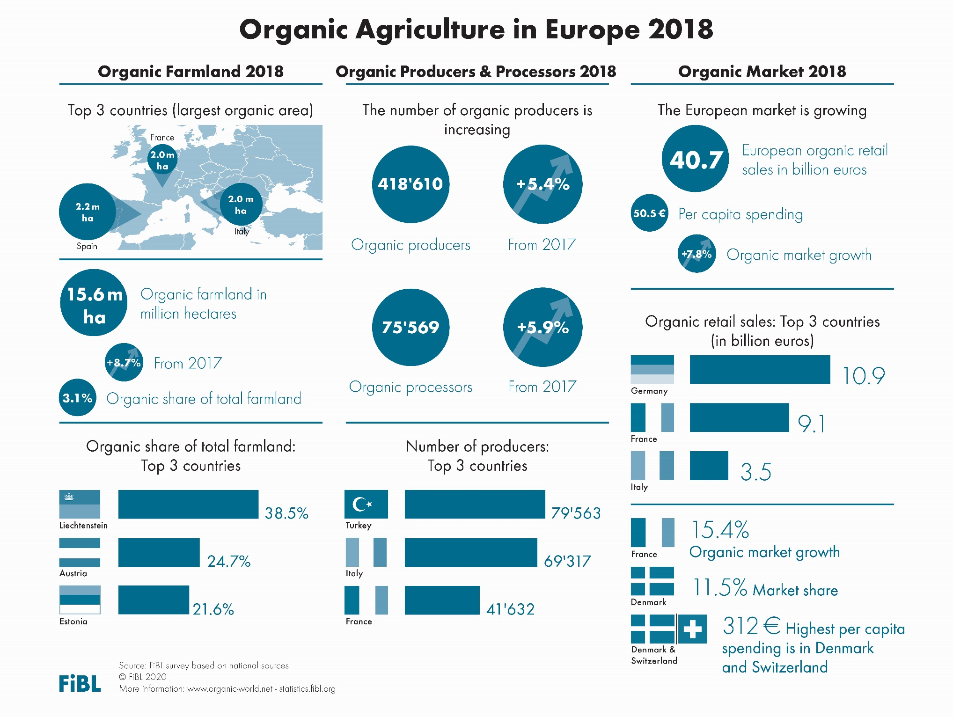

Slide 3
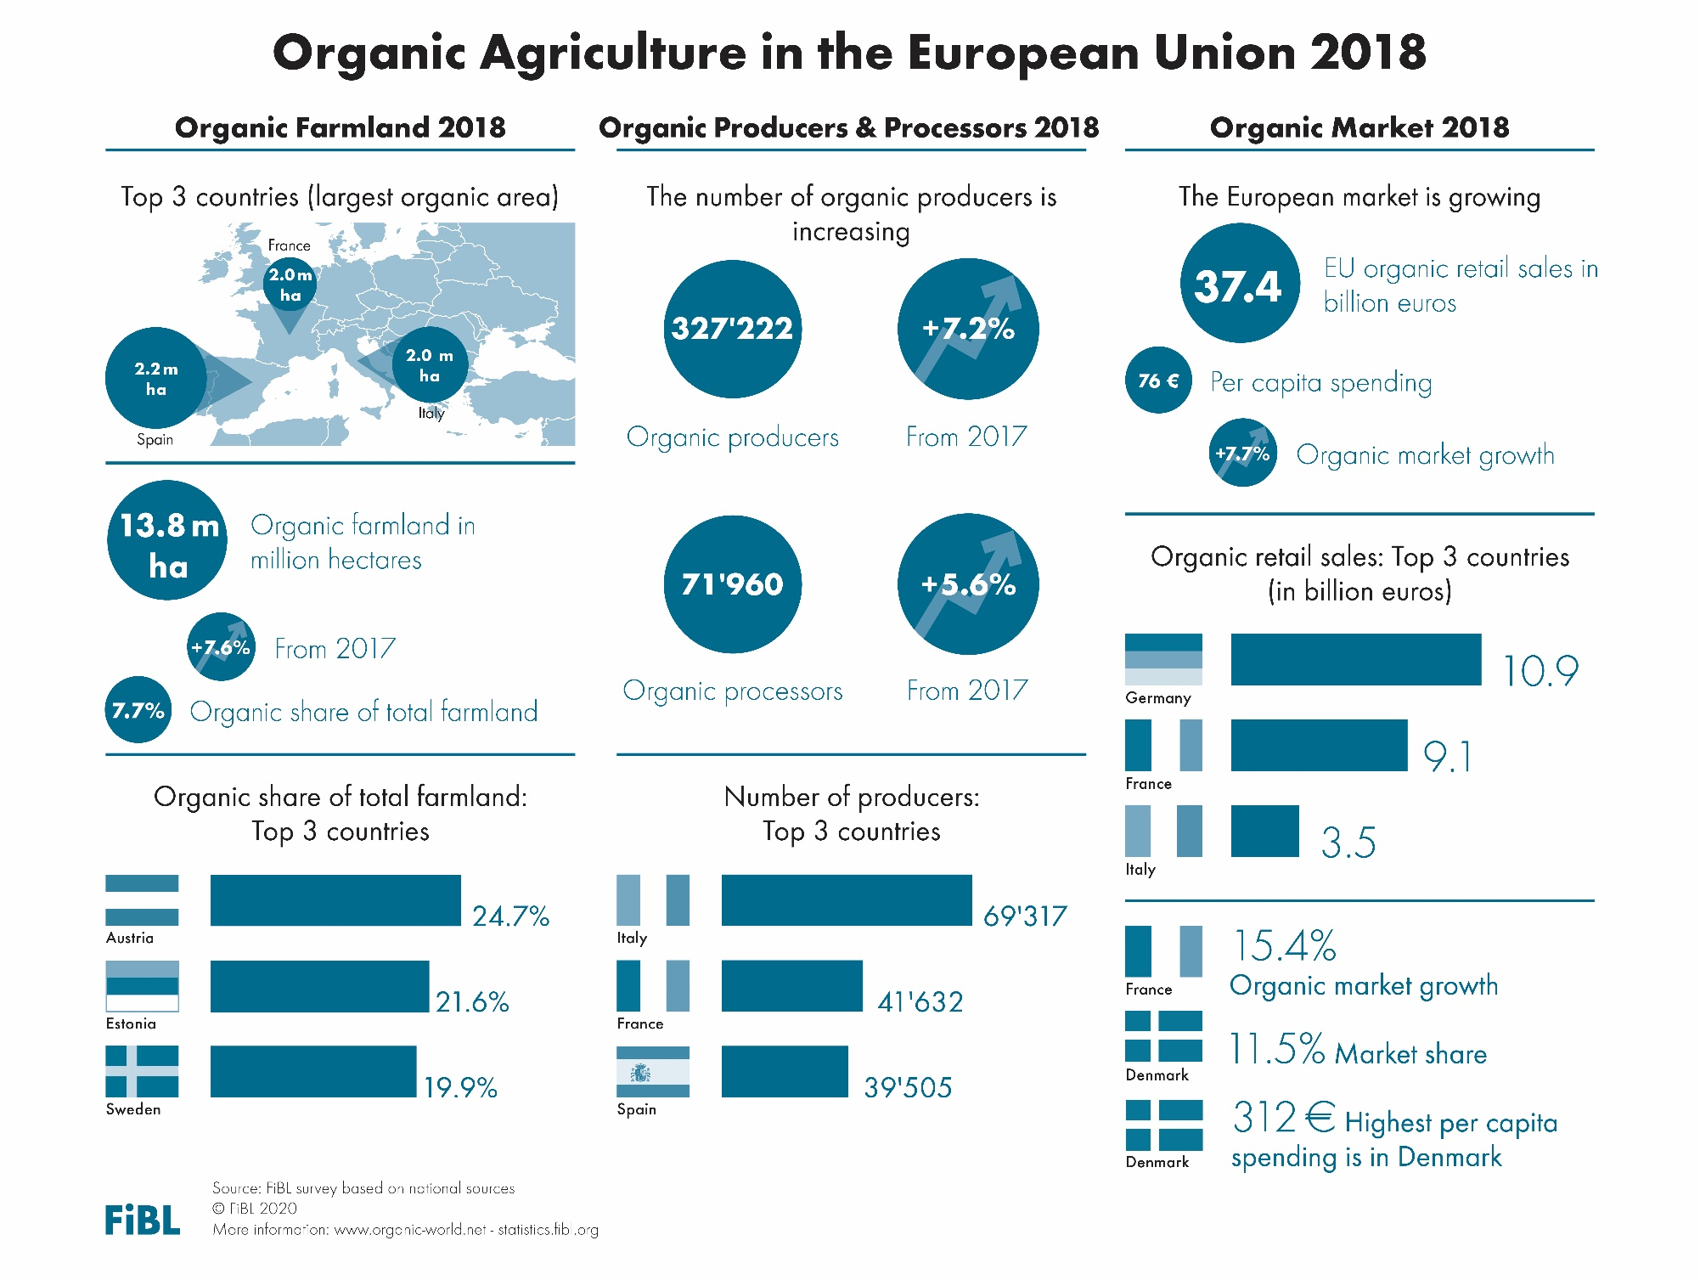

Slide 4
EUROPE: ORGANIC FARMLAND 2018
Europe 15.6 Million ha
Spain 2.2 Million ha
3.1% of Europe’s farmland is organic (EU 7.7%)
+69% in the decade 2009-2018
Half of Europe´s organic farmland is in 4 countries.
The country with the largest area of organic farmland is in Spain, followed by France and Italy.
Ten countries have 10% or more of their agricultural land under organic management.
In 2018 over 1.25 million hectares more were reported compared with 2017.
Spain
Liechtenstein
France
Austria
Italy
Estonia
Germany
Sweden
Turkey
Italy
Percentage
Distribution of organic
agricultural land by country 2018
Top 5 countries with the largest areas of organic agricultural land 2018
Top 5 countries, where more than 10 percent of the farmland is organic 2018
Growth of the organic
agricultural land 1985–2018
Source: FiBL-AMI survey 2020, www.organic-world.net

Slide 5
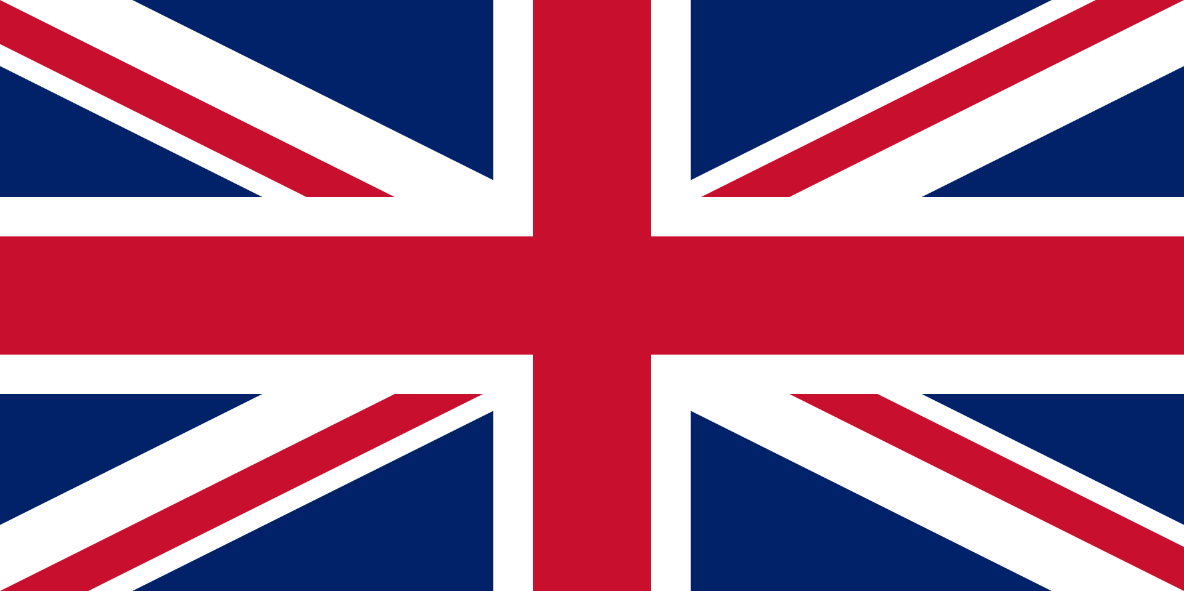
EUROPE: ORGANIC RETAIL SALES 2018
Europe 40.7 billion €
Germany 10.9 billion €
312 € are spent per person in Switzerland and Dennmark
11.5 % of the food market in Denmark is organic
The European Union (37.4 billion €) is the second largest single market after the US (40.6 billion €) and China. By region, North America has the lead (43 billion €), followed by Europe and Asia.
The European countries with the largest markets for organic food are Germany, France (9.1 billion €), Italy (3.5 billion €), and Switzerland (2.7 billion €).
Denmark and Switzerland have the highest per capita consumption worldwide, followed by Sweden, Luxembourg and Austria.
The country with the highest organic share of their total market is Denmark, followed by Switzerland, Sweden, Austria, and Luxembourg.
Germany
Switzerland
Denmark
France
Denmark
Switzerland
Italy
Sweden
Sweden
Switzerland
Luxembourg
Austria
UK
Austria
Luxembourg
Distribution of retail sales value worldwide by Country 2018
The countries with the largest markets for organic food 2018
The countries with the highest
per capita consumption of organic food 2018
The countries with the highest organic shares of the total market 2018
Source: FiBL-AMI survey 2020. www.organic-world.net

Slide 6
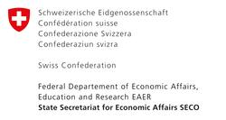
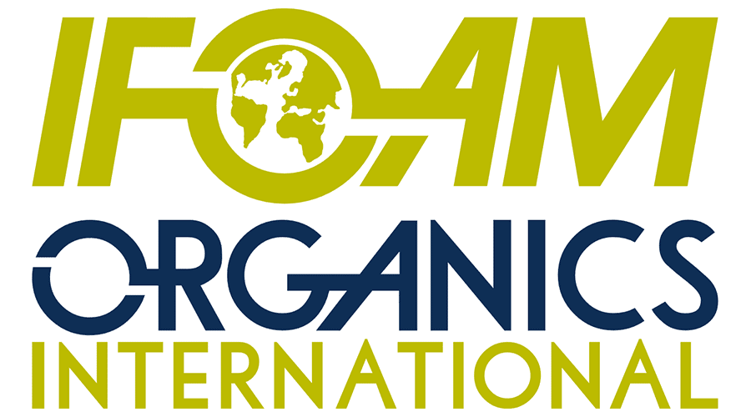
Acknowledgements
Swiss State Secretariat of Economic Affairs (SECO)
International Trade Centre (ITC)
Coop Sustainability Fund
NürnbergMesse, the organizers of BIOFACH
IFOAM – Organics International
More than 200 experts from all parts of the world contributed to the FiBL survey 2020.

Slide 7
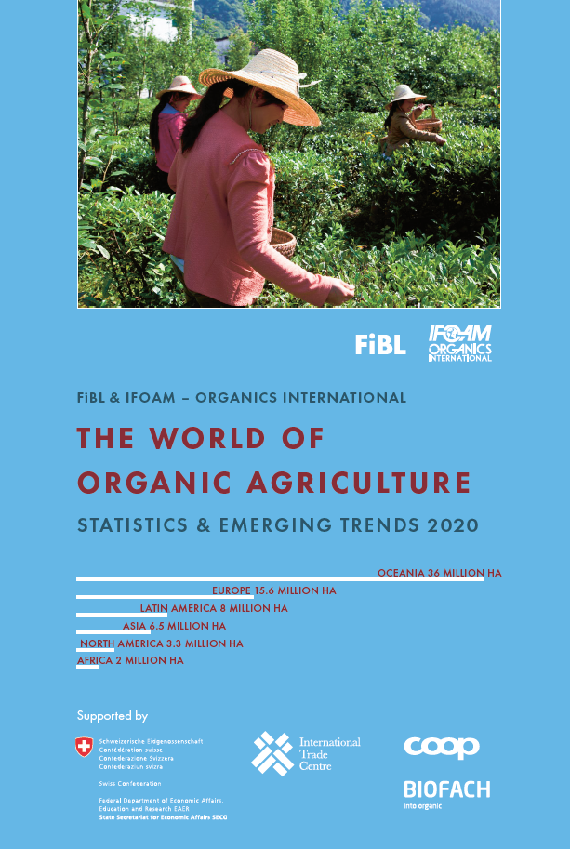
The World of Organic Agriculture 2019 www.organic-world.net
The 21st edition of ‚The World of Organic Agriculture‘, was published by FiBL and IFOAM – Organics International in February 2020.
Data tables
Country and continent reports
Markets, standards, policy support
Get your copy at the FiBL stand in Hall 1/553 or the stand of IFOAM - Organics International (1/451)
www.organic-world.net

Slide 8
Contact
Helga Willer Research Institute of Organic Agriculture (FiBL) Ackerstrasse 113, 5070 Frick, Switzerland Tel. +41 79 218 0626, Fax +41 62 865 7273 helga.willer@fibl.org www.fibl.org, www.organic-world.net; statistics.fibl.org
Willer, Helga, Bernhard Schlatter, Jan Trávníček, Laura Kemper and Julia Lernoud (Eds.) (2020): The World of Organic Agriculture. Statistics and Emerging Trends 2020. Research Institute of Organic Agriculture (FiBL), Frick, and IFOAM – Organics International, Bonn.
Available at www.organic-world.net/yearbook/yearbook-2020.html

