Slide 1
Global organic area continues to grow - Graphs
FiBL-IFOAM media release, February 12, 2020
Research Institute of Organic Agriculture FiBL, CH-Frick and IFOAM – Organics International, DE-Bonn

Slide 2
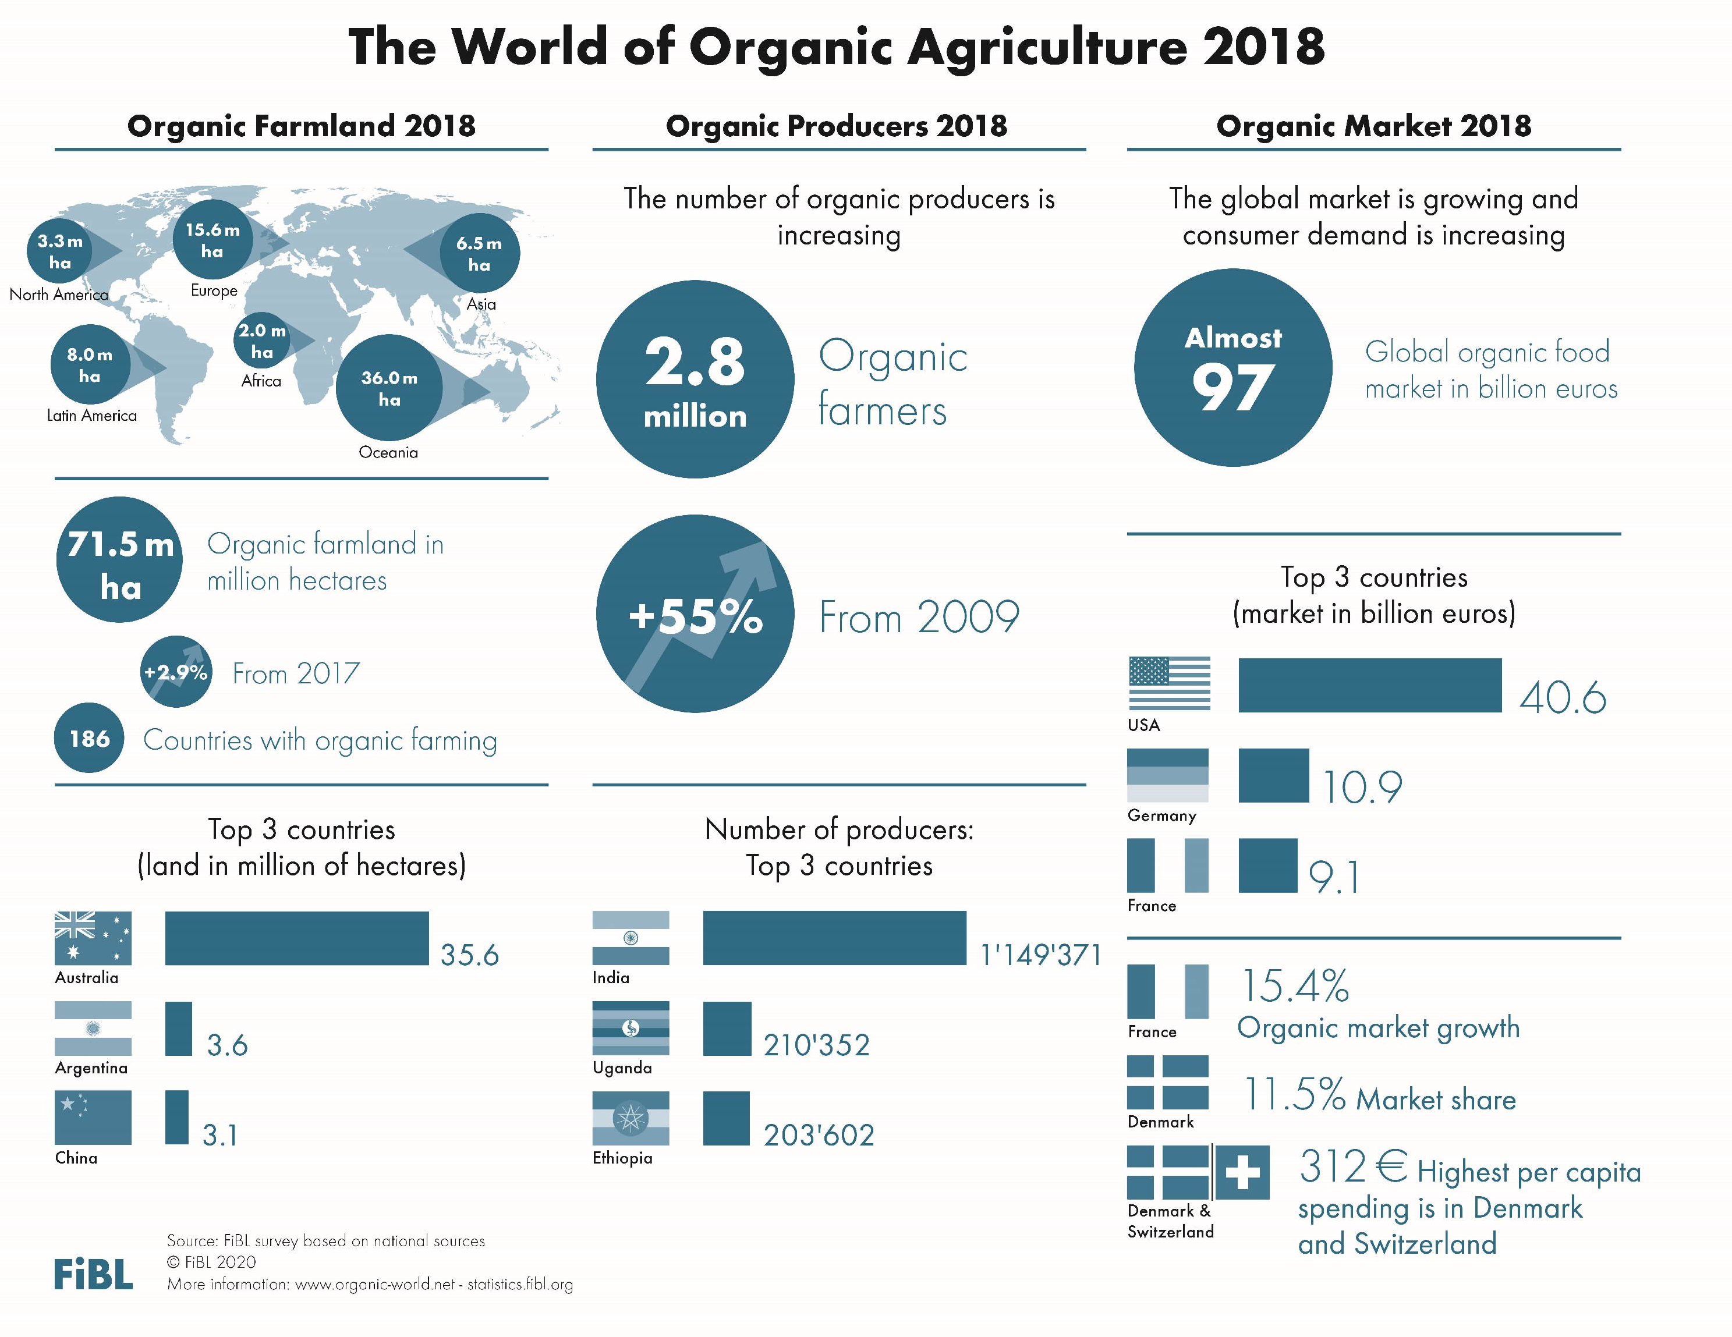

Slide 3
ORGANIC FARMLAND 2018
World 71.5 Mio ha
Australia 35.69 Mio ha
1.5 % of the world’s farmland is organic
+546 % since 1999
In Oceania there were 36.0 Mio ha, in Europe 15.6 Mio ha, and in Latin America 8.0 Mio ha.
The ten countries with the largest organic agricultural areas represent 79% of the world’s organic agricultural land.
16 countries have 10% or more of their agricultural land under organic management.
In 2018, over 2.0 million hectares more were reported compared with 2017.
Percentage
Distribution of organic
agricultural land by region 2018
The five countries with the largest areas of organic agricultural land 2018
Top 5 countries with more than 10 percent of organic agricultural land 2018
Growth of the organic
agricultural land 1999-2018
Source: FiBL survey 2020 www.organic-world.net – statistics.fibl.org

Slide 4
ORGANIC LAND USE 2018
13.3 Mio ha arable land
4.8 Mio ha permanent crops
48.2 Mio ha permanent grassland
35.1 Mio ha wild collection
Arable land constitutes 18.6% of the world’s organic agricultural land, and 1.1% of the world’s arable crop land. It increased by 5.1% over 2017.
Permanent crops constitute 6.7% of the world’s organic agricultural land, and 2.9% of the world’s permanent cropland. It decreased by 2.9% over 2017.
Permanent grassland constitutes 67.4% of the world’s organic agricultural land, and 1.5% of the world´s permanent grassland. It increased by 3.0% over 2017.
Over 82% of the wild collection is in Europe (almost 18 million hectares) and Africa (over 14.3 million hectares)
Organic arable land by region 2018
Organic permanent crops by region 2018
Organic permanent grassland by region 2018
Organic wild collection by region 2018
Organic arable land: The five countries with the largest areas 2018
Organic permanent crops:The five countries with the largest areas 2018
Organic permanet grassland: The five countries with the largest areas 2018
Organic wild collection: The five countries with the largest areas 2018
Source: FiBL survey 2020, www.organic-world.net – statistics.fibl.org

Slide 5
ORGANIC PRODUCERS 2018
World 2.8 million producers
+1ꞌ270% since 1999
47 % in Asia
The country with the most organic producers is India, followed by Uganda and Ethiopia.
More than 90% of the producers are in Asia, Africa, and Europe.
There has been an increase in the number of producers by almost 991'684, or over 55% over the past decade.
The five countries with the largest numbers
of organic producers 2018
Distribution of organic producers by region 2018
Development of the number of organic
producers 1999-2018
Source: FiBL survey 2020 www.organic-world.net – statistics.fibl.org

Slide 6
ORGANIC RETAIL SALES 2018
World almost 97 billion €
North America almost 44 billion €
312€ are spent per person in Denmark and Switzerland
11.5 % of the food market in Denmark is organic
The largest single market is the USA (40.6 billion €), followed by the EU (37.4 billion €) and China. By region, North America has the lead (43.7 billion €), followed by Europe (40.7 billion €) and Asia.
The countries with the largest markets for organic food are the United States (41 billion €), Germany (11 billion €), France (9 billion €) and China (8 billion €).
Denmark and Switzerland have the highest per capita consumption worldwide, followed by Sweden, Luxembourg and Austria.
The highest organic share of the total market is in Denmark, followed by Switzerland, Sweden, Austria, and Luxembourg.
Distribution of retail sales value
by country 2018
The five countries with the largest markets for organic food 2018
The five countries with the highest
per capita consumption 2018
The five countries with the highest organic shares of the total market 2018
Source: FiBL survey 2020 www.organic-world.net – statistics.fibl.org

Slide 11
Growth of the organic agricultural land 1999-2013

Slide 12
Growth of the organic agricultural land by continent 2005-2013

Slide 13
Growth of the organic land by land use type 2004-2013

Slide 14
The ten countries with the largest numbers of organic producers 2013
Notes:
What data year should be mentioned?

Slide 15
Organic producers by region 2013

Slide 17
The ten countries with the largest per capita consumption for 2013
Notes:
Per capita not complete

Slide 18
World: Distribution of organic retail sales 2018

Slide 19
Global market: Distribution of total retail sales value by single markets (total: 47.8 billion) Euros 2013

Slide 20
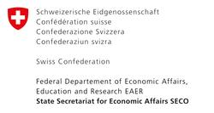
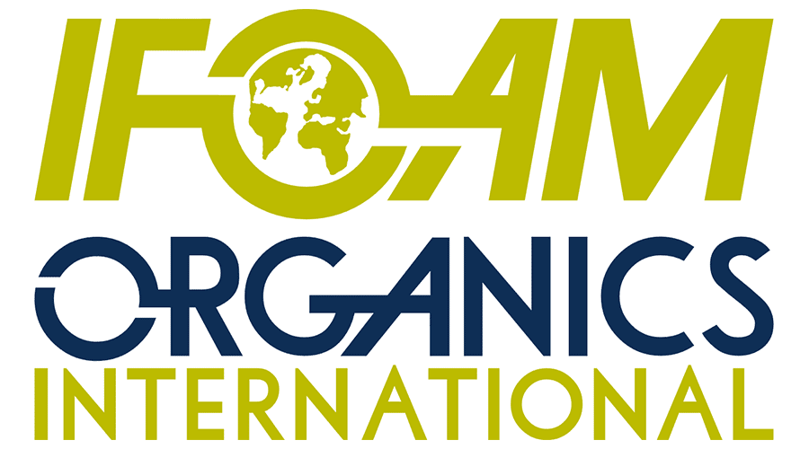
Acknowledgements
The Swiss State Secretariat of Economic Affairs (SECO)
International Trade Centre (ITC)
Coop Sustainability Fund
NürnbergMesse, the organizers of BIOFACH
IFOAM – Organics International
More than 200 experts from all parts of the world contributed to the FiBL survey 2020.

Slide 21
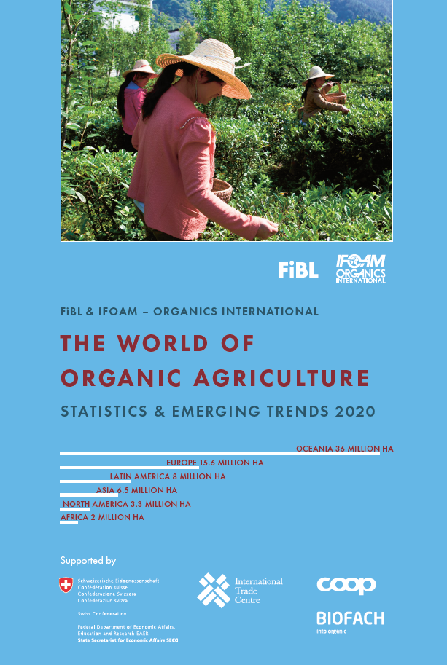
The World of Organic Agriculture 2020 www.organic-world.net
The 21st edition of ‚The World of Organic Agriculture‘, was published by FiBL and IFOAM – Organics International in February 2020.
Data tables
Country and continent reports
Markets, standards, policy support
Get your copy at the FiBL Stand in Hall 1/553 or the stand of IFOAM - Organics International (1/451)
www.organic-world.net

Slide 22
Contact
Helga Willer Research Institute of Organic Agriculture (FiBL) Ackerstrasse 113, 5070 Frick, Switzerland Tel. +41 79 218 0626, Fax +41 62 865 7273 helga.willer@fibl.org www.fibl.org www.organic-world.net; statistics.fibl.org
Willer, Helga, Bernhard Schlatter, Jan Trávníček, Laura Kemper and Julia Lernoud (Eds.) (2020): The World of Organic Agriculture. Statistics and Emerging Trends 2020. Research Institute of Organic Agriculture (FiBL), Frick, and IFOAM – Organics International, Bonn.
Available at www.organic-world.net/yearbook/yearbook-2020.html

