Slide 1
Organic Agriculture Worldwide 2017
Julia Lernoud and Helga Willer
Research Institute of Organic Agriculture (FiBL), Frick, Switzerland
February 09, 2017

Slide 2
Infographics

Slide 4
WORLD: ORGANIC FARMLAND 2015
World 50.9 Mio ha
Australia 22.7 Mio ha
1% of the world’s farmland is organic
+360% since 1999
In Oceania, there were 22.8 Mio ha, in Europe 12.7 Mio ha, and in Latin America 6.7 Mio ha.
The ten countries with the largest organic agricultural areas represent 74% of the world’s organic agri-cultural land.
11 countries have 10% or more of their agricultural land under organic management.
In 2015, almost 6.5 million hectares more were reported compared with 2014.
Australia
Liechtenstein
Argentina
Austria
US
Sweden
Spain
Estonia
China
Sao Tome & Principe
Percentage
Distribution of organic
agricultural land by region 2015
The five countries with the largest areas of organic agricultural land 2015
Top 5 countries , where more than 10 percent of the farmland is organic 2015
Growth of the organic
agricultural land 1999-2015
Source: FiBL survey 2017 www.organic-world.net

Slide 5
WORLD: ORGANIC LAND USE 2015
10 Mio ha arable land
+19% more permanent crops
63% grassland
39.4 Mio ha of wild collection
65% grassland
Arable land represents 0.7% of the world’s arable crop land, 10 Mio ha, and 19.6% of the world’s organic agricultural land. It increased by 12.9% over 2014.
Organic permanent crops represent 2.5% of the world’s permanent cropland, 4 Mio ha, and 8% of the organic agricultural land. They increased by 19% over 2014.
Permanent grassland represents 1.0% of the world’s permanent grassland, 33.1 Mio ha, and 65% of the organic agricultural land. It increased by 17% over 2014.
The organic wild collection areas are concentrated in Europe, Africa, Asia, and Latin America.
Australia
Finland
Argentina
Zambia
Uruguay
India
Spain
Namibia
US
Romania
Organic arable land by region 2015
Organic permanent crops by region 2015
Organic permanent grassland by region 2015
Organic wild collection by region 2015
Organic arable land: Key crops 2015
Organic permanent crops: Key crops 2015
Organic permanet grassland: The five countries with the largest areas 2015
Organic wild collection: The five countries with the largest areas 2015
Source: FiBL survey 2017 www.organic-world.net

Slide 6
WORLD: ORGANIC PRODUCERS 2015
World 2.4 Mio producers
+1’000% since 1999
35% in Asia
The country with the most organic producers is India, followed by Ethiopia and Mexico.
More than 84% of the producers are in Asia, Africa, and Latin America.
There has been an increase in the number of producers by more than 160’000, or over 7% since 2014.
India
Ethiopia
Mexico
Uganda
Philippines
The five countries with the largest numbers
of organic producers 2015
Distribution of organic producers by region 2015
Development of the number of organic
producers 1999-2015
Source: FiBL survey 2017 www.organic-world.net

Slide 7
WORLD: ORGANIC RETAIL SALES 2015
World Approx. 75 billion €
North America almost 39 billion €
262€ are spent per person in Switzerland
8.4% of the food market in Denmark is organic
The largest single market is the USA followed by the EU (27.1 billion €) and China. By region, North America has the lead (38.5 billion €), followed by Europe (29.8 billion €) and Asia.
The countries with the lar-gest market for organic food are the United States (35.8 billion €), followed by Germany (8.6 billion €), France (5.5 billion €) and China (4.7 billion €).
Switzerland has the highest per capita consumption worldwide, followed by Denmark and Sweden.
The highest shares the organic market of the total market is in Denmark, followed by Switzerland, Luxembourg, Sweden, and Austria.
US
Switzerland
Denmark
Germany
Denmark
Switzerland
France
Sweden
Luxembourg
China
Luxembourg
Sweden
Canada
Liechtenstein
Austria (2011)
Distribution of retail sales value
by country 2015
The five countries with the largest markets for organic food 2015
The five countries with the highest
per capita consumption 2015
The five countries with the highest organic shares of the total market 2015
Source: FiBL survey 2017 www.organic-world.net

Slide 8
Graphs

Slide 10
Development of the number of countries with data on organic agriculture

Slide 11
The ten countries with the largest organic agricultural land 2012

Slide 12
Distribution of organic agricultural land by region 2012

Slide 13
The ten countries with the highest shares of organic agricultural land 2012

Slide 14
Growth of the organic agricultural land 1999-2012

Slide 15
Growth of the organic agricultural land by continent 1999-2012

Slide 16
Growth of the organic agricultural land by continent 2005-2013

Slide 17
Growth of the organic land by land use type 2004-2013

Slide 18
The ten countries with the largest numbers of organic producers 2012

Slide 19
Organic producers by region 2012

Slide 20
The ten countries with the largest markets for organic food 2012

Slide 21
The ten countries with the largest per capita consumption for 2012

Slide 22
Global market: Distribution of total retail sales value by country

Slide 23
Global market: Distribution of total retail sales value by single markets (total: 47.8 billion) Euros 2013

Slide 25
Maps

Slide 27
Africa

Slide 28
Asia

Slide 29
Europe

Slide 30
Latin America and the Caribbean

Slide 31
North America

Slide 32
Oceania

Slide 33
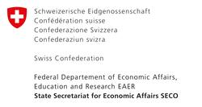
Acknowledgements
The Swiss State Secretariat of Economic Affairs SECO, Berne
International Trade Centre ITC
Nürnberg Messe, the organizers of the BioFach World Organic Trade Fair
200 experts from all parts of the world contributed to the FiBL-IFOAM survey 2017.

Slide 34
The World of Organic Agriculture 2017
The 18th edition of ‚The World of Organic Agriculture‘, was published by FiBL and IFOAM – Organics International in February 2017.*
Contents:
Results of the survey on organic agriculture worldwide;
Organic agriculture in the regions and country reports; Australia, Canada, Kenya, the Pacific Islands, and the United States of America.
Chapters on the global market, standards & legislations, voluntary standards , PGS, and policy support;
Numerous tables and graphs;
New addittions: Metadata on the FiBL survey on organic agriculture worldwide
Land use: a chapter from Textile Exchange on organic cotton production
Global Market: global market for organic food by Organic Monitor, and an overview of the organic and Fairtrade markets
The book can be ordered via IFOAM.bio and shop.FiBL.org.
*Willer, H, Lernoud, J, (eds.) (2017) The World of Organic Agriculture. Statistics and Emerging Trends 2017. FiBL, Frick, and, IFOAM – Organics International, Bonn
http://www.organic-world.net/yearbook/yearbook-2017.html

Slide 35
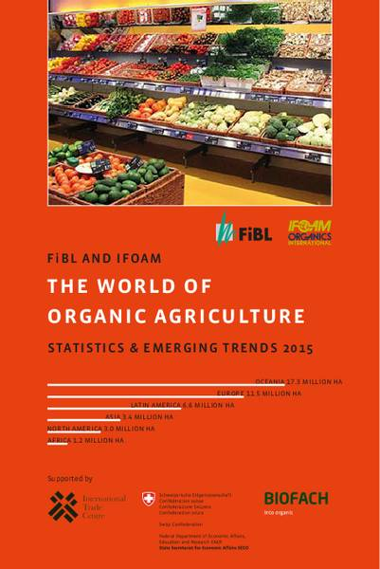
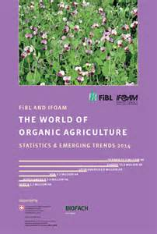
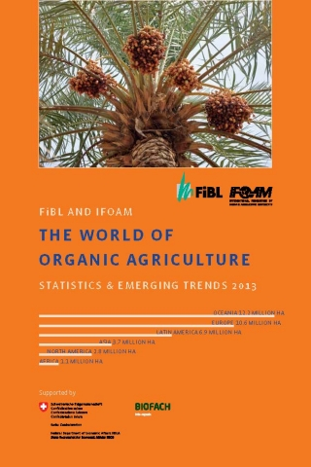
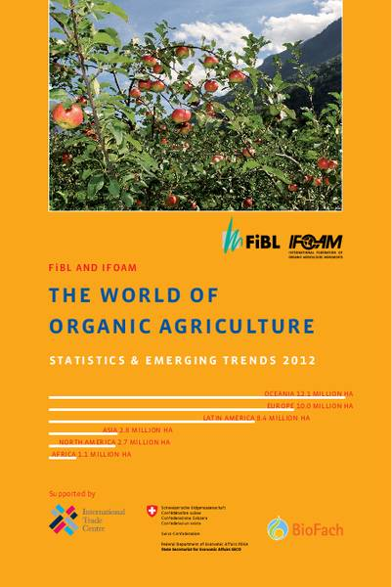
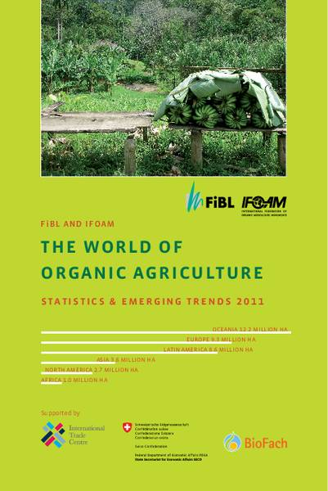
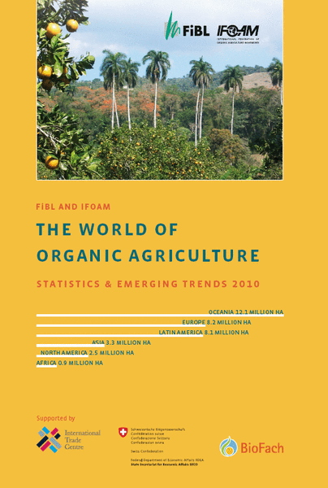
The World of Organic Agriculture, edition 2010 to 2017, www.organic-world.net

Slide 36
Contact
Helga Willer and Julia Lernoud
Research Institute of Organic Agriculture (FiBL)
Ackerstrasse 113, 5070 Frick, Switzerland
Tel. +41 79 218 0626, Fax +41 62 865 7273
helga.willer@fibl.org und julia.lernoud@fibl.org
www.fibl.org, www.organic-world.net
Willer, Helga and Julia Lernoud (Eds.) (2017): The World The World of Organic Agriculture. Statistics and Emerging Trends 2017. FiBL, Frick and IFOAM – Organics International, Bonn
http://www.organic-world.net/yearbook/yearbook-2017.html

