Slide 1
EUROPE: ORGANIC FARMLAND 2016
Europe 13.5 Million ha
Spain 2.02 Million ha
2.7% of Europe s farmland is organic (EU 6.7%)
+73% in the decade 2007-2016
Half of Europe´s organic farmland is in 4 countries.
The country with the largest area of organic farmland is in Spain, followed by Italy and France.
Nine countries have 10% or more of their agricultural land under organic management.
In 2016, almost 0.85 million hectares more were reported compared with 2015.
Spain
Liechtenstein
Italy
Austria
France
Estonia
Germany
Sweden
Austria
Italy
Percentage
Distribution of organic
agricultural land by country 2016
Top 5 countries with the largest areas of organic agricultural land 2016
Top 5 countries , where more than 10 percent of the farmland is organic 2016
Growth of the organic
agricultural land 1985–2016
Source: FiBL survey 2018 www.organic-world.net

Slide 2
EUROPE: ORGANIC RETAIL SALES 2016
Europe 33.5 billion €
Germany 9.5 billion €
274 € are spent per person in Switzerland
9.7 % of the food market in Denmark is organic
The European Union (30.7 billion €) is the second largest single market after the US (38.9 billion) and China. By region, North America has the lead (41.9 billion €), followed by Europe (33.5 billion €) and Asia.
The European countries with the largest markets for organic food are Germany (9.5 billion €), France (6.7 billion €), Italy (2.6 billion €), and the UK (2.5 billion €).
Switzerland has the highest per capita consumption of organic food worldwide, followed by Denmark and Sweden.
The highest organic share of the total market is in Denmark, followed by Luxembourg, Switzerland, Sweden, and Austria.
Germany
Switzerland
Denmark
France
Denmark
Luxembourg
Italy
Sweden
Switzerland
UK
Luxembourg
Sweden
Switzerland
Austria
Austria
Distribution of retail sales value worldwide by country 2016
The countries with the largest markets for organic food 2016
The countries with the highest
per capita consumption of organic food 2016
The countries with the highest organic shares of the total market 2016
Source: FiBL survey 2018 www.organic-world.net

Slide 4
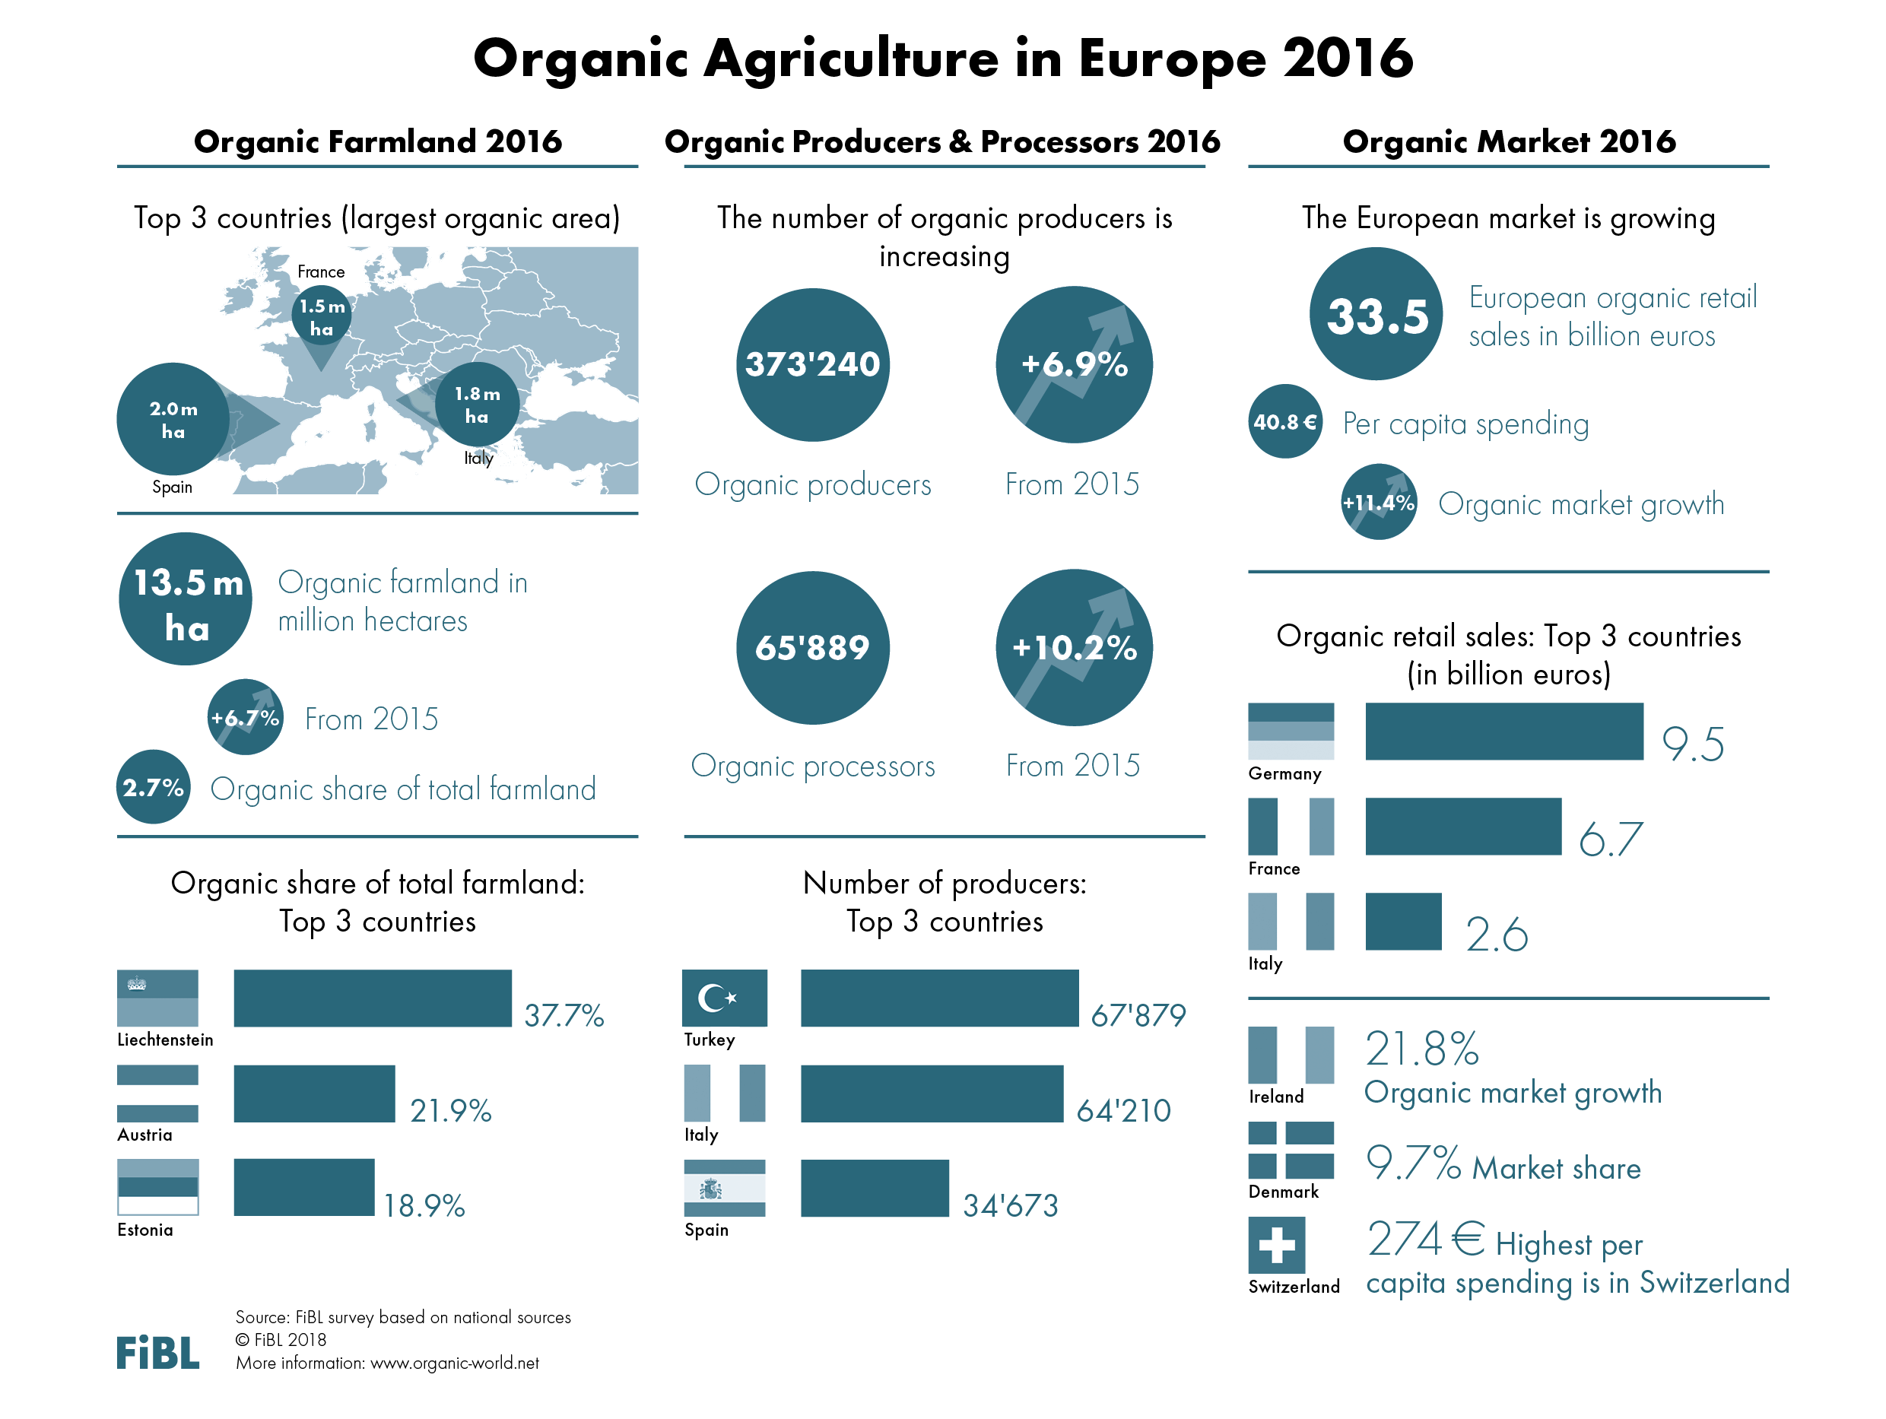

Slide 5
