Slide 1
Press release

Slide 2
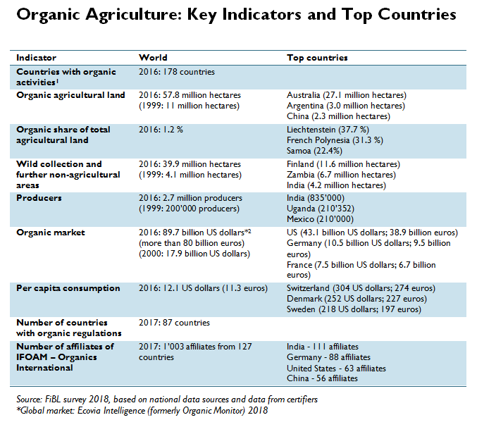


Slide 3
World: Market growth versus retail sales growth 2001-2016

Slide 4
Development of the number of countries with data on organic agriculture

Slide 5
The ten countries with the largest organic agricultural land 2013

Slide 6
Distribution of organic agricultural land by region 2013

Slide 7
The eleven countries with the highest shares of organic agricultural land 2013

Slide 8
Growth of the organic agricultural land 1999-2013

Slide 9
Growth of the organic agricultural land 1999-2013

Slide 10
Growth of the organic agricultural land by continent 1999-2013

Slide 11
Growth of the organic agricultural land by continent 2005-2013

Slide 12
Growth of the organic land by land use type 2004-2013

Slide 13
The ten countries with the largest numbers of organic producers 2013

Slide 14
Organic producers by region 2013

Slide 16
The ten countries with the largest per capita consumption for 2013

Slide 17
Global market: Distribution of total retail sales value by country (total: 56.2billion) Euros 2013

Slide 18
Global market: Distribution of total retail sales value by single markets (total: 47.8 billion) Euros 2013

Slide 19
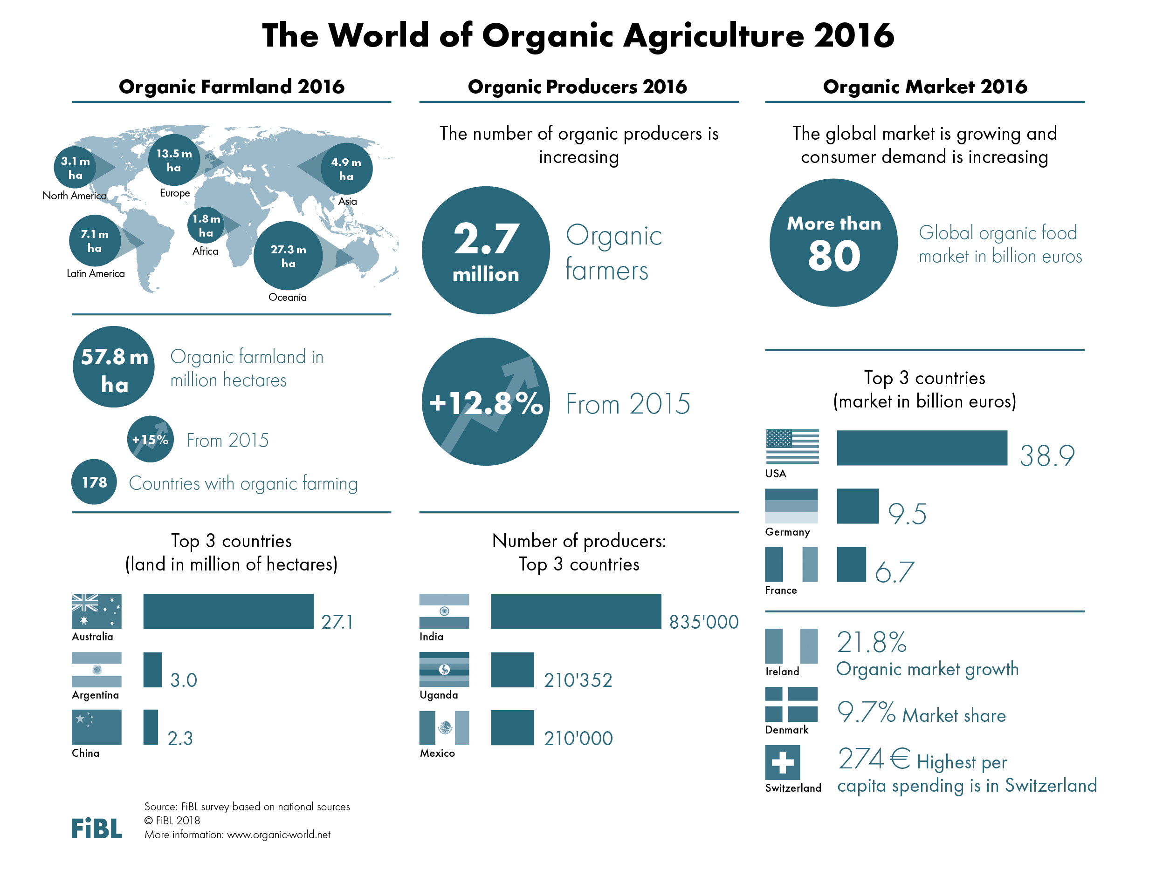

Slide 20


ORGANIC FARMLAND 2016
World
57.8
Mio ha
Australia 27.1
Mio ha
1.2% of the world’s farmland is organic
+420%
since 1999
In Oceania there were 27.3 Mio ha, in Europe 13.5 Mio ha, and in Latin America 7.1 Mio ha.
The ten countries with the largest organic agricultural areas represent 76% of the world’s organic agricultural land.
15 countries have 10% or more of their agricultural land under organic management.
In 2016, over 7.5 million hectares more were reported compared with 2015.
Percentage
Distribution of organic
agricultural land by region 2016
The five countries with
the largest areas of organic agricultural land 2016
Top 5 countries with more than
10 percent of organic agricultural land 2016
Growth of the organic
agricultural land 2000-2016
Source: FiBL survey 2018 www.organic-world.net

Slide 21
ORGANIC LAND USE 2016
10.6
Mio ha
arable land
+9%
more permanent crops
66%
grassland
39.3
Mio ha
of wild collection
Arable land constitutes 18% of the world’s organic agricultural land, and 0.7% of the world’s arable crop land. It increased by 6.2% over 2015.
4.5 Mio ha, which is 2.8% of the world’s permanent cropland, and a 8% share of the organic agricultural land.
38 Mio ha of grassland, and an almost 17% increase compared with 2015.
The organic wild collection areas are concentrated in Europe, Africa, Asia, and
Latin America.
Australia
Finland
Argentina
Zambia
Uruguay
India
Spain
Namibia
USA
Romania
Organic arable land by region 2016
Organic permanent crops by region 2016
Organic permanent grassland
by region 2016
Organic wild collection by region 2016
Organic arable land: Key crops 2016
Organic permanent crops: Key crops 2016
Organic wild collection: The five countries with the largest areas 2016
Organic permanet grassland: The five countries with the largest areas 2016
Source: FiBL survey 2018 www.organic-world.net

Slide 22
ORGANIC PRODUCERS 2016
World
2.7 Mio producers
+1'200% since 1999
40%
in Asia
The country with the most organic producers is India, followed by Uganda and Mexico.
More than 84% of the producers are in Asia, Africa, and Latin America.
There has been an increase in the number of producers by more than 300’000, or over 13% since 2015.
The five countries with the largest numbers
of organic producers 2016
Distribution of organic producers
by region 2016
Development of the number of organic
producers 2000-2016
Source: FiBL survey 2018 www.organic-world.net

Slide 23
ORGANIC RETAIL SALES 2016
World
over
80 billion €
North America
almost
42 billion €
274€
are spent per person in Switzerland
9.7%
of the
food market
in Denmark is organic
The largest single market is the USA followed by the EU (30.7 billion €) and China. By region, North America has the lead (41.9 billion €), followed by Europe (33.5 billion €) and Asia.
The countries with the largest market for organic food are the United States (38.9 billion €), followed by Germany (9.5 billion €), France (6.7 billion €)
and China (5.9 billion €).
Switzerland has the highest per capita consumption worldwide, followed by Denmark and Sweden.
The highest shares the organic market of the total market is in Denmark, followed by Luxembourg, Switzerland, Sweden, and Austria.
Distribution of retail sales value
by country 2016
The five countries with the largest
markets for organic food 2016
The five countries with the highest
per capita consumption 2016
The five countries with
the highest organic shares of the total market 2016
Source: FiBL survey 2018 www.organic-world.net

Slide 24
Indicator | World | Leading countries
Countries with data on certified organic agriculture | 2016: 178 countries
Organic agricultural land | 2016: 57.8 million hectares (1999: 11 million hectares) | Australia (27.1 million hectares) Argentina (3.0 million hectares) China (2.3 million hectares)
Share of total agricultural land | 2016: 1.2 % | Liechtenstein (37.7 %) French Polynesia (31.3 %) Samoa (22.4%)
Further, non-agricultural organic areas (mainly wild collection) | 2016: 39.9 million hectares | Finland (11.6 million hectares) Zambia (6.7 million hectares) India (4.2 million hectares)
Producers | 2015: 2.7 million producers (1999: 200’000 producers) | India (835‘000) Uganda (210‘352) Mexico (210'000)
Organic market size | 2016: 89.7 billion US dollars (more than 80 billion euros) (2000: 17.9 billion US dollars) Source: Ecovia Intelligence | US (43.1 billion US dollars; 38.9 billion euros) Germany (10.5 billion US dollars; 9.5 billion euros) France (7.5 billion US dollars; 6.7 billion euros)
Per capita consumption | 2016: 12.1 US dollars (11.3 euros) | Switzerland (304 US dollars; 274 euros) Denmark (252 US dollars; 227 euros) Sweden (218 US dollars; 197 euros)
Number of countries with organic regulations | 2017: 87 countries
Number of IFOAM affiliates | 2017: 1’003 affiliates from 127 countries | India - 111 affiliates; Germany - 88 affiliates; United States- 63 affiliates; China - 56 affiliates

Slide 25
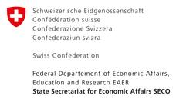
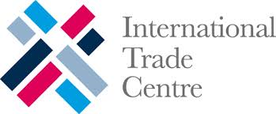
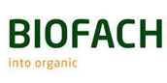
Acknowledgements
The Swiss State Secretariat of
Economic Affairs SECO, Berne
International Trade Centre ITC
Nürnberg Messe, the organizers of the
BioFach World Organic Trade Fair
200 experts from all parts of the world contributed to the FiBL-IFOAM survey 2017.

Slide 26
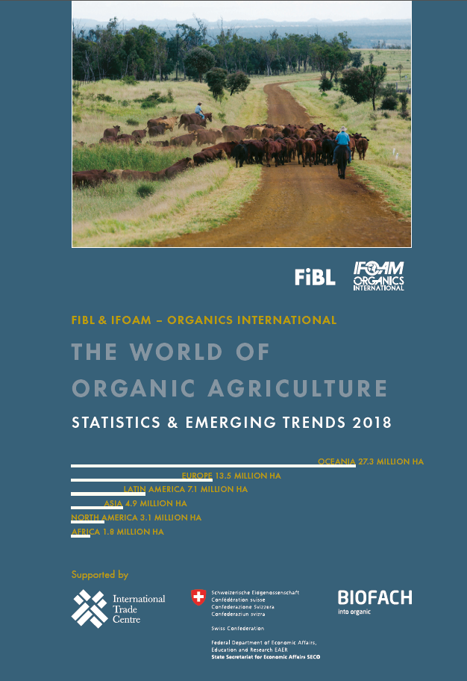
The World of Organic Agriculture 2018 www.organic-world.net
The 19th edition of ‚The World of Organic Agriculture‘, was published by FiBL and IFOAM – Organics International in February 2018.
Data tables
Country and continent reports
Markets, standards, policy support
Get your copy at the FiBL Stand in Hall 1/555 or the stand of IFOAM - Organics International (1/451)
www.organic-world.net

Slide 27
Contact
Helga Willer and Julia Lernoud
Research Institute of Organic Agriculture (FiBL)
Ackerstrasse 113, 5070 Frick, Switzerland
Tel. +41 79 218 0626, Fax +41 62 865 7273
helga.willer@fibl.org und julia.lernoud@fibl.org
www.fibl.org, www.organic-world.net; www.fibl.stats.fibl.org
Willer, Helga and Julia Lernoud (Eds.) (2018): The World The World of Organic Agriculture. Statistics and Emerging Trends 2018. FiBL, Frick and IFOAM – Organics International, Bonn
http://www.organic-world.net/yearbook/yearbook-2018.html

