Slide 1
Organic Agriculture Worldwide 2020: Key results from the FiBL survey on organic agriculture worldwide 2022
Part 1: Global data and survey background
Jan Trávníček, Bernhard Schlatter, Claudia Meier and Helga Willer
© FiBL., April 2022

Slide 2
Organic Agriculture Worldwide: Key results from the FiBL survey on organic agriculture worldwide 2022 Part 1: Global data and survey background
Data compiled by the Research Institute of Organic Agriculture (FiBL), Frick, Switzerland, based on national data sources and data from certifiers.
Data as published February 2022 in The World of Organic Agriculture. Statistics and Emerging Trends 2022.* Frick and Bonn, www.organic-world.net
For updates, check www.organic-world.net
This presentation is available online at: https://www.organic-world.net/yearbook/yearbook-2022/presentations.html
Texts and graphs: Helga Willer, Bernhard Schlatter, Jan Trávníček and Claudia Meier, Research Institute of Organic Agriculture (FiBL), Frick, Switzerland
Contact: Helga Willer, helga.willer@fibl.org, Research Institute of Organic Agriculture (FiBL), Frick, Switzerland
© Research Institute of Organic Agriculture (FiBL), Frick, Switzerland, April 2022
*Citation: Willer, Helga, Jan Trávníček, Claudia Meier and Bernhard Schlatter (Eds.) (2022): The World of Organic Agriculture. Statistics and Emerging Trends 2022. Research Institute of Organic Agriculture FiBL, Frick, and IFOAM – Organics International, Bonn.
Notes:
FiBL
17.04.2022
www.fibl.org
2

Slide 3
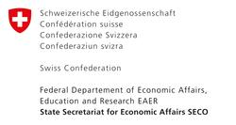
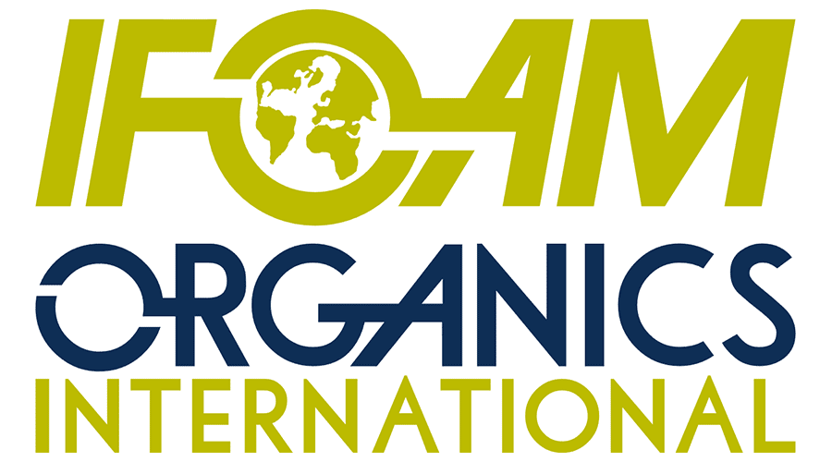
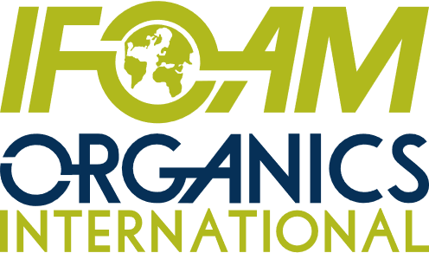
Acknowledgements
The Swiss State Secretariat of Economic Affairs (SECO)
Coop Sustainability Fund
NürnbergMesse, the organizers of BIOFACH
IFOAM – Organics International
More than 200 experts from all parts of the world contributed to the FiBL survey 2022.

Slide 4
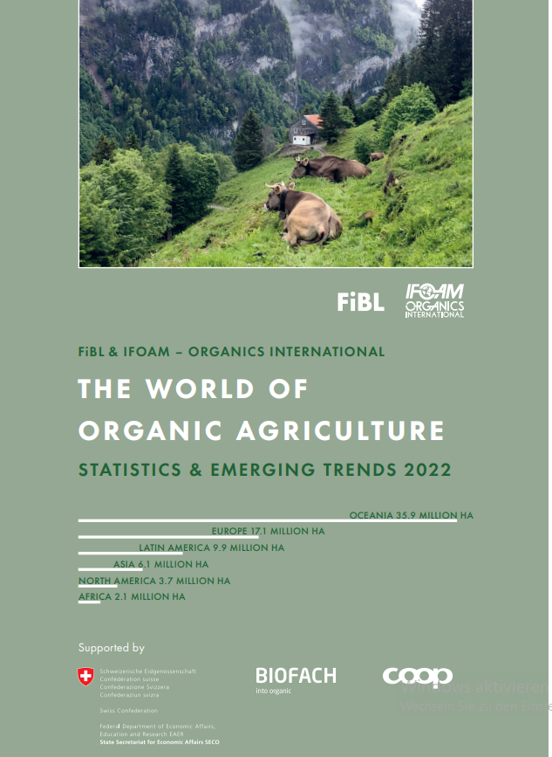
The World of Organic Agriculture 2022
The 23rd edition of «The World of Organic Agriculture», was published by FiBL and IFOAM – Organics International in February 2022.
Data tables
Country and continent reports
Markets, standards, policy support
The book can be ordered or downloaded at (item number 1344): https://www.fibl.org/en/shop-en
www.organic-world.net
https://statistics.fibl.org

Slide 5
About this presentation
In three presentations, the key results of the FiBL survey on organic agriculture worldwide 2022 are summarized (data 2020). Apart from the global data, key results on crop and on regional data are presented.
More information is available at www.organic-world.net
The following three presentations are available at https://www.organic-world.net/yearbook/yearbook-2022/presentations.html:
Part 1: Global data 2020 and survey background
Part 2: Land use and key crops in organic agriculture 2020
Part 3: Organic agriculture in the regions 2020

Slide 6
The 23rd survey on organic agriculture world-wide
The 23rd survey on organic agriculture worldwide was carried out by the Research Institute of Organic Agriculture FiBL in cooperation with partners from all around the world. The results were published jointly by FiBL and IFOAM – Organics International.
The survey was carried out between July 2021 and February 2022.
Data were received from 190 countries.
Updated data on area and producers were available for 142 countries.
Data was provided by over 200 country experts (representatives from NGOs, certification bodies, governments, researchers).
The following data was collected: area data (including land use and crop details); producers, other operator types; domestic market values; export and import data; livestock data (animal heads and production in metric tons).
The results are published in the yearbook “The World of Organic Agriculture 2022” and on www.organic-world.net.

Slide 7
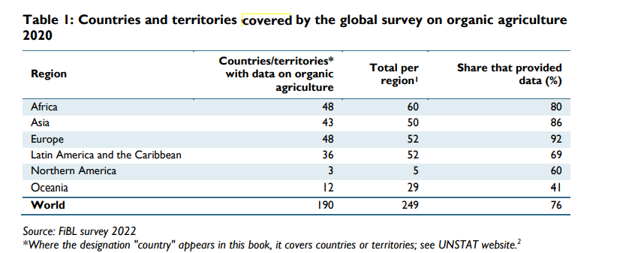
Countries covered by the survey on organic agriculture

Slide 8
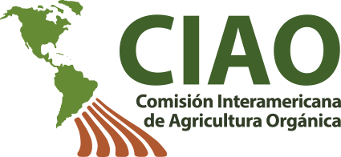
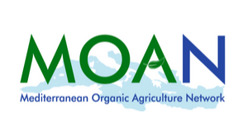
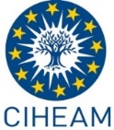
Transnational data collection efforts

Slide 9
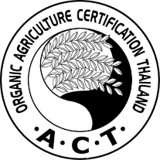
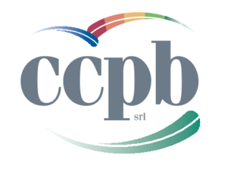
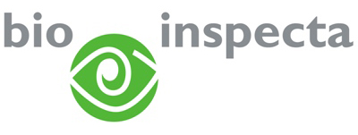
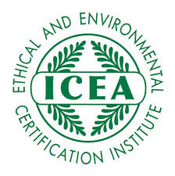
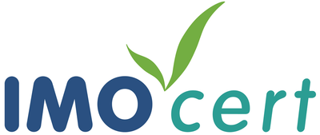
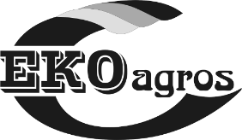
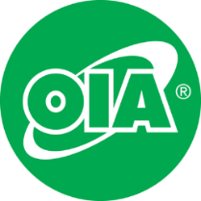
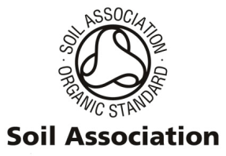
International certifiers that provided data for several countries

Slide 10
General notes on the data
Data sources: For data sources see annex of The World of Organic Agriculture 2021 or www.organic-world.net/statistics-data-sources.html
Countries: For countries and territories, the FAO country list is used. Where the designation "country" appears in this report, it covers countries or territories. For the countries’ grouping by region, the Standard Country and Area Classifications as defined by the United Nations Statistics Division, is used in most cases.
Term organic: In the tables, the term organic refers to the fully converted and in-conversion areas.
Organic share: In some cases, the calculation of the organic share of the total agricultural land or that of individual crops, based on FAOSTAT and in some cases the Eurostat data, might differ from the organic shares obtained from ministries or local experts.
Producers: Some countries report the number of smallholders while others only report the number of companies, projects, or grower groups, which may each comprise a number of producers. This applies in particular to many African countries. The number of producers is, therefore, probably higher than the number communicated in this report.
Data revisions: Should data revisions and corrections become necessary these are communicated on Organic-World.net: https://www.organic-world.net/yearbook/yearbook-2022/yearbook-2022-corrigenda.html. Revised/corected data are included in the database.

Slide 11
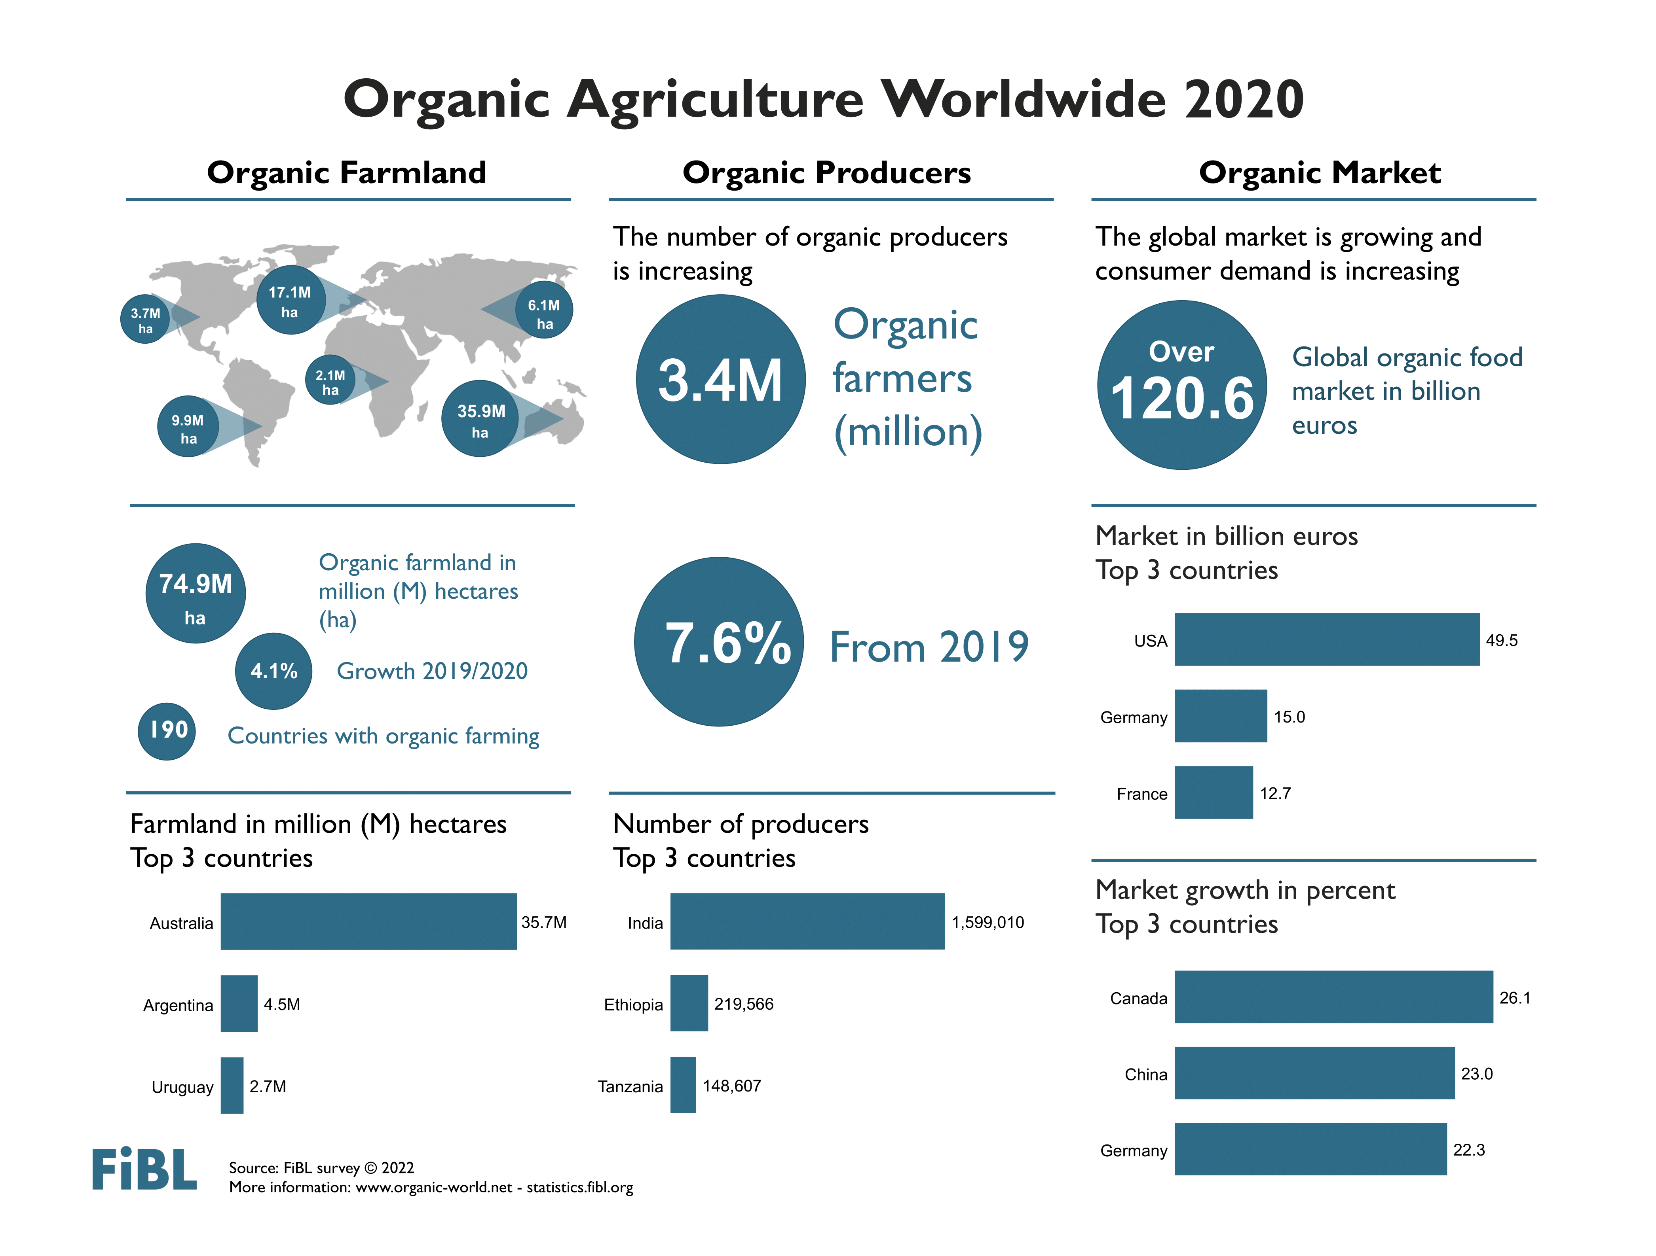

Slide 12
Key data 2020
Organic agricultural land reached 74.9 million hectares
Area growth: 3.0 million hectares more than in 2019, 4.1 percent increase
Area increase mainly due to additional 1.7 million hectares in Latin America
1.6 percent of the agricultural land is organic
In 18 countries 10 percent or more of the farmland is organic
3.4 million producers were reported
190 countries with organic activities
Almost 30 million hectares of non-agricultural areas

Slide 13
Organic farmland 2020
In 2020, over 74.9 million hectares of organic agricultural land, including in-conversion areas, were recorded. Regions with the largest organic agricultural land areas are Oceania (35.9 million hectares – almost half the world’s organic agricultural land) and Europe (17.1 million hectares, 23 percent). Latin America had 9.9 million hectares (13.3 percent), followed by Asia (6.1 million hectares, 8.2 percent), Northern America (3.7 million hectares, 5.0 percent) and Africa (2.1 million hectares, 2.8 percent).
Countries with the most organic agricultural land were Australia (35.7 million hectares), Argentina (4.5 million hectares) and Uruguay (2.7 million hectares).
In 2020, 1.6 percent of the world’s agricultural land was organic. The highest organic shares of the total agricultural land, by region, were in Oceania (9.7 percent) and in Europe (3.4 percent; European Union: 9.2 percent).
Some countries reach far higher shares than the global share: Liechtenstein (41.6 percent) and Austria (26.5 percent) had the highest organic shares. In 18 countries, 10 percent or more of the agricultural land was organic.
Organic farmland increased by 3.0 million hectares (4.1 percent) in 2020. Many countries reported a significant increase; Chile, for instance, showed a 650 percent increase, or over 0.135 million hectares more (mainly due to an increase in organic grazing areas), and Papua New Guinea reported 322 percent more organic farmland (over 72’000 hectares).
In absolute terms, the biggest increases were in Argentina, Uruguay and India: in Argentina, organic farmland increased by 781´000 hectares (+21.3 percent), in Uruguay by more than 589´000 hectares (+27.9 percent) and in India by almost 359´000 hectares (+15.6 percent).
In 2020, organic agricultural land increased in all continents (Table 6). The highest absolute growth was in Latin America (+19.9 percent, +1.7 million hectares), followed by Europe (+3.7 percent, +0.60 million hectares) and Asia (+7.6 percent, +0.43 million hectares).

Slide 14
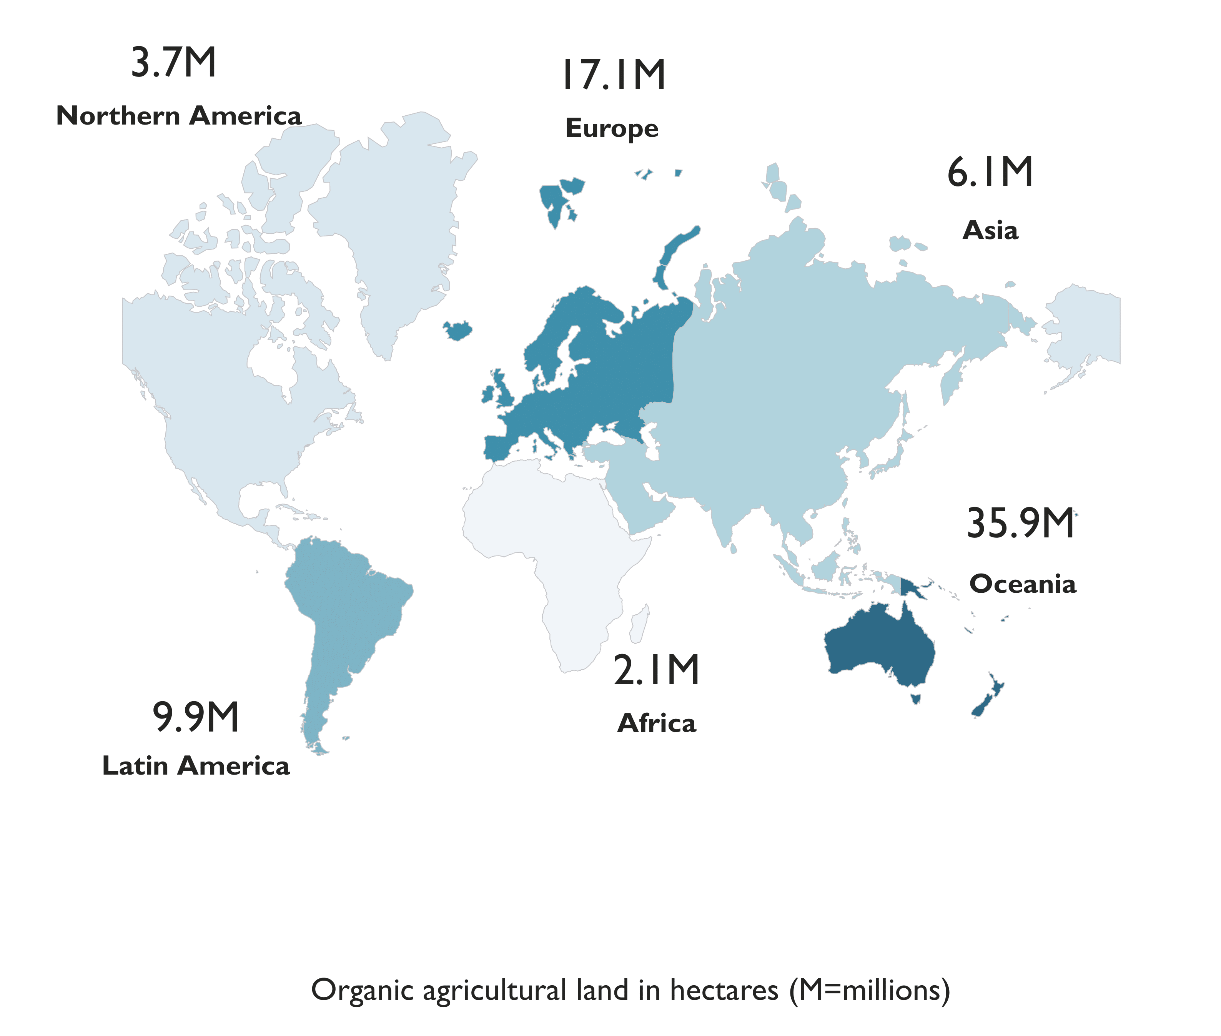
World: Organic agricultural land and other organic areas 2020
Source: FiBL survey 2022

Slide 15
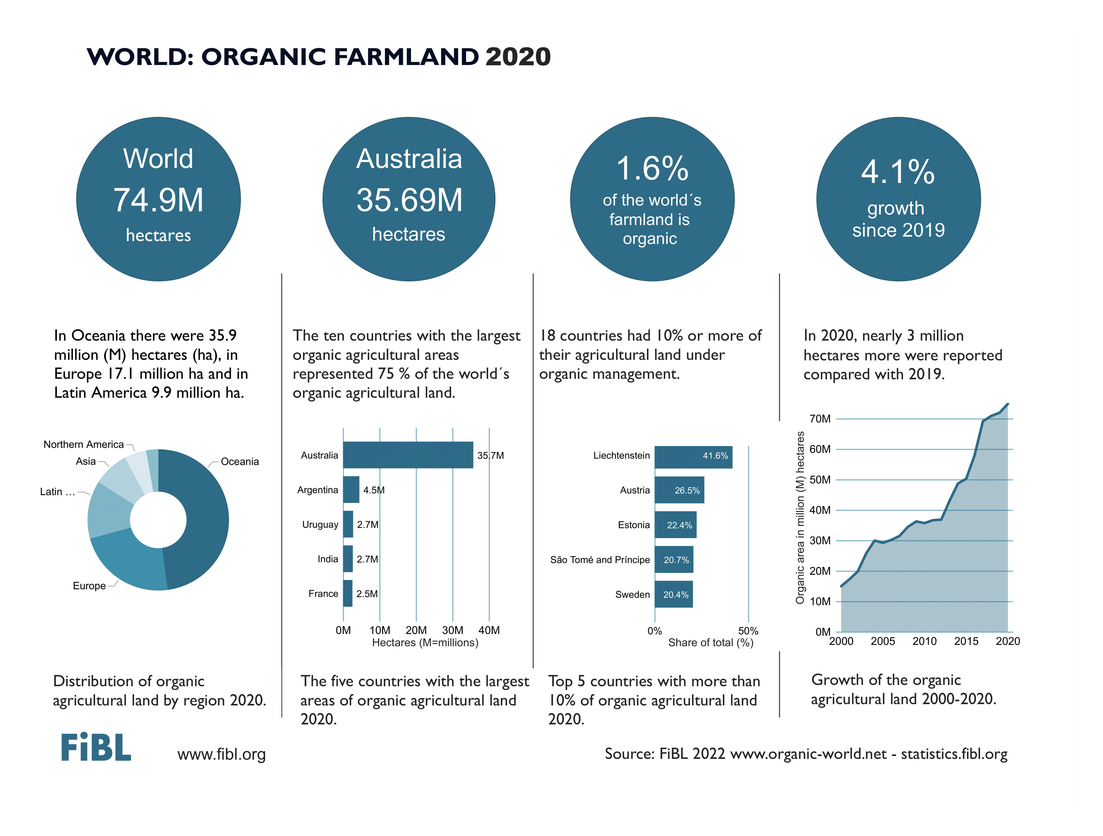

Slide 16
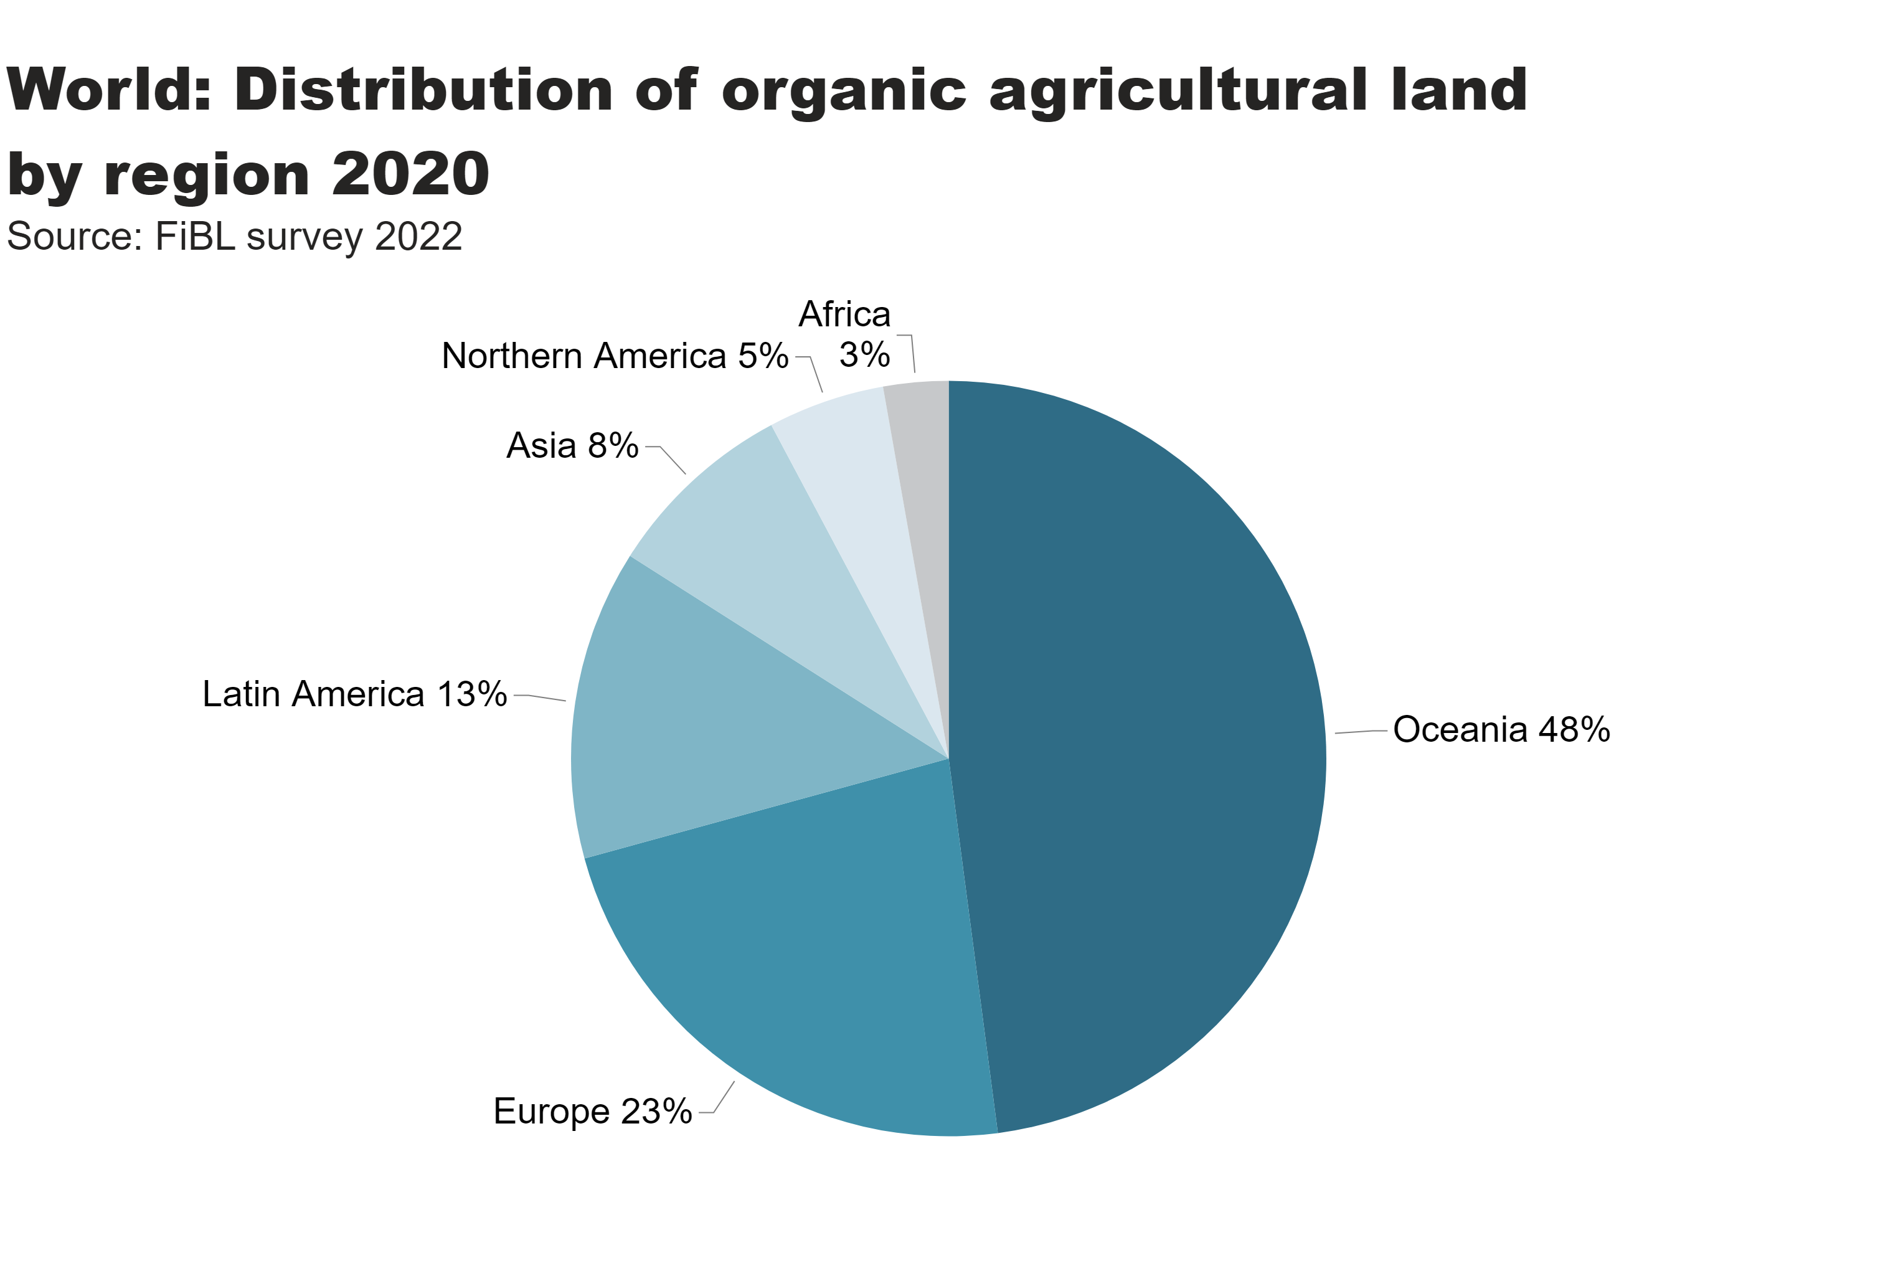
world_land_by_region
Distribution of organic farmland by region 2020
Notes:
textbox
No alt text provided
pieChart
No alt text provided
card
No alt text provided

Slide 17
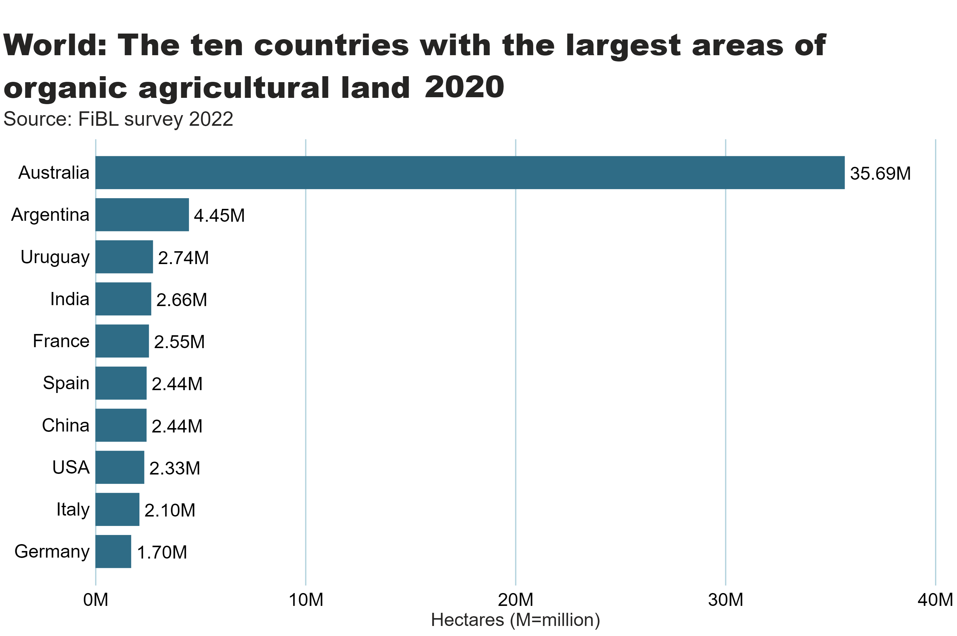
world_land_by_country
Notes:
clusteredBarChart
No alt text provided
textbox
No alt text provided
card
No alt text provided

Slide 18
world_land_share
Notes:
textbox
No alt text provided
barChart
No alt text provided
card
No alt text provided

Slide 19
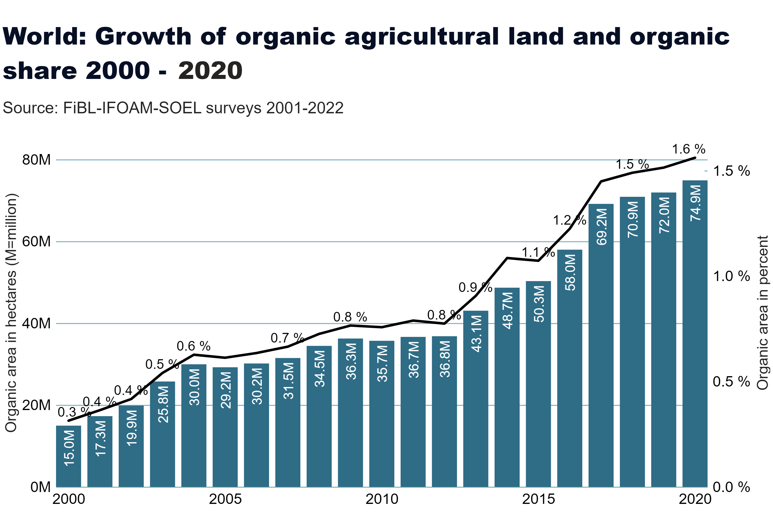
world_land_growth
Notes:
textbox
No alt text provided
lineClusteredColumnComboChart
No alt text provided
card
No alt text provided

Slide 20
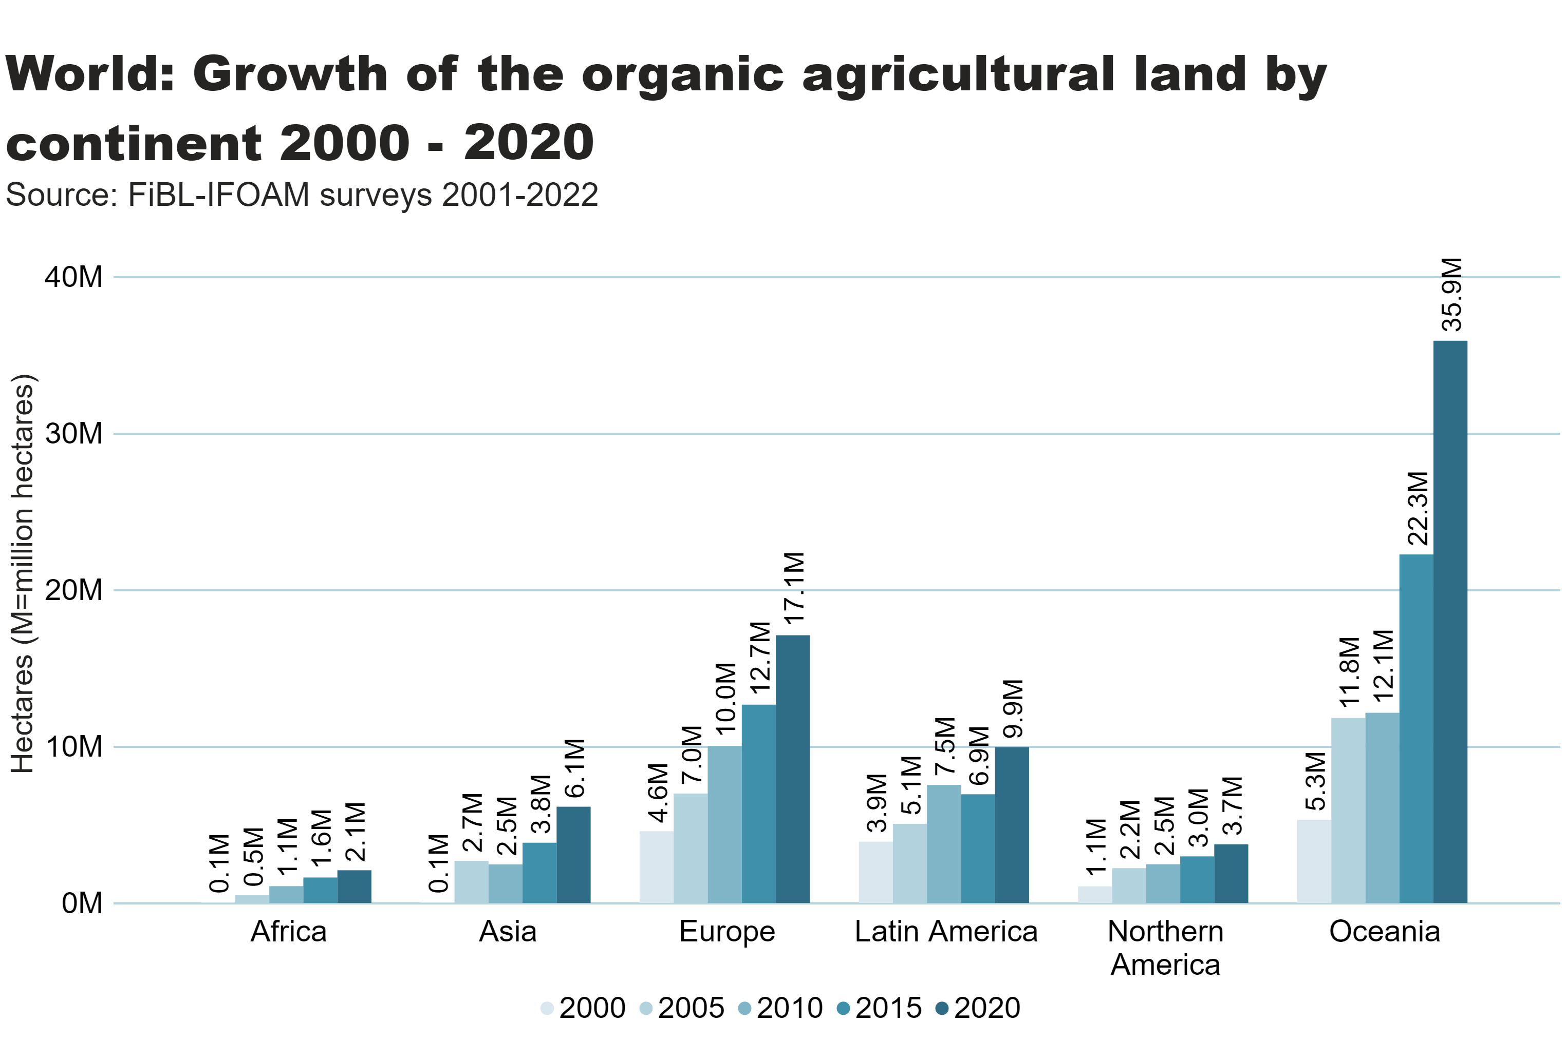
world_land_growth_region
Notes:
textbox
No alt text provided
clusteredColumnChart
No alt text provided
card
No alt text provided

Slide 21
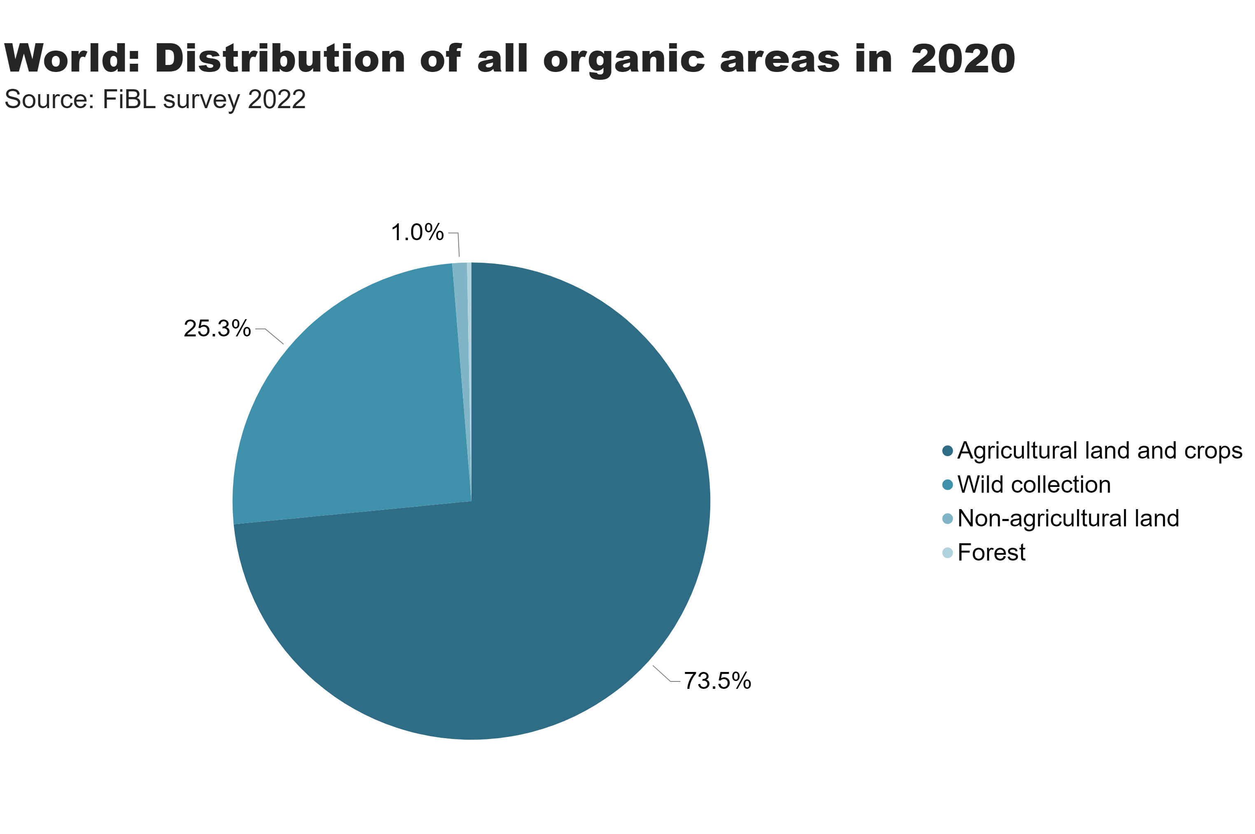
world_land_all_areas
Notes:
textbox
No alt text provided
card
No alt text provided
pieChart
No alt text provided

Slide 22
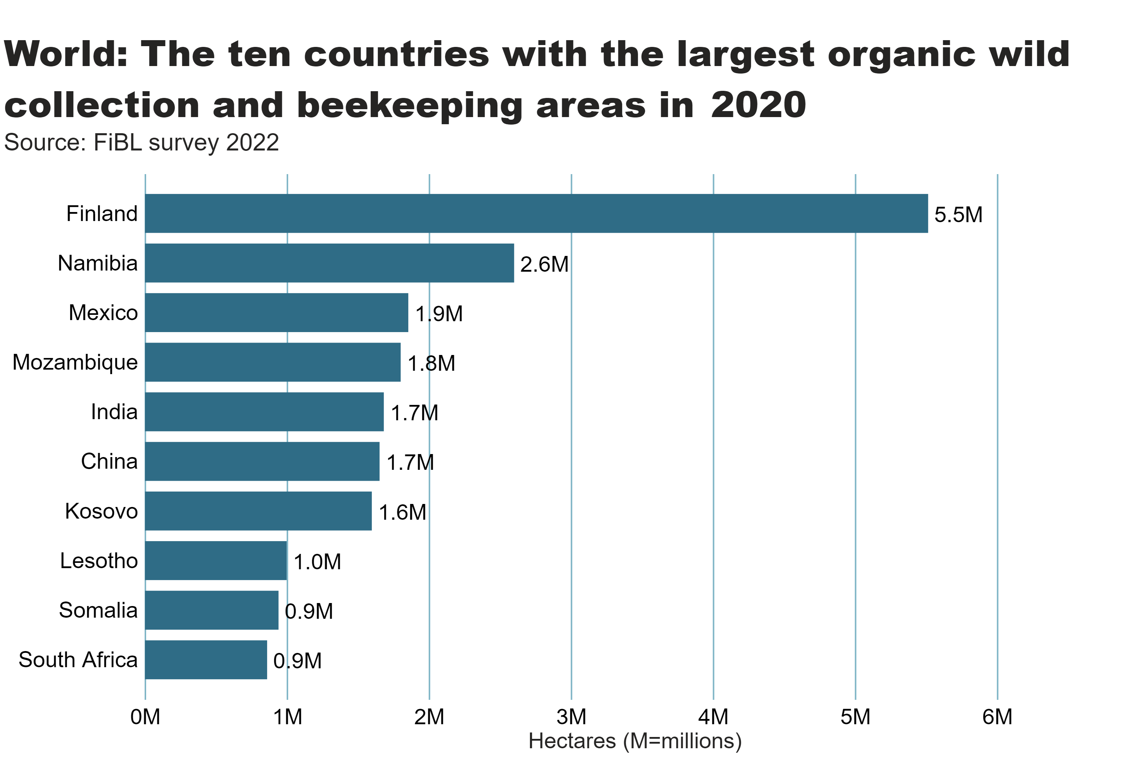
wild_ collection_by_country
Notes:
textbox
No alt text provided
clusteredBarChart
No alt text provided
card
No alt text provided

Slide 23
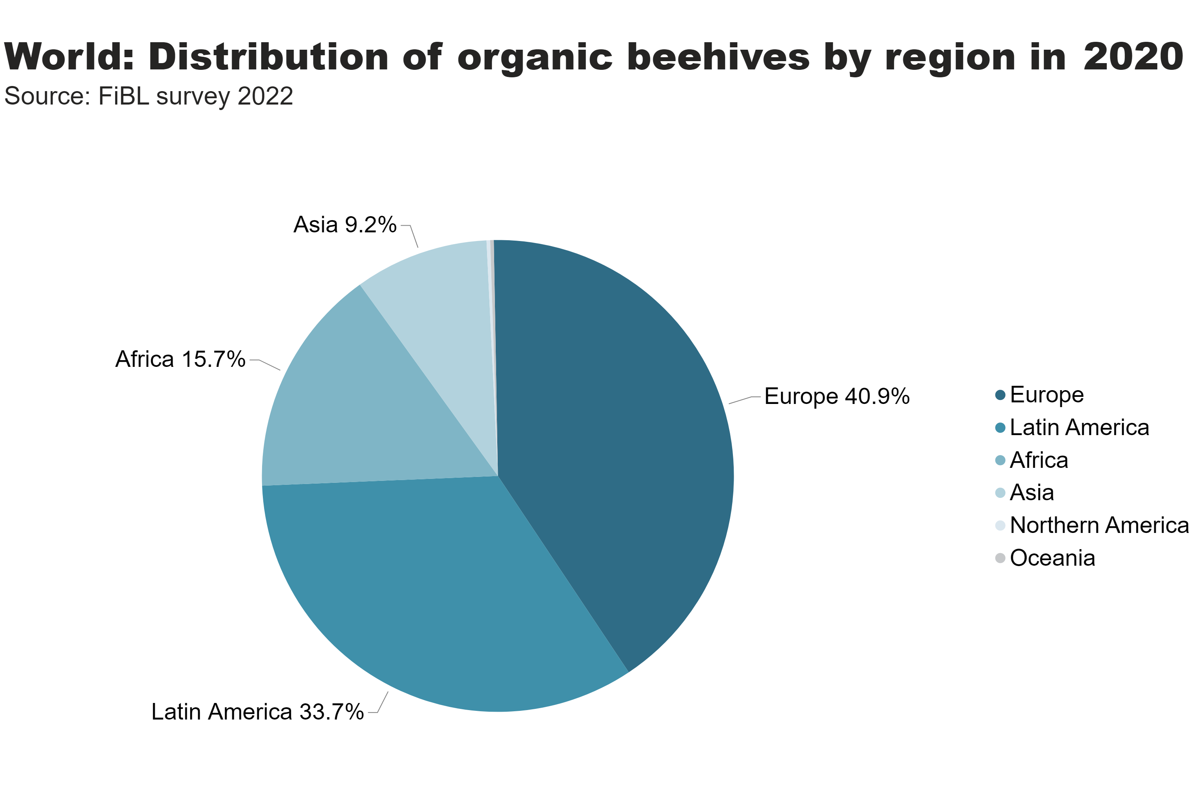
beehives_by_region
Notes:
textbox
No alt text provided
pieChart
No alt text provided
card
No alt text provided

Slide 24
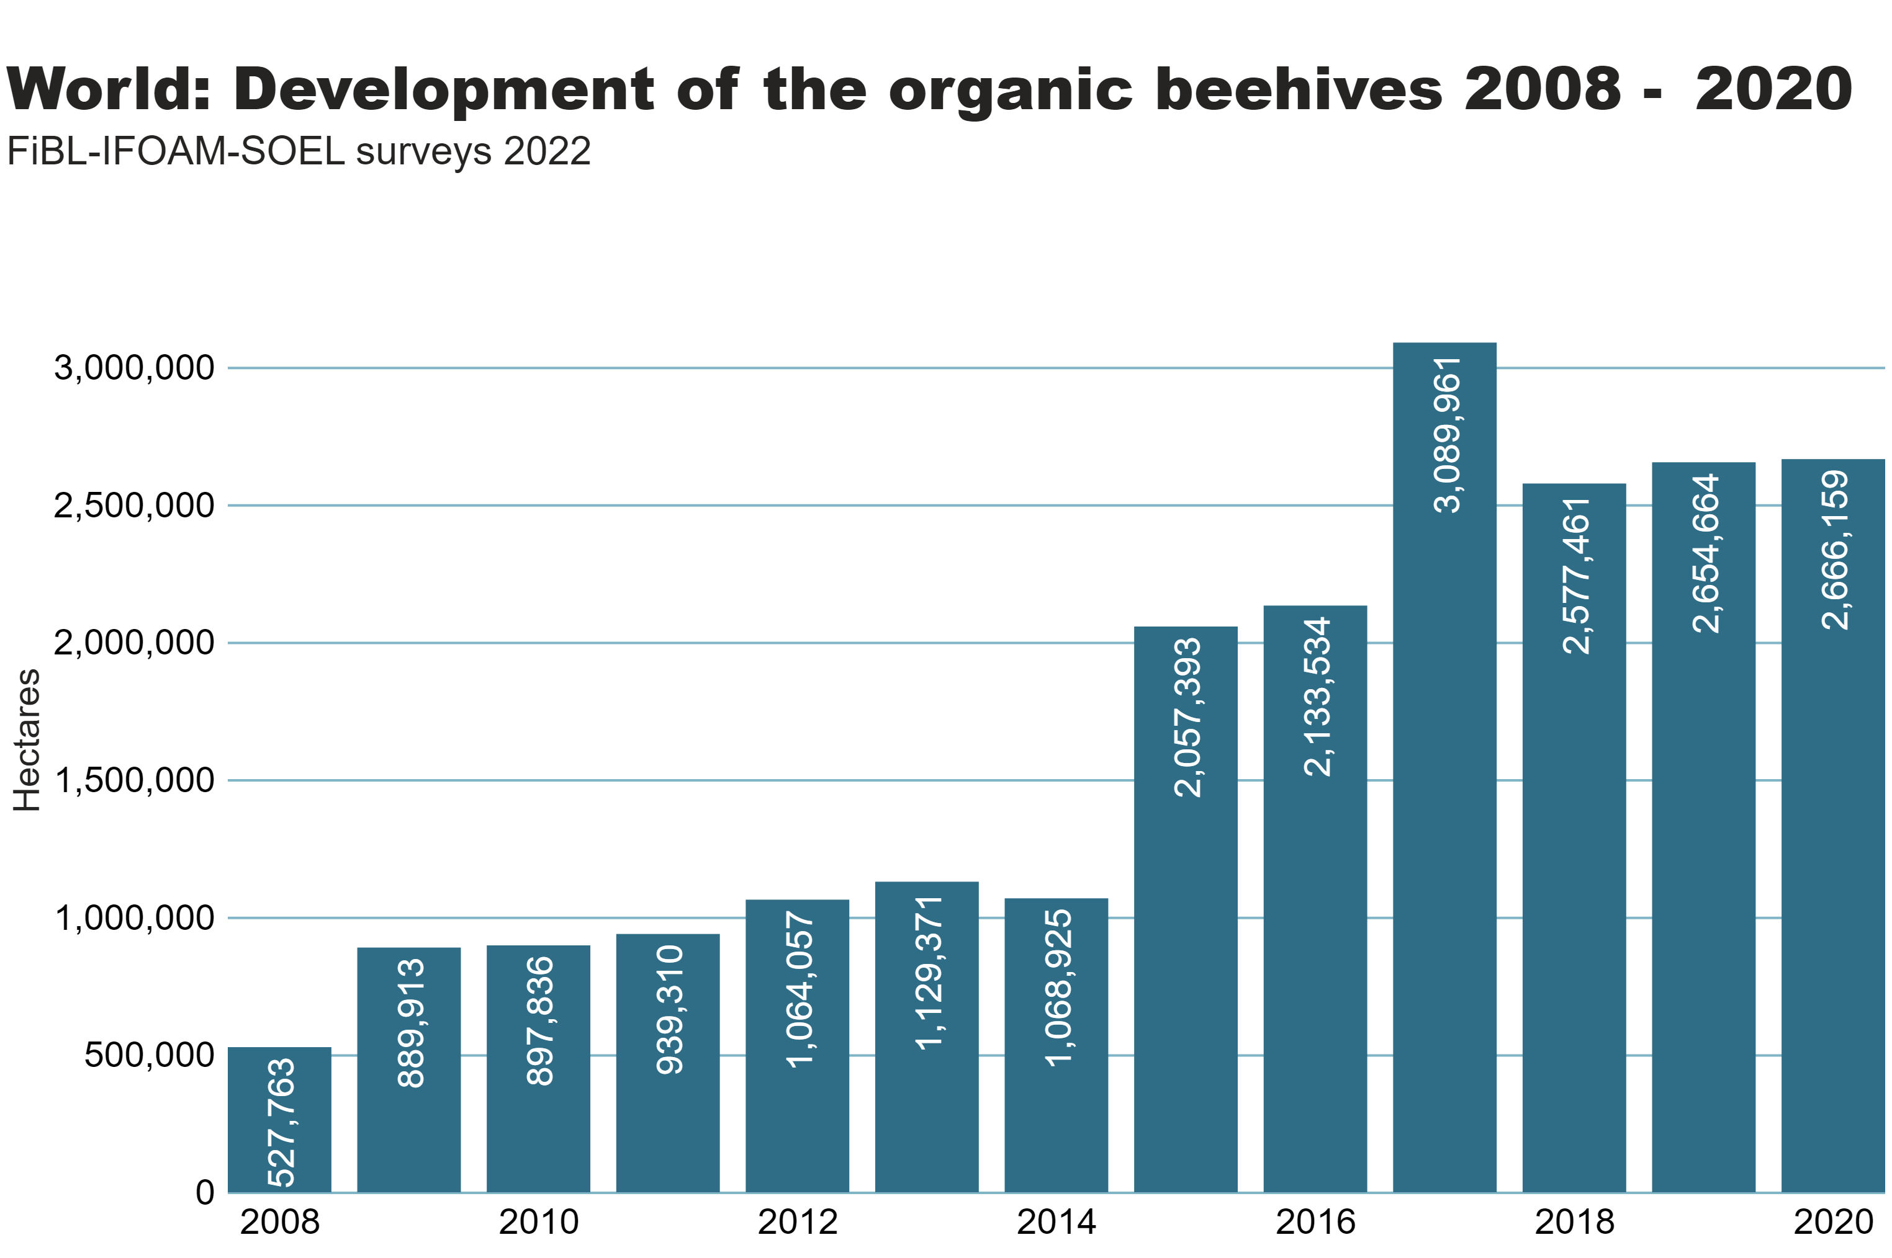
beehives_by country
Notes:
textbox
No alt text provided
clusteredColumnChart
No alt text provided
card
No alt text provided

Slide 25
Organic producers 2020
There were at least 3.4 million organic producers in 2020.
Fifty-six percent of the world’s organic producers are in Asia, followed by Africa (24 percent), Europe (12 percent) and Latin America (8 percent).
The countries with the most producers are India (1´599´010), Ethiopia (219’566) and Tanzania (148’607) (page 59).
There has been an increase in the number of producers of almost 239´000, or 7.6 percent, compared to 2019.
It should be noted that not all data providers reported the number of producers; the number is probably higher than 3.4 million.

Slide 26
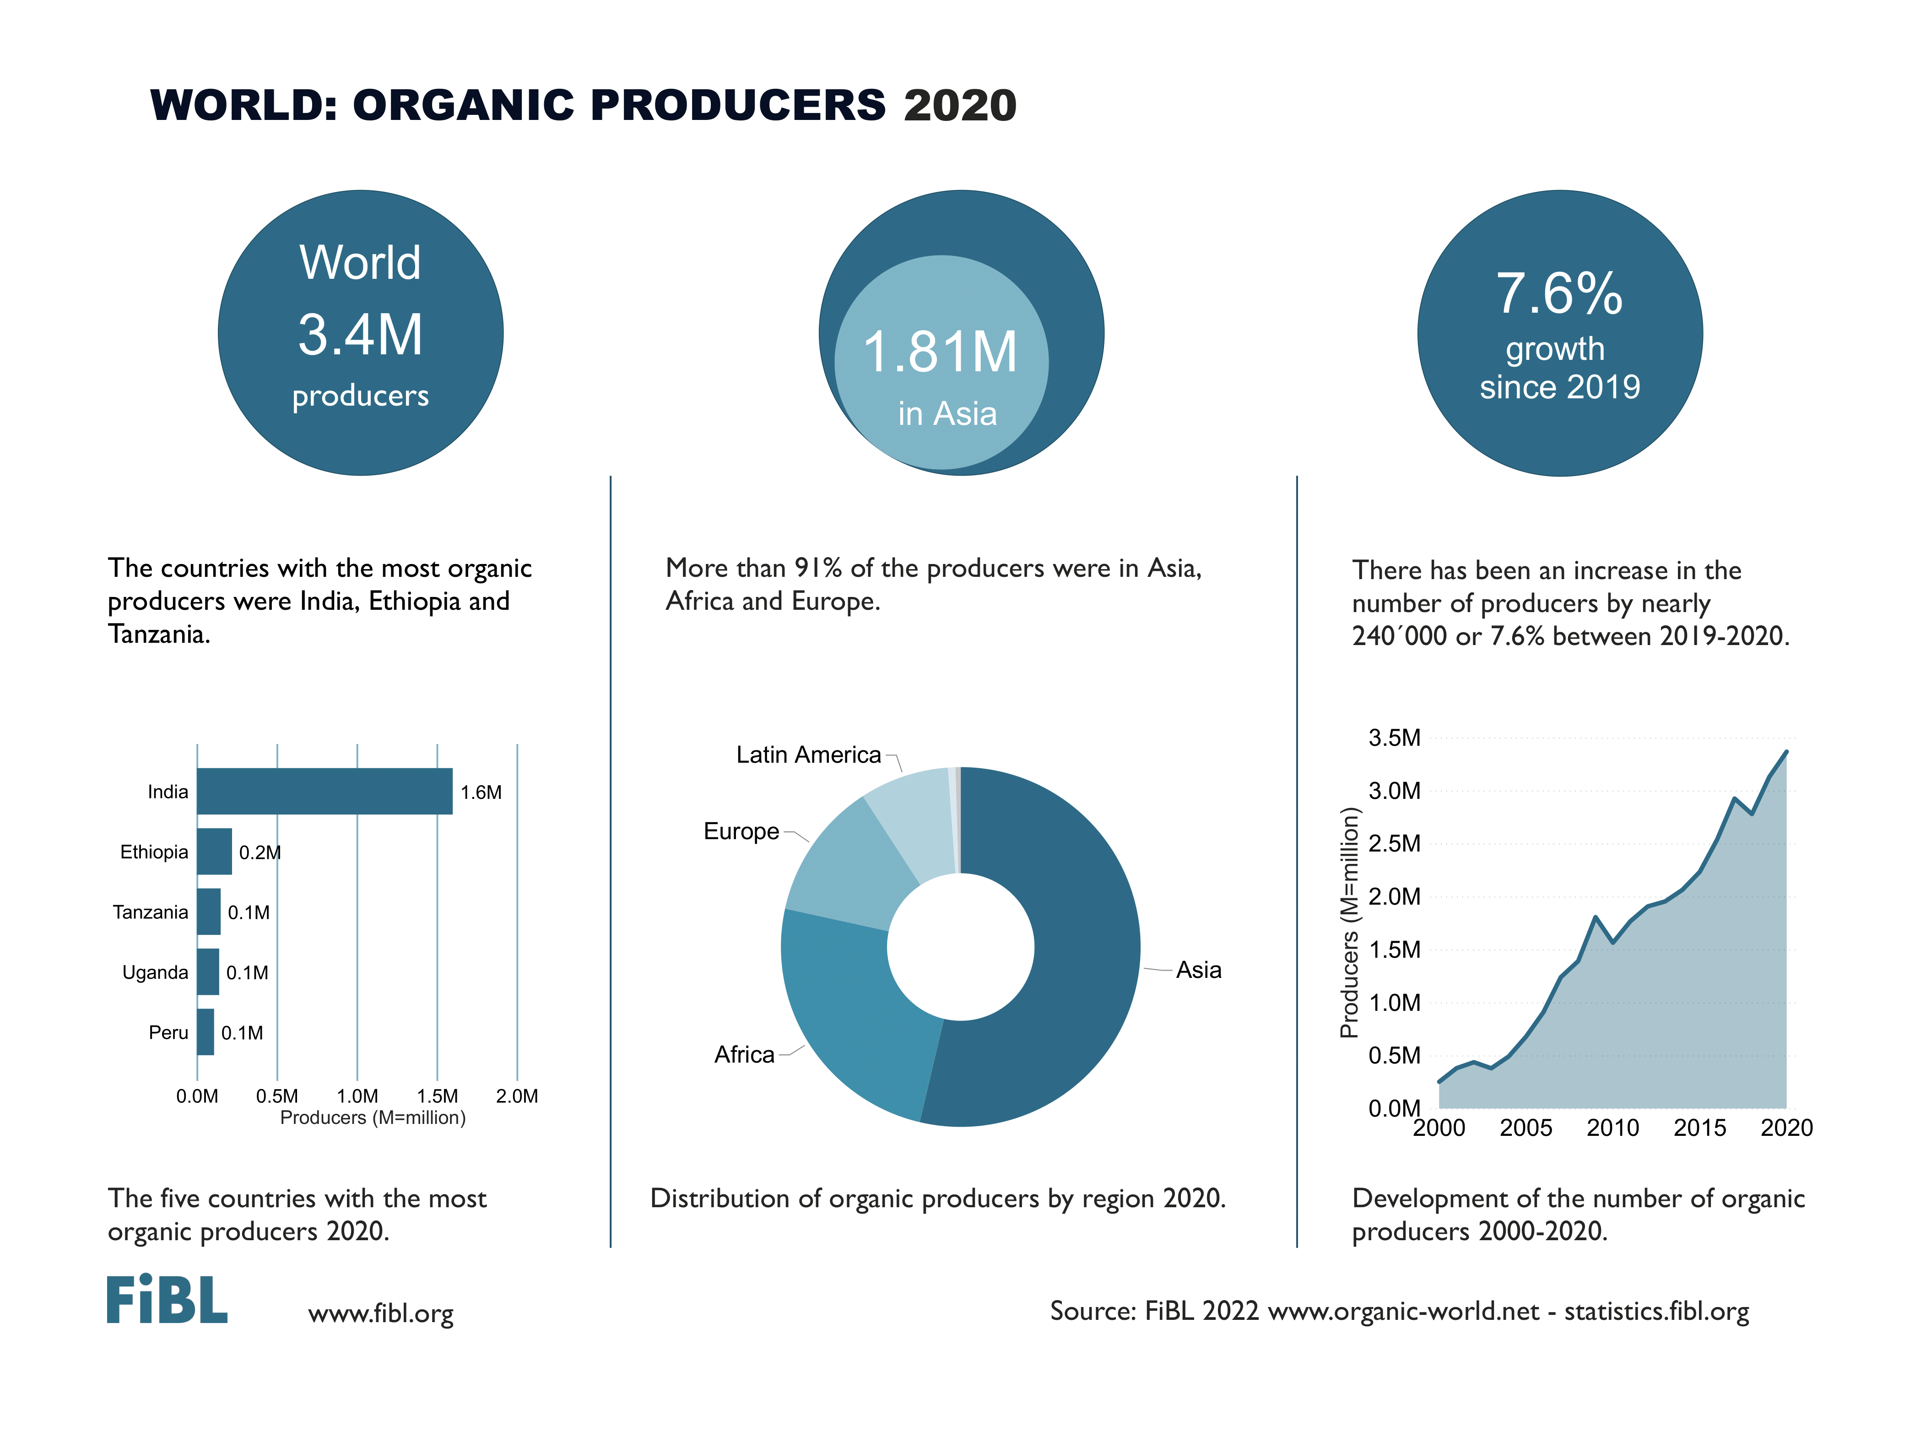

Slide 27
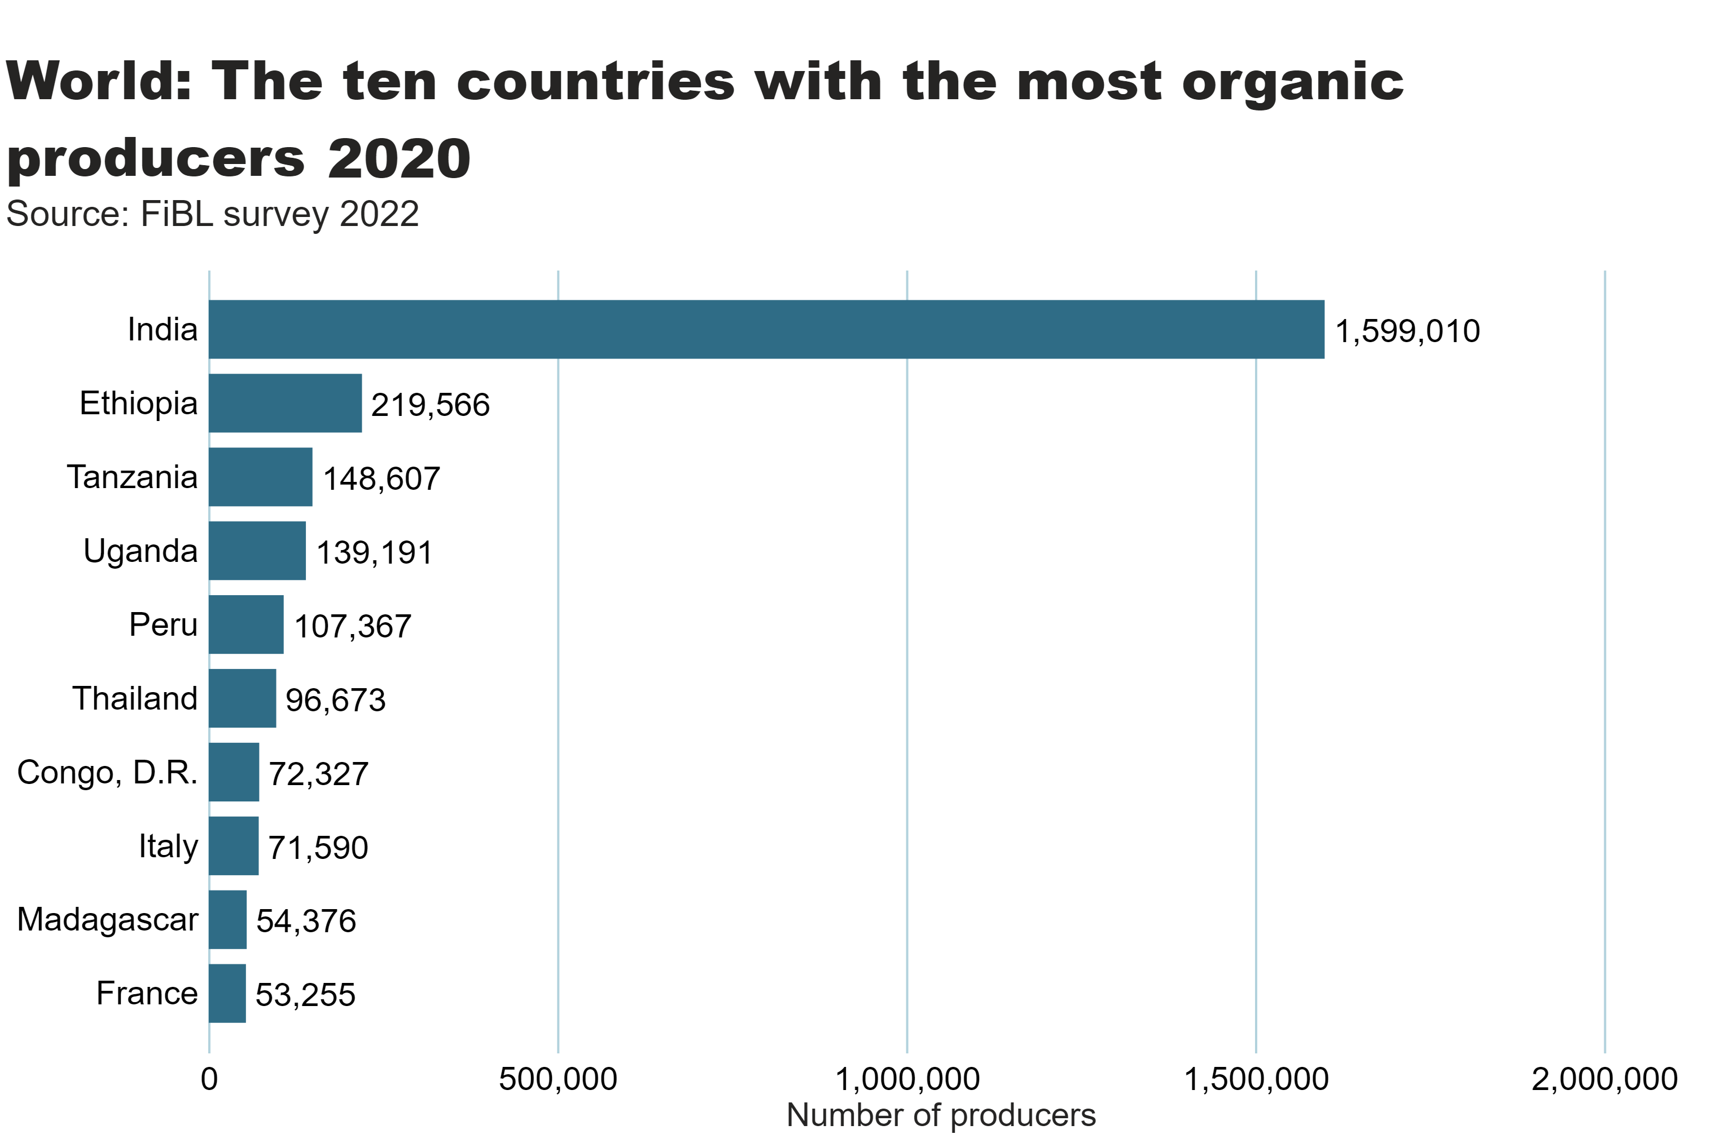
world_producers_country
Notes:
textbox
No alt text provided
card
No alt text provided
barChart
No alt text provided

Slide 28
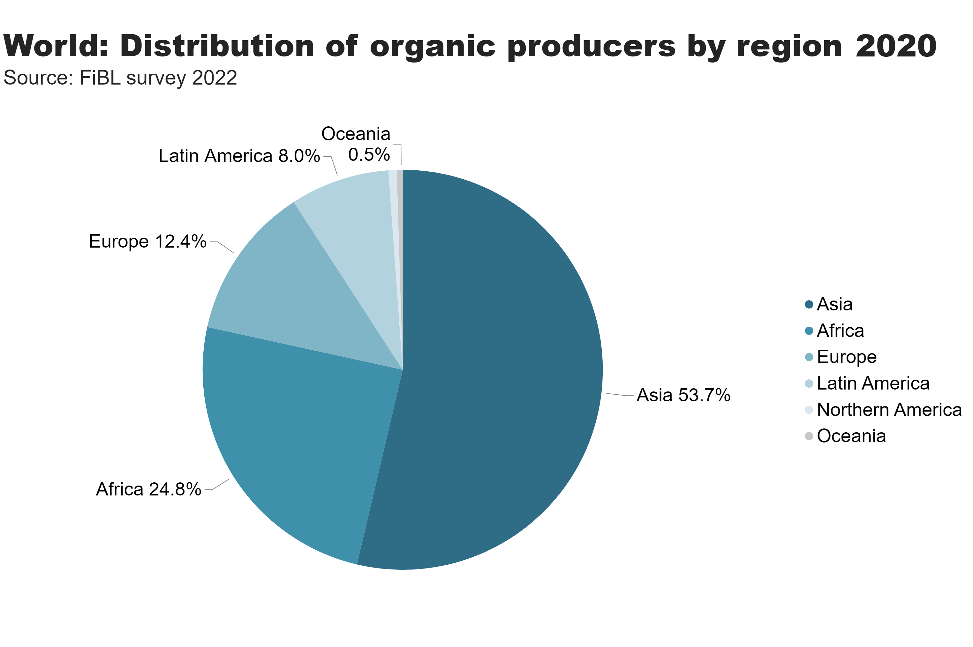
world_producers_region
Notes:
textbox
No alt text provided
pieChart
No alt text provided
card
No alt text provided

Slide 29
Notes:
Numbers doesn´t match with the database

Slide 30
The global market for organic food 2020
Organic food and drink sales reached more than 120 billion euros in 2020.
In 2020, the countries with the largest organic markets were the United States (49.5 billion euros), Germany (15.0 billion euros) and France (12.7 billion euros). T
he largest single market was the United States (41 percent of the global market), followed by the European Union (44.8 billion euros, 37 percent) and China (10.2 billion euros, 8.5 percent).
Switzerland had the highest per-capita consumption in 2020, with 418 euros.
The highest organic market shares were reached in Denmark (13.0 percent), Austria (11.3 percent) and Switzerland (10.8 percent) (
Source: FiBL survey 2022chapter on the FiBL survey on the global market, page 64).

Slide 31
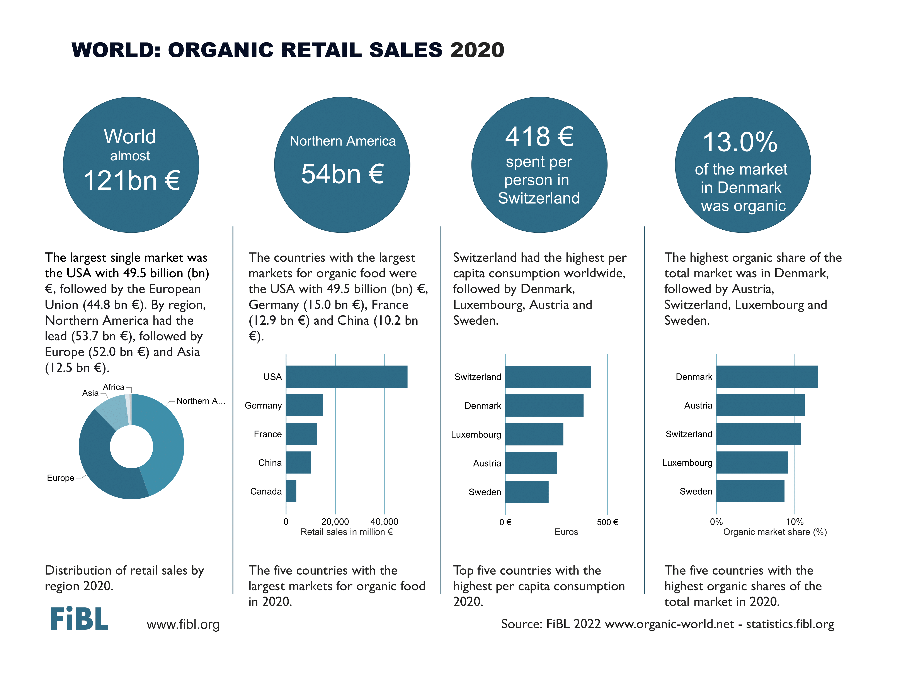

Slide 32
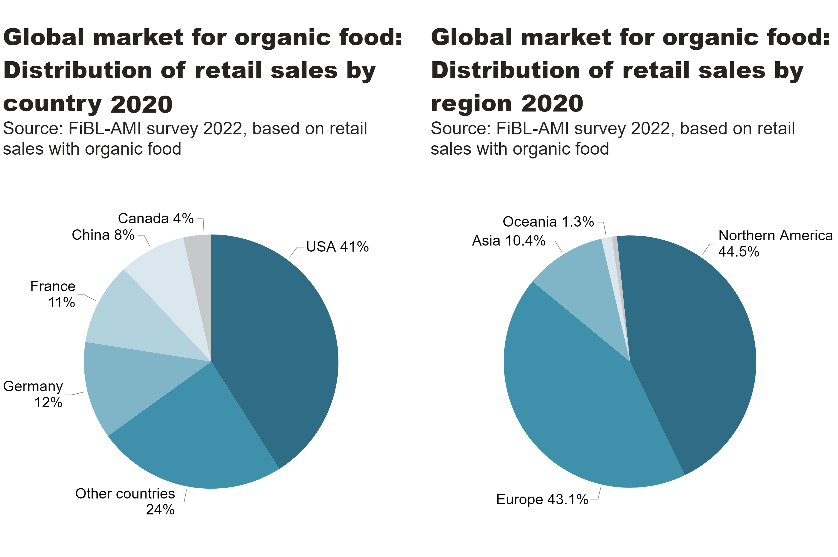
world_retail_sales_region_country
Notes:
pieChart
No alt text provided
textbox
No alt text provided
pieChart
No alt text provided
textbox
No alt text provided
card
No alt text provided
card
No alt text provided

Slide 33
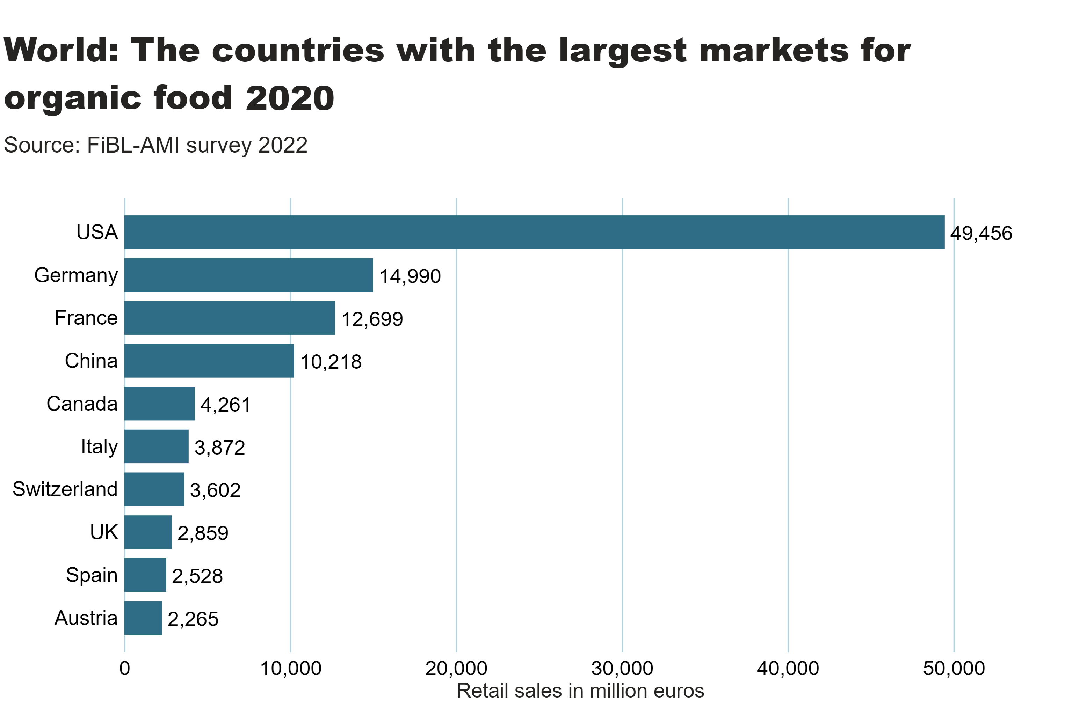
world_retail_sales_country
Notes:
textbox
No alt text provided
card
No alt text provided
barChart
No alt text provided

Slide 34
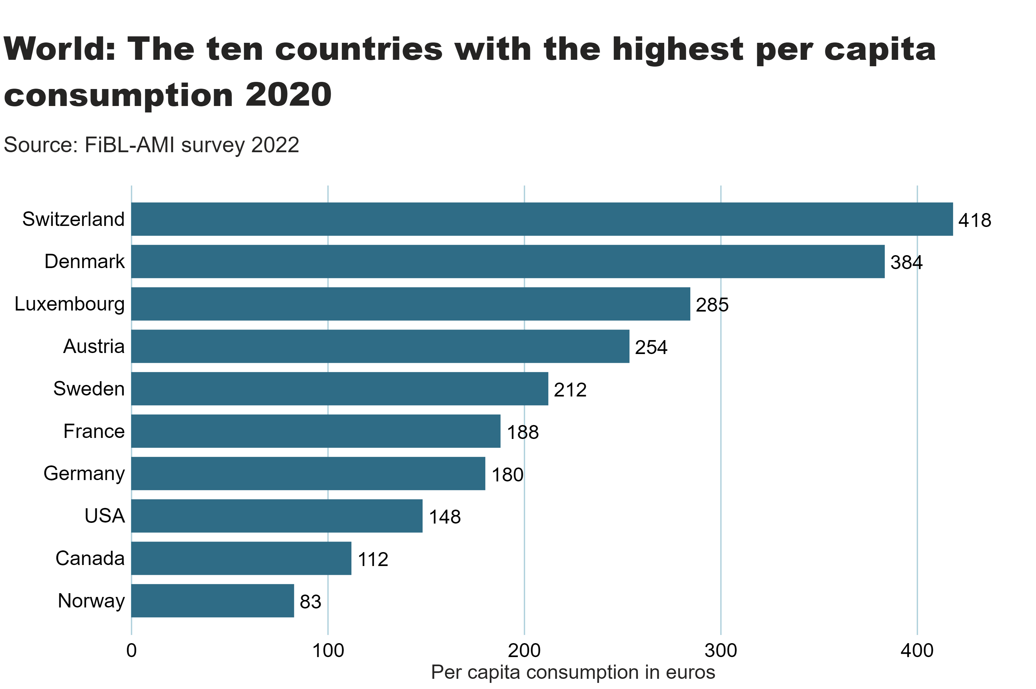
world_retail_sales_per_capita
Notes:
textbox
No alt text provided
card
No alt text provided
barChart
No alt text provided

Slide 35
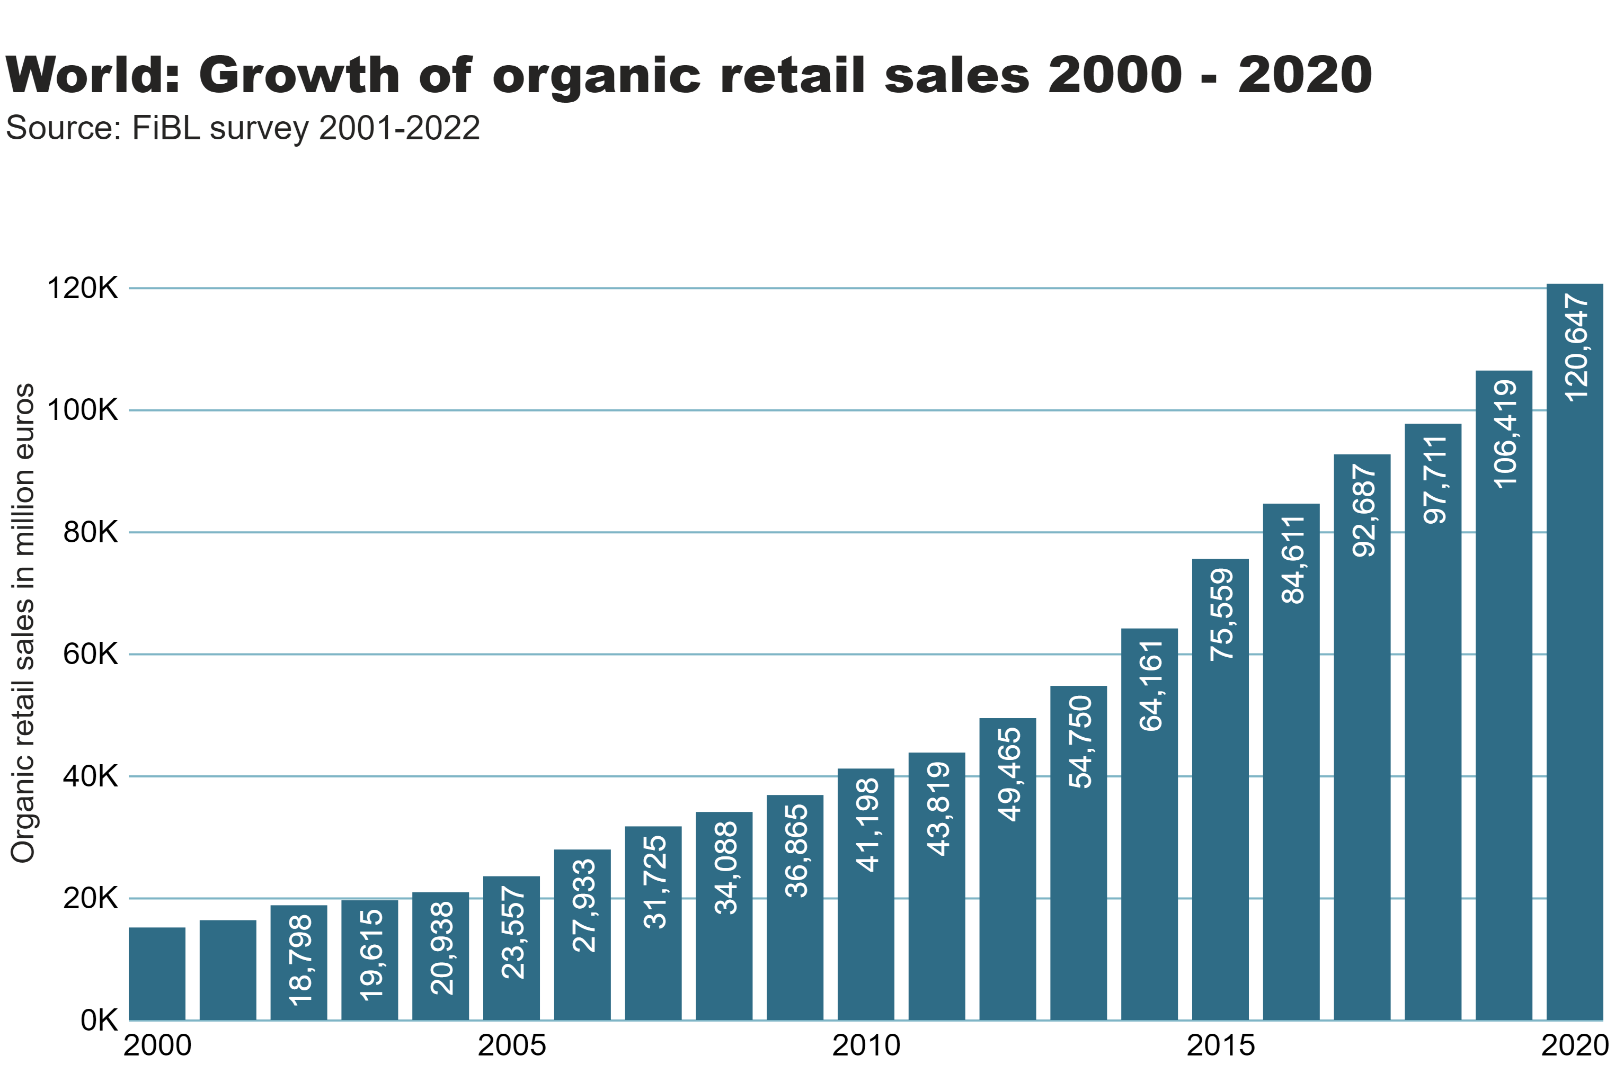
World_retail_growth
Notes:
textbox
No alt text provided
card
No alt text provided
columnChart
No alt text provided

Slide 36
United States of America: Growth of retail sales 2002-2020

Slide 37
Germany: Growth of retail sales 2000-2021

Slide 38
France: Growth of retail sales 2000-2020

Slide 39
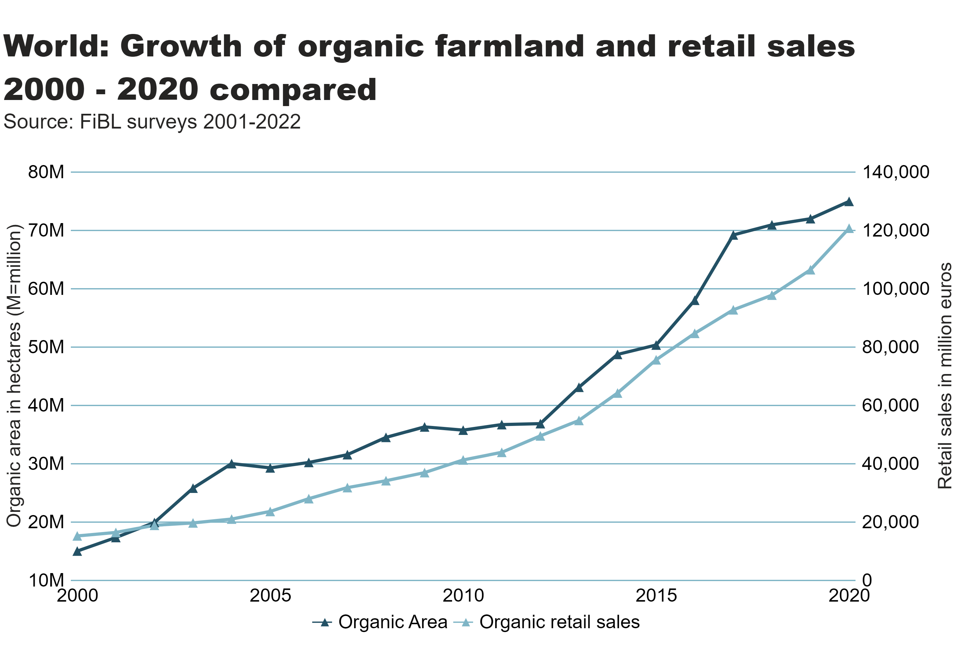
World_land_retail_growth
Notes:
textbox
No alt text provided
lineChart
No alt text provided
card
No alt text provided

Slide 40
Organic farming in developing countries and emerging markets
The Development Assistance Committee (DAC) of the Organisation for Economic Co-operation and Development (OECD) is a forum to discuss issues surrounding aid, development and poverty reduction in developing countries. The recipients of Official Development Assistance (ODA) according to the DAC* are studied on the following pages.
More than 2.9 million organic producers from the countries on the DAC list were counted (87 percent of all organic producers).
More than a fifth of the world’s organic agricultural land, 16.2 million hectares, is located in countries on this list.
If wild collection and beekeeping areas are included, the total area is 38.1 million hectares.
Almost half of the agricultural land of the countries on the DAC list is located in Latin American countries (7.0 million hectares), with Asia (6.0 million) and Africa (2.1 million) in second and third place. The countries with the largest areas of organic agricultural land are Argentina, India, China and Brazil, in that order. Not surprisingly, all of them are large countries (Figure 15).
The countries on the DAC list with the highest percentages of organic agricultural land are São Tomé and Príncipe (20.7 percent), Samoa (14.5 percent) and Timor-Leste (8.5 percent). Argentina, with by far the largest area under organic cultivation (with 4.5 million hectares), is ranked twelfth (3.0 percent) when the organic agricultural area is expressed as a share of the total agricultural area.
* https://www.oecd.org/dac/financing-sustainable-development/development-finance-standards/daclist.htm

Slide 41
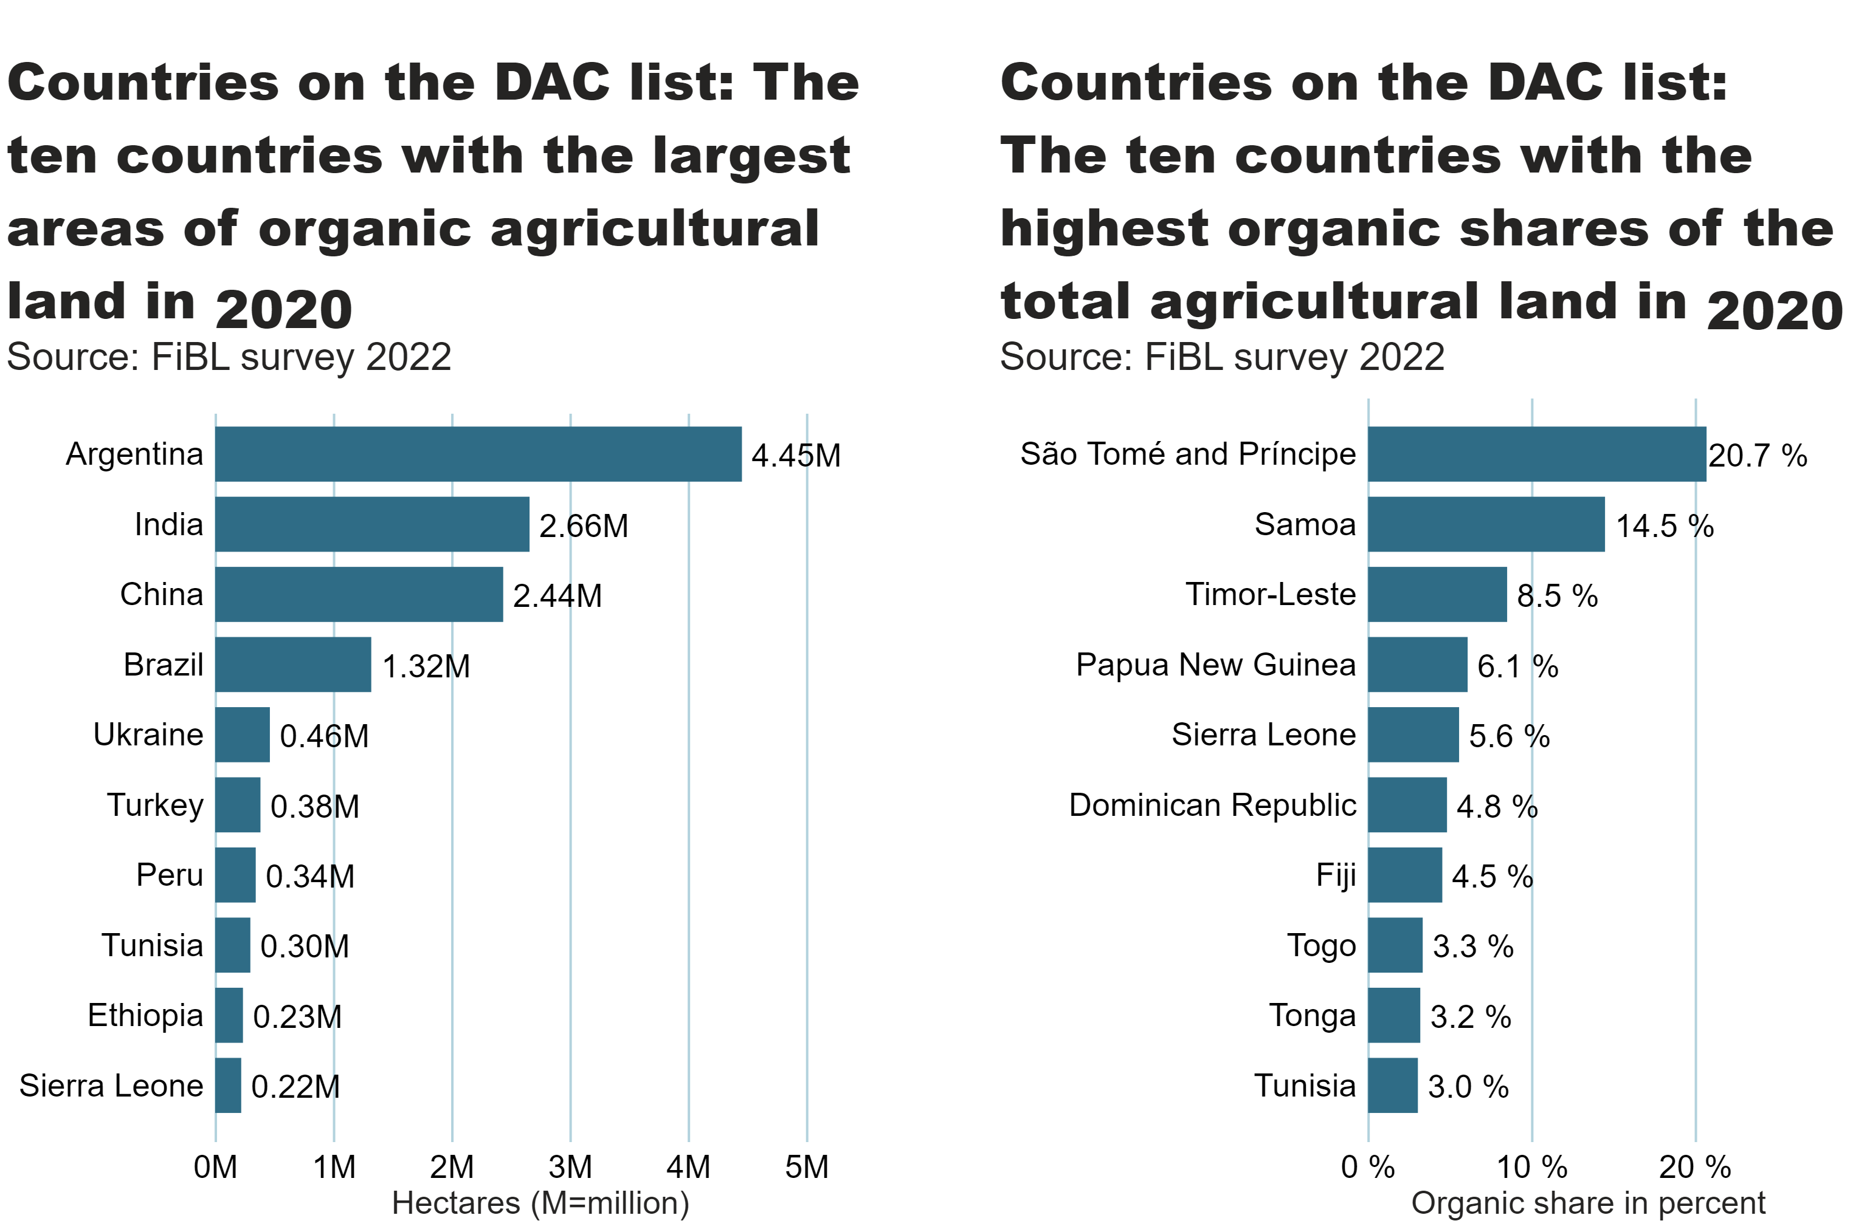
DAC_land_area_share_country
Notes:
textbox
No alt text provided
card
No alt text provided
clusteredBarChart
No alt text provided
textbox
No alt text provided
card
No alt text provided
clusteredBarChart
No alt text provided

Slide 42
More information
More information (PDF, data sources, graphs) at: http://www.organic-world.net/yearbook/yearbook-2022.html
Contact Helga Willer Research Institute of Organic Agriculture (FiBL) 5070 Frick Switzerland helga.willer@fibl.org

Slide 43
Disclaimer
All of the results contained in this slide show have been compiled by the Research Institute of Organic Agriculture (FiBL). However, the possibility of mistakes cannot be ruled out entirely. Therefore, FiBL is not subject to any obligation and makes no guarantees whatsoever regarding any of the statements or results in this work; neither does FiBL accept responsibility or liability for any possible mistakes, nor for any consequences of actions taken by readers based on statements or advice contained therein.
This document has been produced with the support of the Swiss State Secretariat for Economic Affairs (SECO), the Sustainability Fund of Coop Switzerland, NürnbergMesse, IFOAM – Organics International. The views expressed herein can in no way be taken to reflect the official opinions of SECO, Coop, NürnbergMesse or IFOAM – Organics International.

Slide 44
Presentations on www.organic-world.net

Slide 45
Statistics.FiBL.org

Slide 46
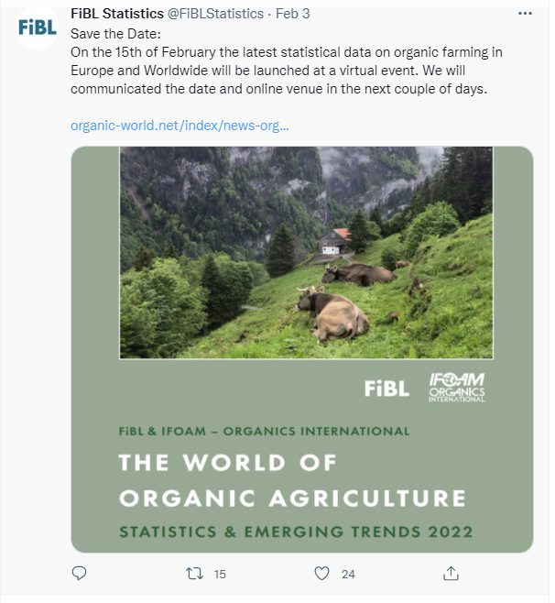
www.twitter.com/fiblstatistics

Slide 47
Contact
Helga Willer Research Institute of Organic Agriculture FiBL Ackerstrasse 113, Box 219 5070 Frick Switzerland
Phone +41 62 865 72 72 Phone +41 62 865 72 07 (direct)
info.suisse@fibl.org, helga.willer@fibl.org www.fibl.org, www.organic-world.net, https://statistics.fibl.org

Slide 48
FiBL online
www.fibl.org
www.bioaktuell.ch
fiblfilm
@fiblorg
@FiBLaktuell
linkedin.com/company/fibl

