Slide 1
Organic Agriculture Worldwide 2020: Key results from the FiBL survey on organic agriculture worldwide 2022
Part 3: Organic agriculture in the regions
Jan Trávníček, Bernhard Schlatter, Claudia Meier and Helga Willer
© FiBL., April 2022

Slide 2
Organic Agriculture Worldwide: Key results from the FiBL survey on organic agriculture worldwide 2022 Part 3: Organic agriculture in the regions
Data compiled by the Research Institute of Organic Agriculture (FiBL), Frick, Switzerland, based on national data sources and data from certifiers.
Data as published February 2022 in The World of Organic Agriculture. Statistics and Emerging Trends 2022.* Frick and Bonn, www.organic-world.net
For updates, check www.organic-world.net
This presentation is available online at: https://www.organic-world.net/yearbook/yearbook-2022/presentations.html
Texts and graphs: Helga Willer, Bernhard Schlatter, Jan Trávníček and Claudia Meier, Research Institute of Organic Agriculture (FiBL), Frick, Switzerland
Contact: Helga Willer, helga.willer@fibl.org, Research Institute of Organic Agriculture (FiBL), Frick, Switzerland
© Research Institute of Organic Agriculture (FiBL), Frick, Switzerland, April 2022
*Citation: Willer, Helga, Jan Trávníček, Claudia Meier and Bernhard Schlatter (Eds.) (2022): The World of Organic Agriculture. Statistics and Emerging Trends 2022. Research Institute of Organic Agriculture FiBL, Frick, and IFOAM – Organics International, Bonn.
Notes:
FiBL
24.07.2022
www.fibl.org
2

Slide 3
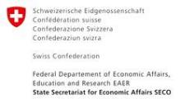
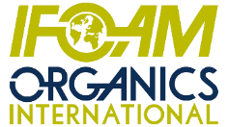
Acknowledgements
The Swiss State Secretariat of Economic Affairs (SECO)
Coop Sustainability Fund
NürnbergMesse, the organizers of BIOFACH
IFOAM – Organics International
More than 200 experts from all parts of the world contributed to the FiBL survey 2022.

Slide 4
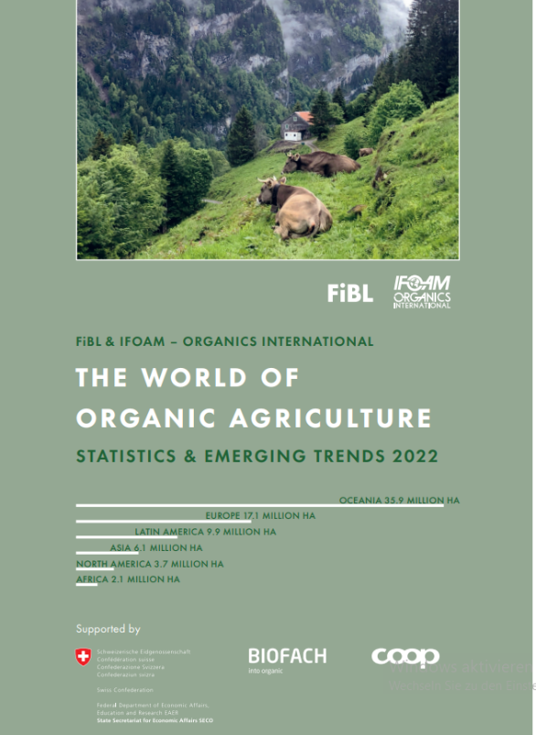
The World of Organic Agriculture 2022
The 23rd edition of «The World of Organic Agriculture», was published by FiBL and IFOAM – Organics International in February 2022.
Data tables
Country and continent reports
Markets, standards, policy support
The book can be ordered or downloaded at (item number 1344): https://www.fibl.org/en/shop-en
www.organic-world.net
https://statistics.fibl.org

Slide 5
About this presentation
In three presentations, the key results of the FiBL survey on organic agriculture worldwide 2022 are summarized (data 2020). Apart from the global data, key results on crop and on regional data are presented.
More information is available at www.organic-world.net
The following three presentations are available at https://www.organic-world.net/yearbook/yearbook-2022/presentations.html:
Part 1: Global data 2020 and survey background
Part 2: Land use and key crops in organic agriculture 2020
Part 3: Organic agriculture in the regions 2020

Slide 6
The 23rd survey on organic agriculture world-wide
The 23rd survey on organic agriculture worldwide was carried out by the Research Institute of Organic Agriculture FiBL in cooperation with partners from all around the world. The results were published jointly by FiBL and IFOAM – Organics International.
The survey was carried out between July 2021 and February 2022.
Data were received from 190 countries.
Updated data on area and producers were available for 142 countries.
Data was provided by over 200 country experts (representatives from NGOs, certification bodies, governments, researchers).
The following data was collected: area data (including land use and crop details); producers, other operator types; domestic market values; export and import data; livestock data (animal heads and production in metric tons).
The results are published in the yearbook “The World of Organic Agriculture 2022” and on www.organic-world.net.

Slide 7
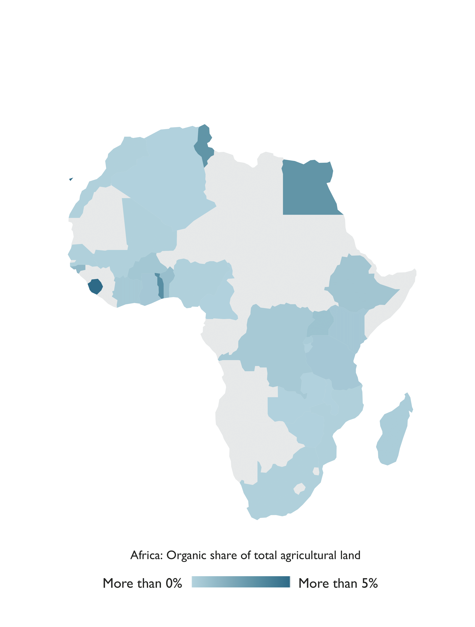
Africa

Slide 8
Organic agriculture in Africa 2020
There were more than 2 million hectares of certified organic agricultural land in Africa in 2020.
Africa reported 149´000 hectares more than in 2019, a 7.7 percent increase, and nearly 834´000 producers.
Tunisia was the country with the largest organic area (more than 290´000 hectares in 2020), and Ethiopia had the largest number of organic producers (almost 220´000).
The country with the highest percentage of land devoted to organic farming in the region was the island state of São Tomé and Príncipe, with 20.7 percent of its agricultural area dedicated to organic crops.
The majority of certified organic products in Africa are destined for export markets. Key crops are nuts, olives, coffee, cocoa, oilseeds and cotton.
Five countries in Africa have legislation on organic agriculture, and five countries are drafting legislation. Six countries have a national standard but lack legislation on the definition of organic farming (East African Organic Product Standard).
Source: FiBL survey 2022

Slide 9
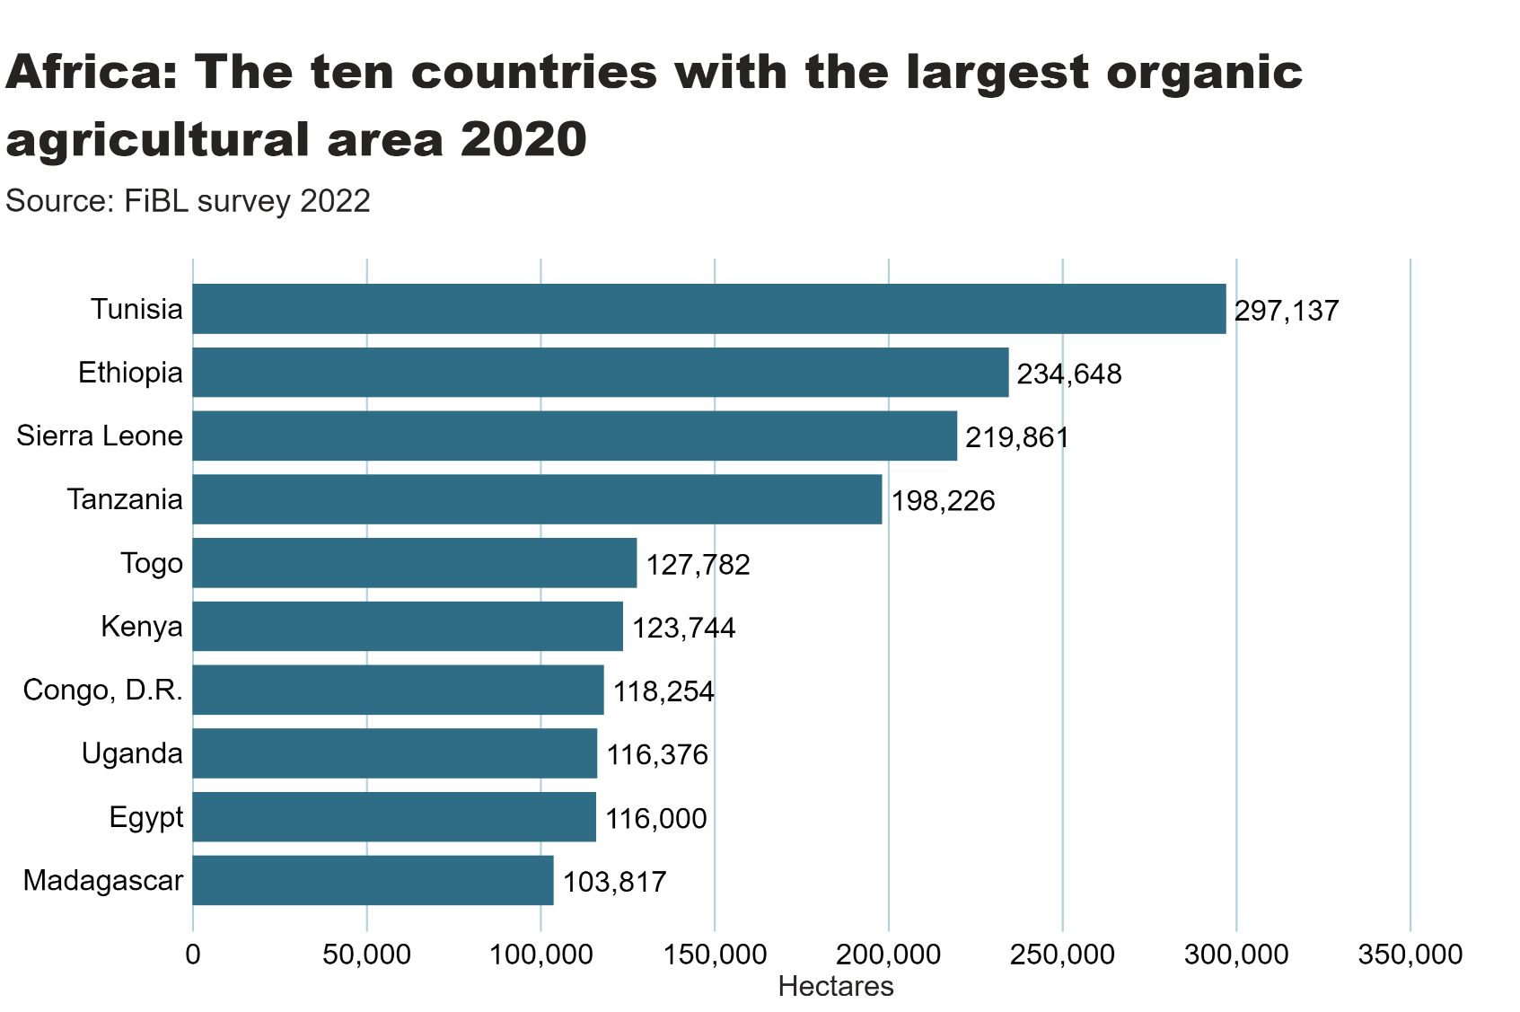
africa_land_country
Notes:
textbox
No alt text provided
Source: FiBL survey 2022
No alt text provided
card
No alt text provided

Slide 10
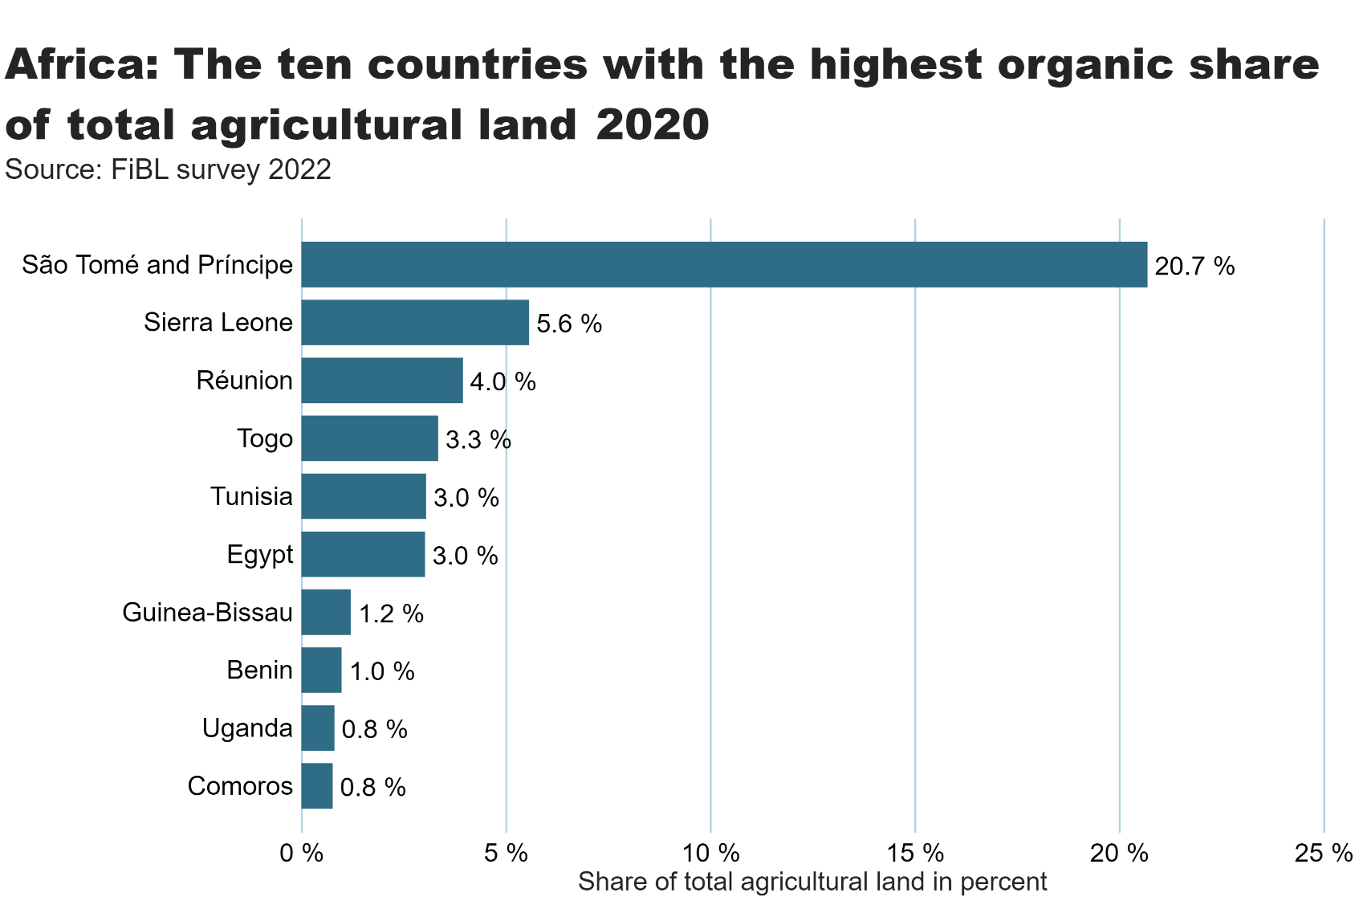
Africa_land_share
Notes:
textbox
No alt text provided
card
No alt text provided
barChart
No alt text provided

Slide 11
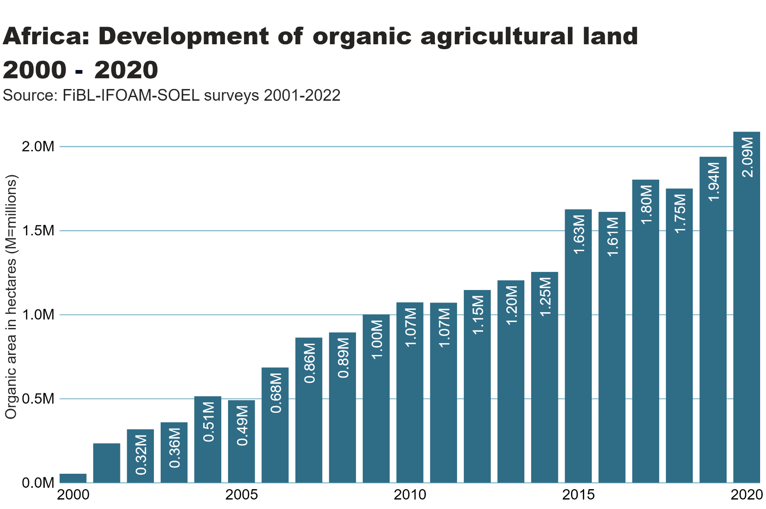
africa_land_growth
Notes:
textbox
No alt text provided
card
No alt text provided
lineClusteredColumnComboChart
No alt text provided

Slide 12
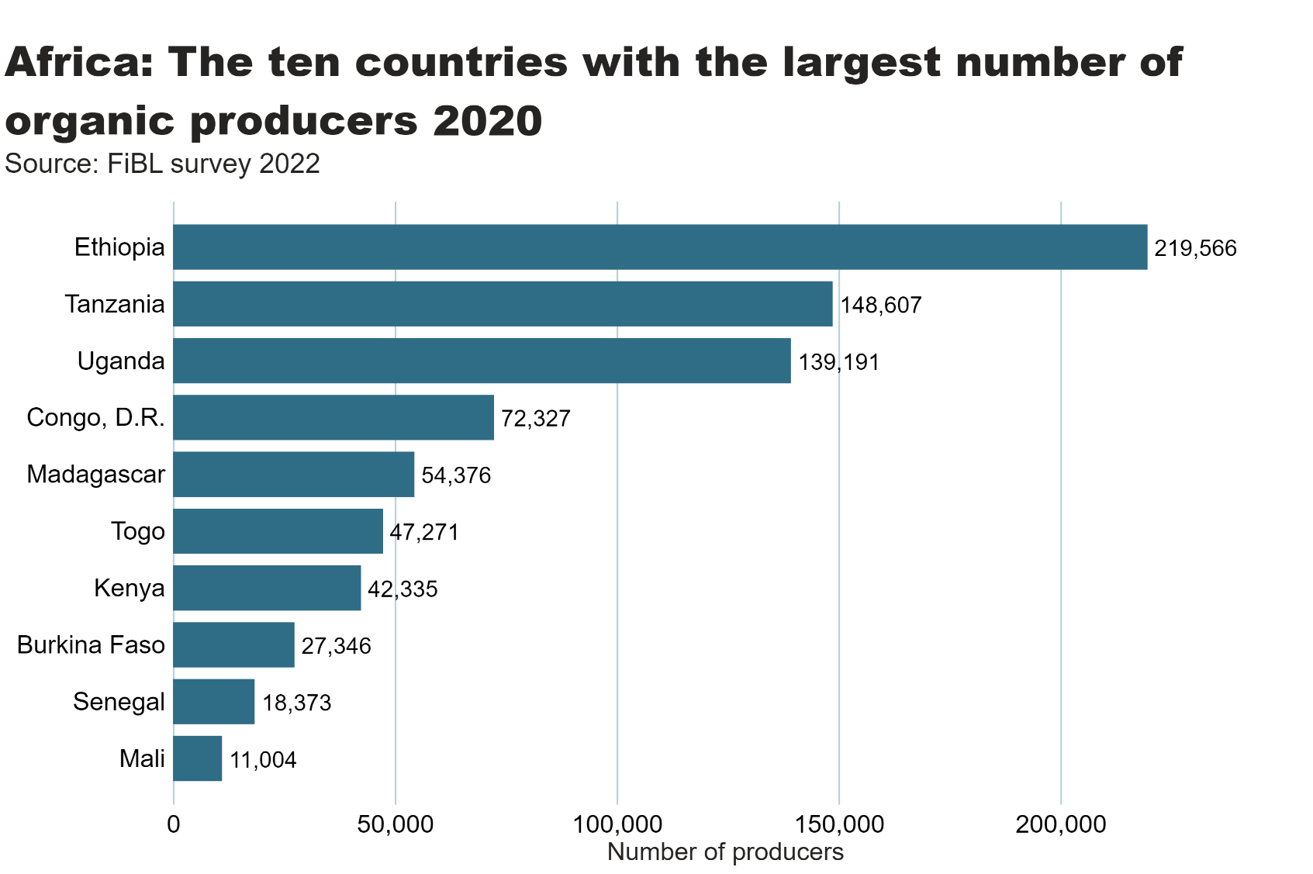
africa_producers_country
Notes:
textbox
No alt text provided
card
No alt text provided
barChart
No alt text provided

Slide 13
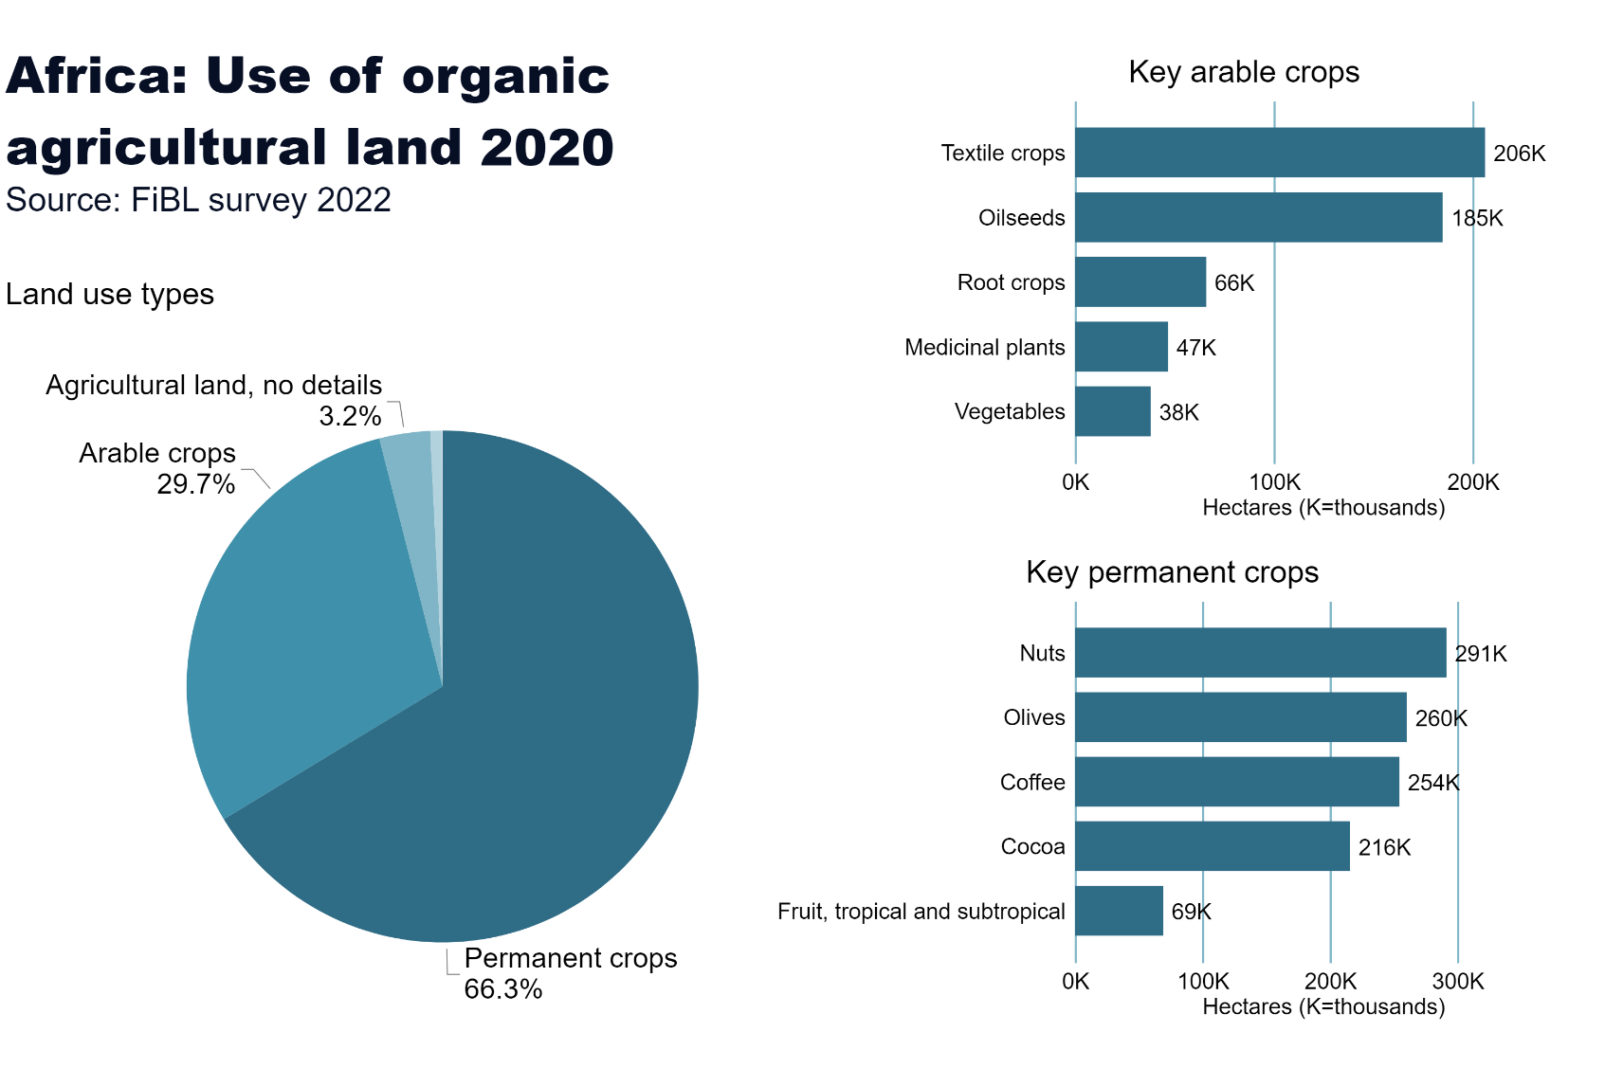
Africa_land_use
Notes:
Land use types
No alt text provided
card
No alt text provided
Key arable crops
No alt text provided
Key permanent crops
No alt text provided
textbox
No alt text provided

Slide 14
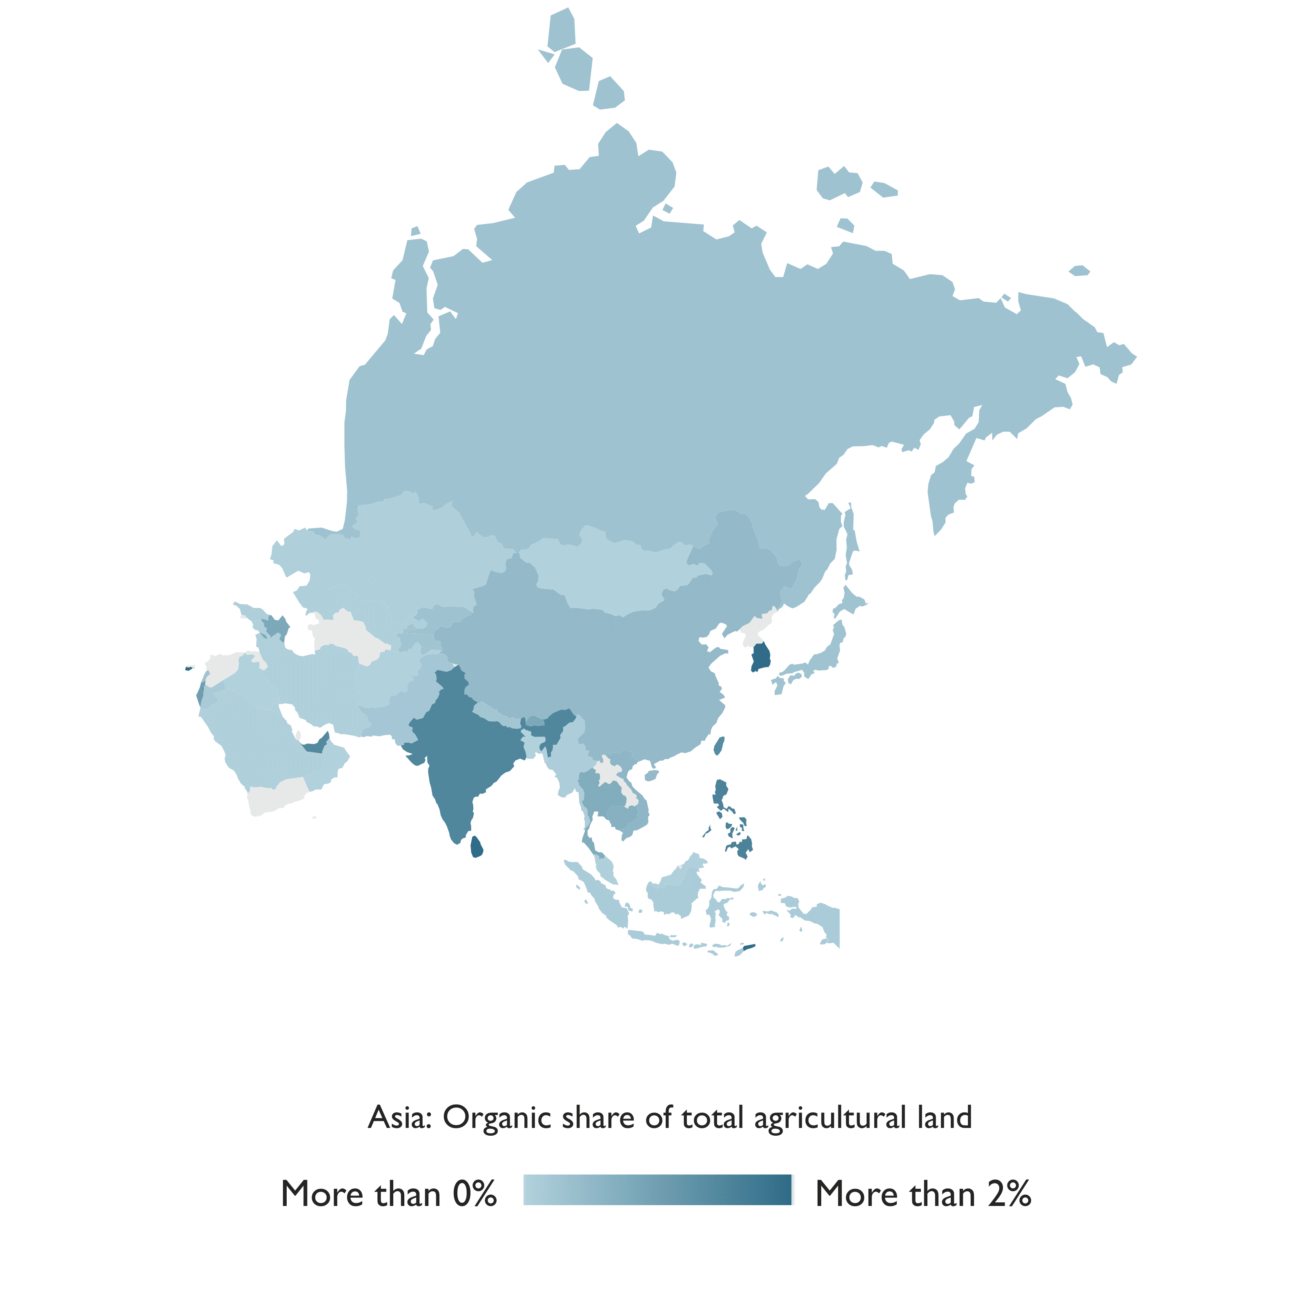
Asia

Slide 15
Organic Agriculture in Asia 2020
The total area dedicated to organic agriculture in Asia was more than 6.1 million hectares in 2020.
The leading countries by area were India (2.7 million hectares) and China (over 2.4 million hectares).
Timor-Leste had the highest proportion of organic agricultural land (8.5 percent).
There were nearly two million producers, most of whom were in India.
Twenty countries in the region have legislation on organic agriculture, and six countries are drafting legislation.
Source: FiBL survey 2022

Slide 16
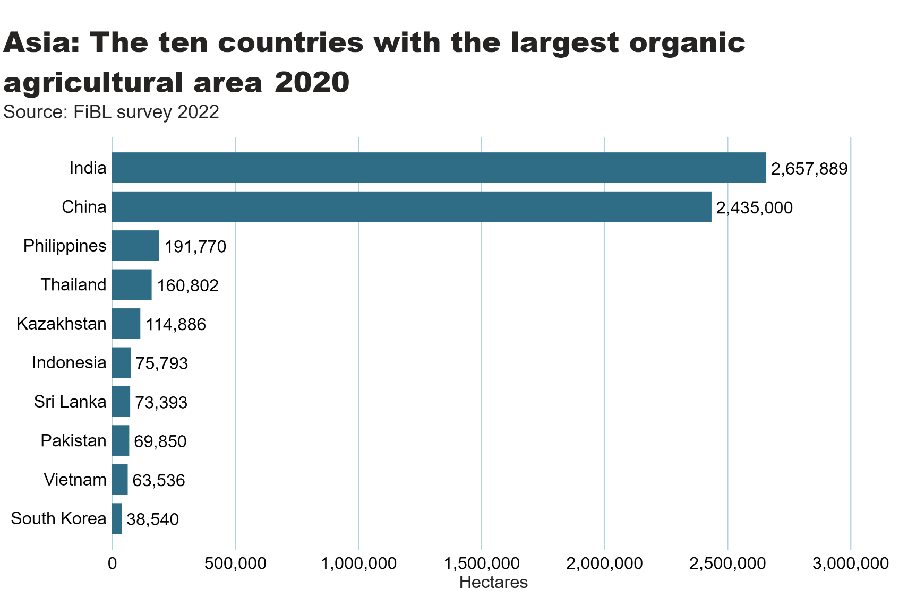
Asia_land_country
Notes:
clusteredBarChart
No alt text provided
textbox
No alt text provided
card
No alt text provided

Slide 17
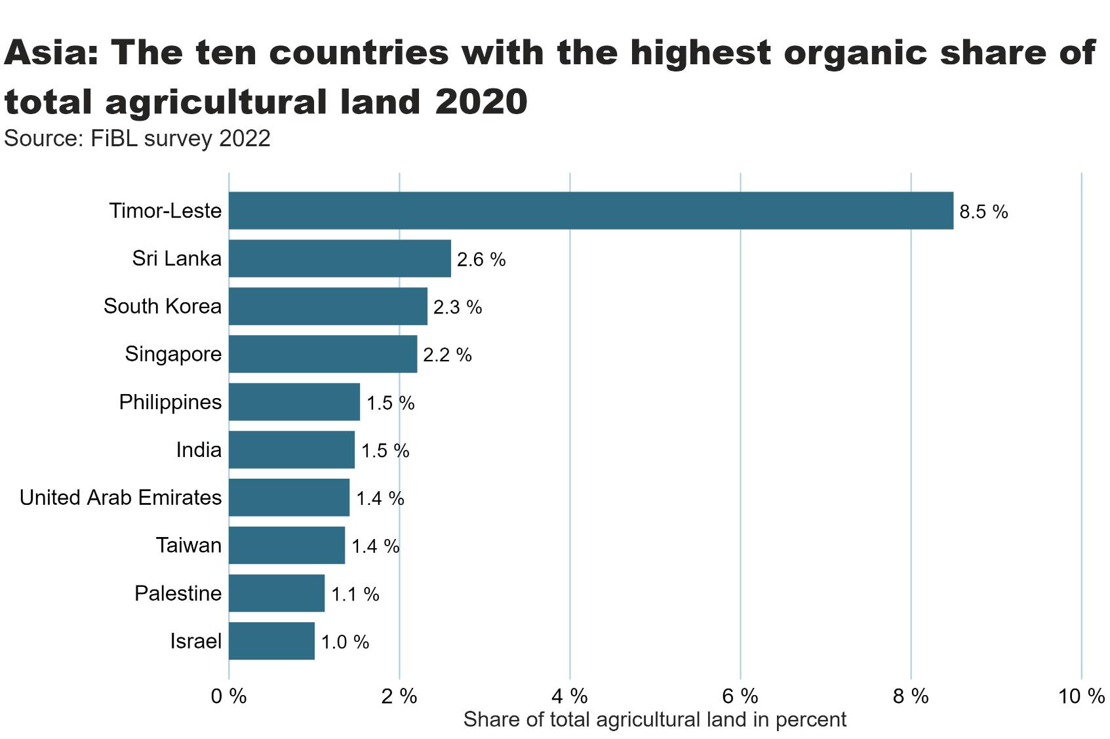
Asia_land_share_country
Notes:
textbox
No alt text provided
Source: FiBL survey 2022
No alt text provided
card
No alt text provided

Slide 18
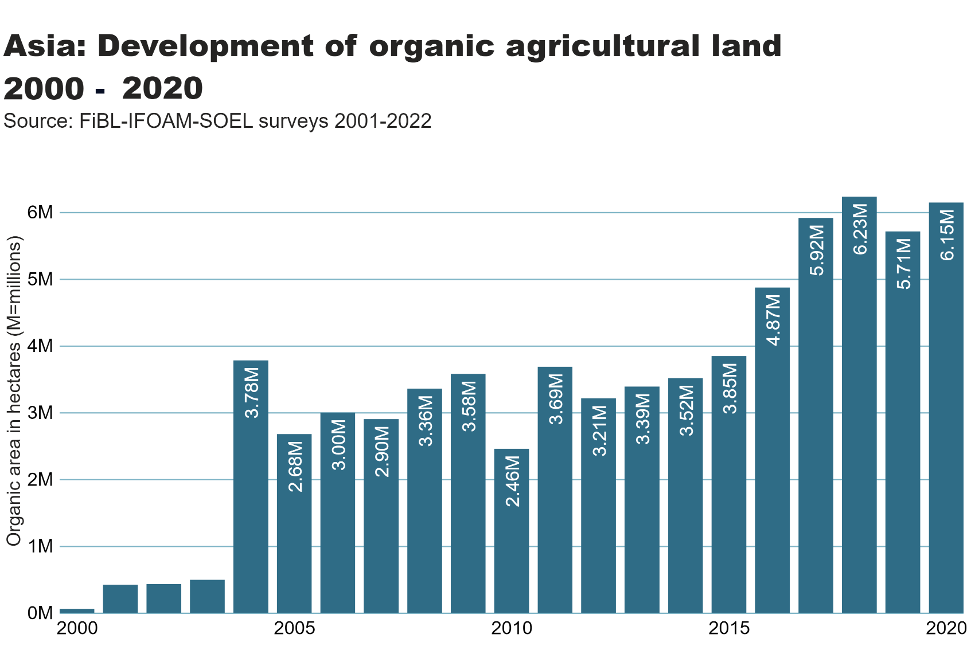
asia_land_growth
Notes:
textbox
No alt text provided
card
No alt text provided
Source: FiBL-IFOAM-SOEL surveys 2001-2022
No alt text provided

Slide 19
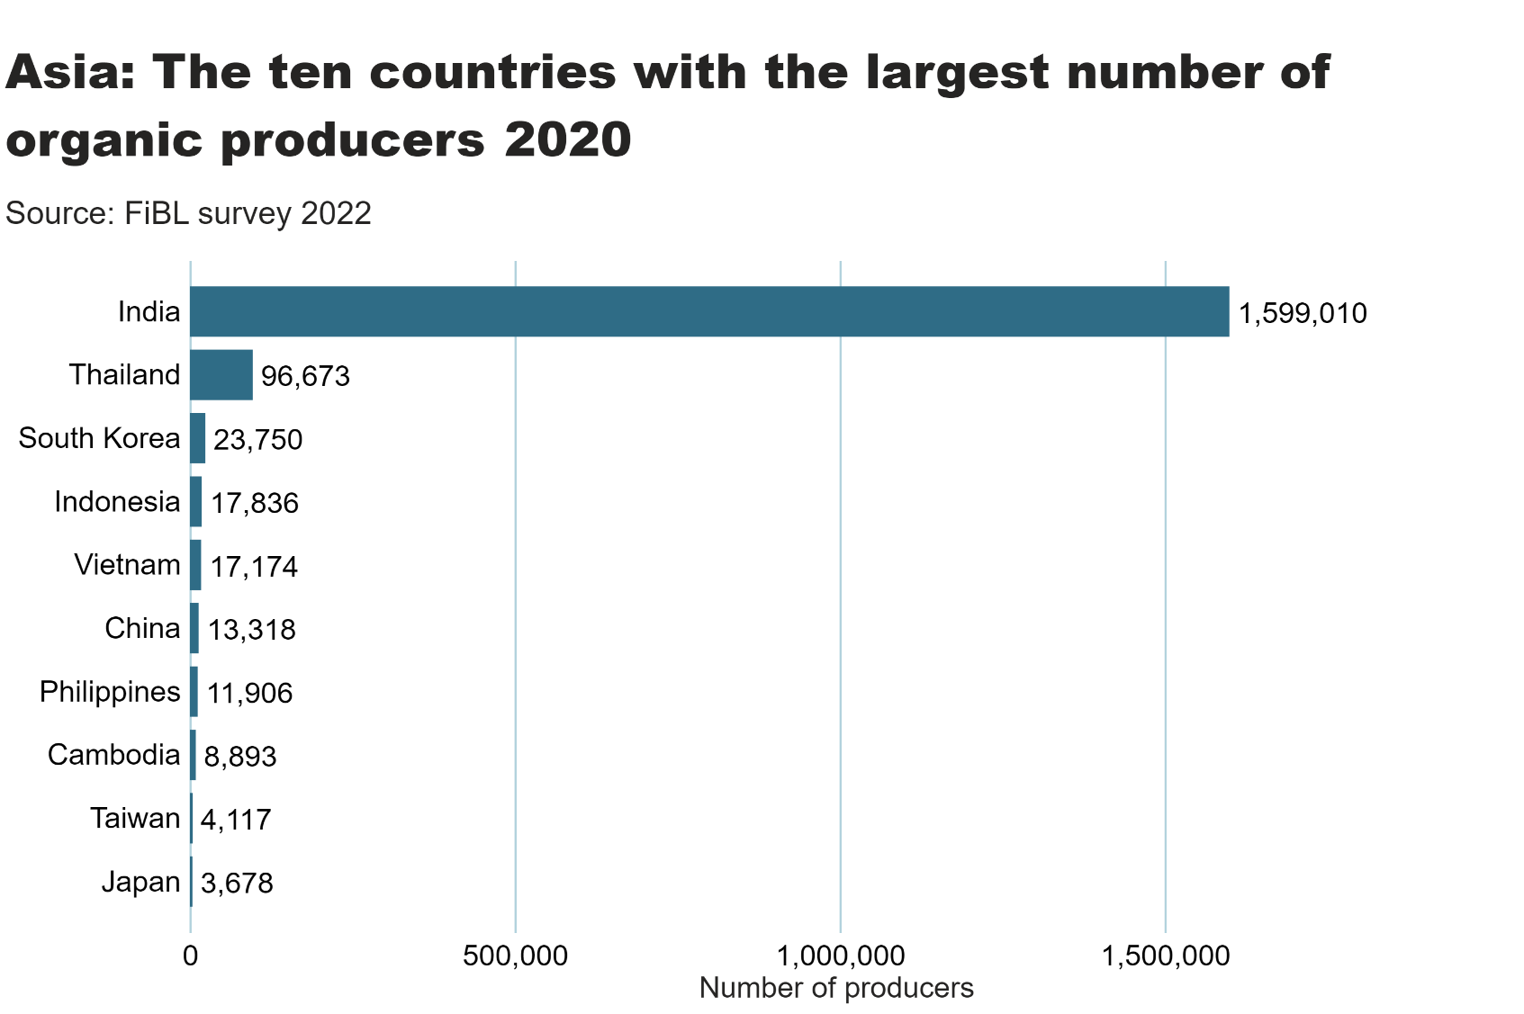
Asia_producers_country
Notes:
textbox
No alt text provided
card
No alt text provided
barChart
No alt text provided

Slide 20
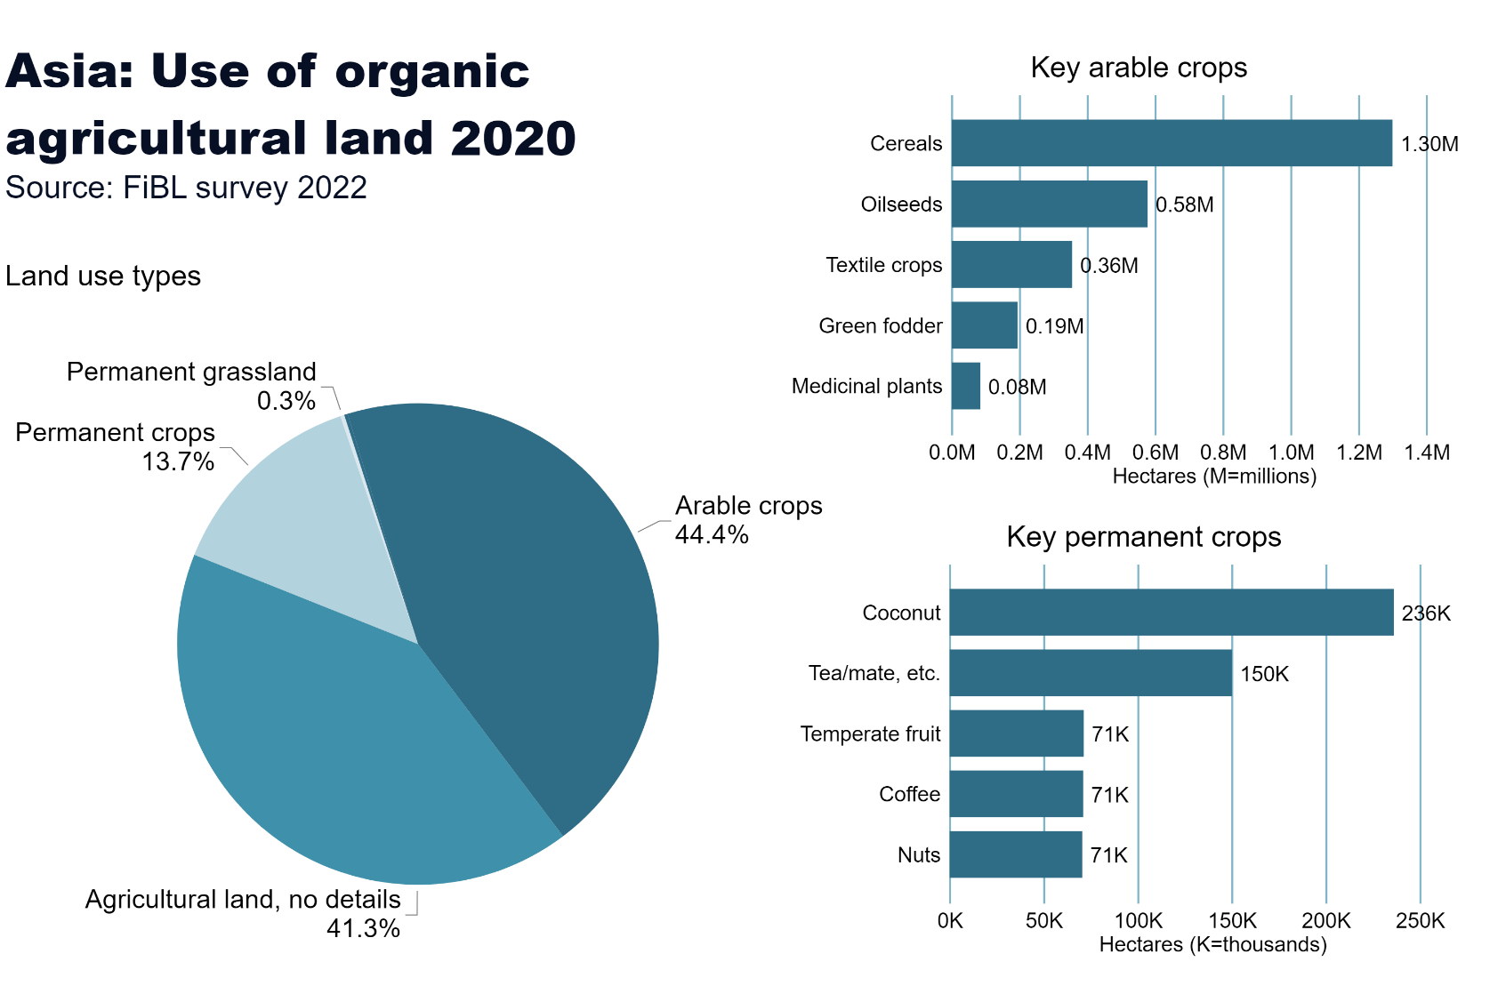
Asia_land_use
Notes:
Land use types
No alt text provided
card
No alt text provided
Key arable crops
No alt text provided
Key permanent crops
No alt text provided
textbox
No alt text provided

Slide 21
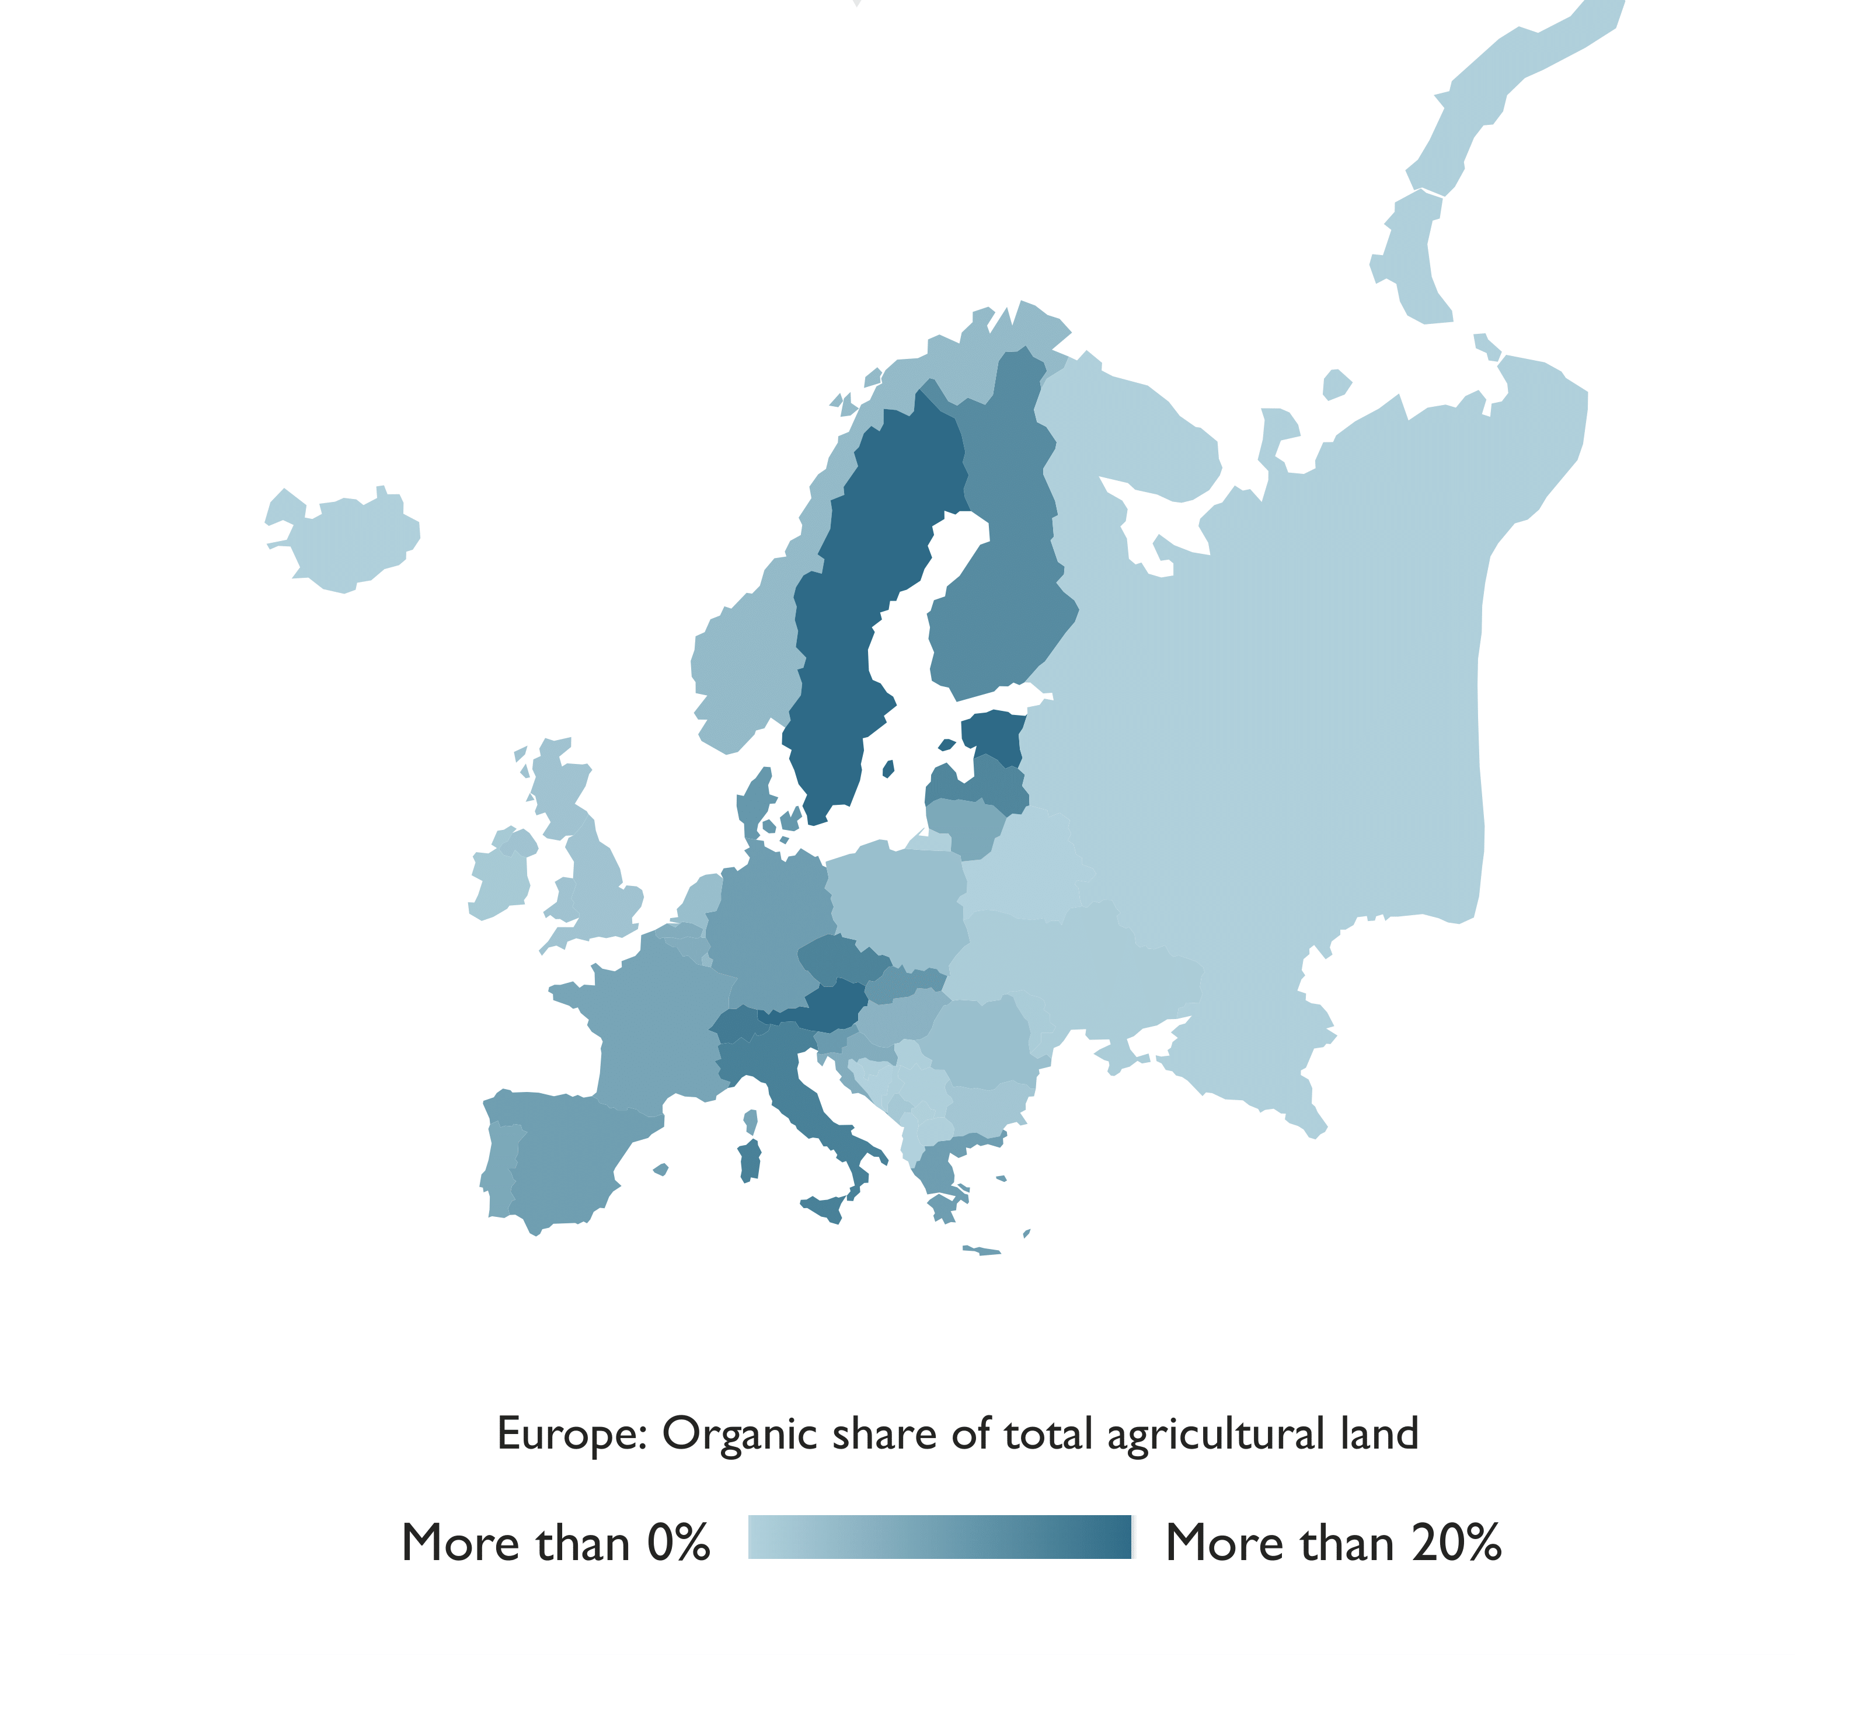
Europe: Organic agricultural land 2020
Source: FiBL survey 2022, based on national sources and Eurostat.

Slide 22
Organic agriculture in Europe: Key data 2020
As of the end of 2020, 17.1 million hectares of agricultural land in Europe (European Union: 14.9 million hectares) were managed organically by almost 420’000 producers (European Union: almost 350’000).
In Europe, 3.4 percent of the agricultural area was organic (European Union: 9.2 percent).
Organic farmland has increased by over 0.7 million hectares compared to 2019.
The countries with the largest organic agricultural areas were France (2.5 million hectares), Spain (2.4 million hectares) and Italy (2.1 million hectares).
In 15 countries, at least 10 percent of the farmland was organic: Liechtenstein had the lead (41.6 percent), followed by Austria (26.5 percent) and Estonia (22.4 percent).
Retail sales of organic products totalled 52 billion euros in 2020 (European Union: 44.8 billion euros), an increase of 15 percent compared to 2020.
The largest market for organic products in 2020 was Germany, with retail sales of 15.0 billion euros, followed by France (12.7 billion euros) and Italy (3.9 billion euros)
In Europe, 46 countries have legislation on organic agriculture.
Source: FiBL survey 2022, based on national sources and Eurostat.

Slide 23
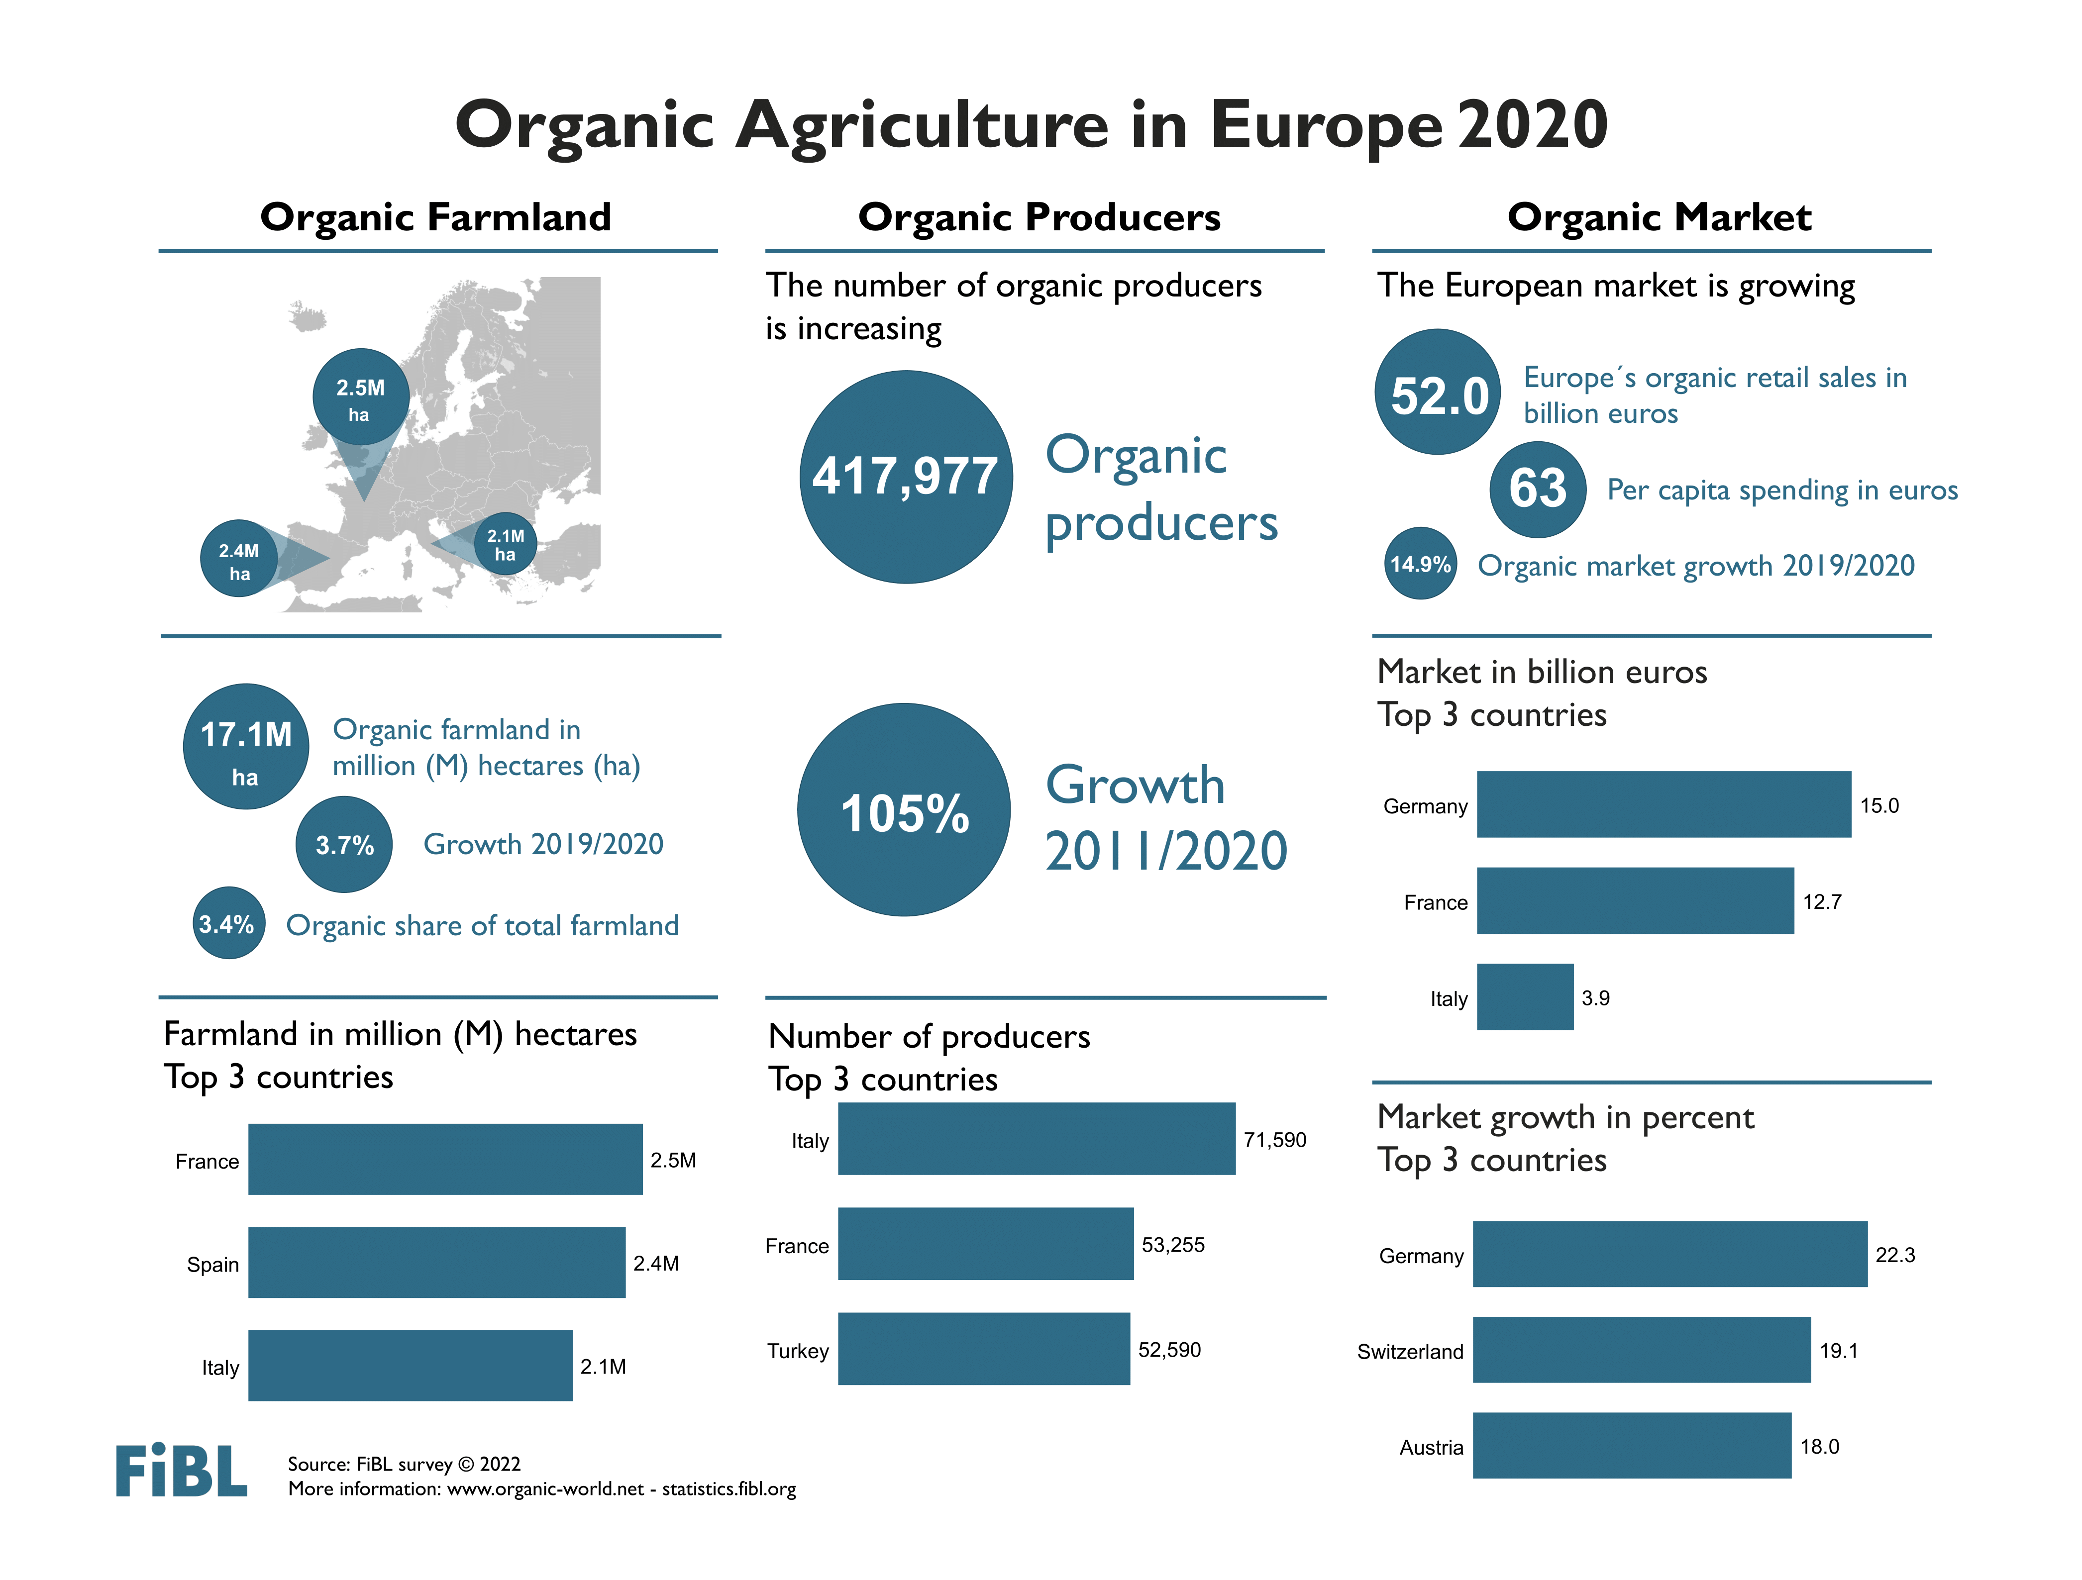

Slide 24
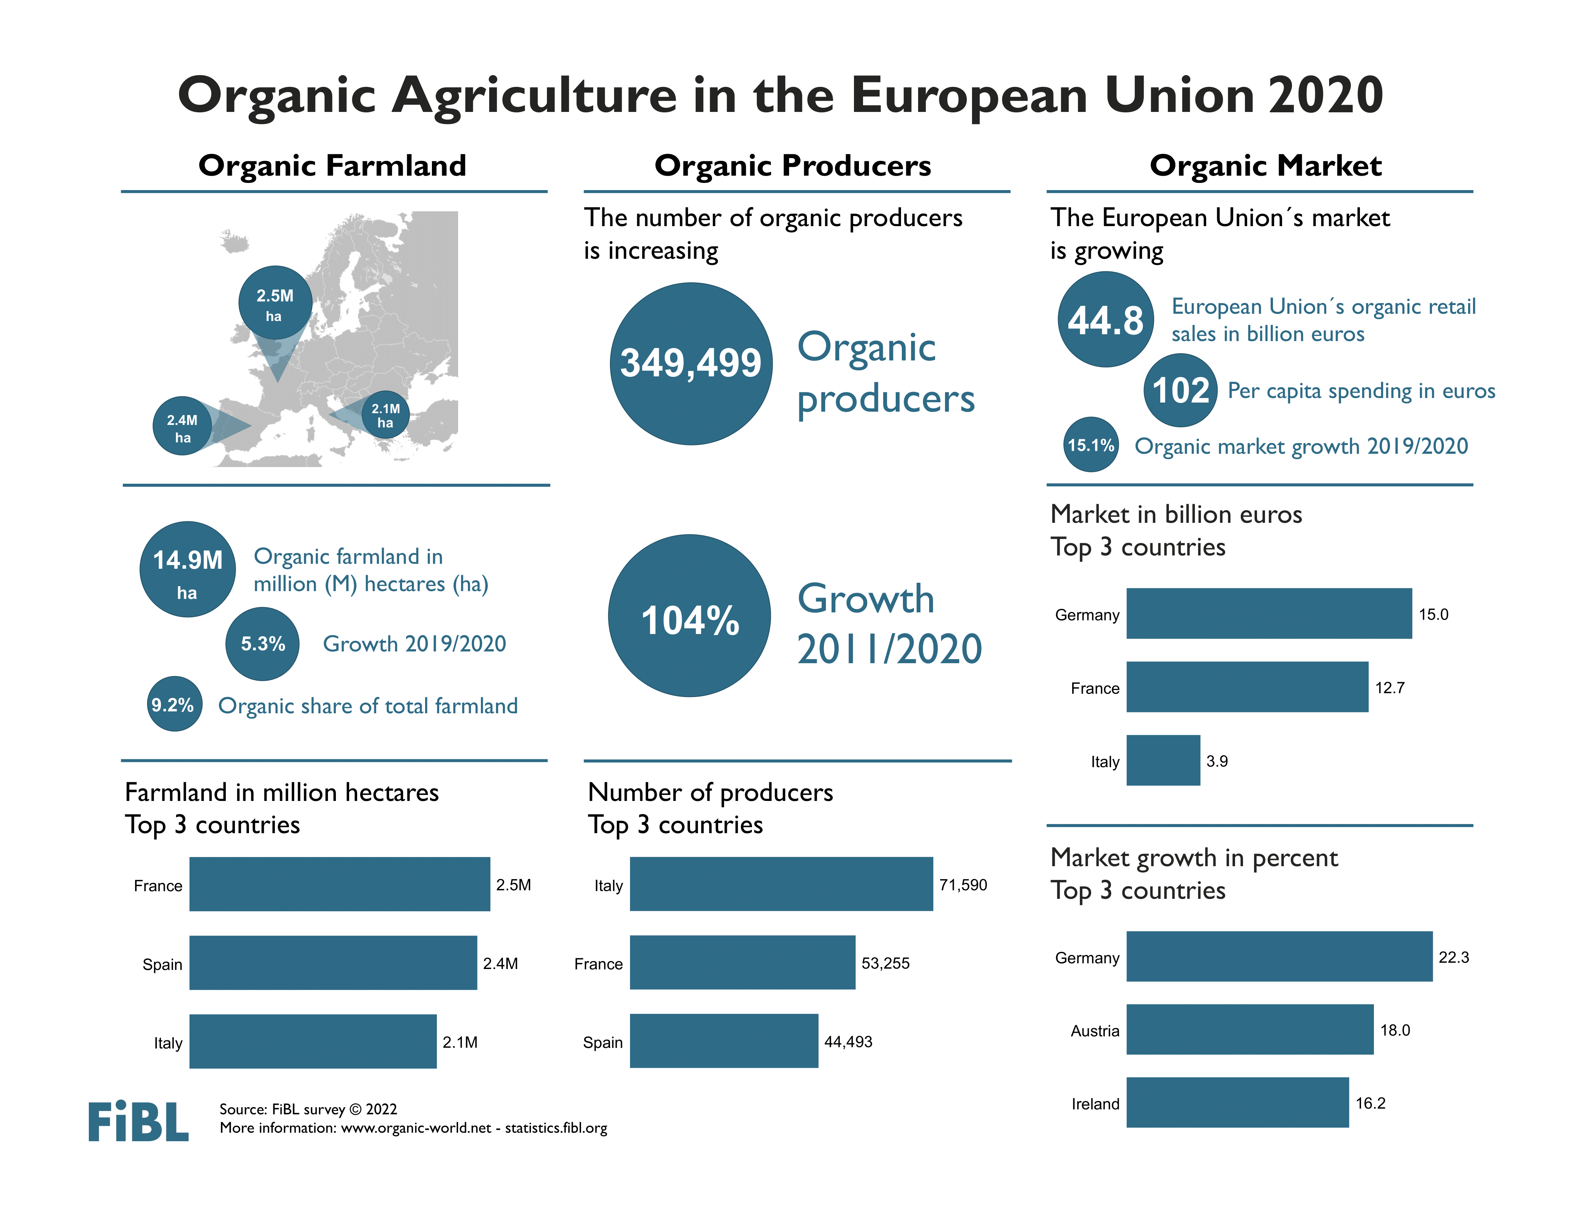

Slide 25
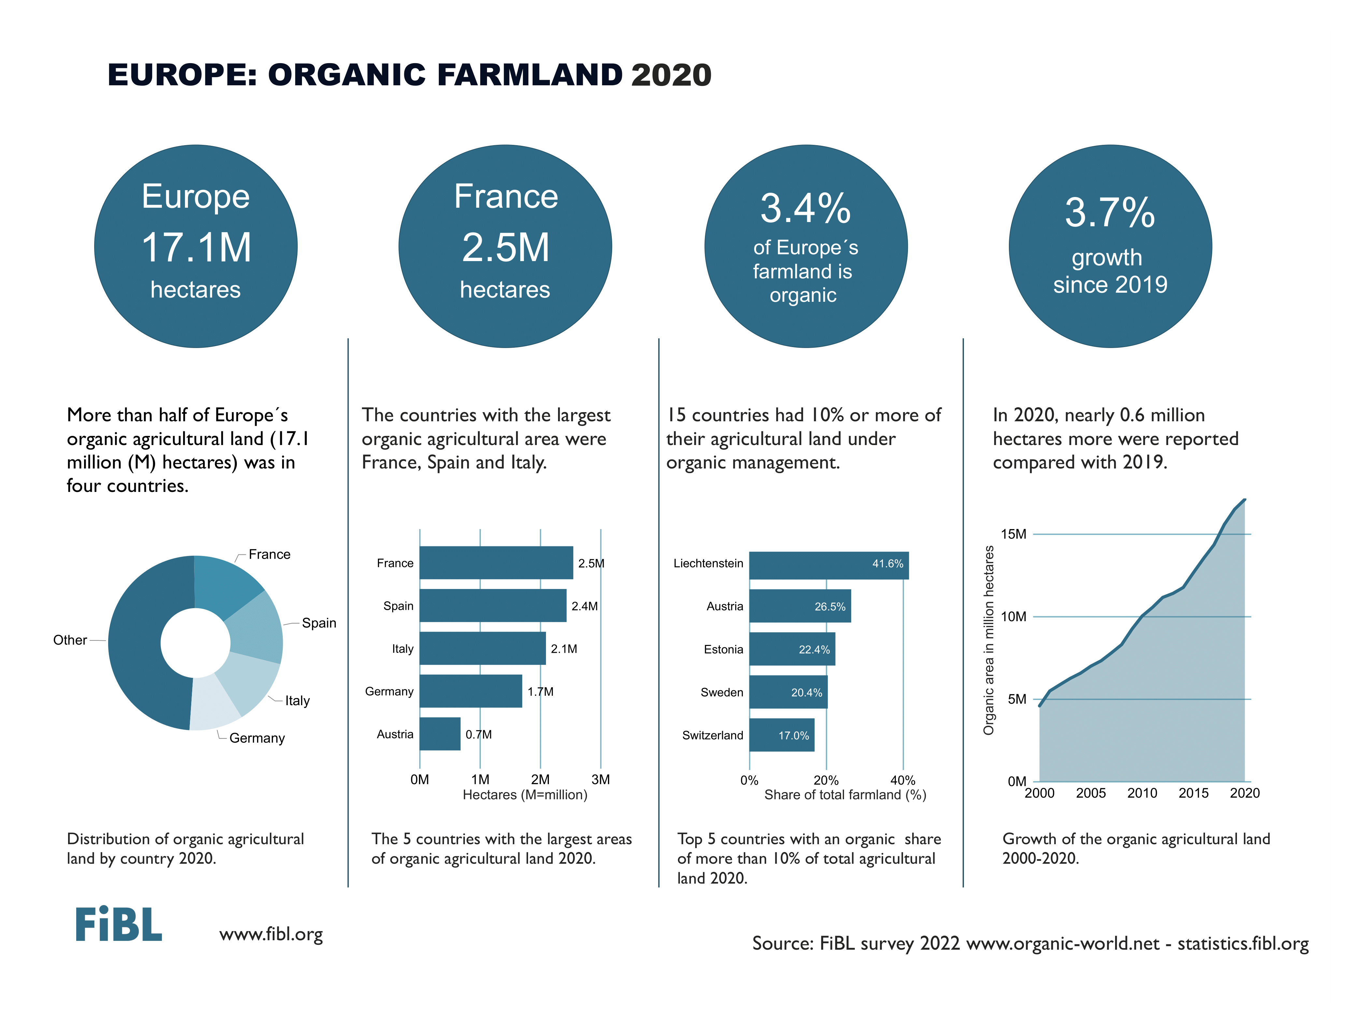

Slide 26
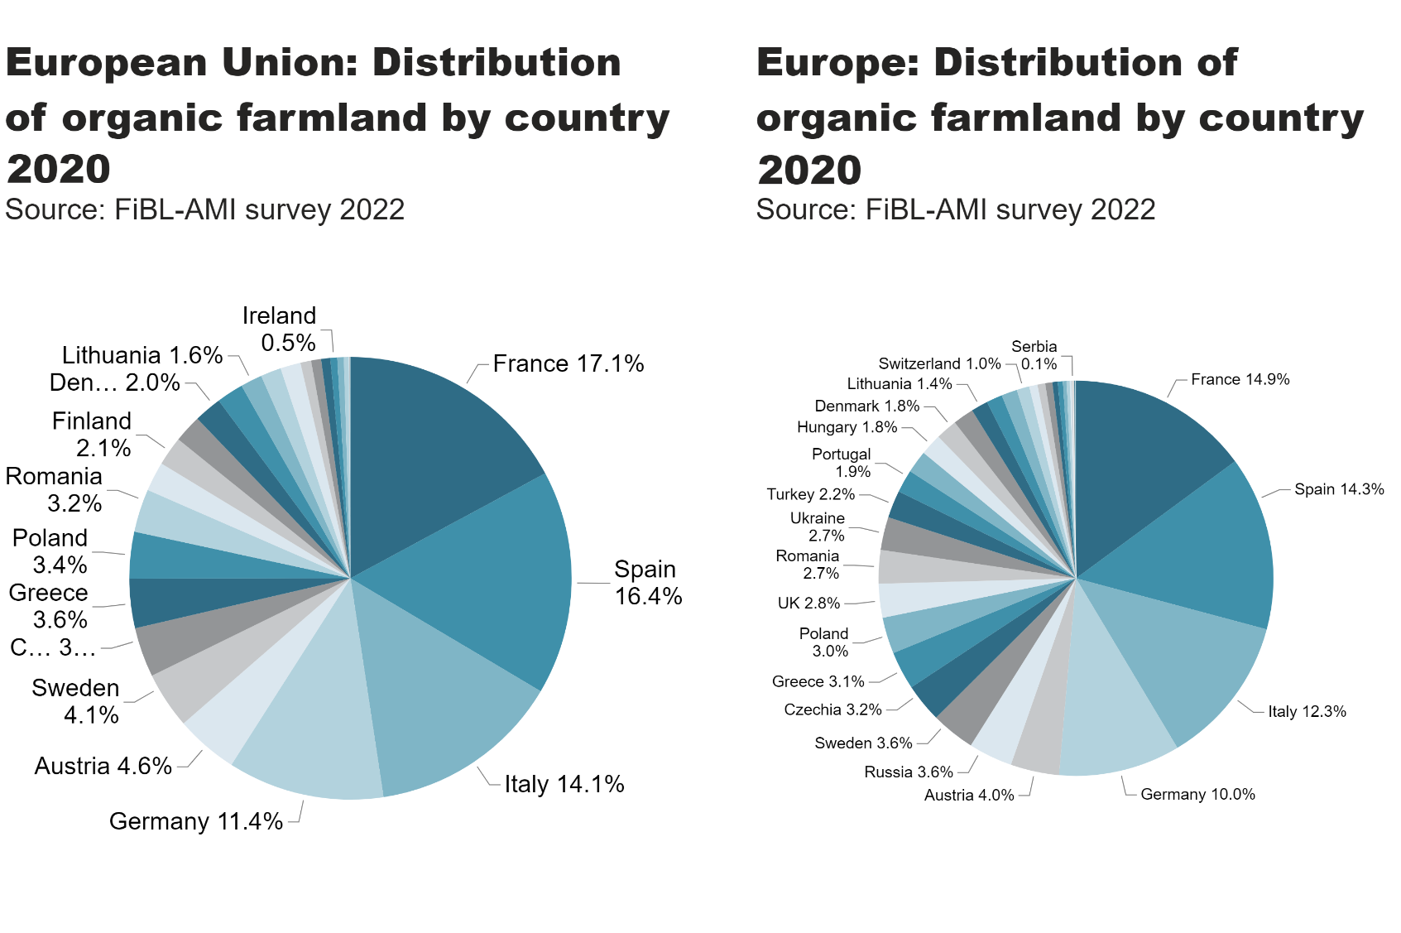
EU_Europe_land_distribution_country
Notes:
pieChart
No alt text provided
textbox
No alt text provided
card
No alt text provided
pieChart
No alt text provided
textbox
No alt text provided
card
No alt text provided

Slide 27
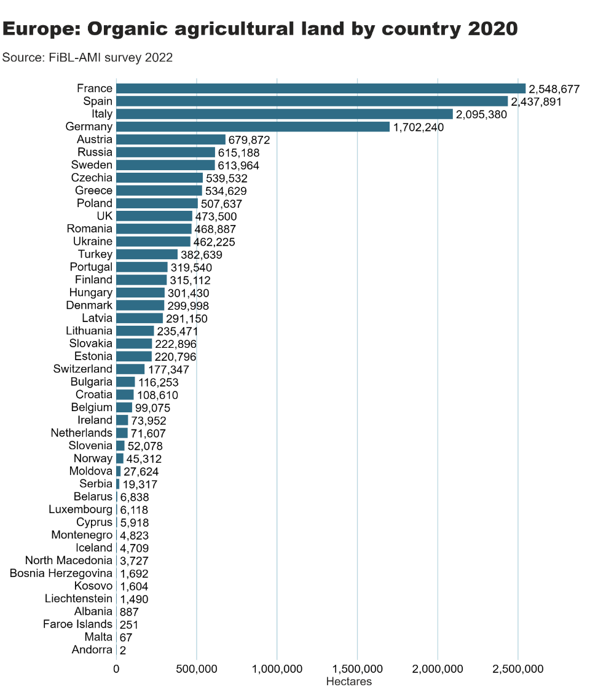
Europe_land_by_country
Notes:
clusteredBarChart
No alt text provided
textbox
No alt text provided
card
No alt text provided

Slide 28
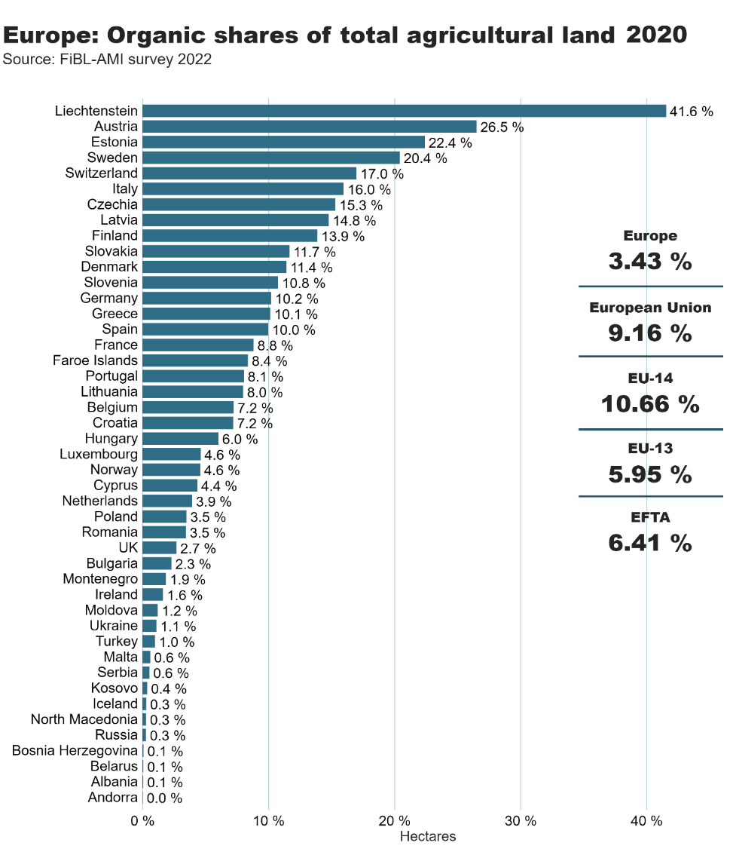
Europe_land_share_country
Notes:
clusteredBarChart
No alt text provided
textbox
No alt text provided
card
No alt text provided
European Union
No alt text provided
Europe
No alt text provided
EFTA
No alt text provided
EU-14
No alt text provided
EU-13
No alt text provided
shape
No alt text provided
shape
No alt text provided
shape
No alt text provided
shape
No alt text provided

Slide 29
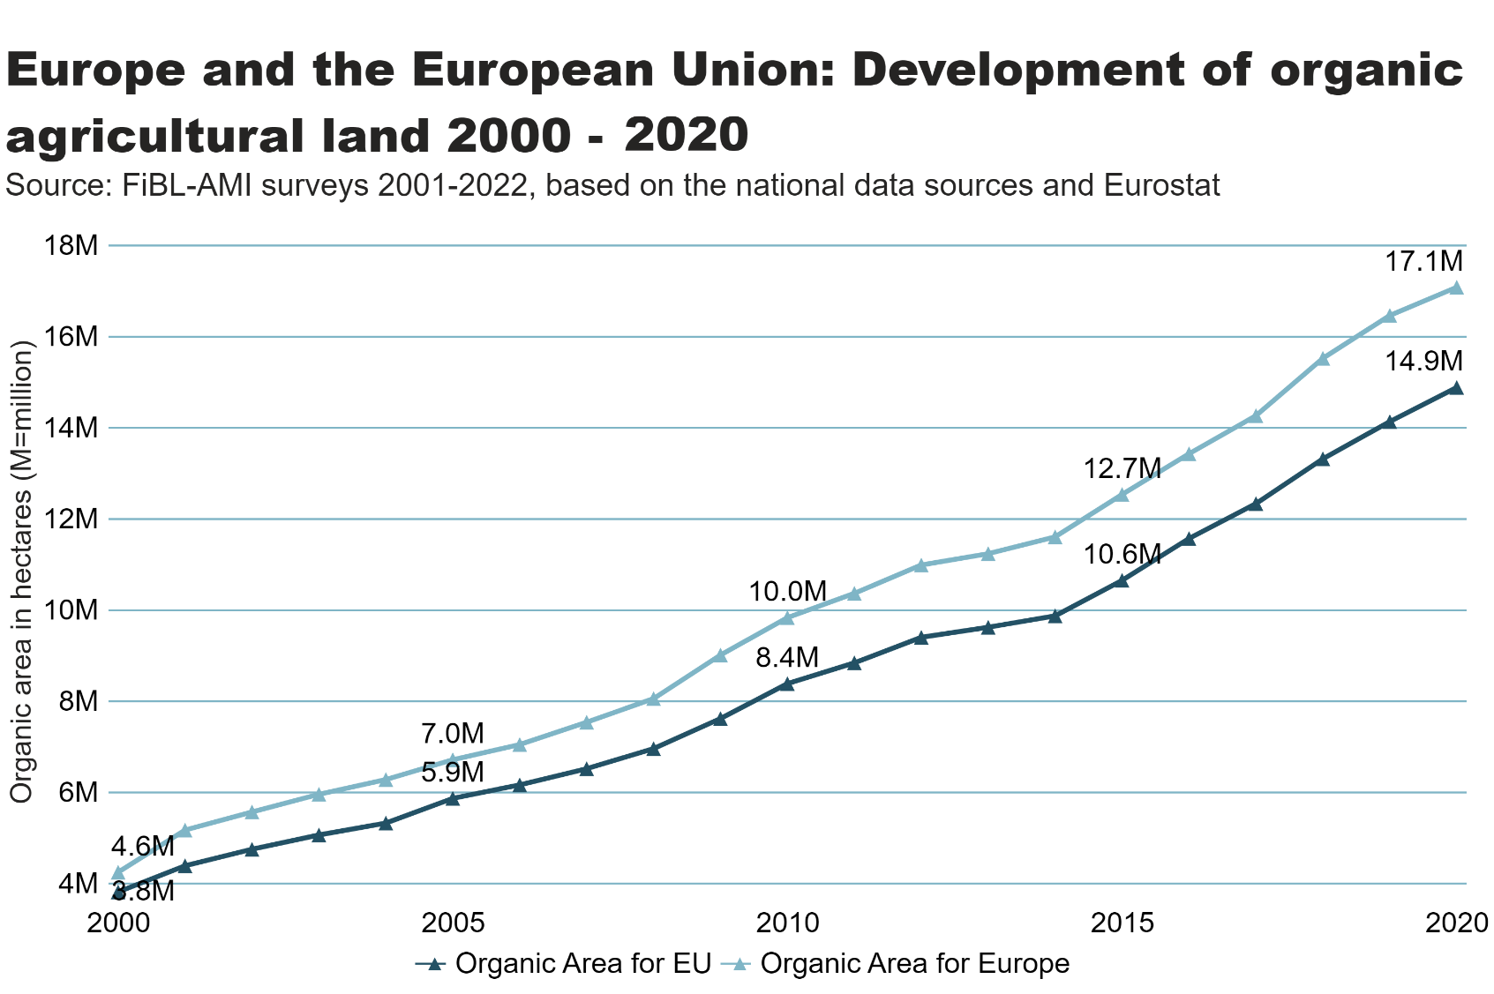
Europe_EU_growth_land
Notes:
textbox
No alt text provided
lineChart
No alt text provided
card
No alt text provided

Slide 30
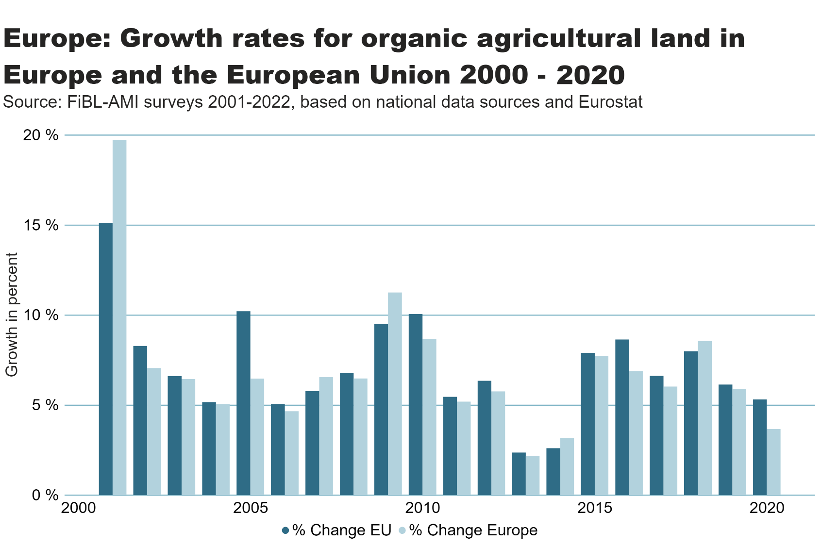
Europe_growth_percent
Notes:
textbox
No alt text provided
clusteredColumnChart
No alt text provided
card
No alt text provided

Slide 31
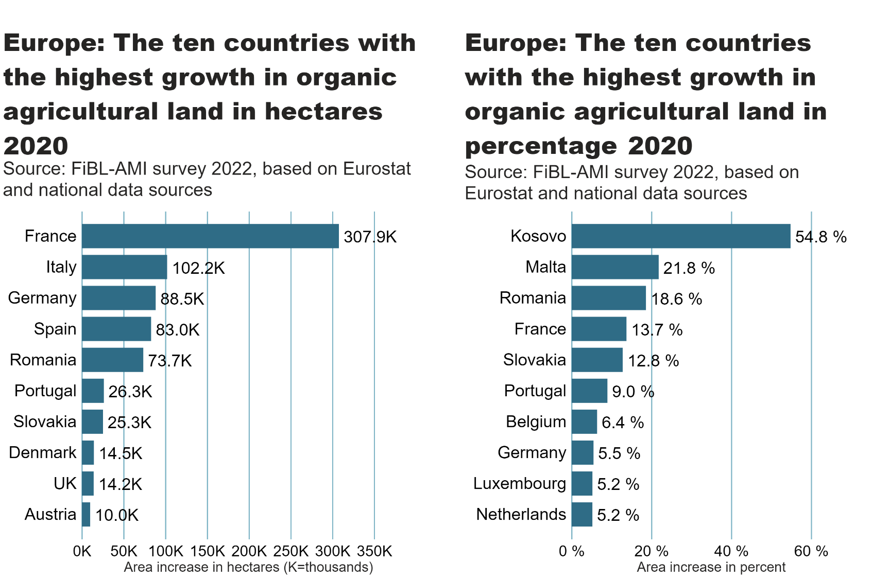
Europe_top10_land_growth_area+share
Notes:
textbox
No alt text provided
card
No alt text provided
barChart
No alt text provided
textbox
No alt text provided
card
No alt text provided
barChart
No alt text provided

Slide 32
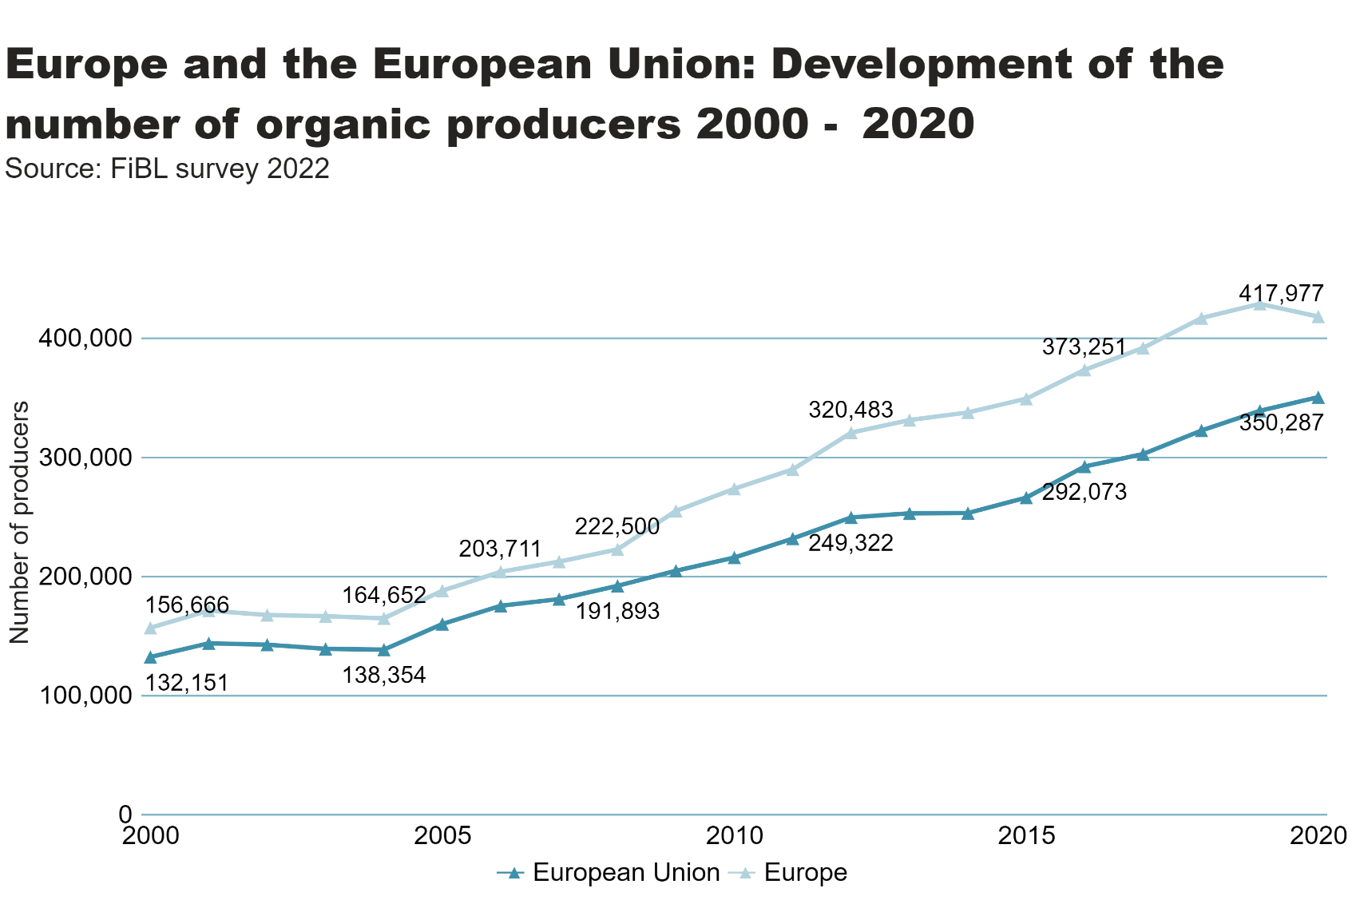
Europe_EU_growth_producers
Notes:
textbox
No alt text provided
lineChart
No alt text provided
card
No alt text provided

Slide 33
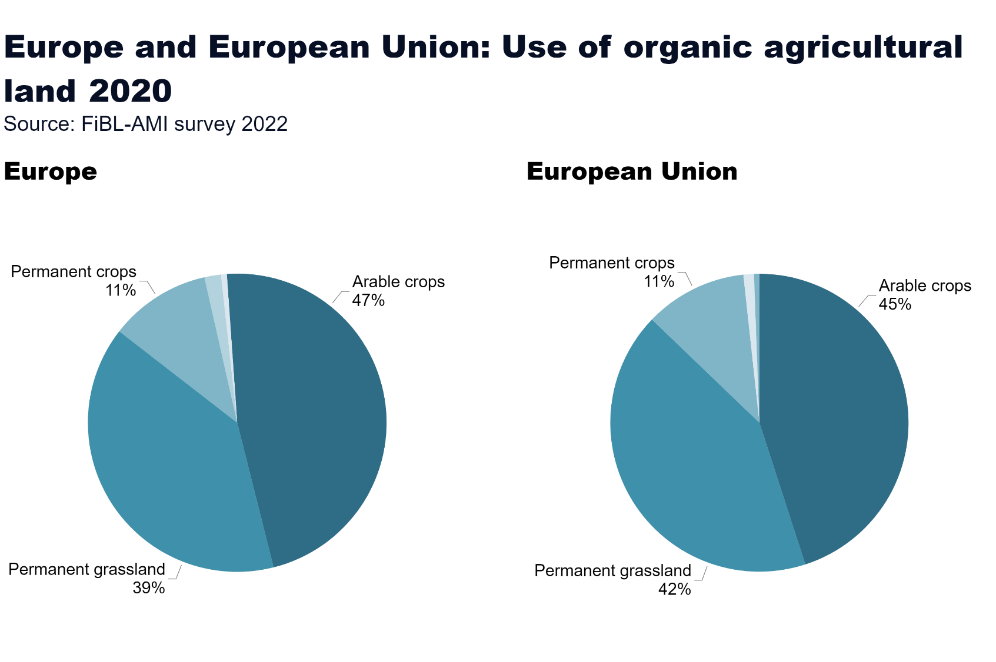
Europe_land_use
Notes:
European Union
No alt text provided
card
No alt text provided
Europe
No alt text provided
textbox
No alt text provided

Slide 34
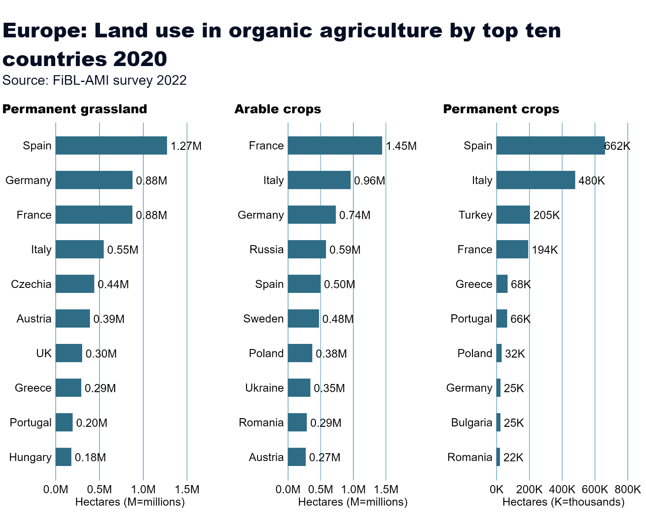
Europe_land_use_by_culture
Notes:
Arable crops
No alt text provided
textbox
No alt text provided
card
No alt text provided
Permanent crops
No alt text provided
Permanent grassland
No alt text provided

Slide 35
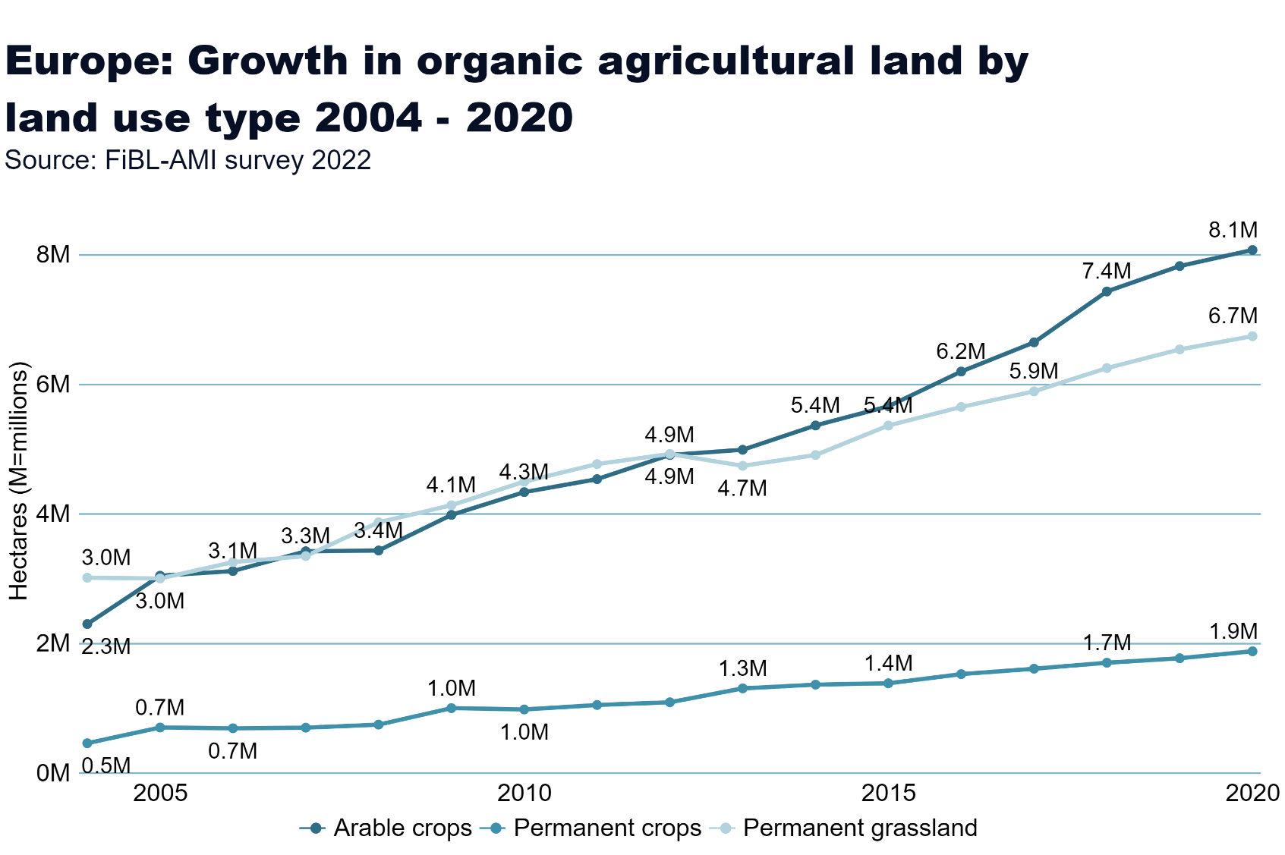
Europe_land_use_development
Notes:
Arable land
No alt text provided
textbox
No alt text provided
card
No alt text provided

Slide 36
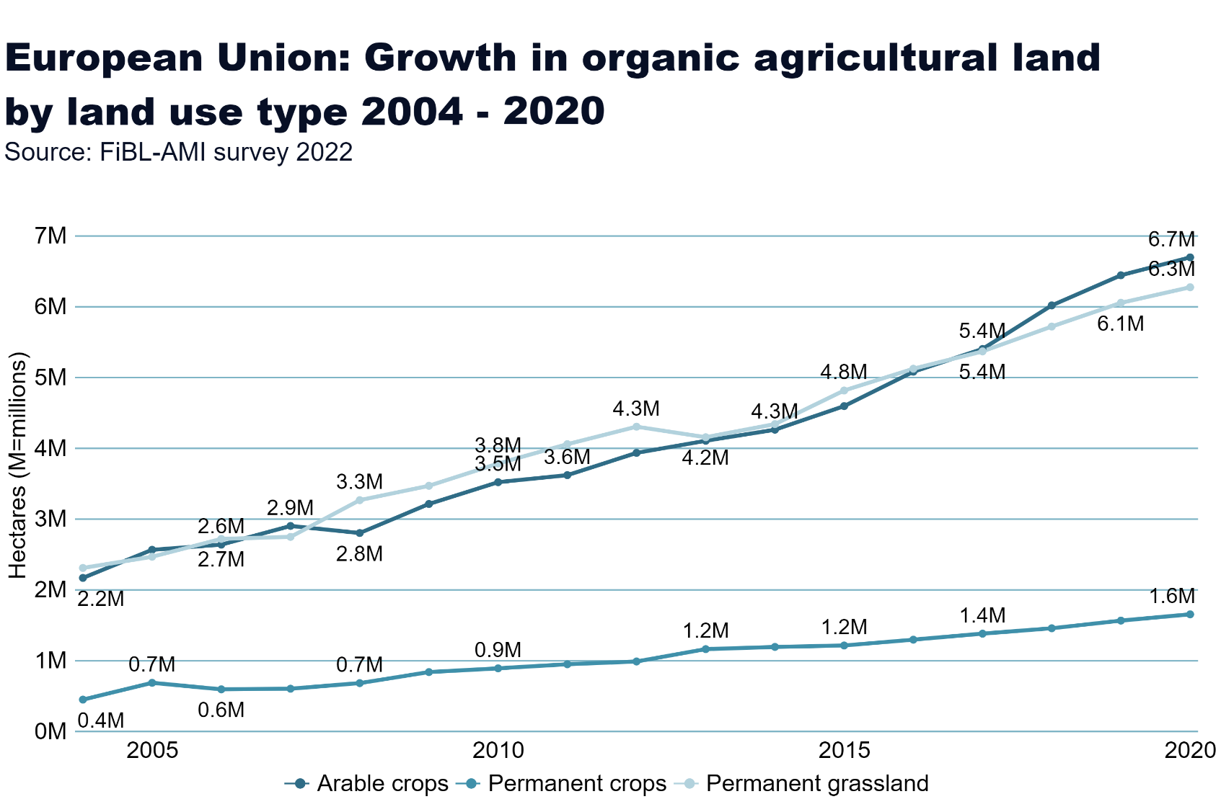
European_Union_land_use_by_culture
Notes:
Arable land
No alt text provided
textbox
No alt text provided
card
No alt text provided

Slide 37
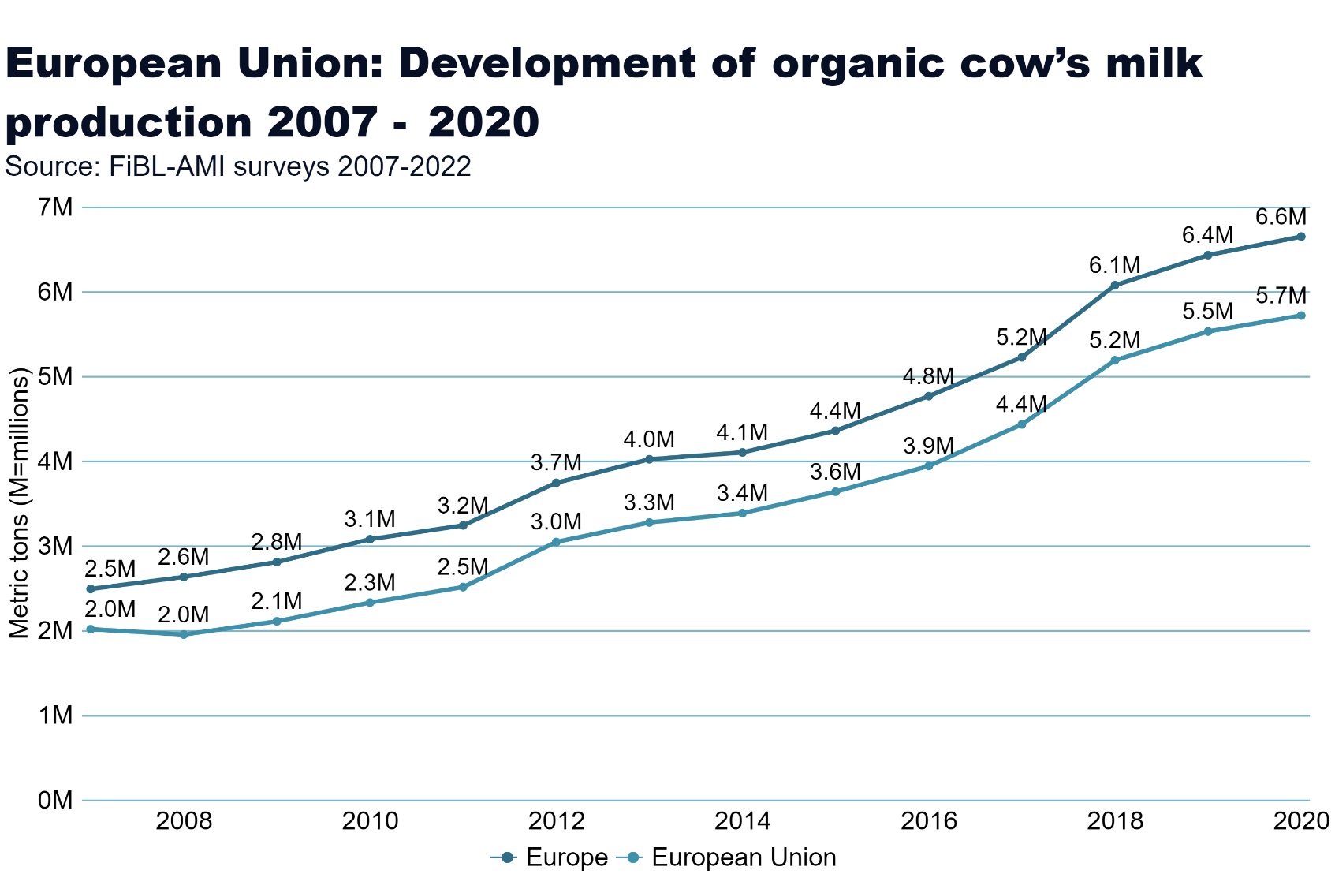
milk
Notes:
Arable land
No alt text provided
textbox
No alt text provided
card
No alt text provided

Slide 38
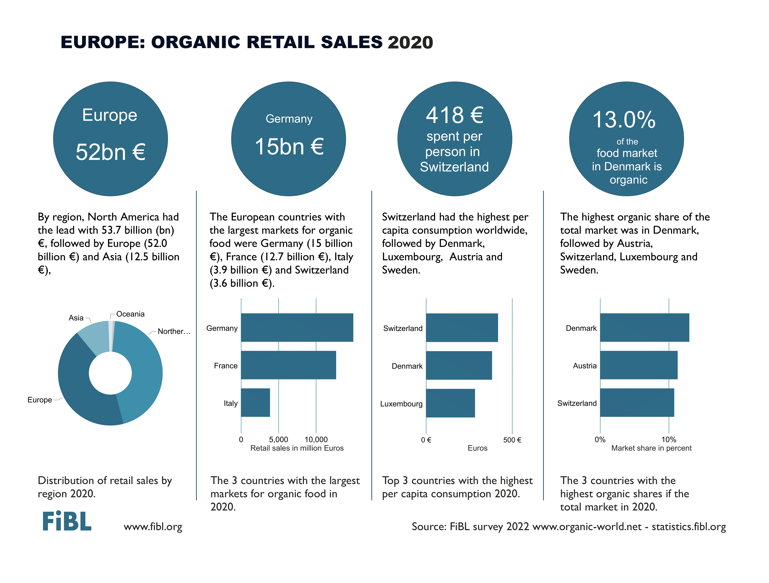

Slide 39
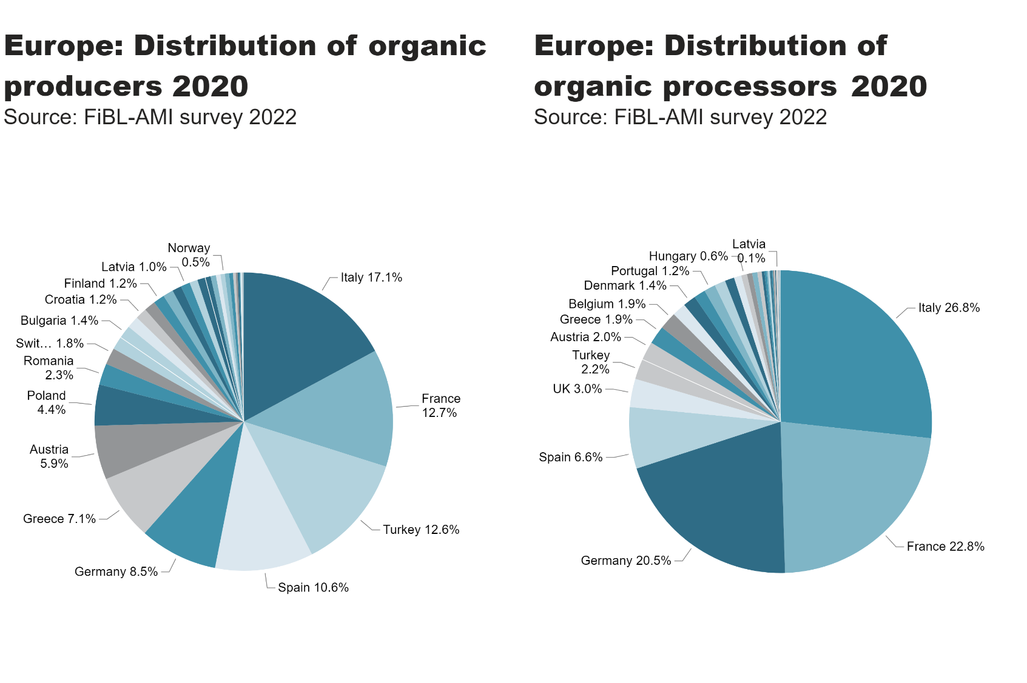
EU_producers, processors_distribution
Notes:
pieChart
No alt text provided
textbox
No alt text provided
card
No alt text provided
pieChart
No alt text provided
textbox
No alt text provided
card
No alt text provided

Slide 40
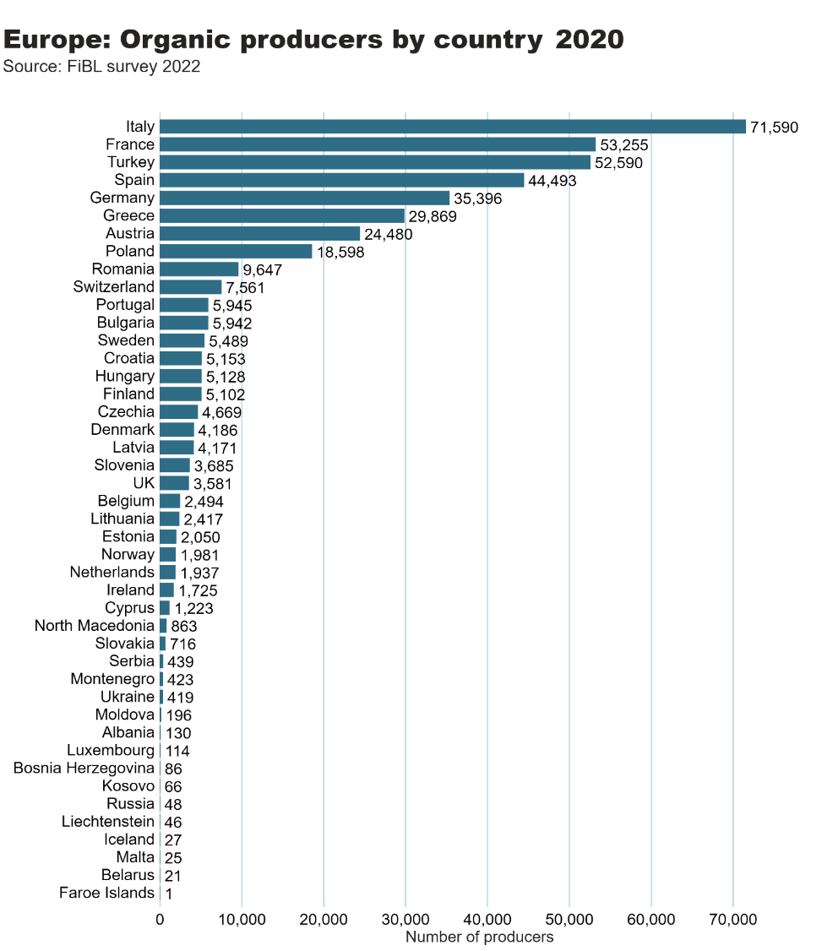
Europe_producers_by_country
Notes:
clusteredBarChart
No alt text provided
textbox
No alt text provided
card
No alt text provided

Slide 41
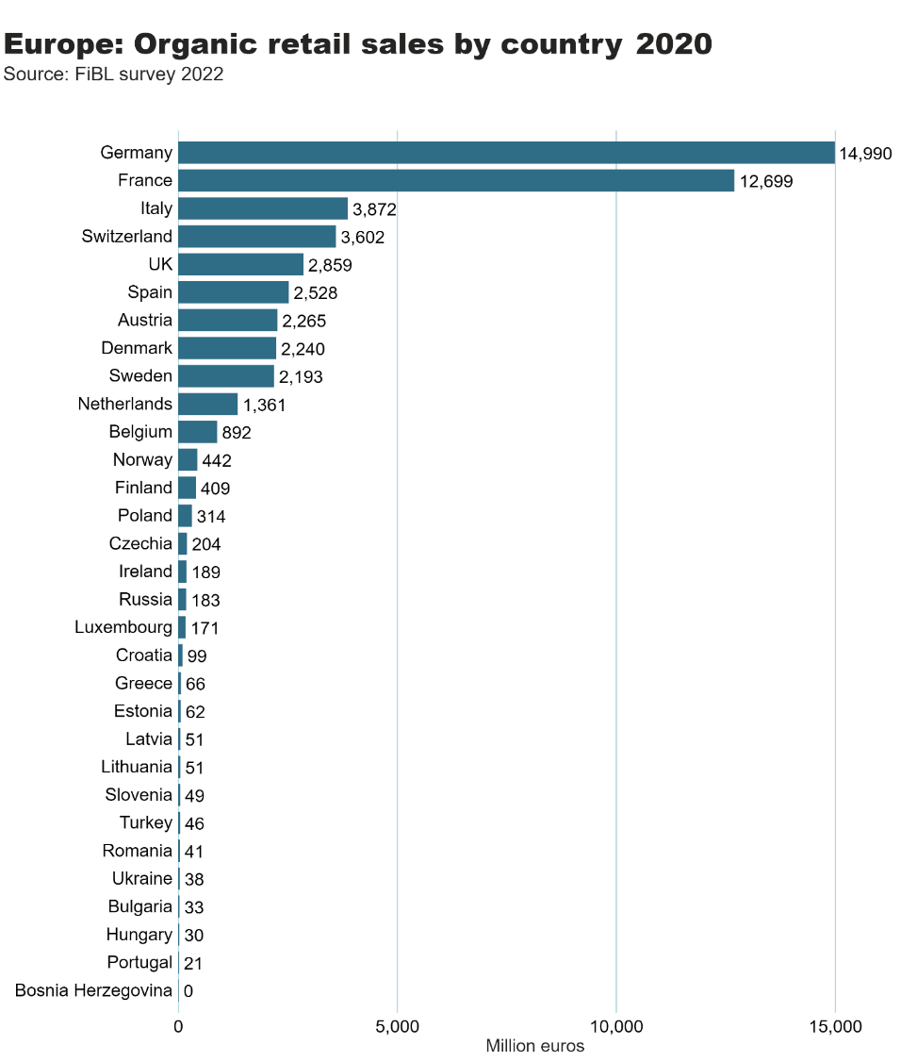
Europe_retail_sales_by_country
Notes:
clusteredBarChart
No alt text provided
textbox
No alt text provided
card
No alt text provided

Slide 42
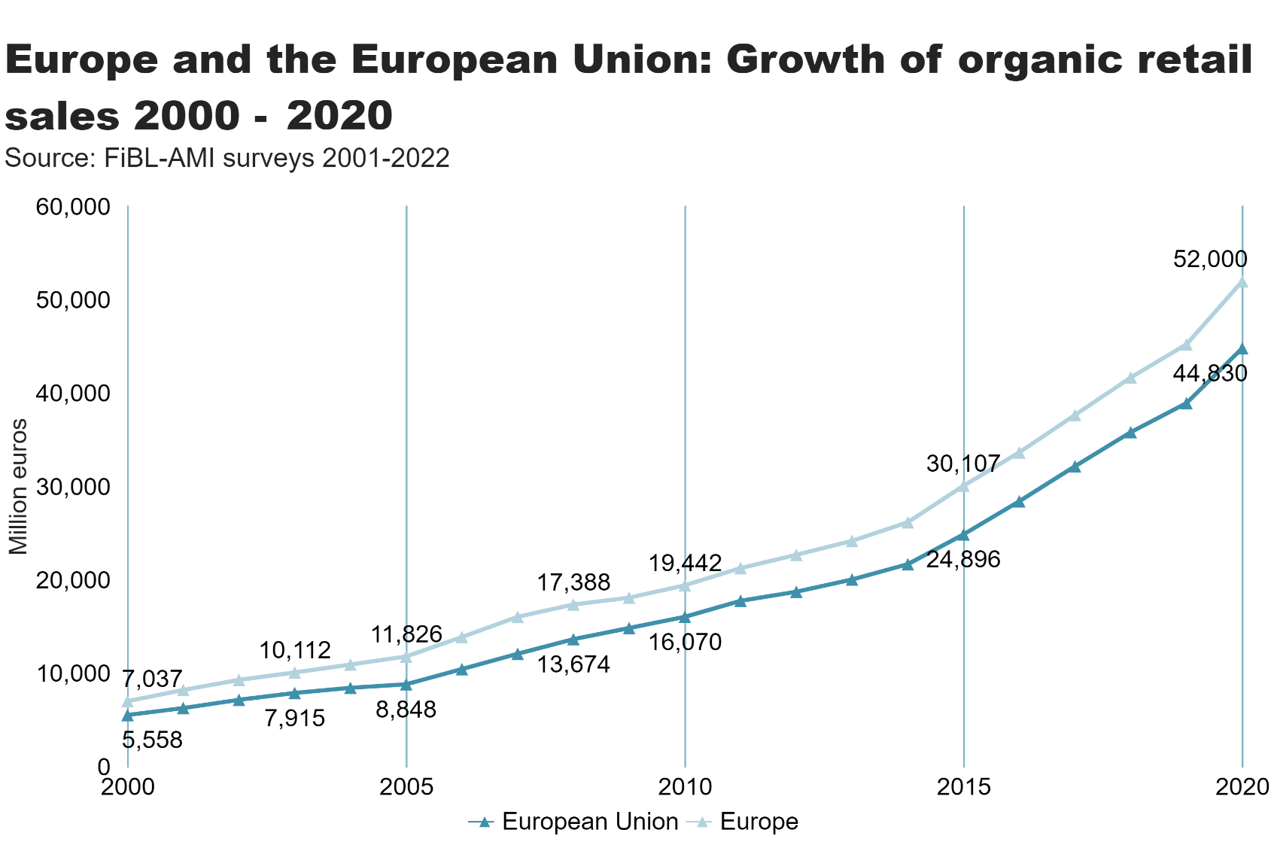
Europe_EU_growth_retail
Notes:
textbox
No alt text provided
lineChart
No alt text provided
card
No alt text provided

Slide 43
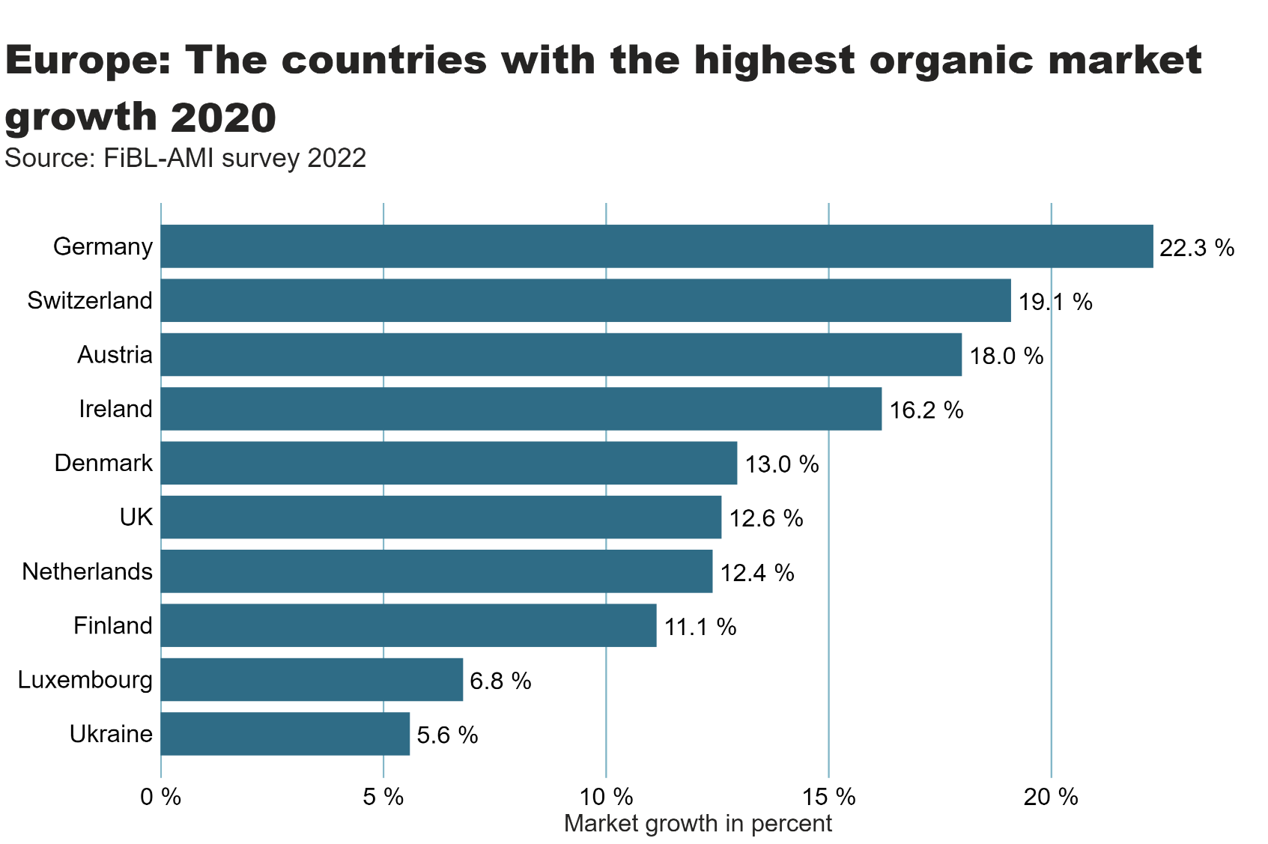
Europe_retail_growth
Notes:
textbox
No alt text provided
card
No alt text provided
clusteredBarChart
No alt text provided

Slide 44
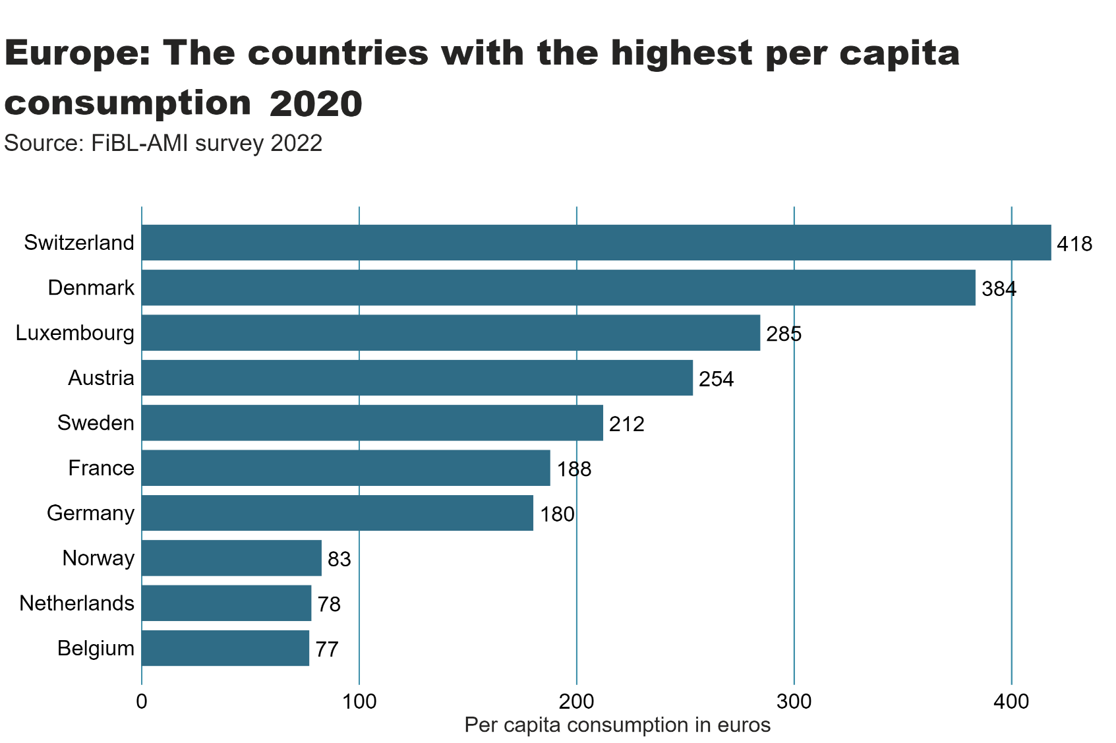
Europe_retail_per_capita
Notes:
textbox
No alt text provided
card
No alt text provided
clusteredBarChart
No alt text provided

Slide 45
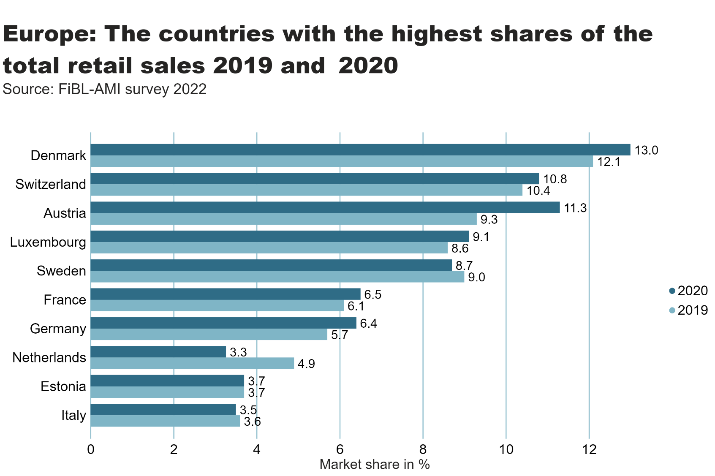
Europe_retail_share
Notes:
textbox
No alt text provided
card
No alt text provided
clusteredBarChart
No alt text provided

Slide 46
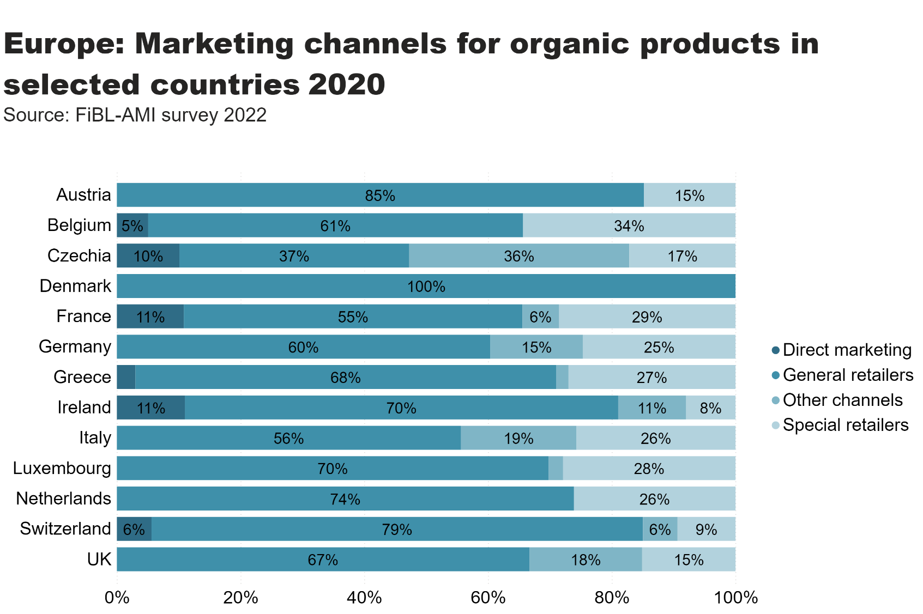
Europe_retail_by_channel
Notes:
textbox
No alt text provided
card
No alt text provided
hundredPercentStackedBarChart
No alt text provided

Slide 47
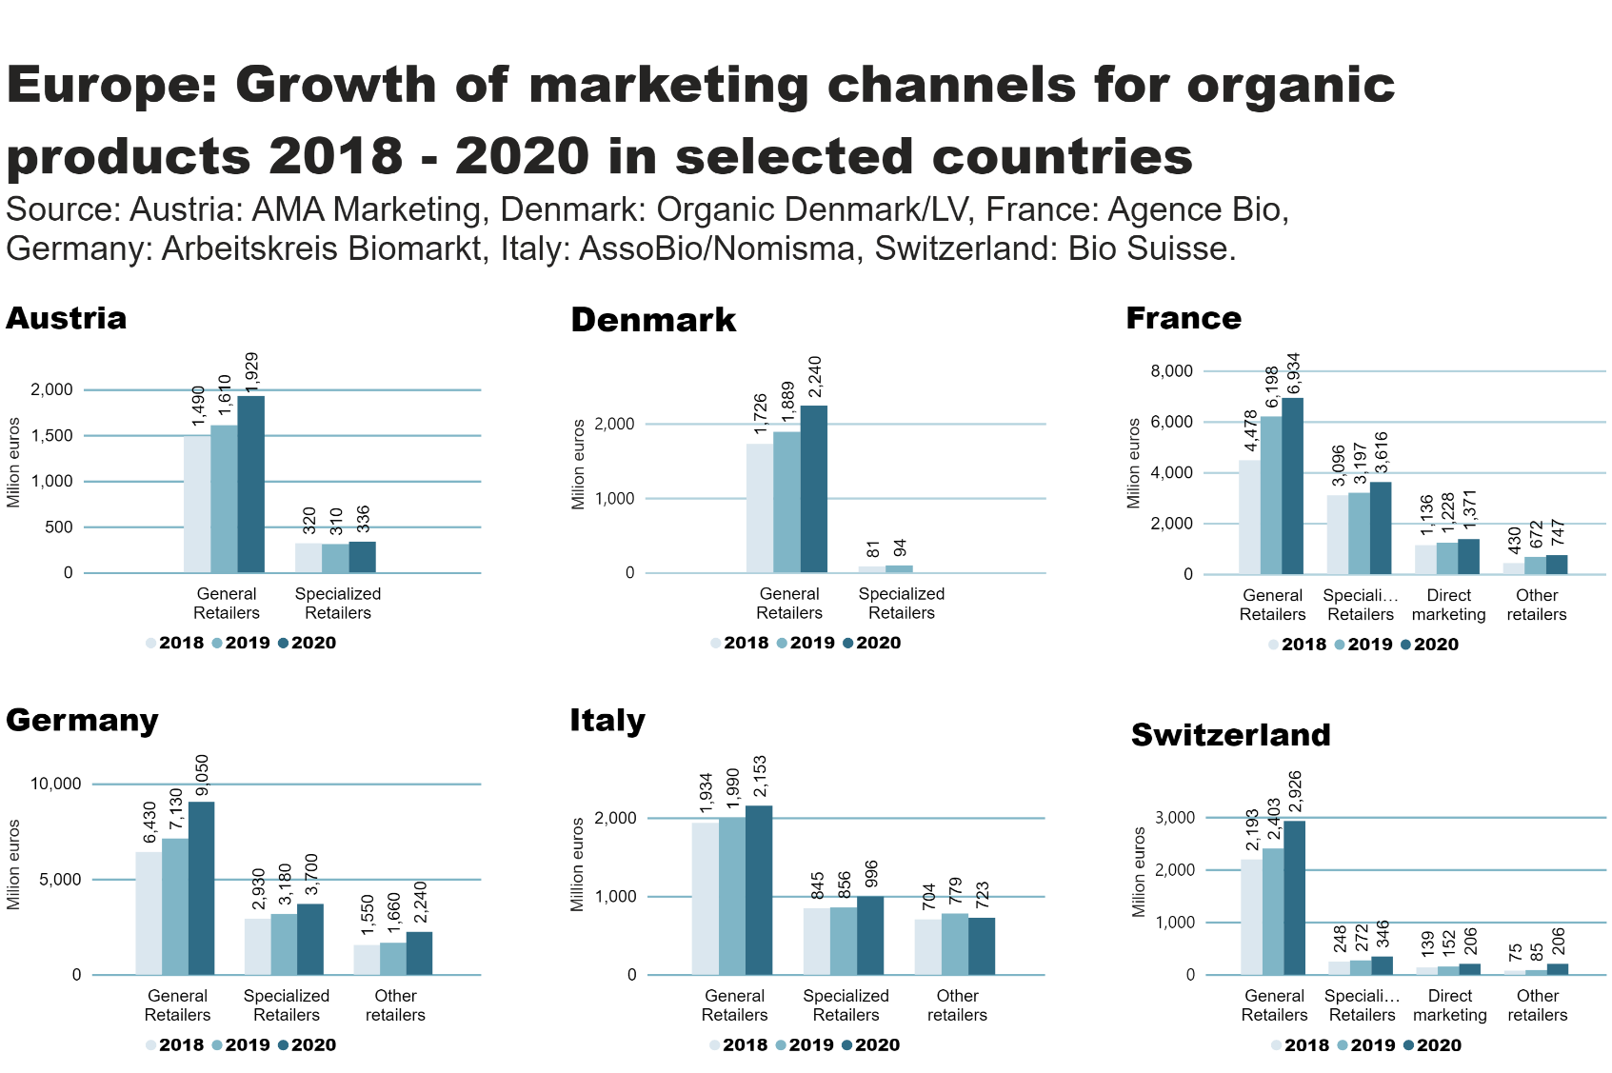
Europe_retail_by_channel_by_country
Notes:
textbox
No alt text provided
Austria
No alt text provided
Denmark
No alt text provided
France
No alt text provided
Germany
No alt text provided
Italy
No alt text provided
Switzerland
No alt text provided

Slide 48
EU organic imports
While the growth of the EU organic agri-food products market continued, imports of organic agri-food products decreased slightly between 2019 and 2020.
In 2020, 2.79 million metric tons (MT) of organic agri-food products were imported, representing a 1.9 percent decrease compared to the 2.85 million MT imported in 2019.
A detailed look at the product categories shows that increased imports of organic tropical fruit and rice were outweighed by lower imports of other cereals, oilcake and sugar.
The ranking of the main trading partners also changed, with China and Ukraine losing their top spots to Ecuador and Dominican Republic.
The main importing EU Member States in 2020 were the Netherlands, Germany and Belgium. For more information.
Source: European Commission/Traces 2022

Slide 49
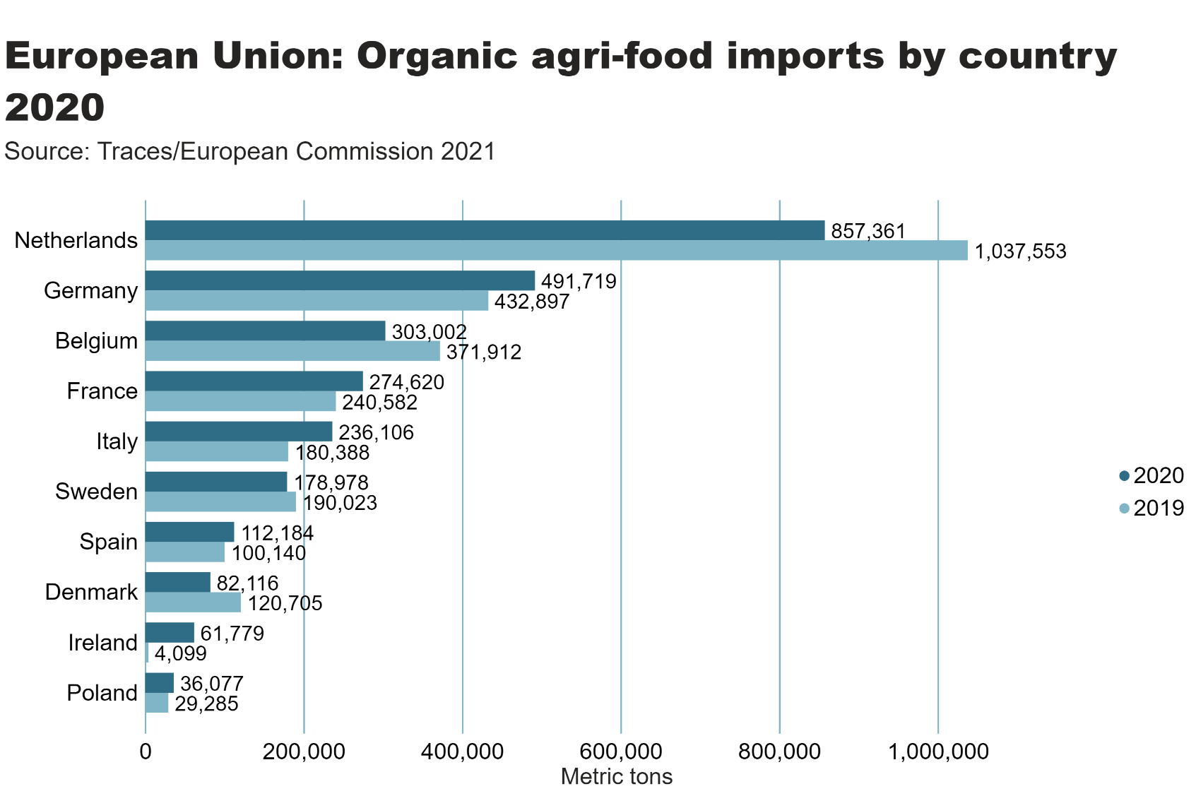
Europe_import_country
Notes:
textbox
No alt text provided
card
No alt text provided
clusteredBarChart
No alt text provided

Slide 50
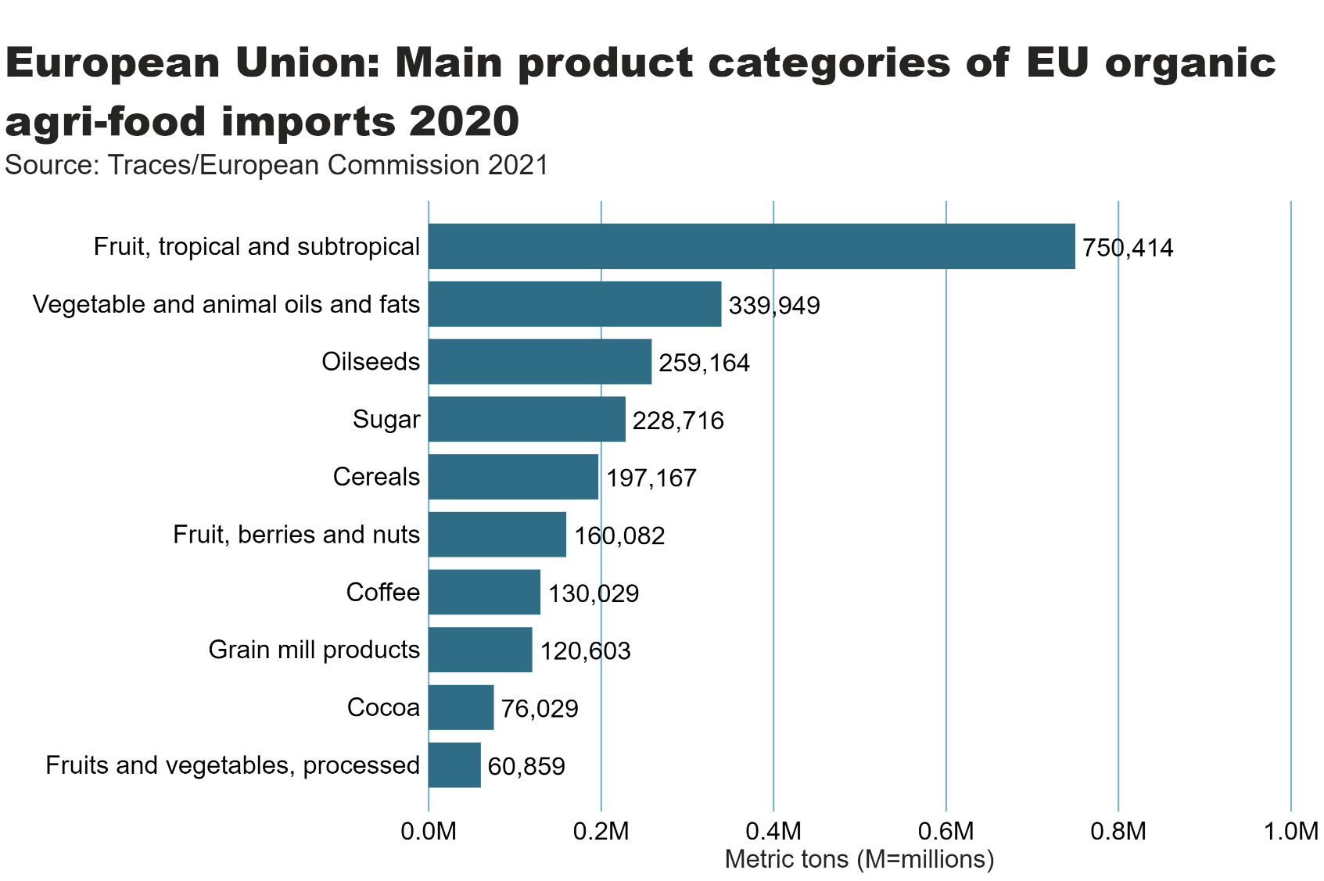
EU_import_by_food_product
Notes:
clusteredBarChart
No alt text provided
textbox
No alt text provided
card
No alt text provided

Slide 51
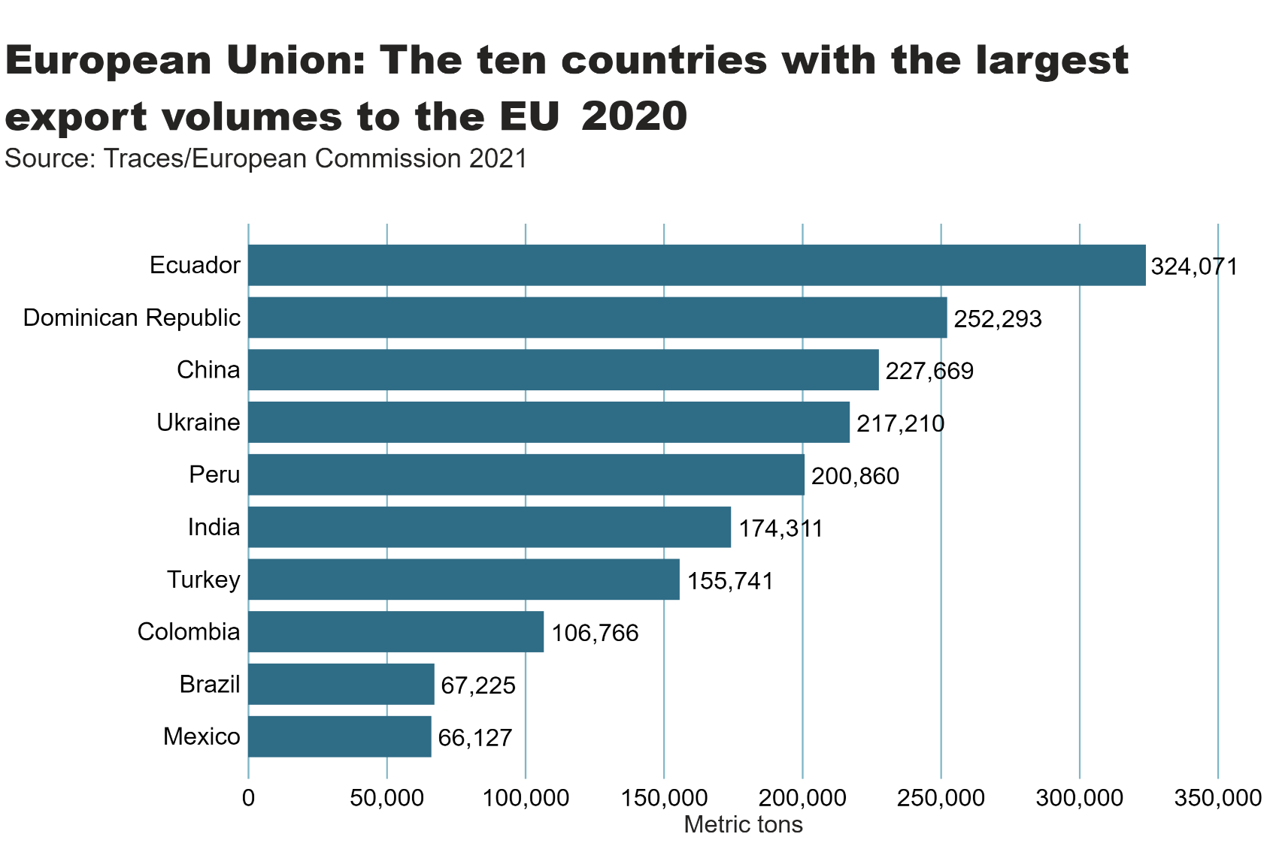
EU_import_by_exporter
Notes:
clusteredBarChart
No alt text provided
textbox
No alt text provided
card
No alt text provided

Slide 52
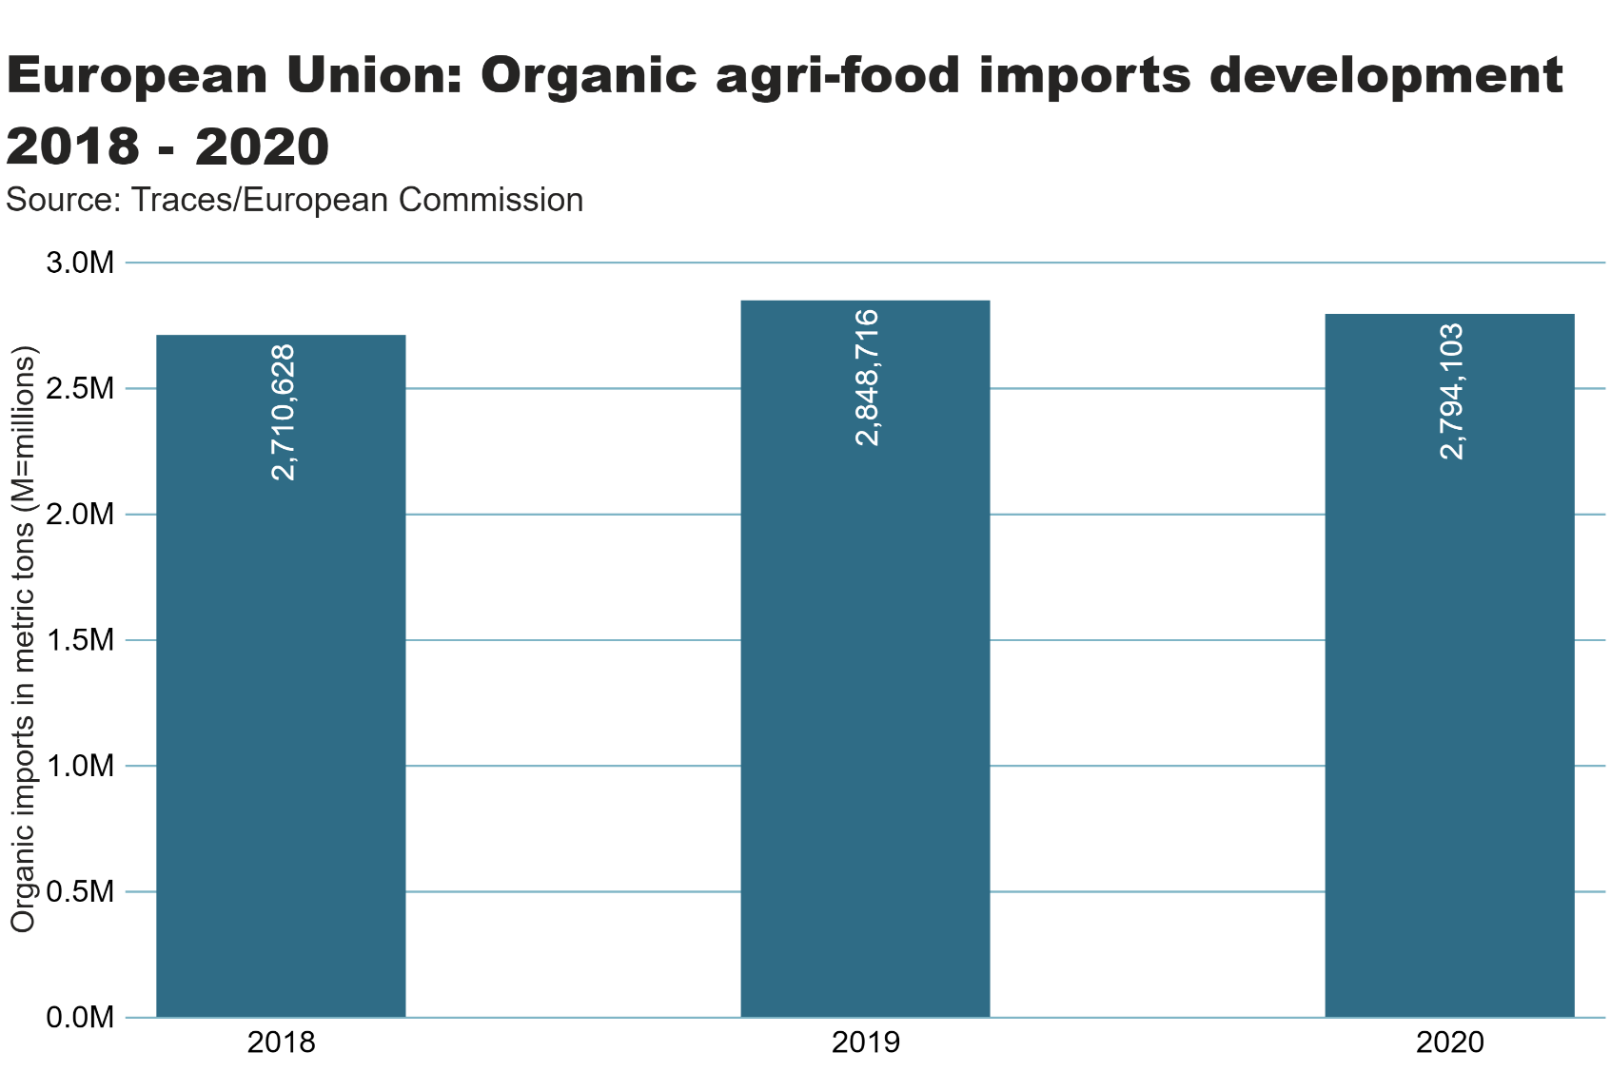
Europe_imports development
Notes:
textbox
No alt text provided
columnChart
No alt text provided
card
No alt text provided

Slide 53
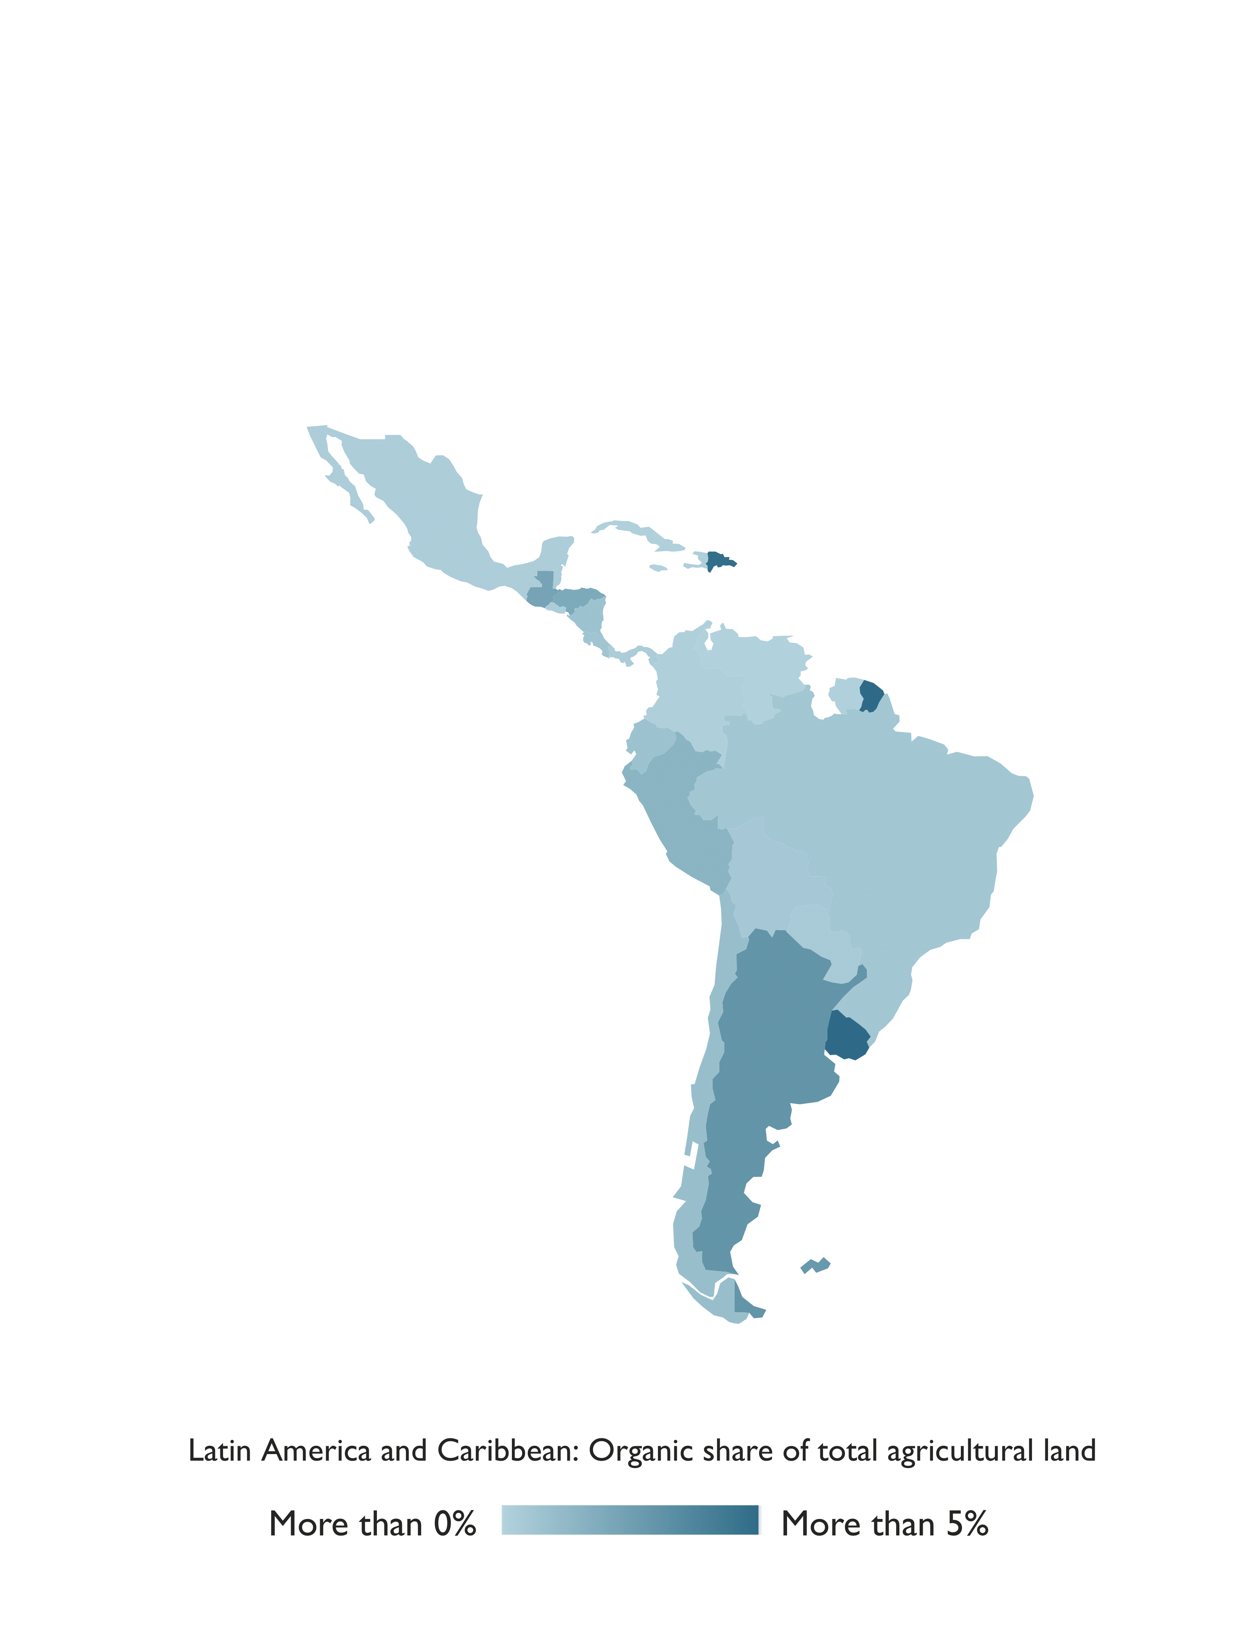
Latin America and the Caribbean

Slide 54
Latin America and Caribbean: Key figures 2020
In Latin America, over 270’000 producers managed over 9.9 million hectares of agricultural land organically in 2020.
This constituted 13.3 percent of the world’s organic land and 1.4 percent of the region’s agricultural land.
The leading countries were Argentina (4.4 million hectares), Uruguay (2.7 million hectares) and Brazil (1.3 million hectares).
The highest organic shares of total agricultural land were in Uruguay (19.6 percent), French Guiana (11.3 percent) and the Dominican Republic (4.8 percent).
Many Latin American countries remain important exporters of organic products such as coffee, cocoa and bananas.
In Argentina and Uruguay, temperate fruit and meat are key export commodities.
Brazil has the largest domestic market for organic products in Latin America.
Nineteen countries in the region have legislation on organic agriculture, and two countries are drafting such legislation.
Source: FiBL survey 2022

Slide 55
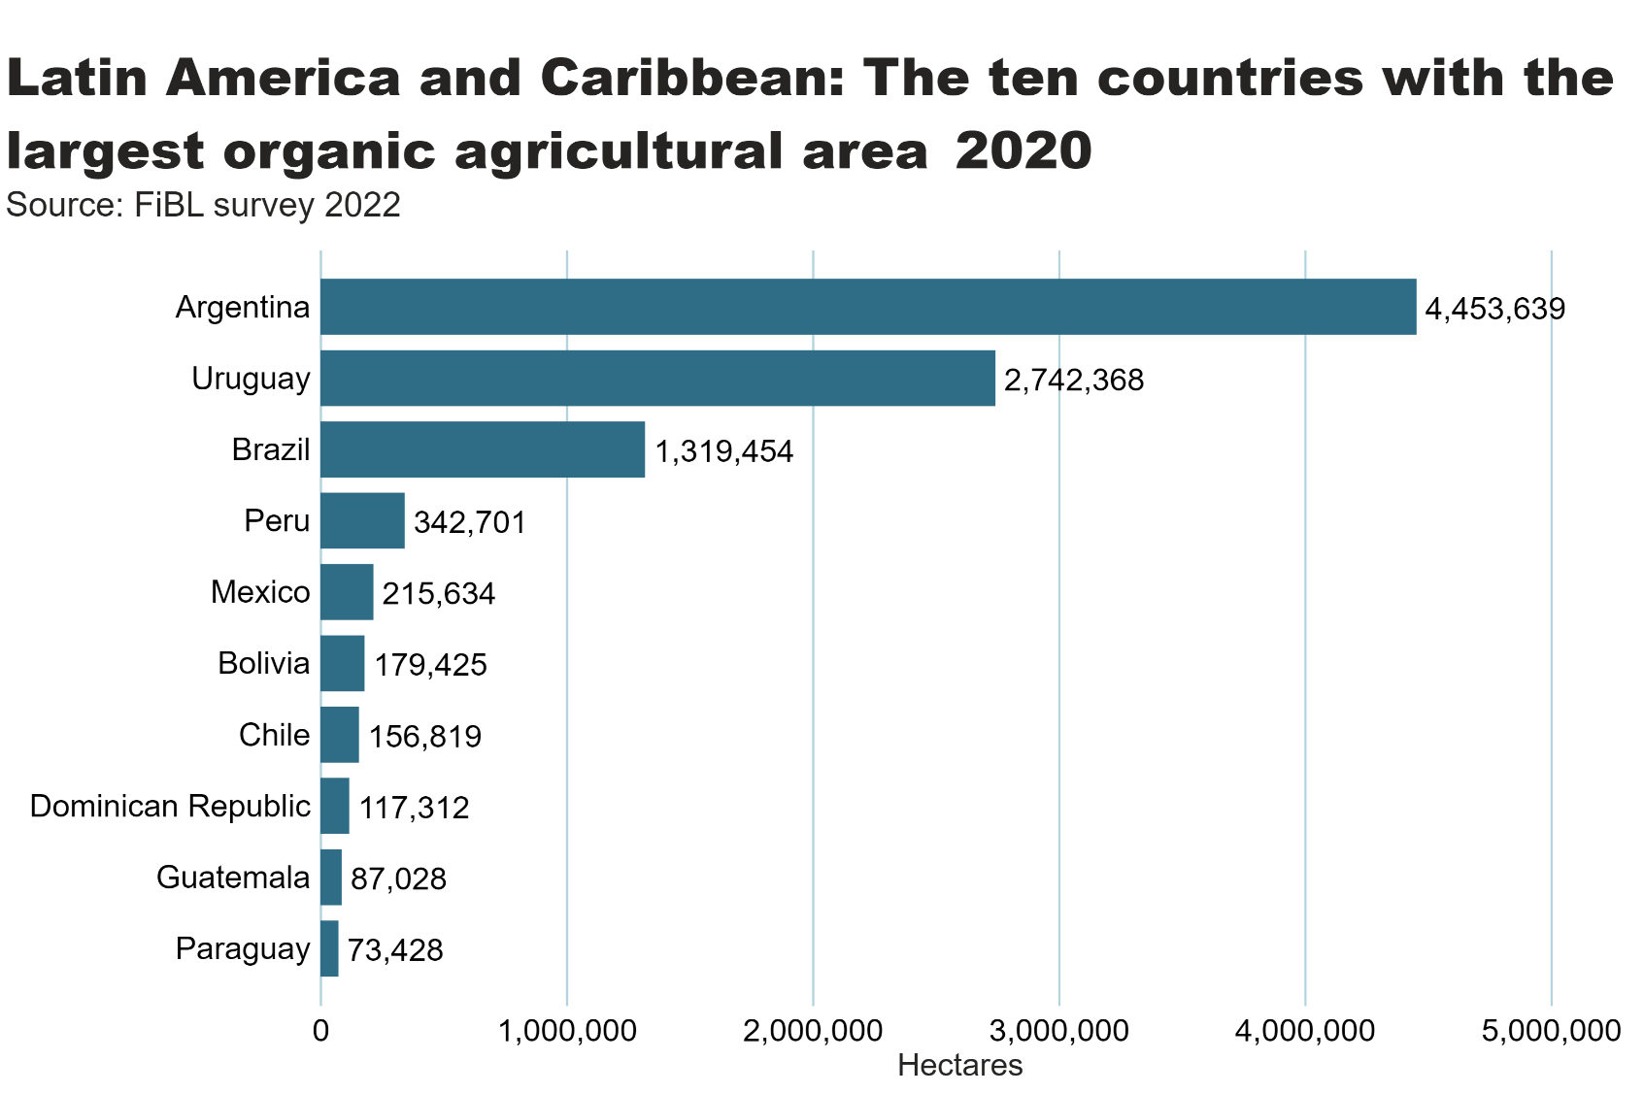
LA_land_country
Notes:
clusteredBarChart
No alt text provided
textbox
No alt text provided
card
No alt text provided

Slide 56
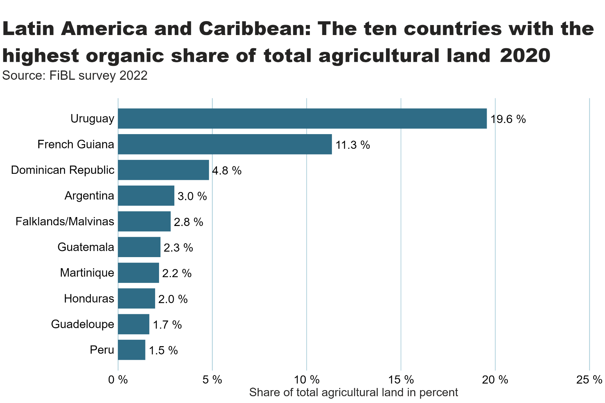
LA_land_share_country
Notes:
textbox
No alt text provided
barChart
No alt text provided
card
No alt text provided

Slide 57
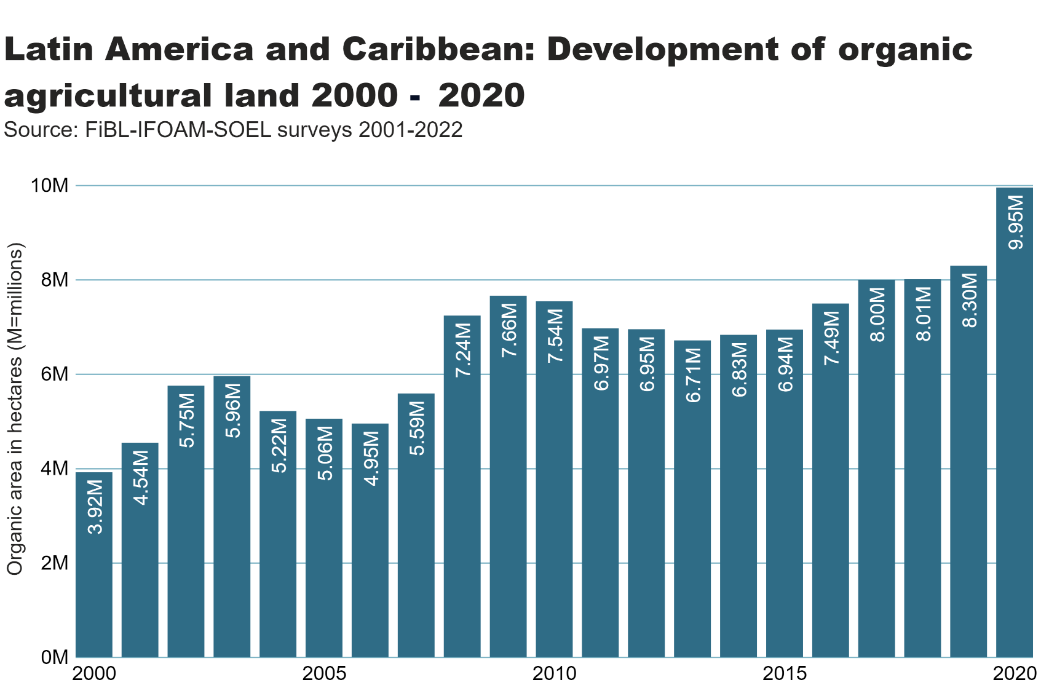
LA_land_growth
Notes:
textbox
No alt text provided
lineClusteredColumnComboChart
No alt text provided
card
No alt text provided

Slide 58
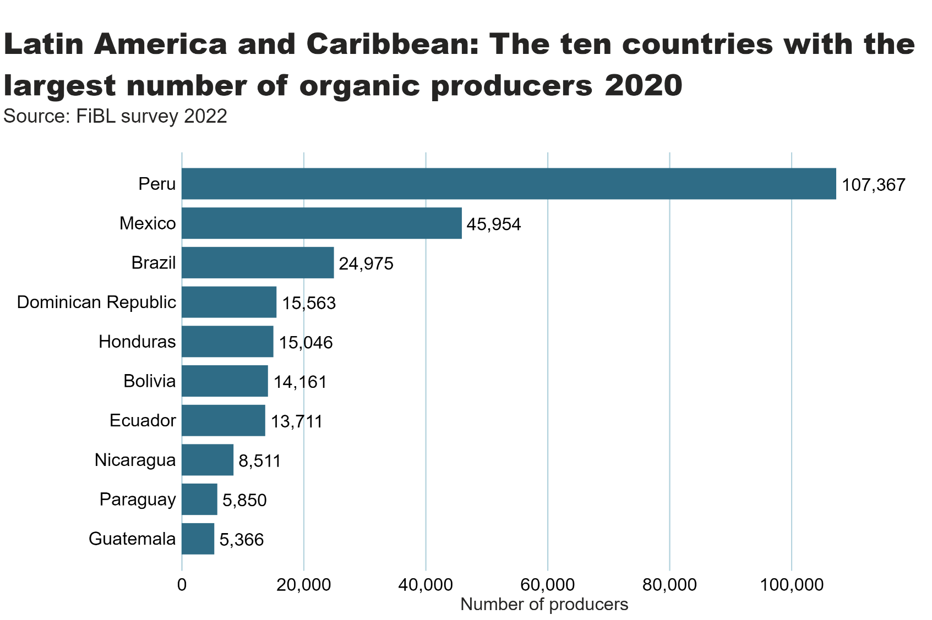
LA_producers_country
Notes:
textbox
No alt text provided
card
No alt text provided
barChart
No alt text provided

Slide 59
LA_land_use
Notes:
Land use types
No alt text provided
card
No alt text provided
Key arable crops
No alt text provided
Key permanent crops
No alt text provided
textbox
No alt text provided

Slide 60
North America

Slide 61
Organic Agriculture in North America: Key figures 2020
In Northern America, over 3.7 million hectares of farmland were managed organically in 2020.
Of these, 2.3 million were in the United States and 1.4 million in Canada, representing 0.8 percent of the total agricultural area in the region (see page 284).
US organic food sales soared to a new high in 2020, jumping to 56.5 billion US dollars (49.5 billion euros).
In Canada, Organic food and beverage sales in 2020 topped 4.3 billion euros, about 33 percent higher than in 2017.
Please note: US data are from 2019.
Source: USDA and COTA 2022

Slide 62
NA_land_country
Notes:
clusteredBarChart
No alt text provided
textbox
No alt text provided
card
No alt text provided

Slide 63
NA_land_share_country
Notes:
textbox
No alt text provided
Source: COTA and USDA, 2022
No alt text provided
card
No alt text provided

Slide 64
NA_land_growth
Notes:
textbox
No alt text provided
lineClusteredColumnComboChart
No alt text provided
card
No alt text provided

Slide 65
NA_producers_country
Notes:
textbox
No alt text provided
card
No alt text provided
barChart
No alt text provided

Slide 66
NA_land_use
Notes:
Land use types
No alt text provided
card
No alt text provided
Key arable crops
No alt text provided
Key permanent crops
No alt text provided
textbox
No alt text provided

Slide 67
Oceania

Slide 68
Organic agriculture in Oceania: Key figures 2020
This region includes Australia, New Zealand and the Pacific Islands states.
Altogether, there were over 16’000 producers on 35.9 million hectares, constituting 9.7 percent of the region’s agricultural land and half the world’s organic land.
More than 99 percent of the organic land in the region is in Australia (35.7 million hectares, mostly extensive grazing land), followed by New Zealand (over 79’000 hectares) and Papua New Guinea (over 72’000 hectares).
The highest organic shares of all national agricultural land were in Samoa (14.5 percent), followed by Australia (9.9 percent), Papua New Guinea (6.1 percent), Fiji (4.5 percent), French Polynesia (3.4 percent) and Tonga (3.2 percent).
Four countries in Oceania have legislation on organic agriculture, and twelve countries have a national standard but no organic legislation.
FiBL survey 2022

Slide 69
Oceania_land_country
Notes:
clusteredBarChart
No alt text provided
textbox
No alt text provided
card
No alt text provided

Slide 70
Oceania_land_share_country
Notes:
textbox
No alt text provided
barChart
No alt text provided
card
No alt text provided

Slide 71
Oceania_land_growth
Notes:
textbox
No alt text provided
lineClusteredColumnComboChart
No alt text provided
card
No alt text provided

Slide 72
Oceania_producers_country
Notes:
textbox
No alt text provided
card
No alt text provided
barChart
No alt text provided

Slide 73
Oceania_land_use
Notes:
Land use types
No alt text provided
card
No alt text provided
Key arable crops
No alt text provided
Key permanent crops
No alt text provided
textbox
No alt text provided

Slide 74
More information
More information (PDF, data sources, graphs) at: http://www.organic-world.net/yearbook/yearbook-2022.html
Contact Helga Willer Research Institute of Organic Agriculture (FiBL) 5070 Frick Switzerland helga.willer@fibl.org

Slide 75
Disclaimer
All of the results contained in this slide show have been compiled by the Research Institute of Organic Agriculture (FiBL). However, the possibility of mistakes cannot be ruled out entirely. Therefore, FiBL is not subject to any obligation and makes no guarantees whatsoever regarding any of the statements or results in this work; neither does FiBL accept responsibility or liability for any possible mistakes, nor for any consequences of actions taken by readers based on statements or advice contained therein.
This document has been produced with the support of the Swiss State Secretariat for Economic Affairs (SECO), the Sustainability Fund of Coop Switzerland, NürnbergMesse, IFOAM – Organics International. The views expressed herein can in no way be taken to reflect the official opinions of SECO, Coop, NürnbergMesse or IFOAM – Organics International.

Slide 76
Presentations on www.organic-world.net

Slide 77
Statistics.FiBL.org

Slide 78
www.twitter.com/fiblstatistics

Slide 79
Contact
Helga Willer Research Institute of Organic Agriculture FiBL Ackerstrasse 113, Box 219 5070 Frick Switzerland
Phone +41 62 865 72 72 Phone +41 62 865 72 07 (direct)
info.suisse@fibl.org, helga.willer@fibl.org www.fibl.org, www.organic-world.net, https://statistics.fibl.org

Slide 80
FiBL online
www.fibl.org
www.bioaktuell.ch
fiblfilm
@fiblorg
@FiBLaktuell
linkedin.com/company/fibl

