Slide 1
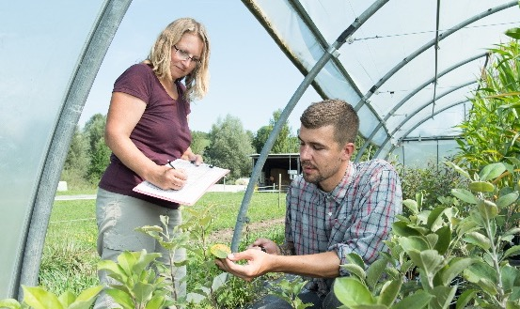
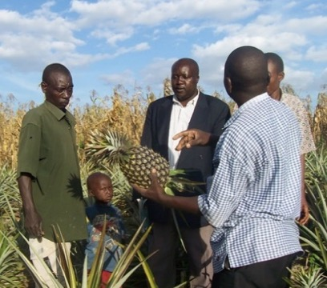
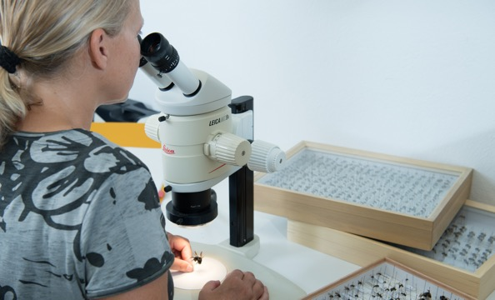
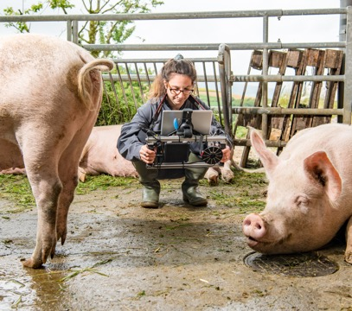
Der europäische Biomarkt wuchs auf 52,0 Milliarden Euro in 2022 – Grafiken
Medienmitteilung FiBL and AMI, 15. Februar 2022
Forschungsinstitut für biologischen Landbau, CH-Frick, and Agrarmarkt Informations-Gesellschaft, DE-Bonn

Slide 2
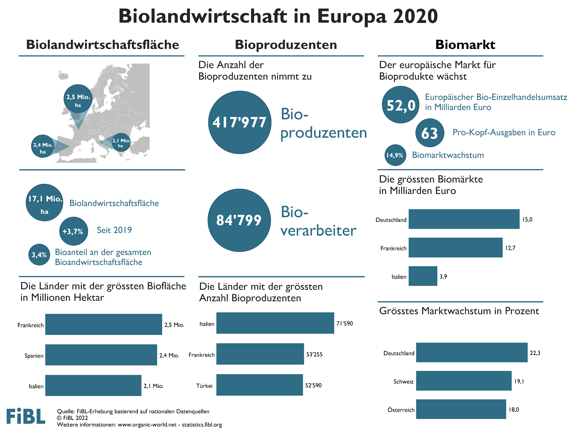

Slide 3
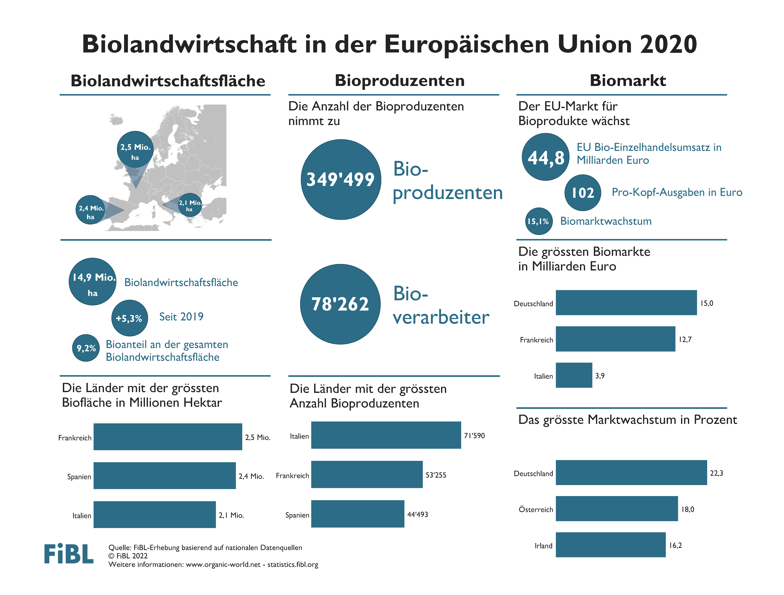

Slide 4
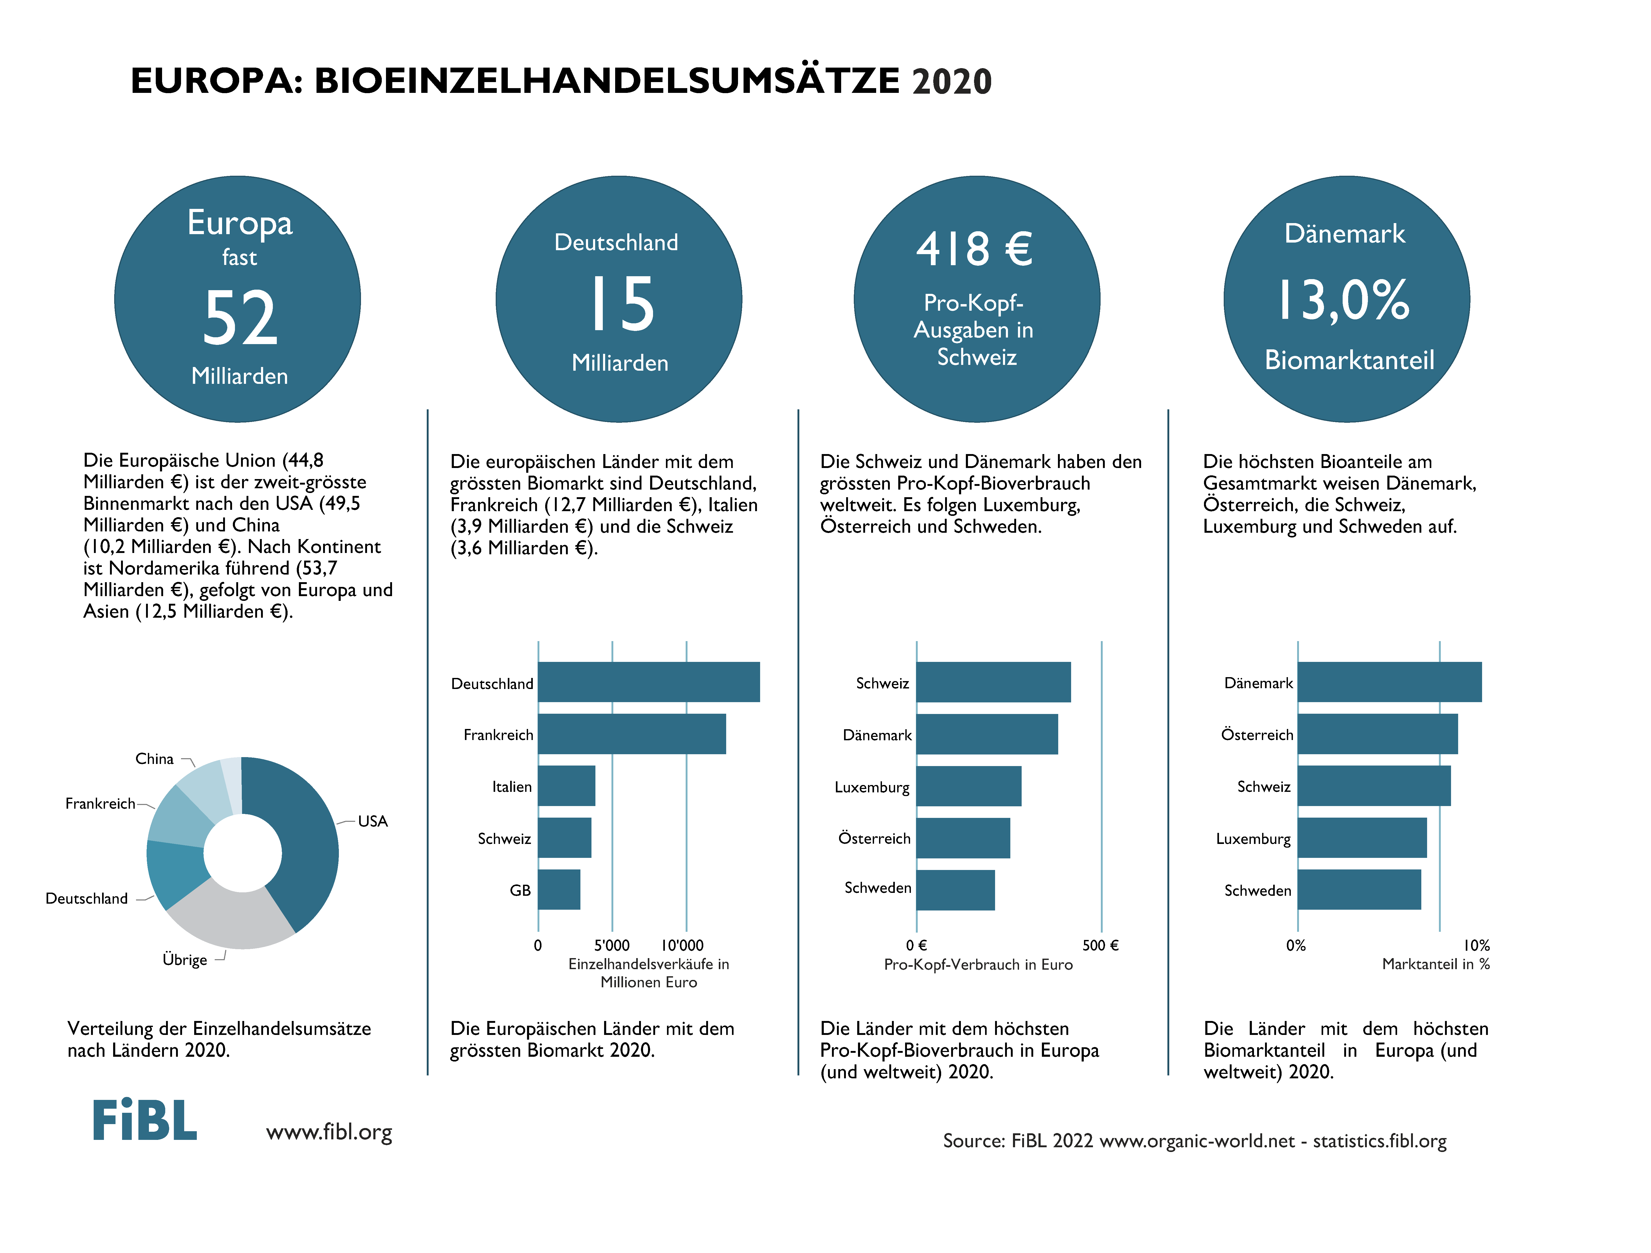

Slide 5
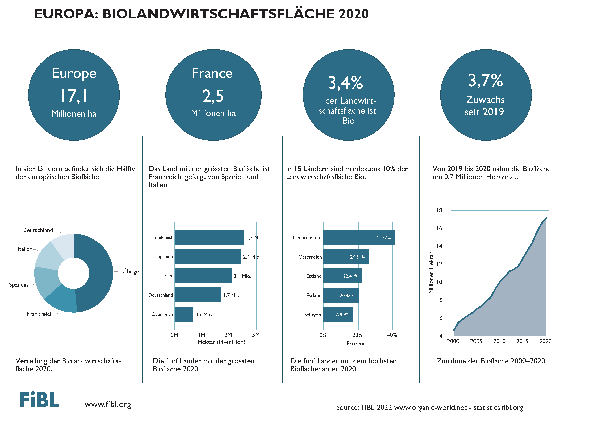

Slide 6
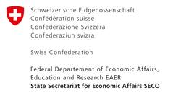

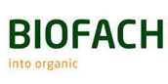
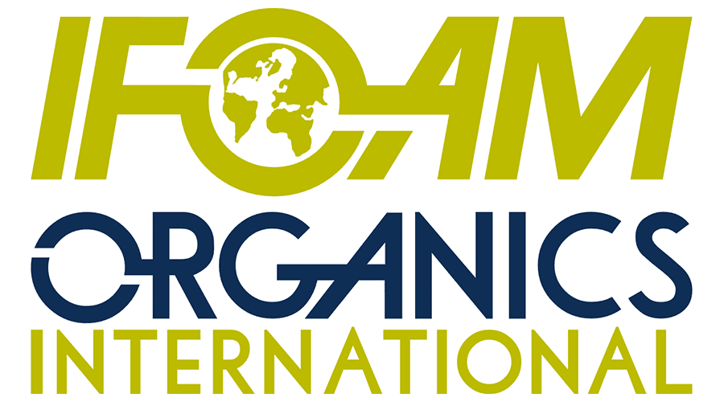
Acknowledgements
The Swiss State Secretariat of
Economic Affairs (SECO)
Coop Sustainability Fund
NürnbergMesse, the organizers of BIOFACH
IFOAM – Organics International
More than 200 experts from all parts of the world contributed to the FiBL survey 2022.

Slide 7
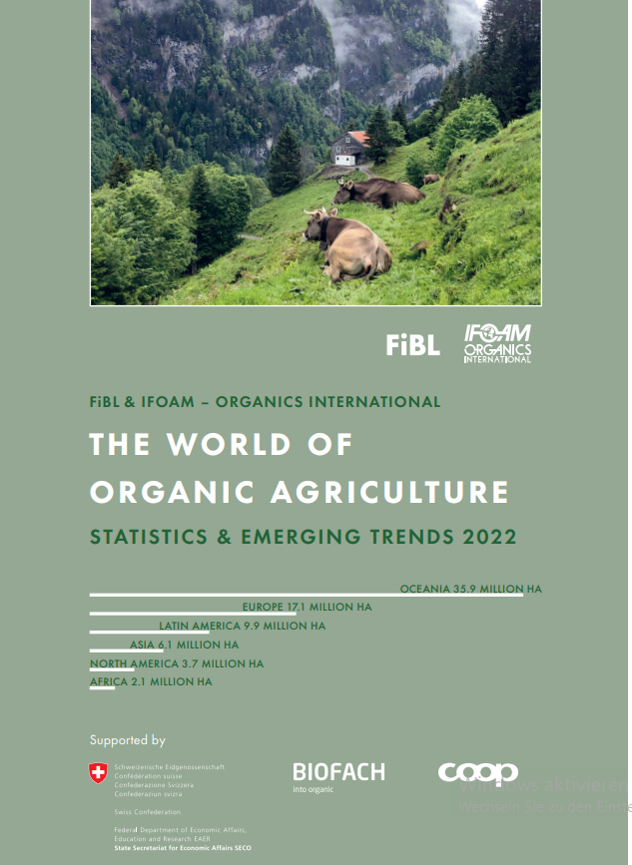
The World of Organic Agriculture 2022 www.organic-world.net
The 23rd edition of «The World of Organic Agriculture», was published by FiBL and IFOAM – Organics International in February 2022.
Data tables
Country and continent reports
Markets, standards, policy support
The book can be ordered or downloaded at (item number 1344): https://www.fibl.org/en/shop-en

Slide 8
Contact
Helga Willer
Research Institute of Organic Agriculture (FiBL)
Ackerstrasse 113, 5070 Frick, Switzerland
Tel. +41 79 218 0626
helga.willer@fibl.org
www.fibl.org
www.organic-world.net; statistics.fibl.org
Willer, Helga, Jan Trávníček, Claudia Meier and Bernhard Schlatter (Eds.) (2022): The World of Organic Agriculture. Statistics and Emerging Trends 2022. Research Institute of Organic Agriculture (FiBL), Frick, and IFOAM – Organics International, Bonn.
Available at www.organic-world.net/yearbook/yearbook-2022

Slide 9






FiBL online
www.fibl.org
www.bioaktuell.ch
fiblfilm
@fiblorg
@FiBLaktuell
linkedin.com/company/fibl

