Slide 1
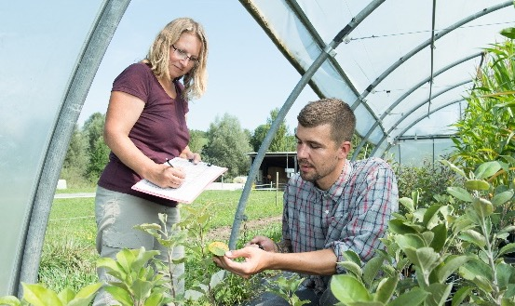
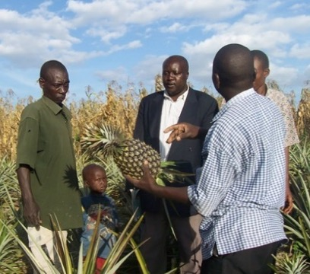
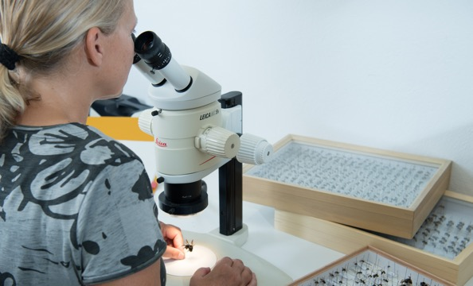
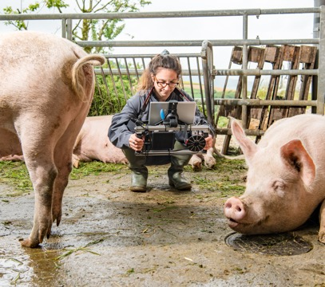
Organic Agriculture Worldwide 2022:
Infographics
Jan Trávníček, Bernhard Schlatter and Helga Willer
© FiBL, February 2024

Slide 2
GLOBAL DATA

Slide 3
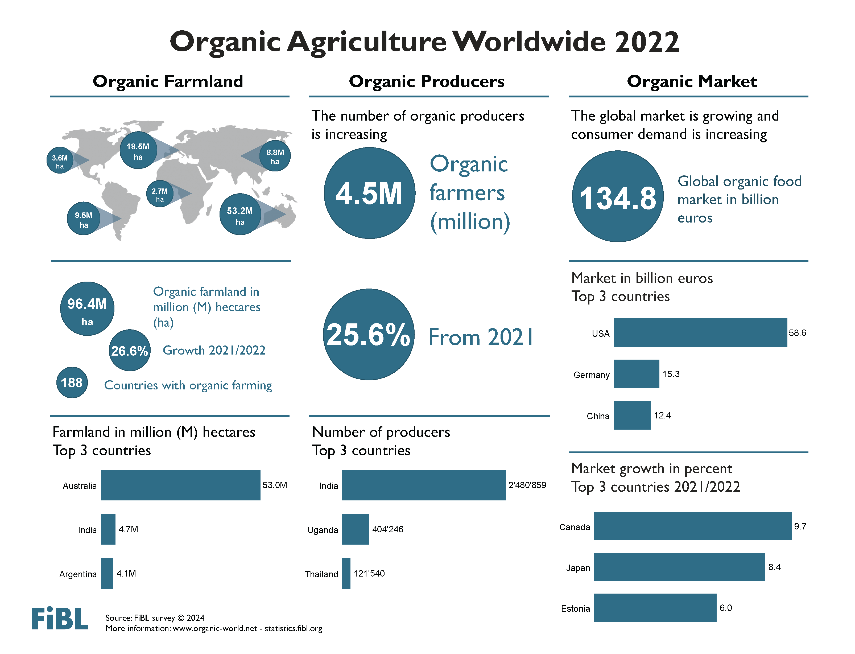

Slide 4
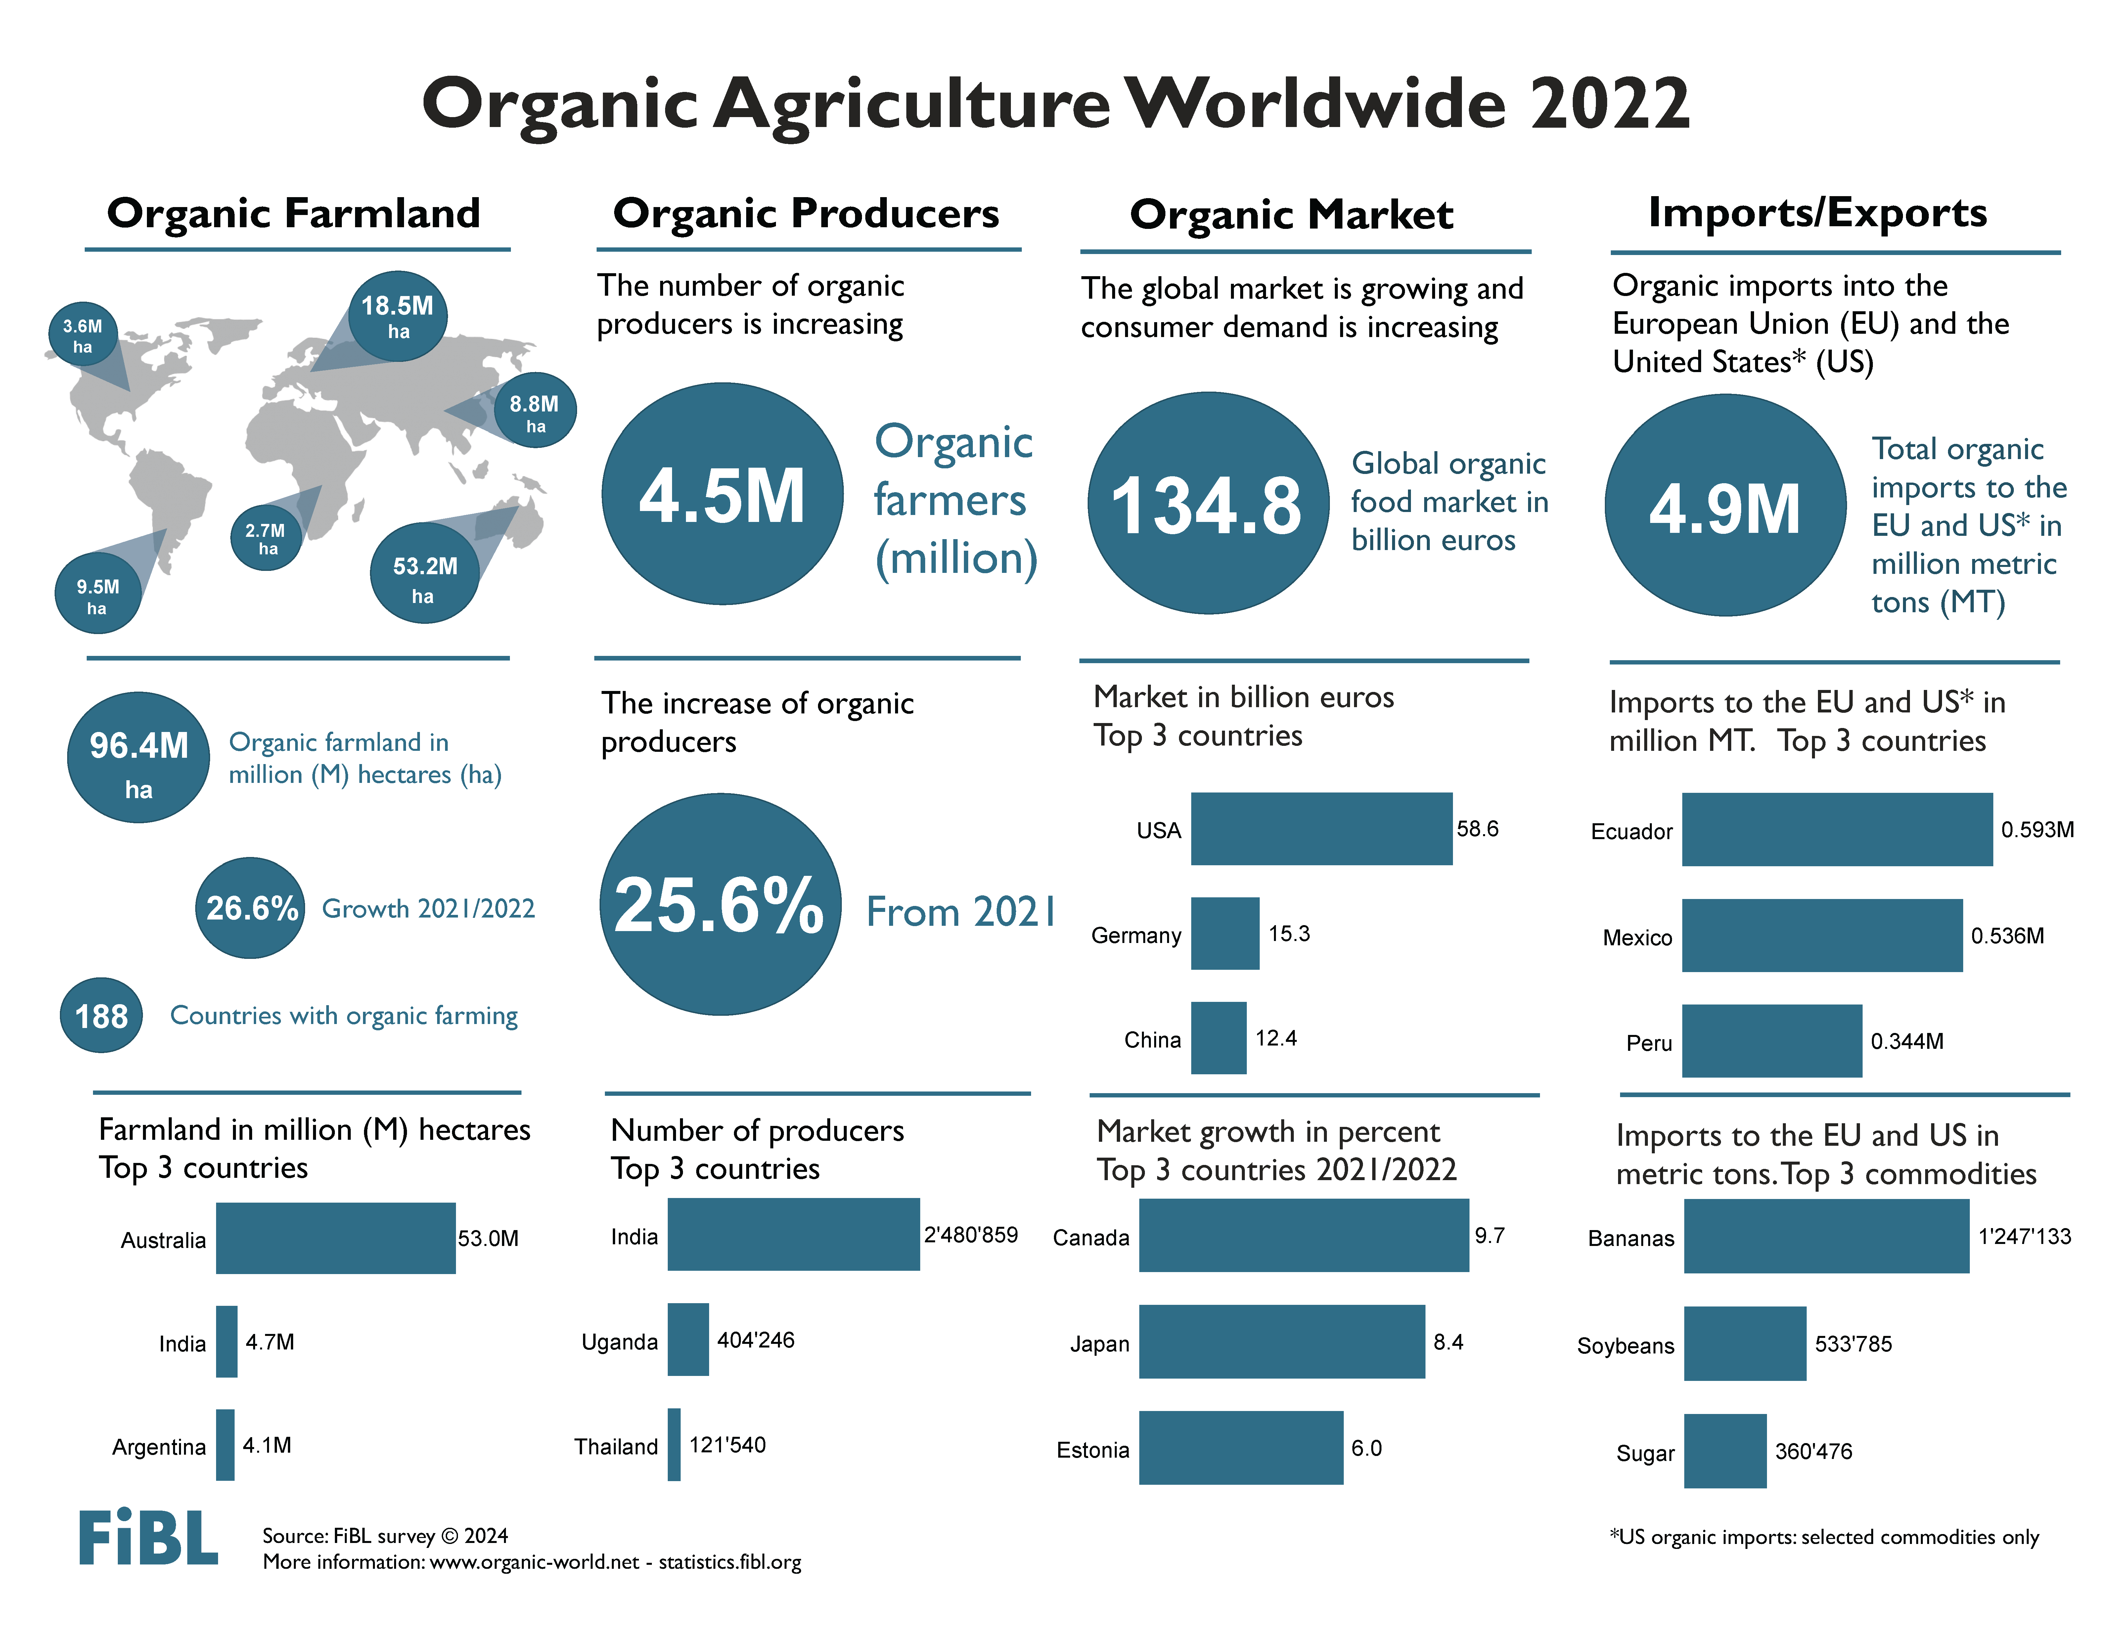

Slide 5
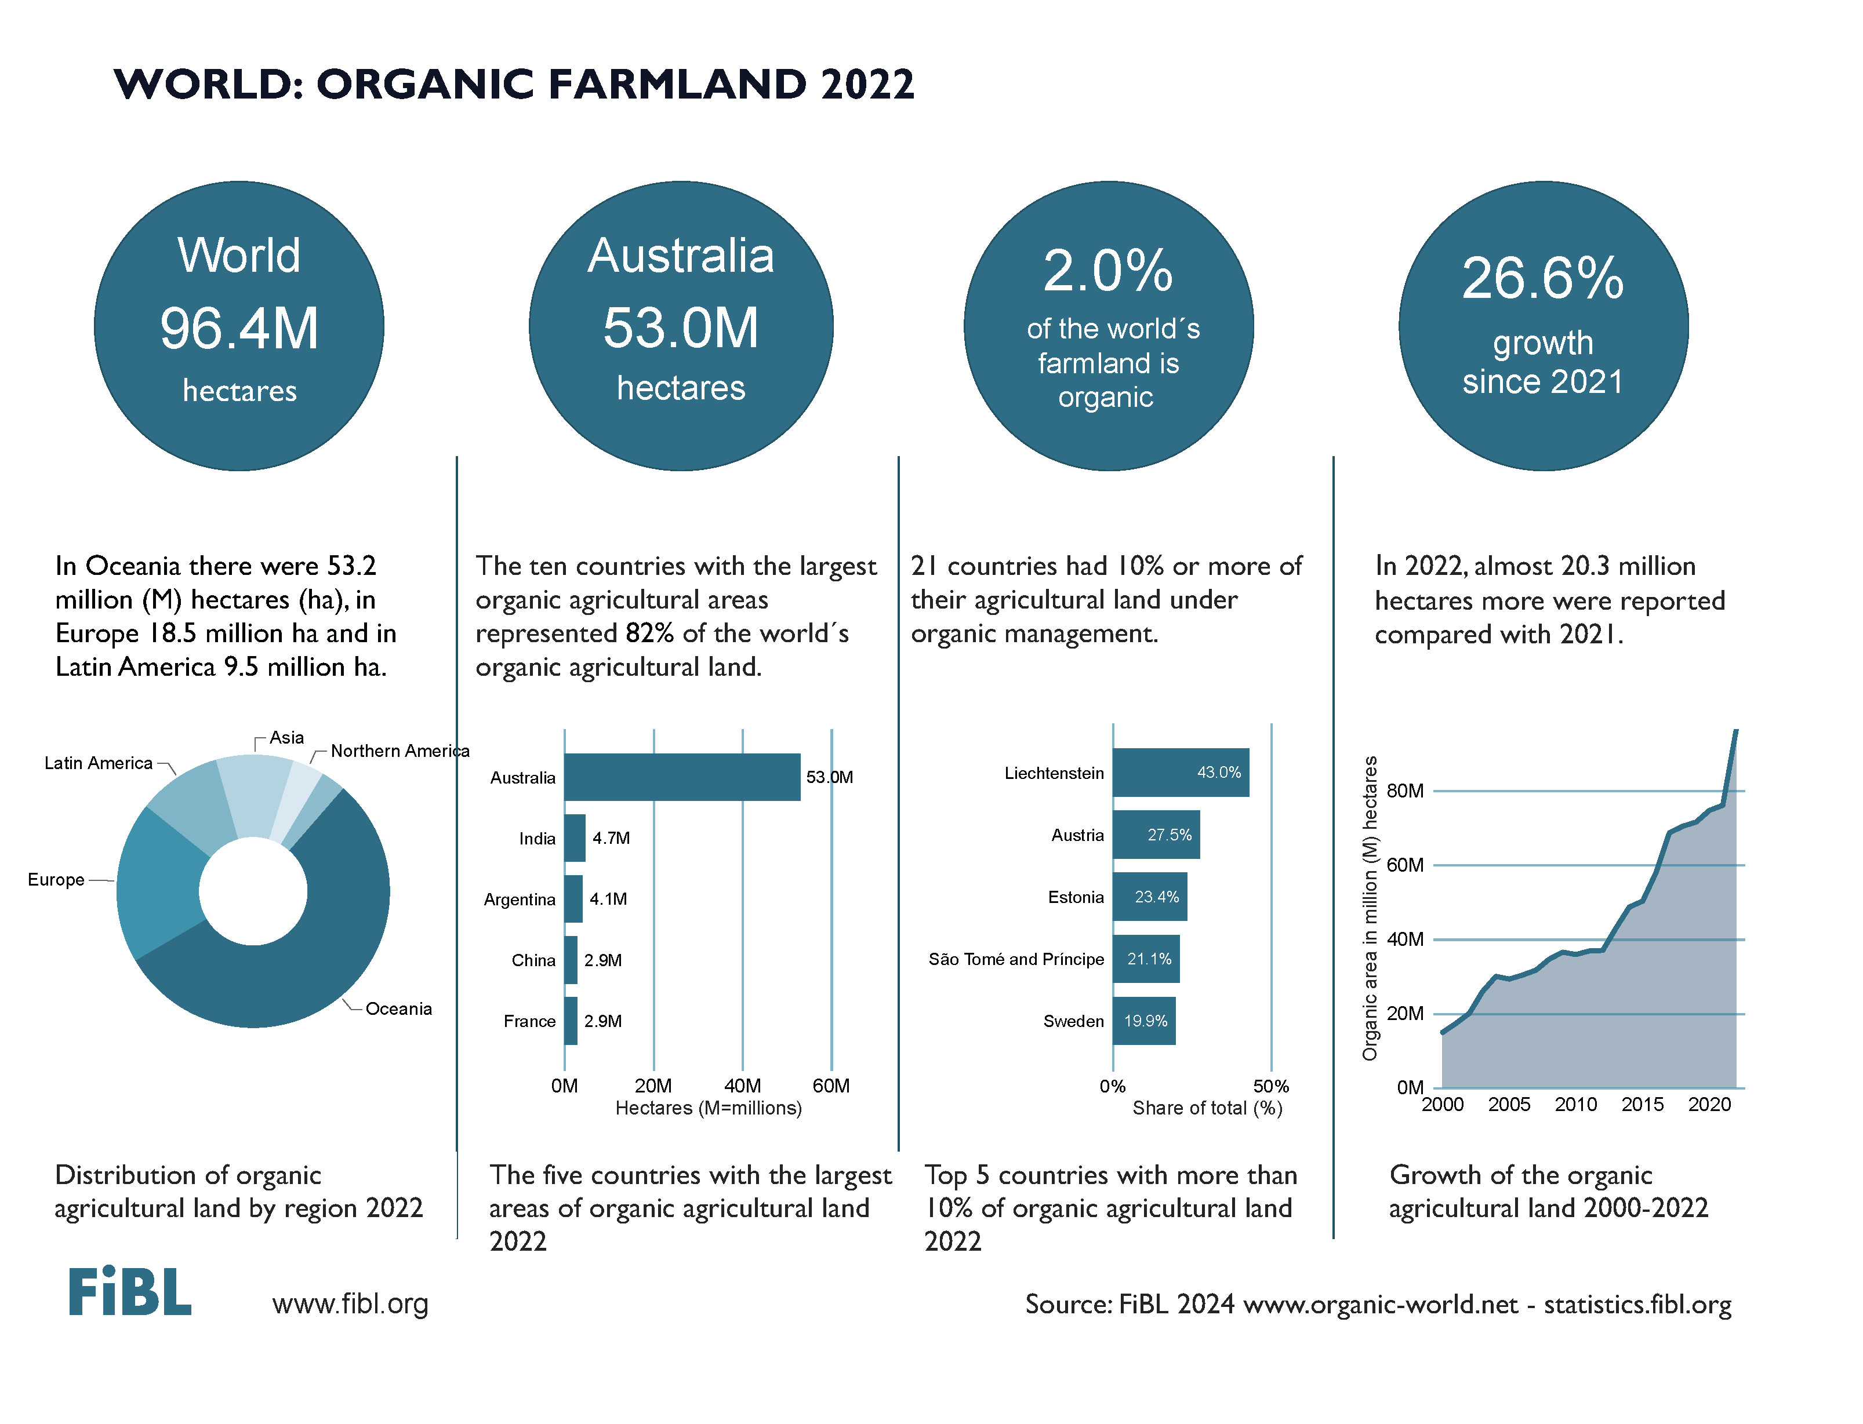

Slide 6
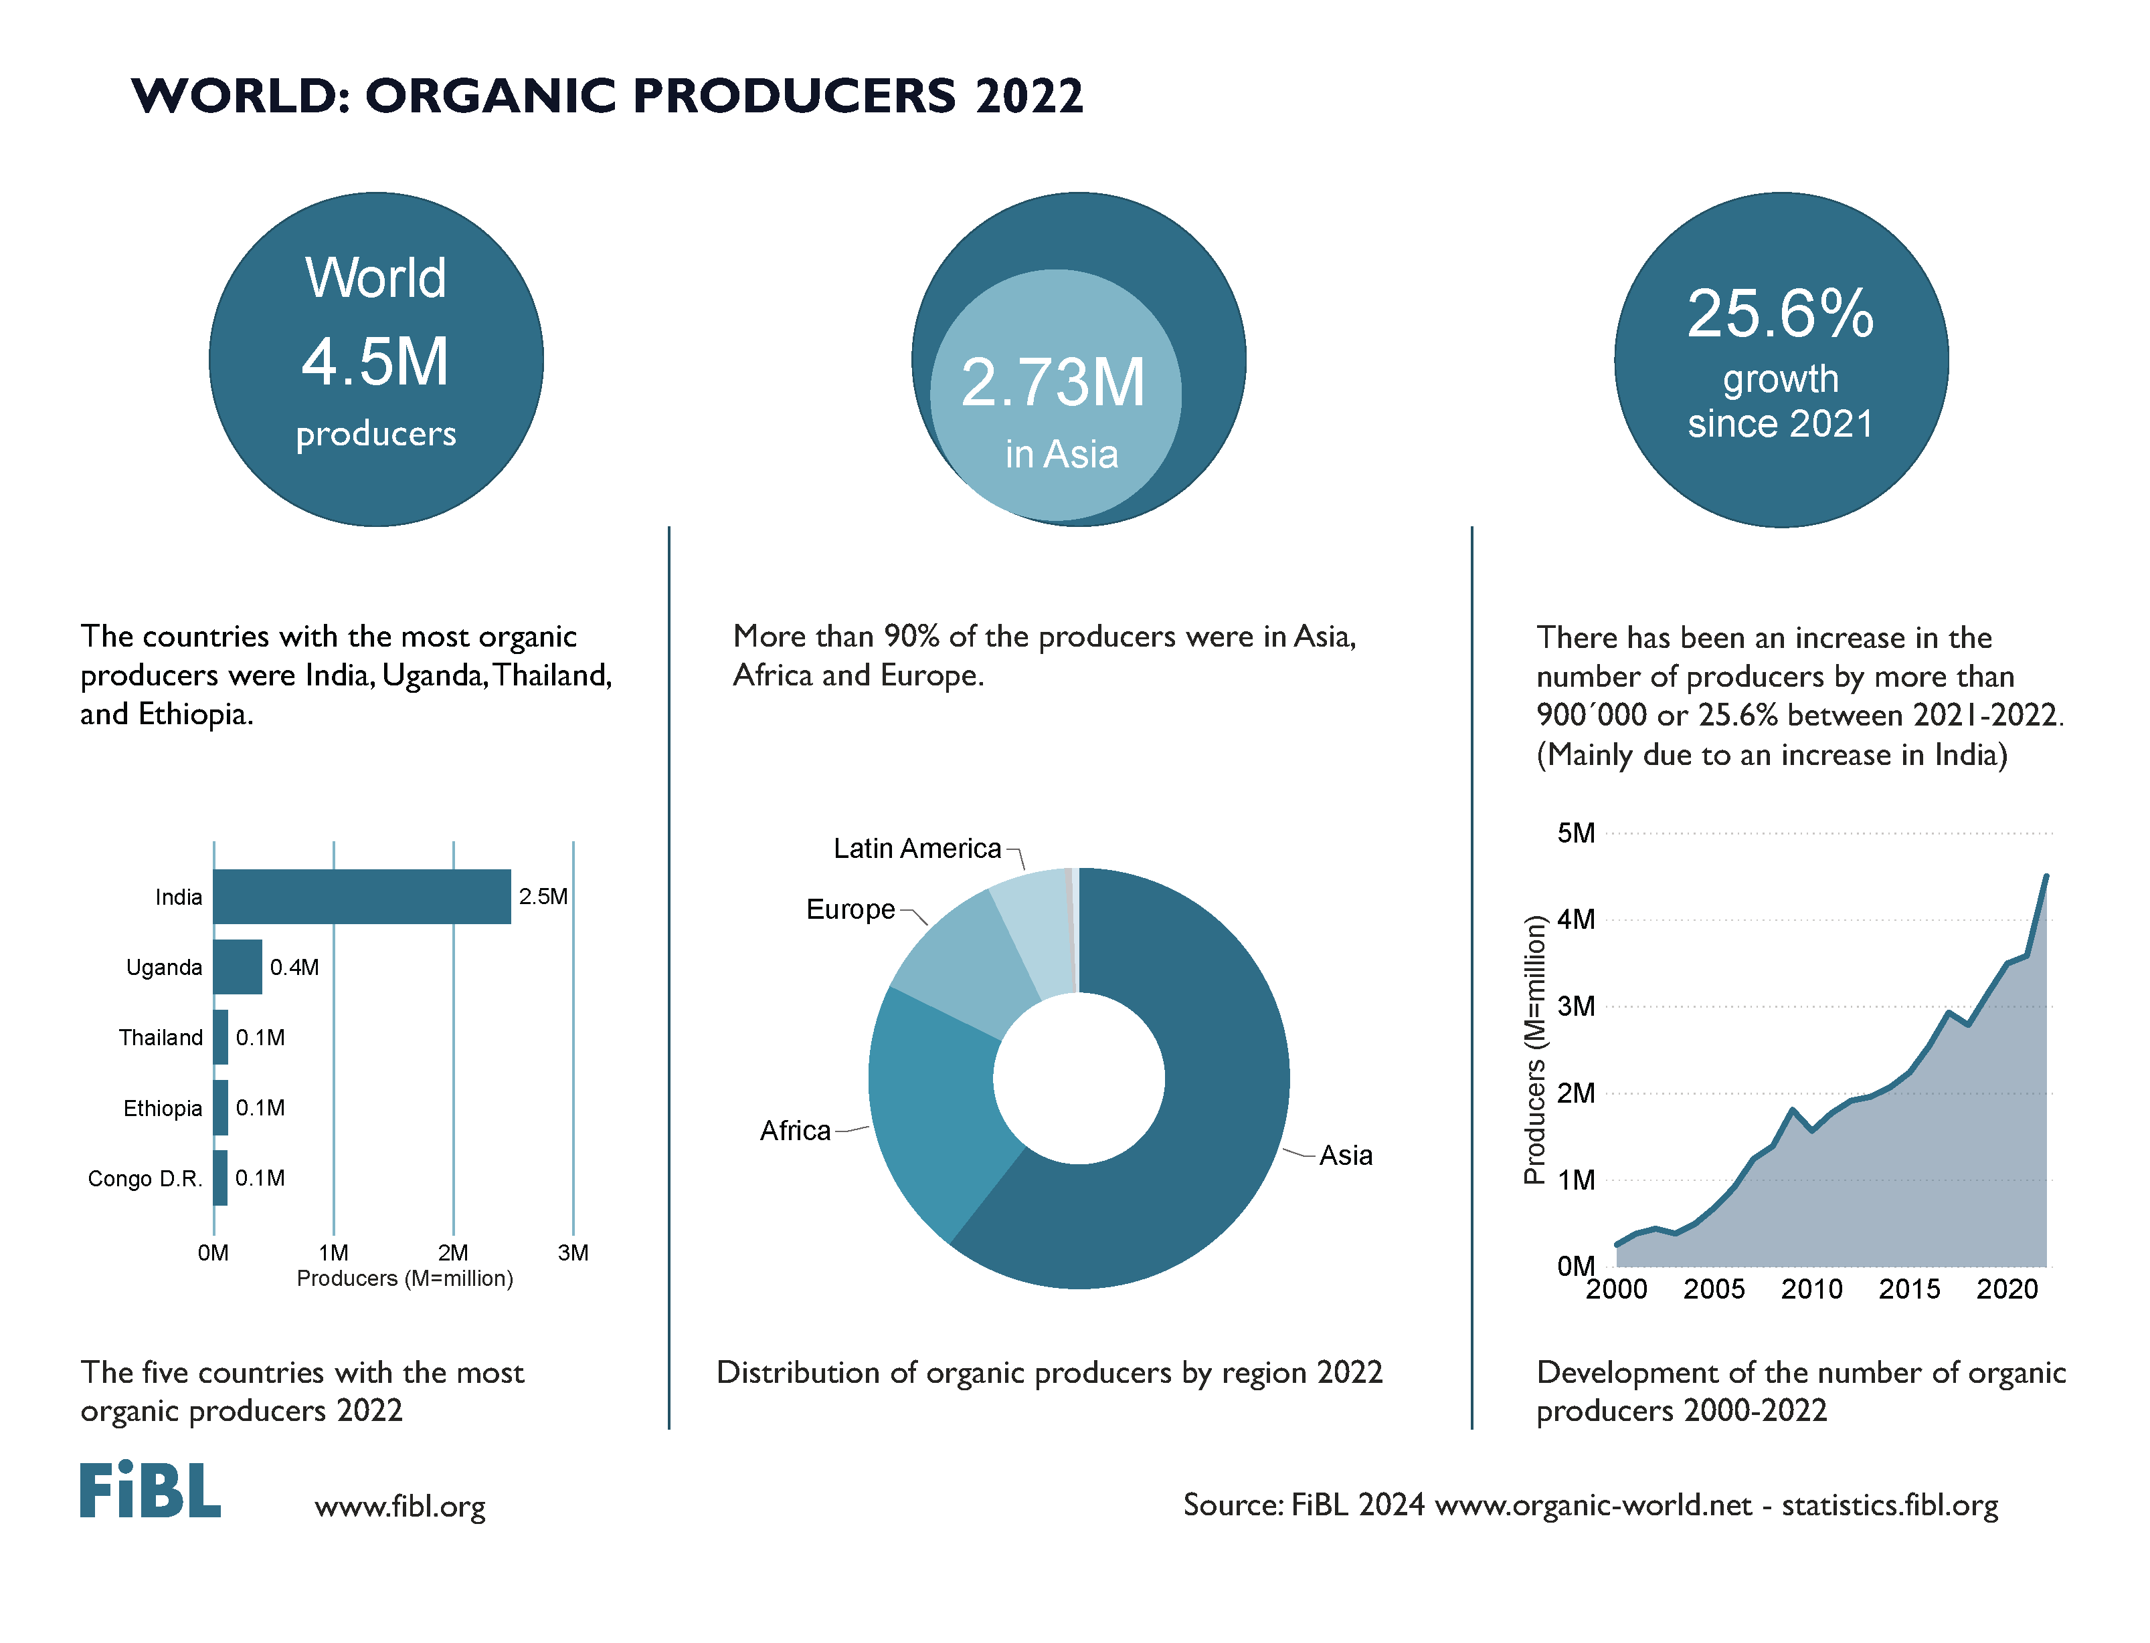

Slide 7
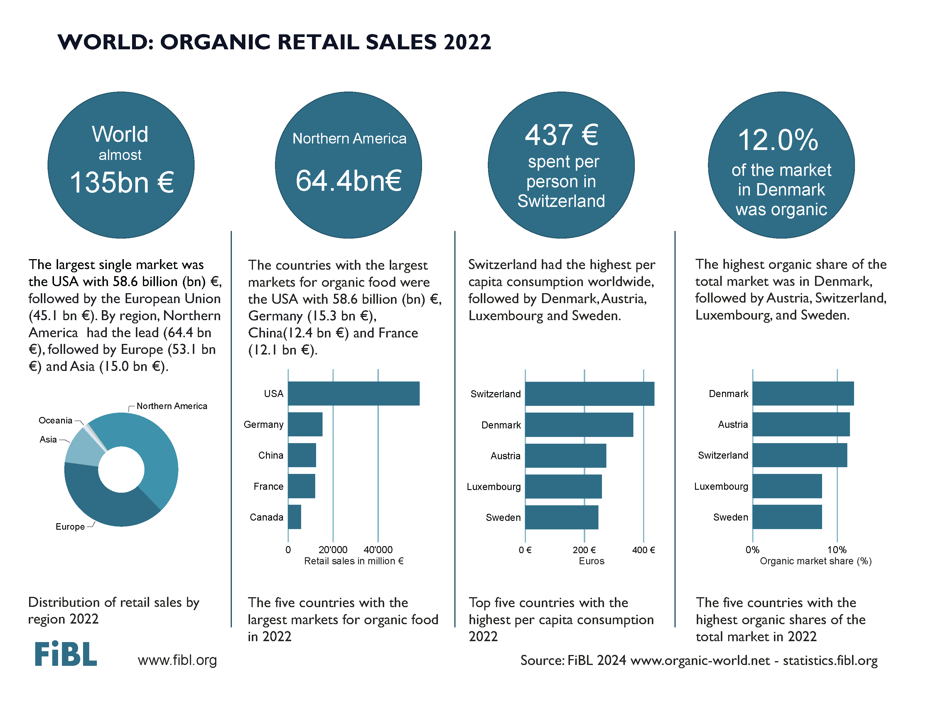

Slide 8
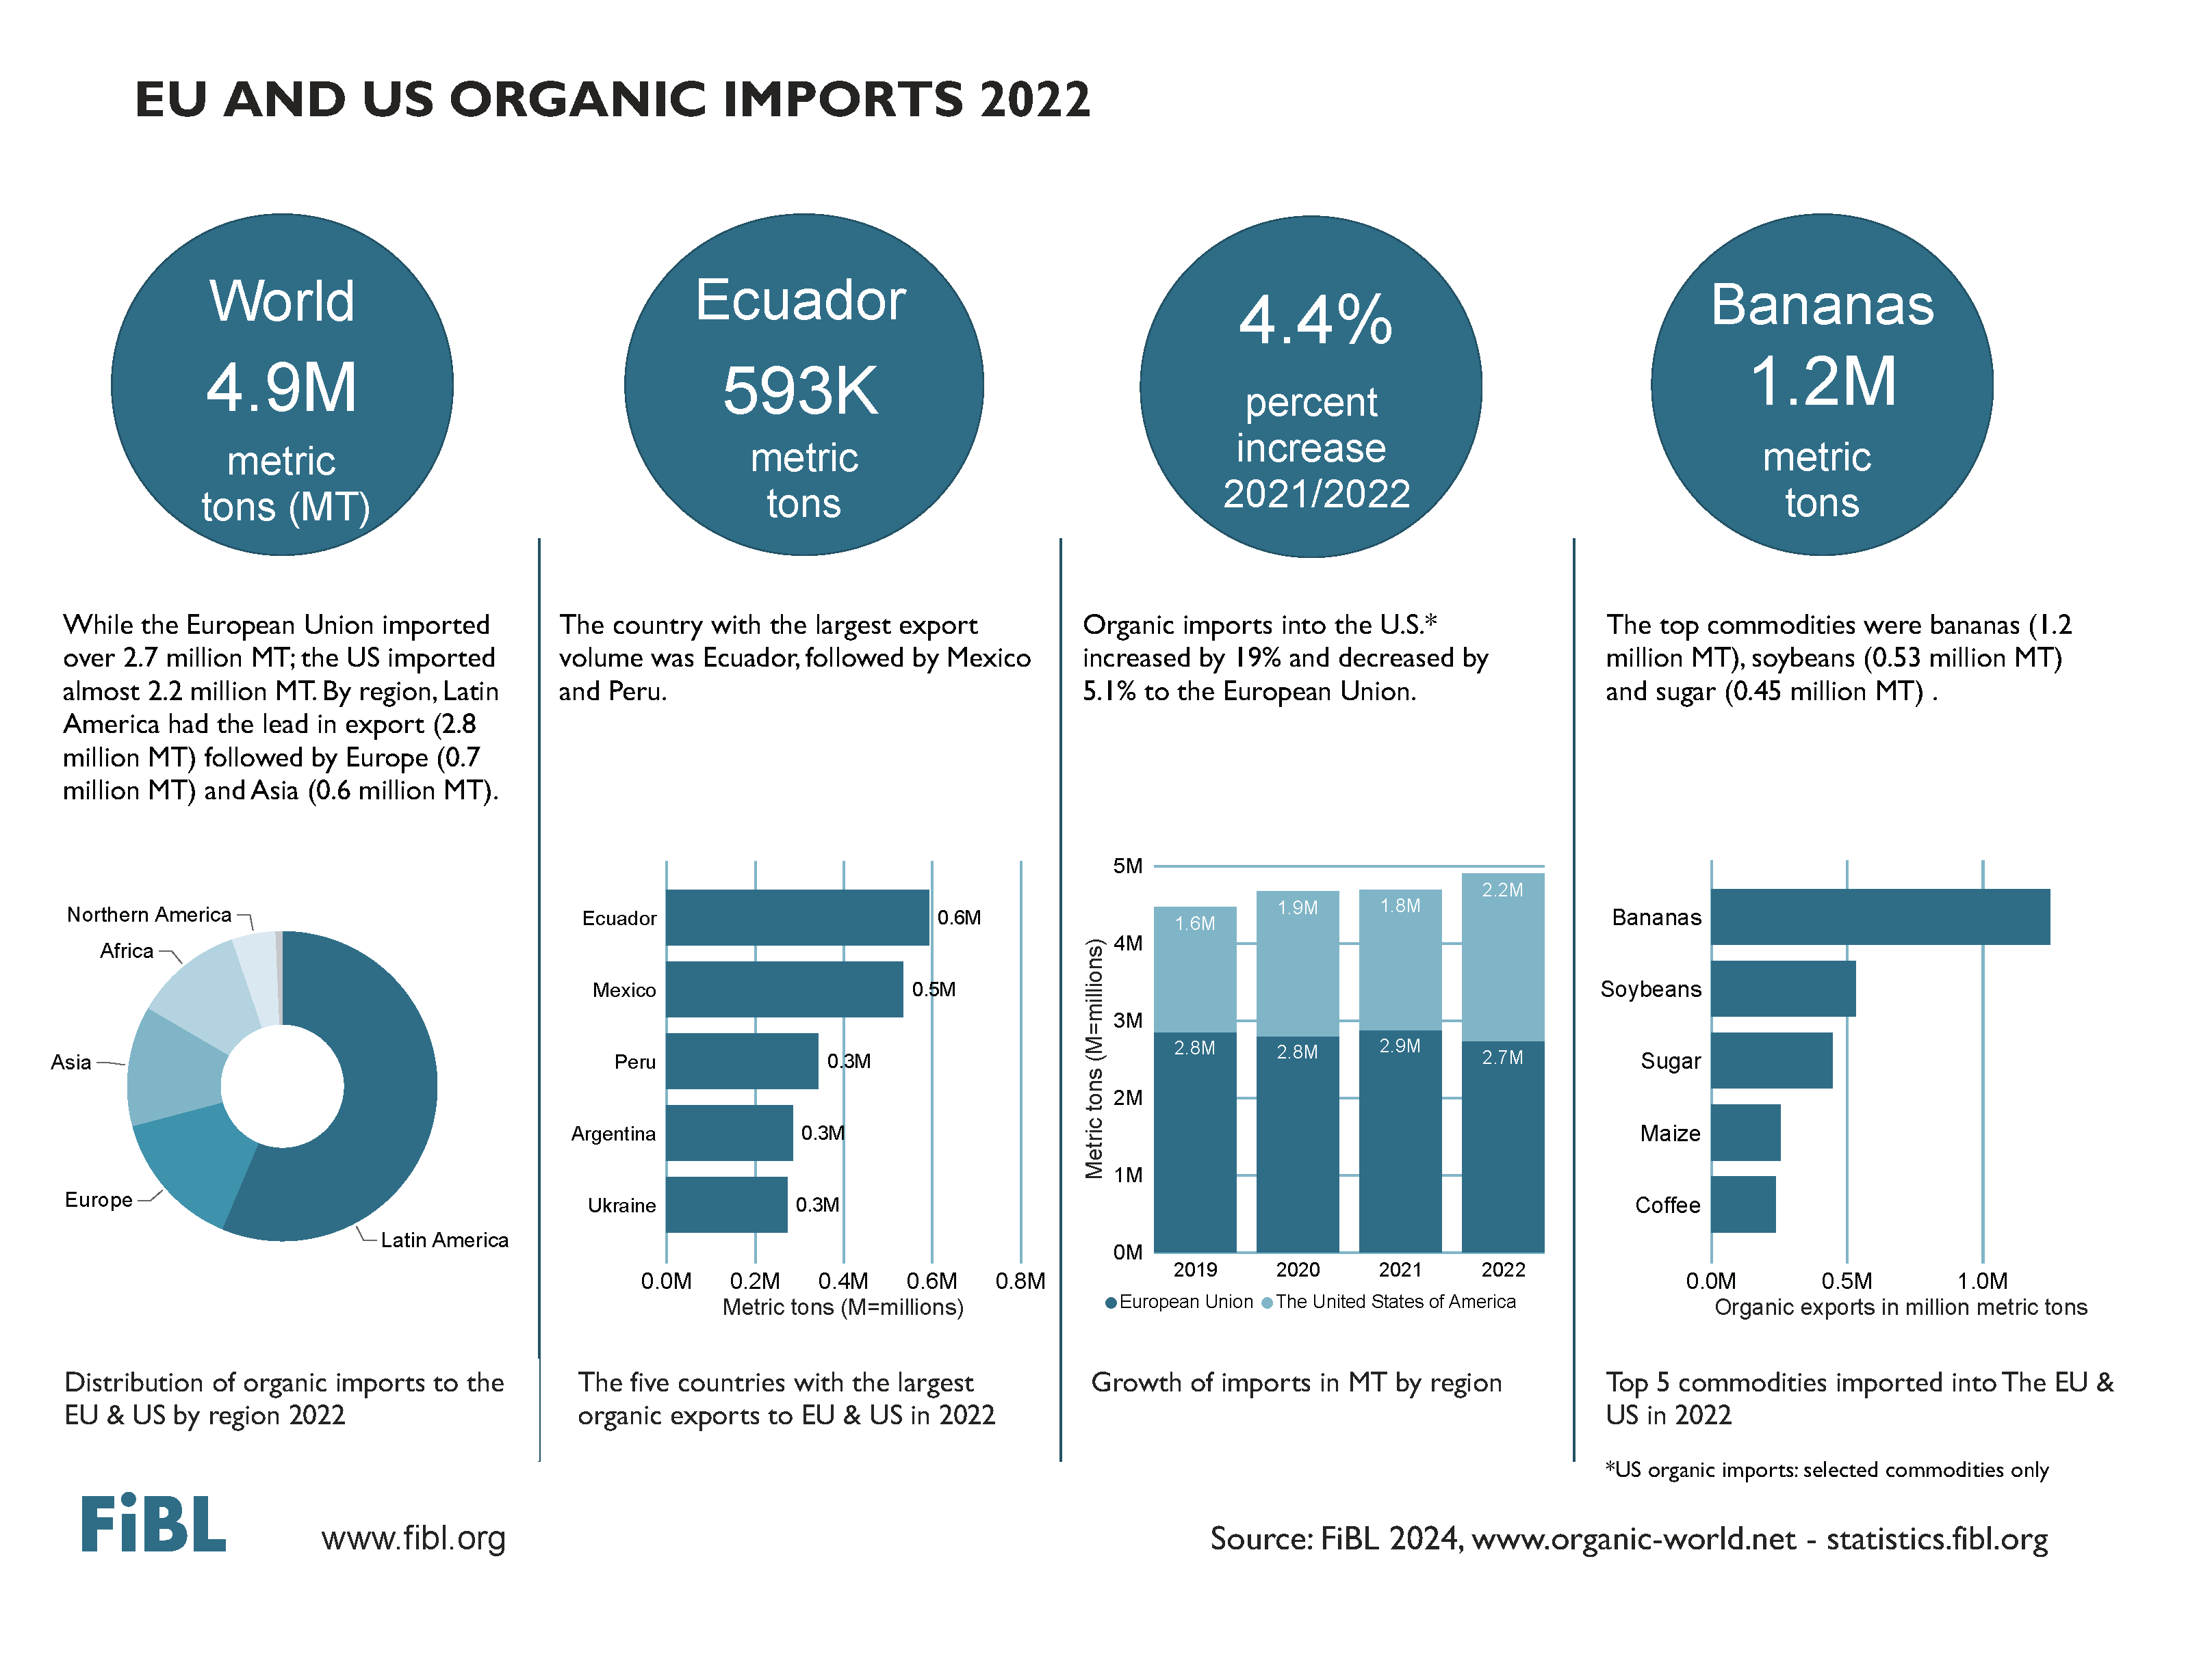

Slide 9
EUROPE

Slide 10
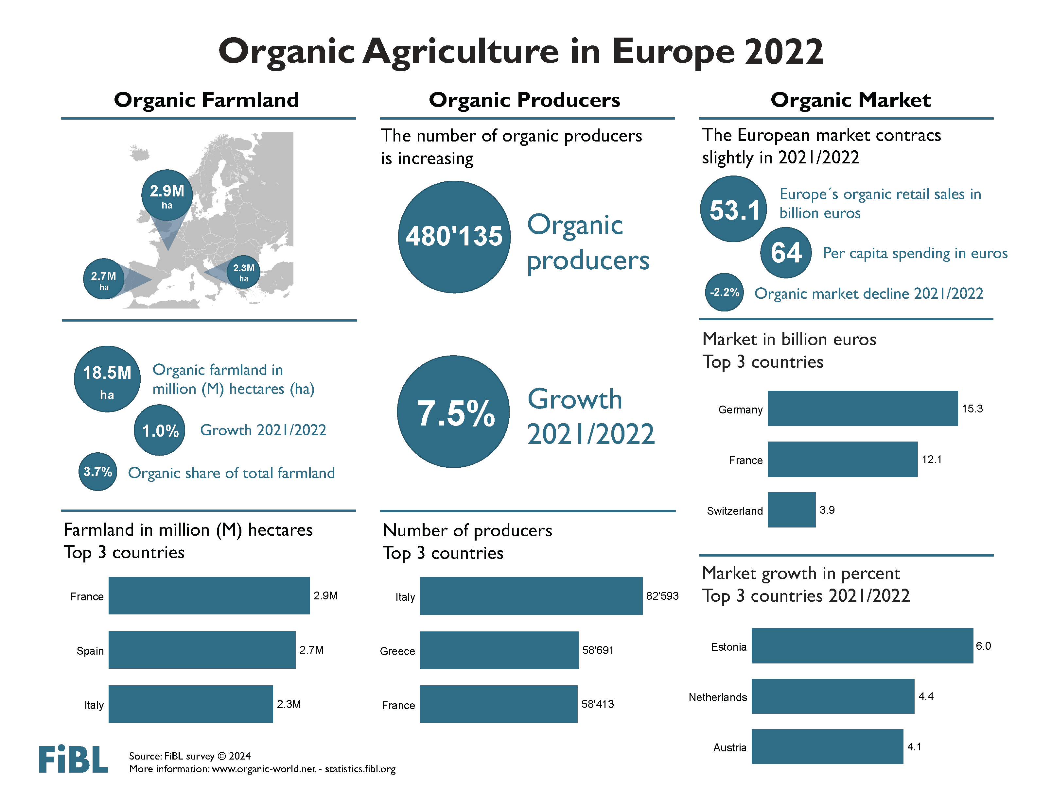

Slide 11
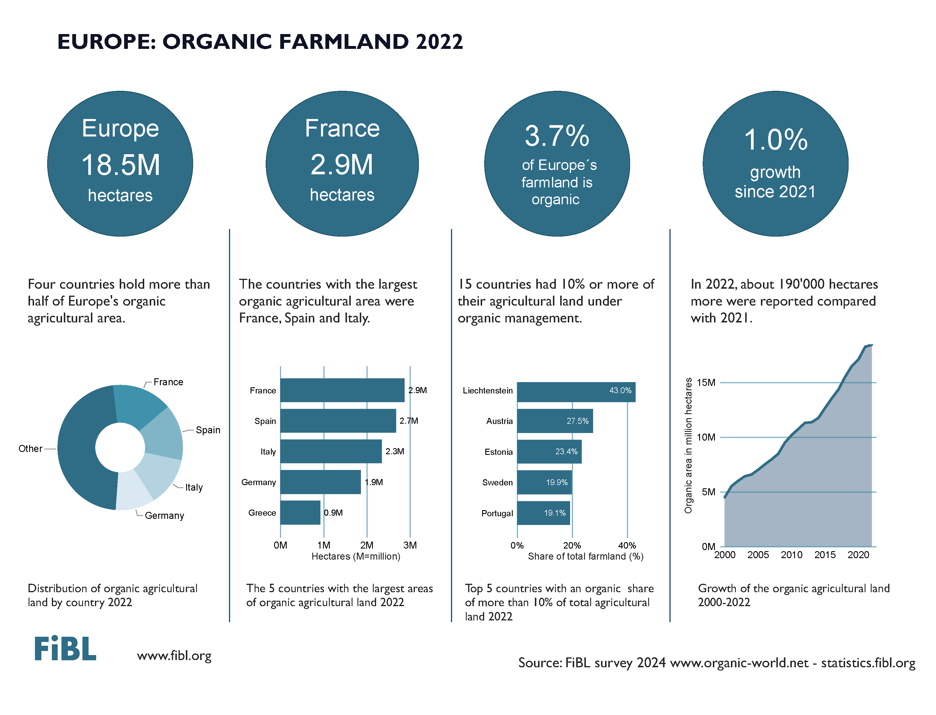

Slide 12
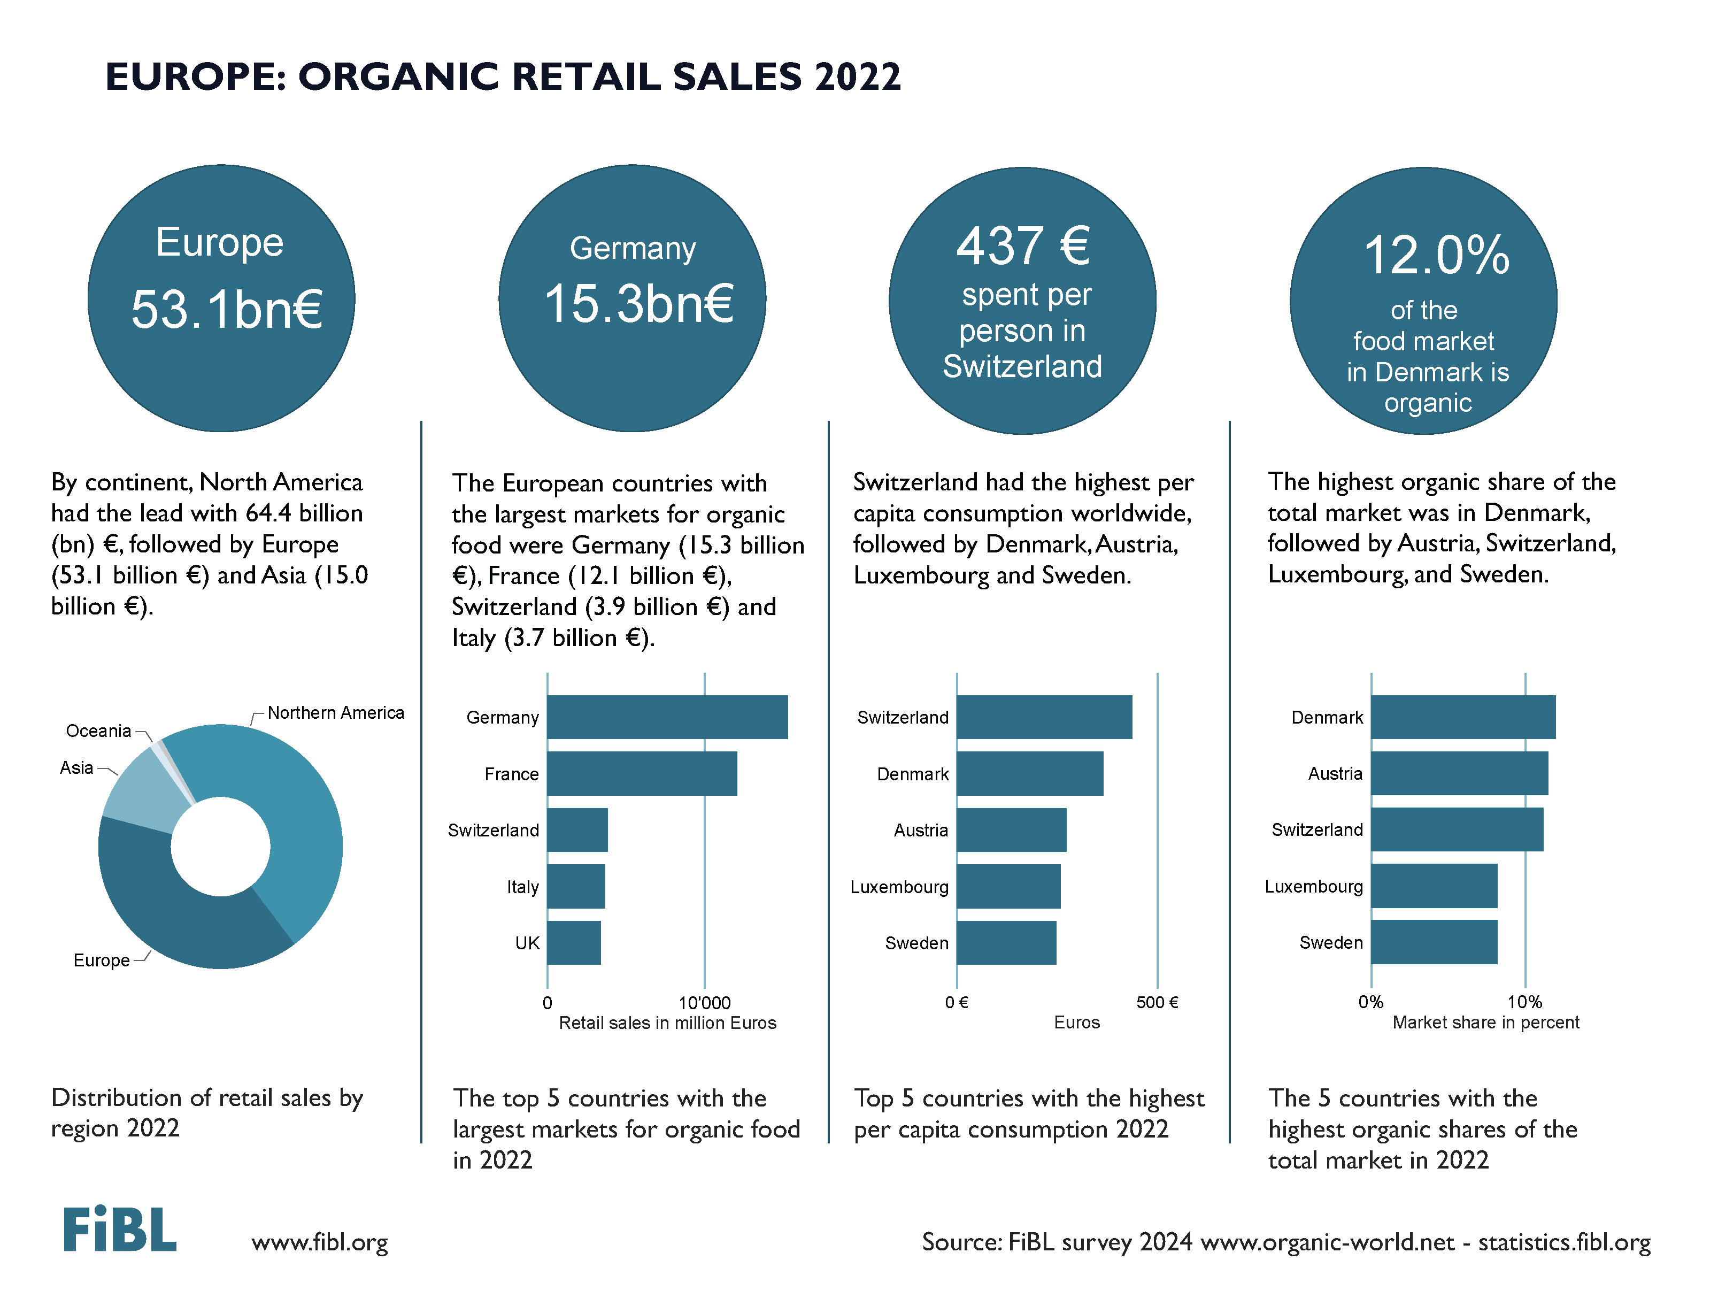

Slide 13
EUROPEAN UNION

Slide 14
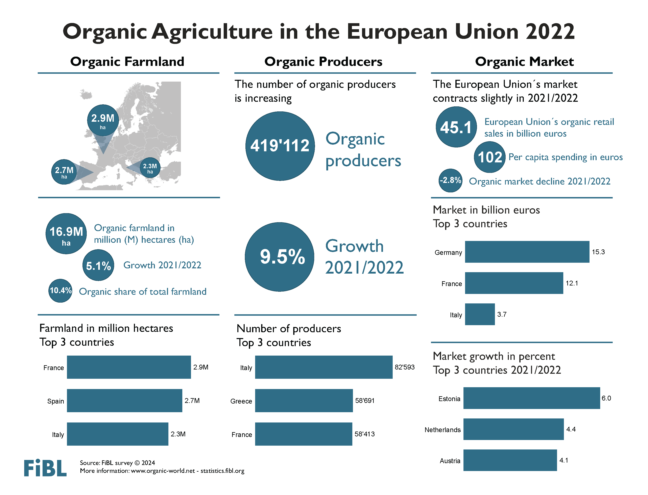

Slide 15
BACKGROUND

Slide 16
Organic Agriculture Worldwide: Key results from the FiBL survey on organic agriculture worldwide 2024
Data compiled by the Research Institute of Organic Agriculture (FiBL), Frick, Switzerland, based on national data sources and data from certifiers.
Data as published February 2024 in The World of Organic Agriculture. Statistics and Emerging Trends 2023.* Frick and Bonn, www.organic-world.ne t
For updates, check www.organic-world.net
This presentation is available online at: https://www.organic-world.net/yearbook/yearbook-2024/presentations.html
Texts and graphs: Helga Willer, Bernhard Schlatter, Jan Trávníček and Claudia Meier, Research Institute of Organic Agriculture (FiBL), Frick, Switzerland
Contact: Helga Willer, helga.willer@fibl.org, Research Institute of Organic Agriculture (FiBL), Frick, Switzerland
© Research Institute of Organic Agriculture (FiBL), Frick, Switzerland, February 2024
*Citation: Willer, Helga, Bernhard Schlatter and Jan Trávníček (Eds.) (2024): The World of Organic Agriculture. Statistics and Emerging Trends 2024. Research Institute of Organic Agriculture FiBL, Frick, and IFOAM – Organics International, Bonn.
Notes:
FiBL
07.02.2024
www.fibl.org
16

Slide 17
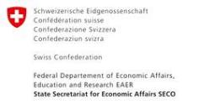

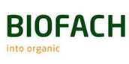


Acknowledgements
The Swiss State Secretariat of
Economic Affairs (SECO)
Coop Sustainability Fund
NürnbergMesse, the organizers of BIOFACH
IFOAM – Organics International
More than 200 experts from all parts of the world contributed to the FiBL survey 2024.

Slide 18
The World of Organic Agriculture 2024
The 25th edition of «The World of Organic Agriculture», was published by FiBL and IFOAM – Organics International in February 2024.
Data tables
Country and continent reports
Markets, standards, policy support
The book can be ordered or downloaded at (item 1747): https://www.fibl.org/en/shop-en
www.organic-world.net
https://statistics.fibl.org

Slide 19
The 25th survey on organic agriculture world-wide
The 25th survey on organic agriculture worldwide was carried out by the Research Institute of Organic Agriculture FiBL in cooperation with partners from all around the world. The results were published jointly by FiBL and IFOAM – Organics International.
The survey was carried out between July 2023 and February 2024.
Data were received from 188 countries.
Data was provided by over 200 country experts (representatives from NGOs, certification bodies, governments, researchers).
The following data was collected: area data (including land use and crop details); producers, other operator types; domestic market values; export and import data; livestock data (animal heads and production in metric tons).
The results are published in the yearbook “The World of Organic Agriculture 2024” and on www.organic-world.net.

Slide 20
More information
More information (PDF, data sources, graphs) at:
http://www.organic-world.net/yearbook/yearbook-2024.html
Contact
Helga Willer
Research Institute of Organic Agriculture (FiBL)
5070 Frick
Switzerland
helga.willer@fibl.org

Slide 21
Disclaimer
All of the results contained in this slide show have been compiled by the Research Institute of Organic Agriculture (FiBL). However, the possibility of mistakes cannot be ruled out entirely. Therefore, FiBL is not subject to any obligation and makes no guarantees whatsoever regarding any of the statements or results in this work; neither does FiBL accept responsibility or liability for any possible mistakes, nor for any consequences of actions taken by readers based on statements or advice contained therein.
This document has been produced with the support of the Swiss State Secretariat for Economic Affairs (SECO), the Sustainability Fund of Coop Switzerland, NürnbergMesse, IFOAM – Organics International. The views expressed herein can in no way be taken to reflect the official opinions of SECO, Coop, NürnbergMesse or IFOAM – Organics International.

Slide 22
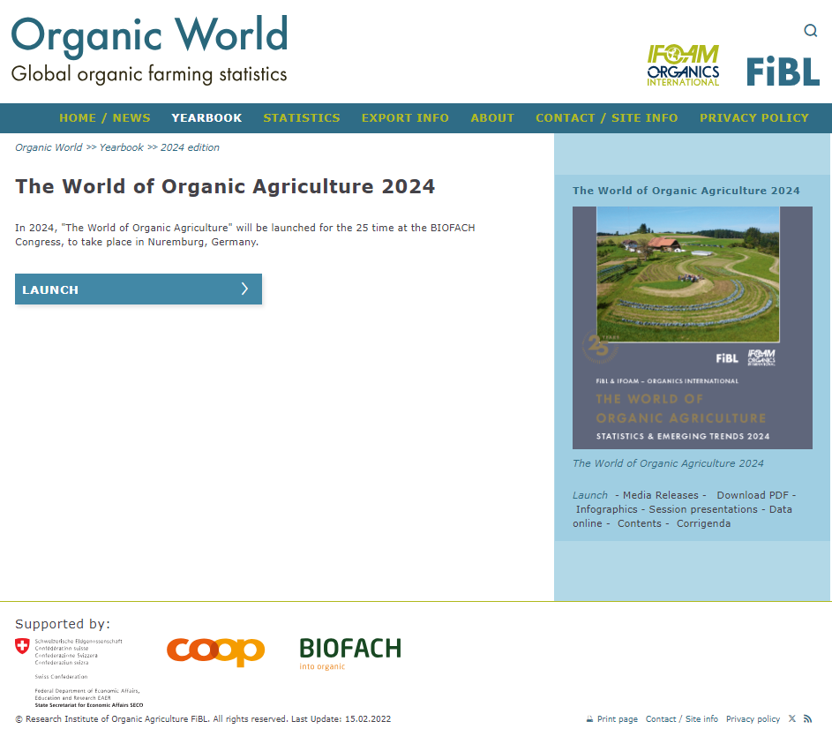
Presentations on www.organic-world.net

Slide 23
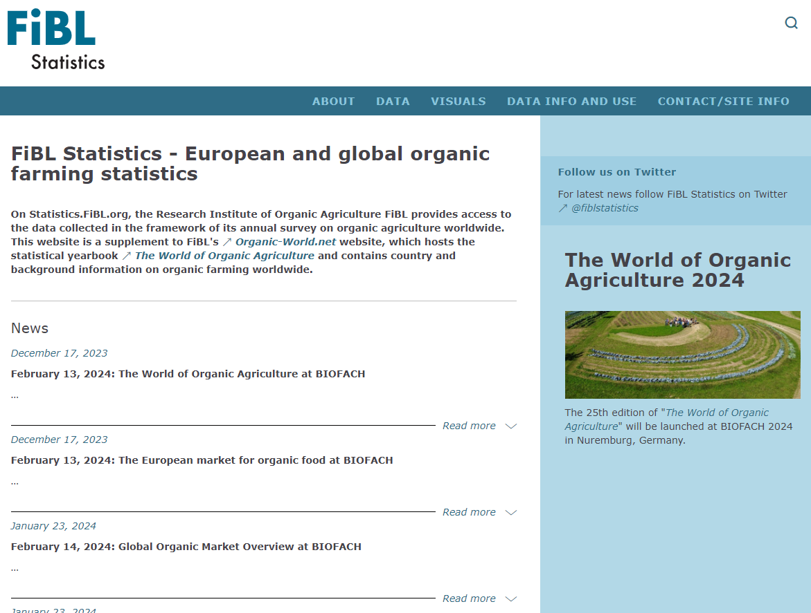
Statistics.FiBL.org

Slide 24
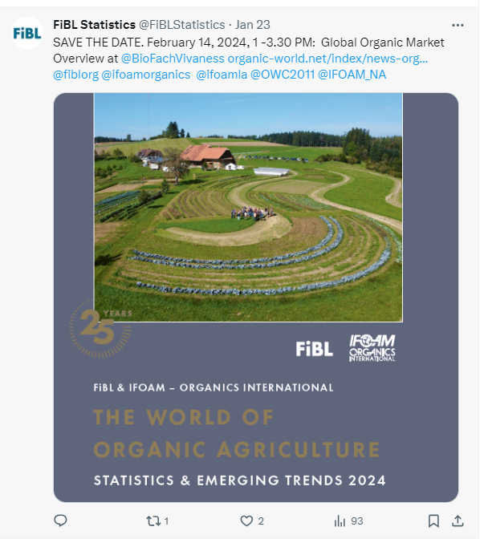
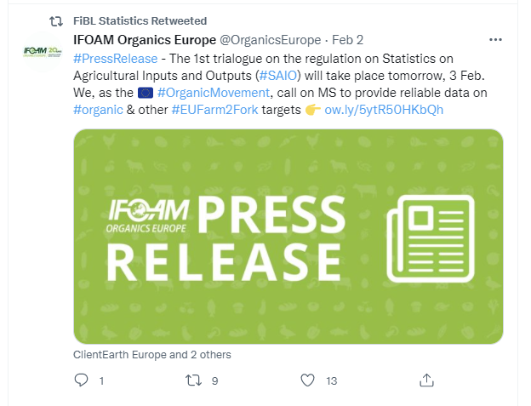
www.twitter.com/fiblstatistics

Slide 25
Contact
Helga Willer
Research Institute of Organic Agriculture FiBL
Ackerstrasse 113, Box 219
5070 Frick
Switzerland
Phone +41 62 865 72 72
Phone +41 62 865 72 07 (direct)
info.suisse@fibl.org, helga.willer@fibl.org
www.fibl.org, www.organic-world.net, https://statistics.fibl.org

Slide 26






FiBL online
www.fibl.org
www.bioaktuell.ch
fiblfilm
@fiblorg
@FiBLaktuell
linkedin.com/company/fibl

