Slide 1
Organic Agriculture Worldwide:
Key results from the FiBL survey on organic agriculture worldwide 2021
Part 2: Land use and key crops in organic agriculture 2019
Jan Trávníček, Bernhard Schlatter, Claudia Meier, and Helga Willer
Research Institute of Organic Agriculture (FIBL), Frick, Switzerland
© FiBL 2021

Slide 2
Organic Agriculture Worldwide: Key results from the FiBL survey on organic agriculture worldwide 2021
Part 2: Land use and key crops in organic agriculture 2019
Data compiled by the Research Institute of Organic Agriculture FiBL, Frick, Switzerland, based on national data sources and data from certifiers.
Data as published February 2021 in FiBL & IFOAM – Organics International (2021): The World of Organic Agriculture. Statistics and Emerging Trends 2021. Frick and Bonn
For updates check www.organic-world.net
This presentation is available online at: http://www.organic-world.net/yearbook/yearbook2021/slide-presentations.html
Texts and graphs: Jan Trávníček, Bernhard Schlatter, Claudia Meier, and Helga Willer, Research Institute of Organic Agriculture, FiBL, Frick, Switzerland
Contact: Helga Willer, helga.willer@fibl.org, Research Institute of Organic Agriculture, FiBL, Frick, Switzerland
© Research Institute of Organic Agriculture (FiBL), Frick, Switzerland, February, 2021
Notes:
FiBL
17.02.2021
www.fibl.org
2

Slide 3
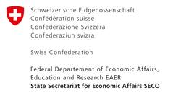

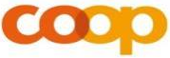
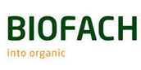
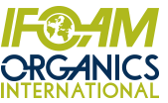
Acknowledgements*
The Swiss State Secretariat of
Economic Affairs (SECO), Berne
International Trade Centre (ITC)
Sustainability Fund of Coop Switzerland
Nürnberg Messe, the organizers of the
BioFach World Organic Trade Fair
IFOAM – Organics International
200 experts from all parts of the world contributed to the FiBL survey 2021
* See also disclaimer on last page of this slide show

Slide 4
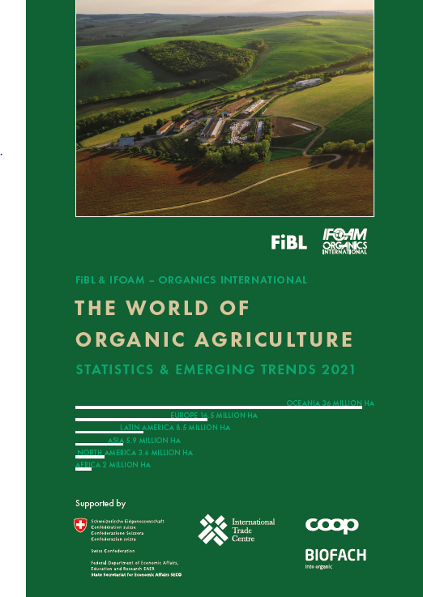
The World of Organic Agriculture 2021
The 22nd edition of “The World of Organic Agriculture”, was published by FiBL and IFOAM in February 2021.*
Contents:
      Results of the survey on organic agriculture worldwide.
      Numerous graphs, tables, maps and infographics.
      Organic agriculture in the regions and reports from Australia, Canada, the Pacific Islands, and The United States of America.
      Chapters on the global market, standards & legislations, PGS, policy support, the European market, etc.
      The book can be ordered via IFOAM.bio and shop.FiBL.org.
* Willer, Helga, Jan Trávníček, Claudia Meier and Bernhard Schlatter (Eds.) (2021): The World of Organic Agriculture. Statistics and Emerging Trends 2021. Research Institute of Organic Agriculture FiBL, Frick, and IFOAM – Organics International, Bonn

Slide 5
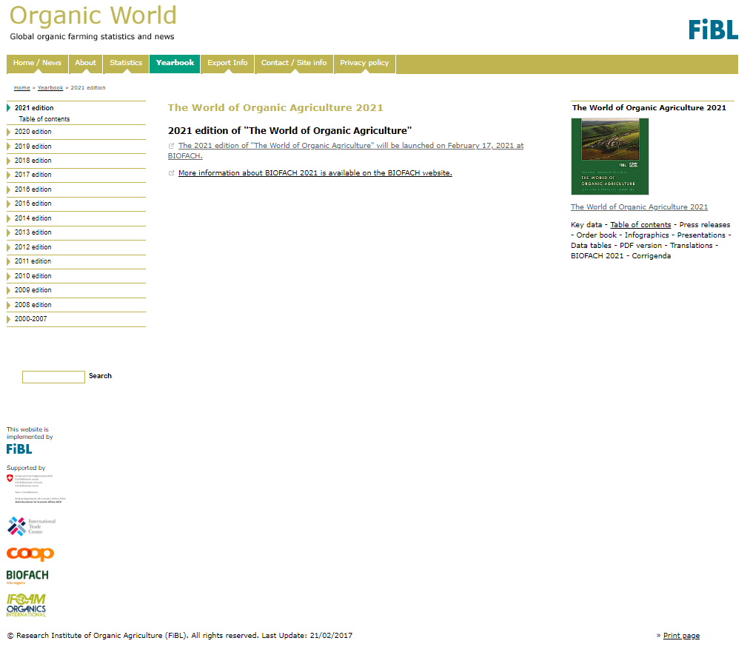
Website www.organic-world.net
Detailed statistics
in excel format
Graphs & Maps
Data revisions
News and
background
information

Slide 6
About this presentation
There are 3 presentations summarizing the key results of the FiBL survey on organic agriculture worldwide 2021(data 2019). Apart from the global data, key results on crop and on regional data are presented.
More information is available at www.organic-world.net
The following three presentations are available at http://www.organic-world.net/yearbook/yearbook2021/slide-presentations.html:
  Part 1: Global data 2019 and survey background
  Part 2: Land use and key crops in organic agriculture 2019
  Part 3: Organic agriculture in the regions 2019

Slide 7
The 22nd survey on organic agriculture world-wide
The 22nd survey on organic agriculture worldwide was carried out by the Research Institute of Organic Agriculture FiBL in cooperation with partners from all around the world. The results were published jointly by FiBL and IFOAM – Organics International.
The survey was carried out between July 2020 and February 2021.
Data were received from 187 countries.
Updated data on area and producers were available for 142 countries.
Data was provided by over 200 country experts (representatives from NGOs, certification bodies, governments, researchers).
The following data was collected: area data (including land use and crop details); producers, other operator types; domestic market values; export and import data; and livestock data (animal heads and production in metric tons);
The results are published in the yearbook “The World of Organic Agriculture 2021” and at www.organic-world.net.

Slide 8
World: Distribution of organic areas 2019
Agricultural land (72.3 million hectares in 2019)
  Cropland
    Arable land (cereals, green fodders, oilseeds, etc.)
    Permanent crops (olives, nuts, coffee, etc.)
    Cropland, no details (arable land and permanent crops with no further details)
    Permanent grassland
    Other agricultural land
Non-agricultural areas (34.8 million hectares in 2019)
    Wild collection/Bee keeping (34.8 million hectares)
    Forest
    Aquaculture
    Grazing areas on non-agricultural land

Slide 9
World: Use of organic agricultural land 2019
(total: 72.3 million hectares)

Slide 10
Main land use types in organic agriculture 2019
The chart of the share of land use types in the regions shows:
  For a large part of the organic agricultural land in both Latin America (13%) and Asia (37%), land use information is not available
  Africa has a large proportion of permanent crops (63%); these are mainly cash crops such as coffee, olives, nuts, and cocoa.
  Europe and North America use about half of their organic agricultural land as grassland, and the other half is arable land. In Europe the share of permanent crops is higher than in North America, mainly due to olives and grapes grown in the Mediterranean countries.
  Latin America has little arable land and permanent crops land compared to the large grazing areas (Uruguay and Argentina). It has a comparatively high share of permanent crops (mainly coffee and cocoa).
  Oceania is characterized by the large grazing areas of Australia. The Pacific Islands produce a large range of permanent crops, such as coconuts; New Zealand produces a lot of grapes and temperate fruits.
Source: FiBL survey 2021

Slide 11


ORGANIC LAND USE 2019
13.1
Mio ha
arable land
4.7
Mio ha
permanent crops
48.9
Mio ha
permanent grassland
34.8
Mio ha
wild collection
Arable land constitutes 18 % of the world’s organic agricultural land, and 1.0 % of the world’s arable crop land. It decreased by 1.7 % over 2019.
Permanent crops constitute 6.5 % of the world’s organic agricultural land, and 2.8 % of the world’s permanent cropland. It increased by 0.4 % over 2019.
Permanent grassland constitutes 68 % of the world’s organic agricultural land, and 1.5 % of the world´s permanent grassland. It increased by 1.2 % over 2019.
Over 47 % of the wild collection is in Africa (over 16 million hectares) and Europe (almost 11 million hectares)
Organic arable land by region 2019
Organic permanent crops by region 2019
Organic permanent grassland by region 2019
Organic wild collection by region 2019
Organic arable land: The five countries with the largest areas 2019
Organic permanent crops:The five countries with the largest areas 2019
Organic permanet grassland: The five countries with the largest areas 2019
Organic wild collection: The five countries with the largest areas 2019
Source: FiBL survey 2021, www.organic-world.net – statistics.fibl.org

Slide 12
World: Agricultural land use by region in organic agriculture 2019

Slide 13
World: Development of land use types in organic agriculture 2004-2019

Slide 14
World: Use of organic agricultural land 2019
(total: 72.3 million hectares)
14

Slide 15
World: Key crop groups in organic agriculture: 2018 and 2019 compared

Slide 16
World: Organic grassland/grazing areas 2019
With a total of almost 48.9 million hectares, the organic grassland/grazing areas constitute over two thirds or 69 percent of the organic agricultural land.
The organic grassland/grazing areas account for
1.5 percent of the world’s total grassland/grazing areas.
An increase of 0.6 million hectares or nearly 1.2 percent was reported compared with 2018.
More than two third of the organic grassland/grazing areas is located in Oceania (over 70 percent of the organic grassland/grazing area or nearly 35 million hectares), followed by Europe (13 percent or 6.5 million hectares) and Latin America (12 percent or 5.9 million hectares).
Source: FiBL survey 2021

Slide 17
World: Organic permanent grassland/grazing areas by region 2019 (total 48.9 million hectares)

Slide 18
World: Organic arable land 2019
With a total of almost 13.1 million hectares, organic arable land constitutes 18 percent of the world’s organic agricultural land and 1.0 of the world’s arable cropland.
A decrease of 3 percent over 2019 was reported, mainly due to drop in temporary grasslands reported from China.
More than 59 percent of the arable land is located in Europe, followed by Asia (22 percent), and North America (10 percent).
Most of the arable cropland is used for cereals including rice (5.1 million hectares), green fodder (3.2 million hectares), and oilseeds (1.7 million hectares).
Source: FiBL survey 2021

Slide 19
World: Organic arable land by region 2019
(total 13.1 million hectares)

Slide 20
World: Organic arable land worldwide by main crop groups 2019 (total 13.1 million hectares)

Slide 21
World: Permanent cropland 2019
Permanent crops account for more than 4.7 million hectares, which is 2.8 percent of the world’s permanent cropland.
Compared with 2018, an increase of more than 17’000 hectares, or 0.4 percent, was reported.
With 7.0 percent, permanent cropland has a higher share in organic agriculture than in total agriculture, where it accounts for 3.0 of the agricultural land.
Most of the permanent cropland is in Europe (1.8 million hectares), followed by Africa (1.3 million hectares), and Asia (almost 0.8 million hectares).
The most important crops are olives, with nearly 0.9 million hectares, constituting almost 19 percent of the organic permanent cropland, followed by coffee (more than 0.7 million hectares), nuts (0.6 million hectares), grapes (almost 0.5 million hectares), and cocoa (almost 0.4 million hectares)
Source: FiBL survey 2021

Slide 22
World: Organic permanent cropland by region 2019

Slide 23
World: Organic permanent cropland worldwide by crop groups 2019

Slide 24
World: Organic wild collection and beekeeping 2019
A collection area (including beekeeping) of more than 34.8 million hectares was reported in 2019.
The organic wild collection areas are concentrated in Europe, Africa, Latin America, and Asia.
The countries with the largest areas are Finland (mainly berries), followed by Zambia and Namibia.
According to experts, wild berries, apiculture, and medicinal and aromatic plants, as well as shea nuts in Africa and Brazil nuts in Latin America, play the most important roles. Unfortunately, for most of the wild collection areas, no details are available.
Source: FiBL survey 2020

Slide 25
Distribution of organic wild collection areas by region 2013

Slide 26
The ten countries with the largest wild collection areas 2013

Slide 27
World: Use of organic wild collection and beekeeping land worldwide 2019

Slide 28
World: Organic beehives 2019
There were almost 3 million organic beehives in 2019, representing almost 3.4 percent of the world’s beehives.
Organic beehives are concentrated in Europe (47 percent) and Latin America (30 percent).
The country with the largest number of organic beehives is Brazil (629’939), followed by Zambia (368’274), and Bulgaria (264’069).
The total number increased almost five-fold since 2007, when over 535’000 beehives were reported. However, it is important to note that some of the increases can be attributed to the continually improving data availability.
Source: FiBL survey 2021

Slide 29
Development of the global organic beehives 2007-2013

Slide 30
World: Distribution of organic beehives by region 2019

Slide 31
World: The ten countries with the largest number of organic beehives 2019

Slide 32
World: Organic aquaculture 2019
A production volume of nearly 690’000 metric tons of organic aquaculture was reported in 2019.
According to the available data, aquaculture production is concentrated in Europe Asia (81 percent mainly China), and Europe (15 percent).
The largest production volume was found in China (almost 561’000 metric tons) followed by Ireland (more than 27’000 metric tons, mainly blue mussel, salmon and oysters) and Chile (almost 26’000 metric tons).
A breakdown by species was only available for two thirds of the total production. According to the available data, organic mussels are the most produced species (over 27’000 metric tons), followed by salmon (16’400 metric tons), sturgeon (1´800 metric tons), r. trouts (1´600 metric tons), and carps (1´600 metrics tons).
Source: FiBL survey 2021

Slide 35
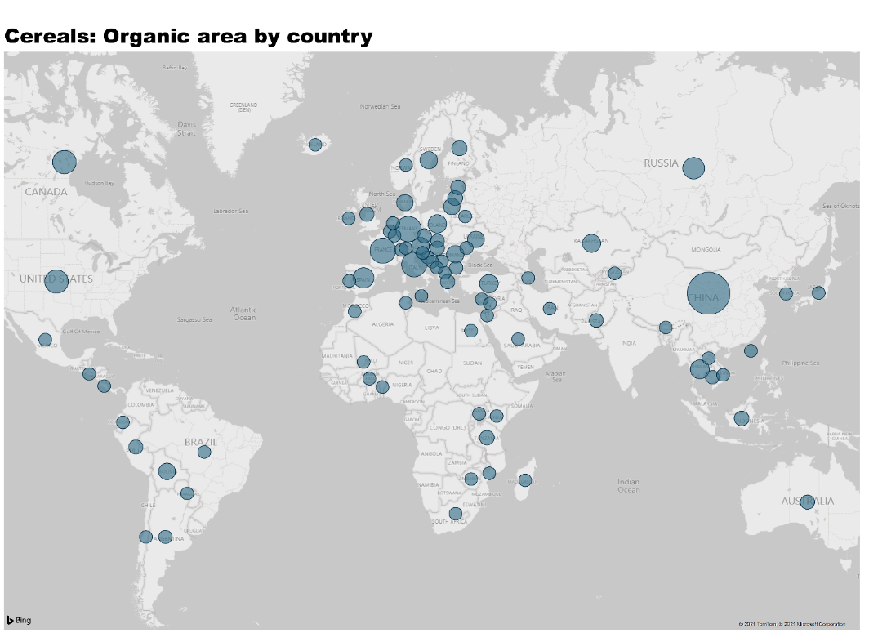
World: Organic cereals: Global distribution 2019

Slide 36

World: Cereals distribution of the global organic cereal area by cereal type 2019

Slide 37
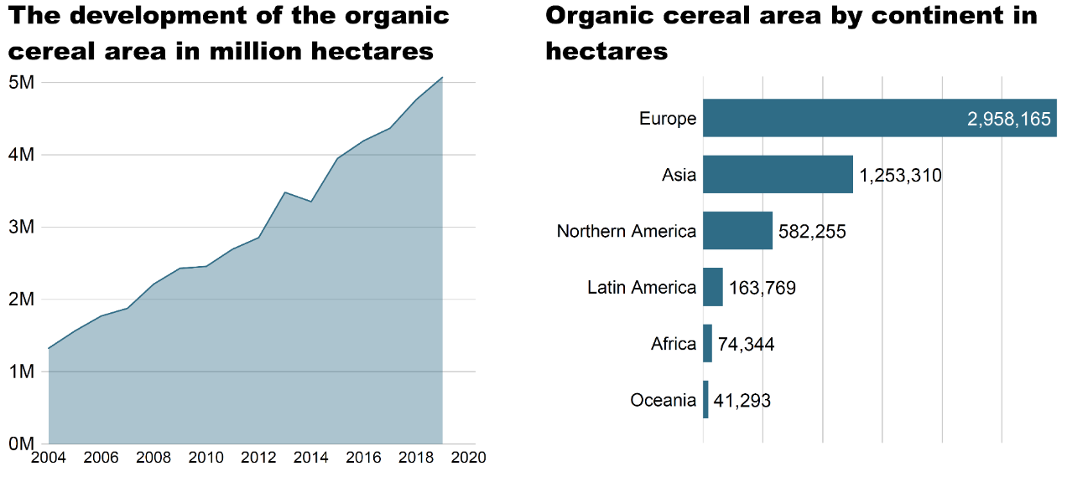
World: Development of the organic cereal area and area by continent 2019

Slide 38
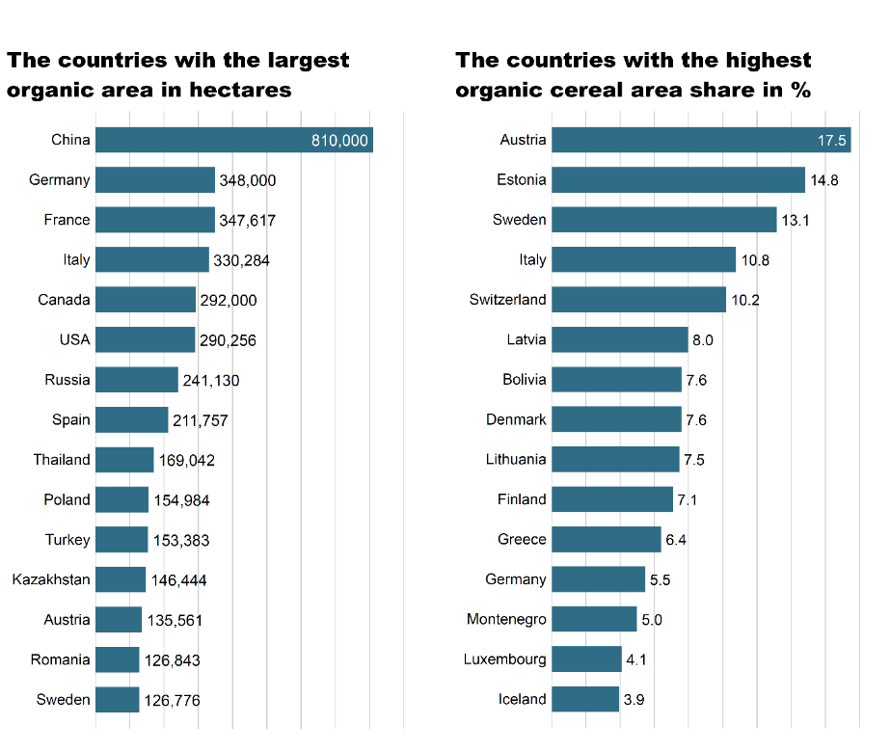
World: Countries with the largest organic cereal area and highest organic cereal area share 2019

Slide 39
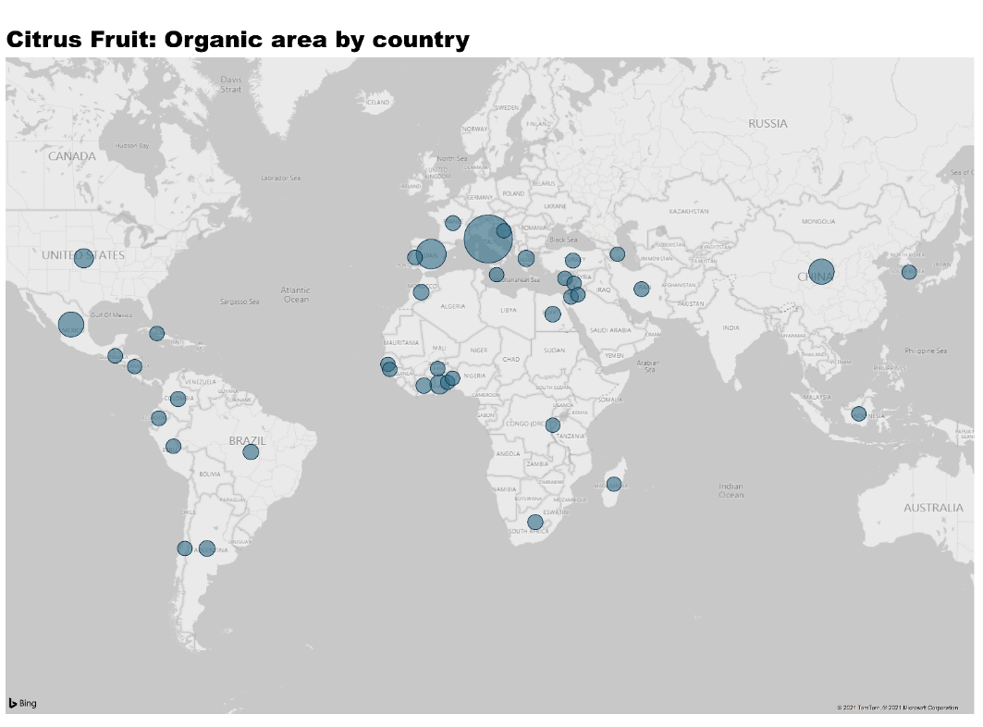
World: Organic citrus fruit: Global distribution 2019

Slide 40

World: Use of organic citrus fruit area 2019

Slide 41
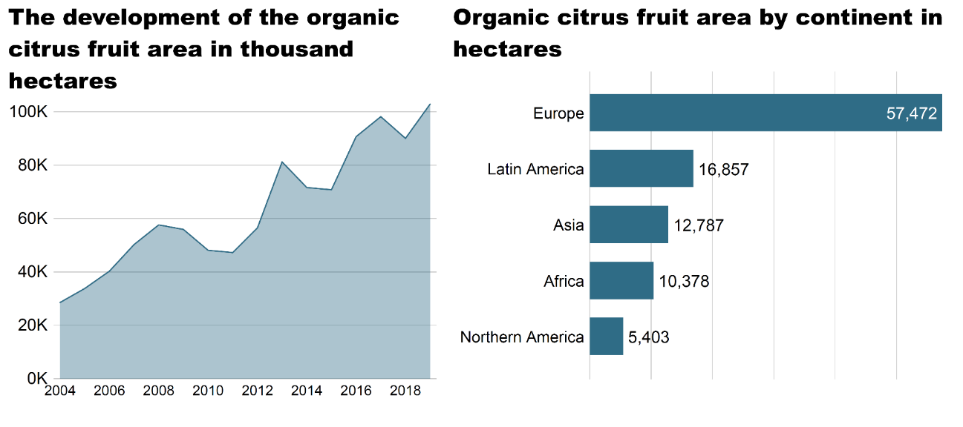
World: Development of the organic citrus fruit area and area by continent 2019

Slide 42

World: Countries with the largest organic citrus area and highest organic citrus fruit area share 2019

Slide 43
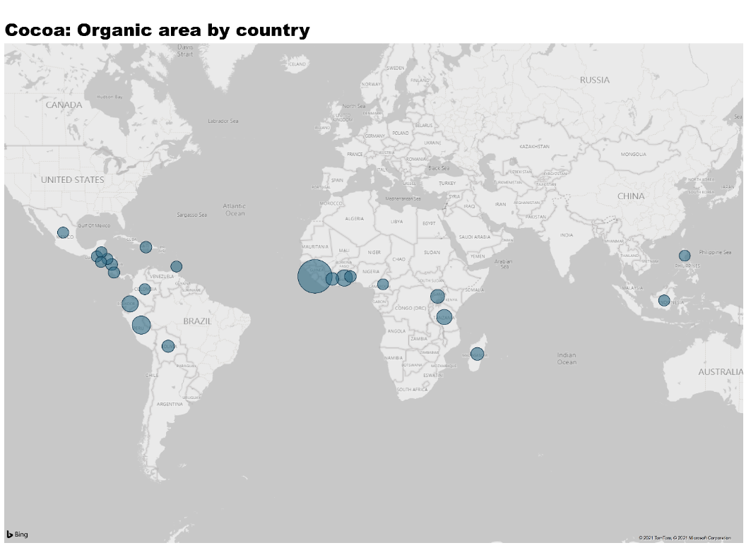
World: Organic cocoa: Global distribution 2019

Slide 44
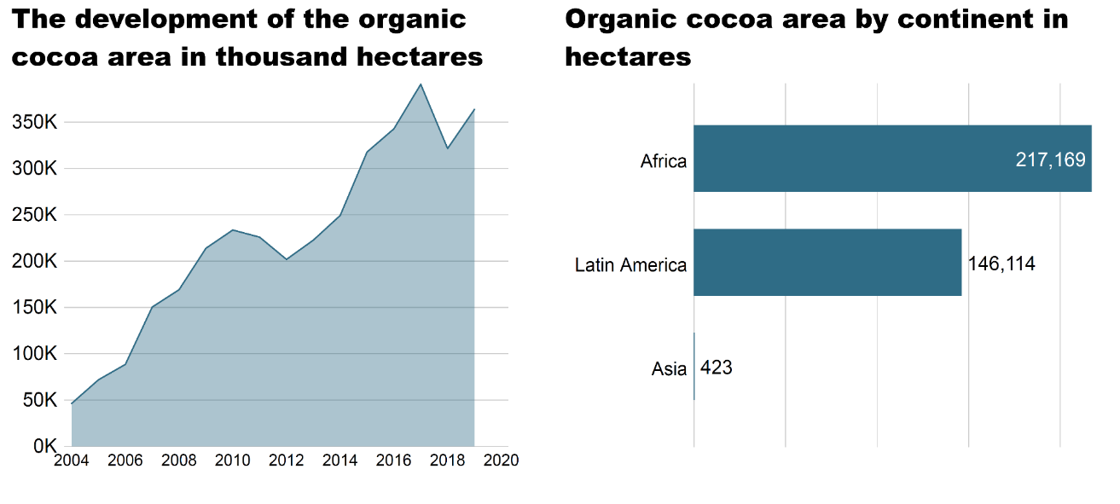
World: Development of the organic cocoaarea and area by continent 2019

Slide 45

World: Countries with the largest organic cocoa area and highest organic cocoa area share 2019

Slide 46
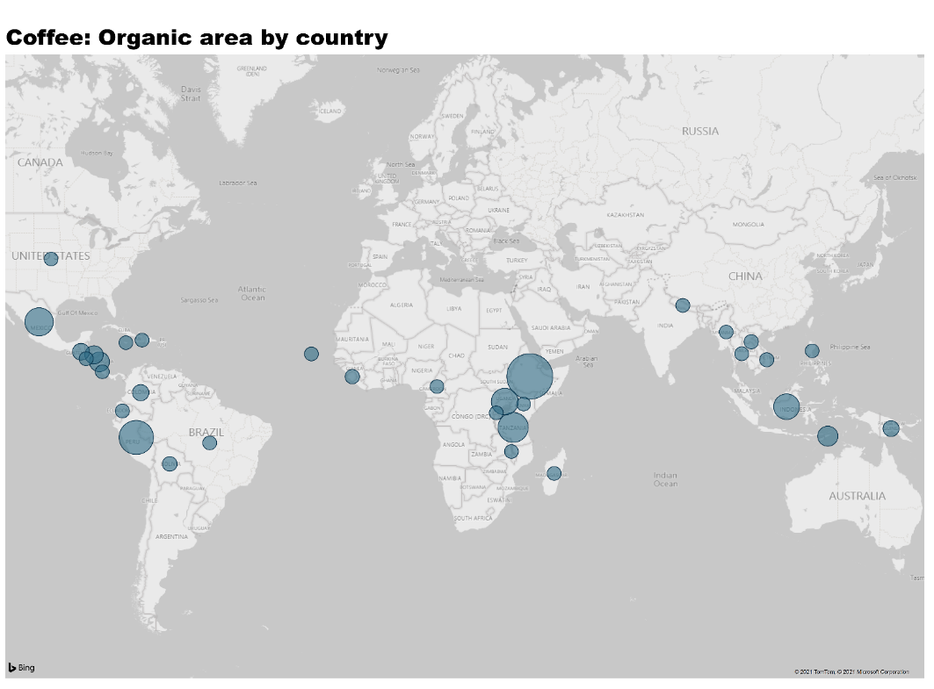
World: Organic coffee: Global distribution 2019

Slide 47
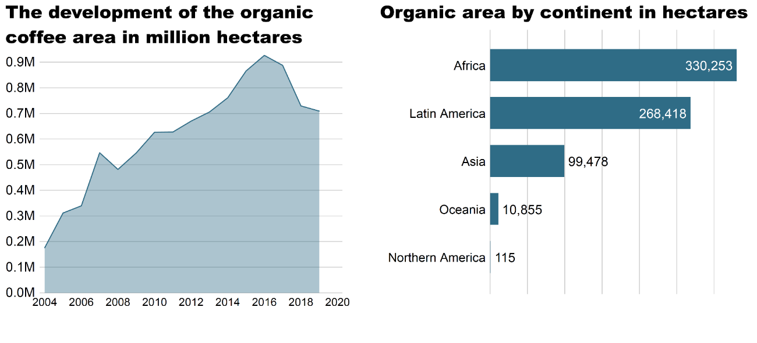
World: Development of the organic coffee area and area by continent 2019

Slide 48
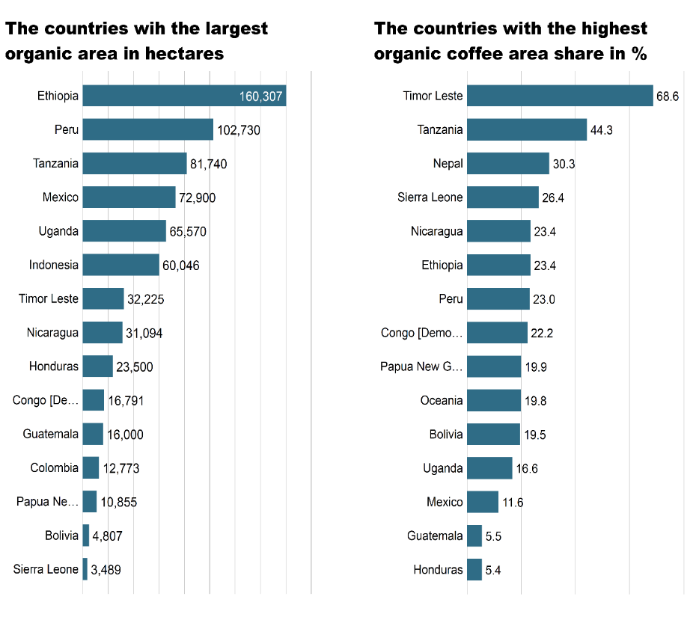
World: Countries with the largest organic coffee area and highest organic coffee area share 2019

Slide 49
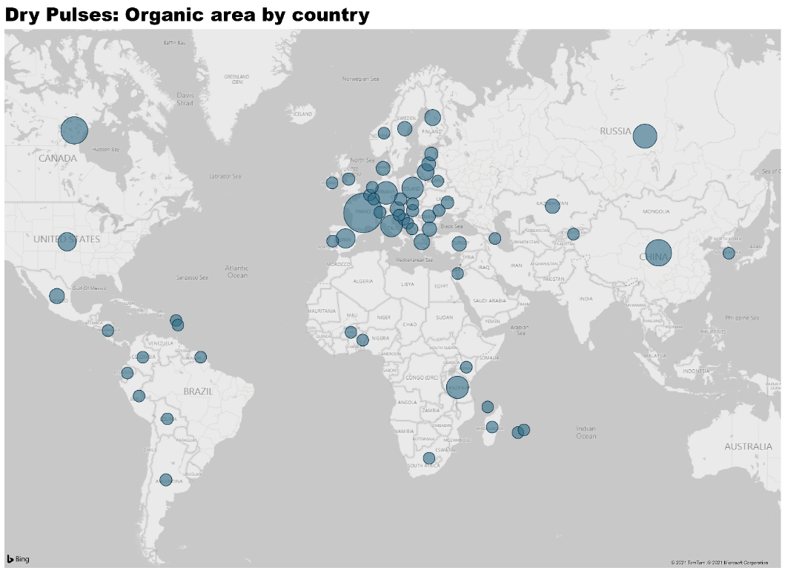
World: Organic dry pulses: Global distribution 2019

Slide 50

World: Use of organic dry pulses area 2019

Slide 51
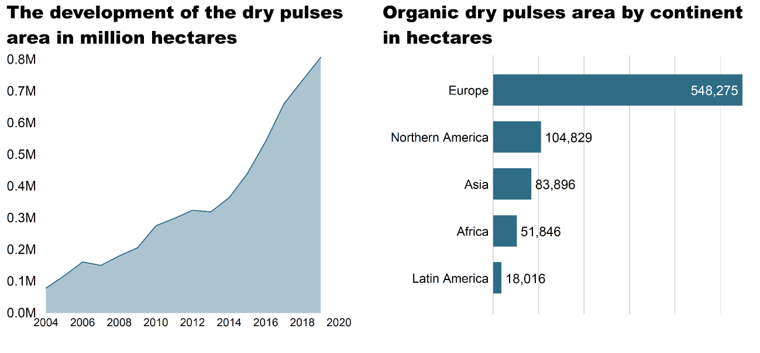
World: Development of the organic dry pulses area and area by continent 2019

Slide 52

World: Countries with the largest dry pulses area and highest organic dry pulses area share 2019

Slide 53
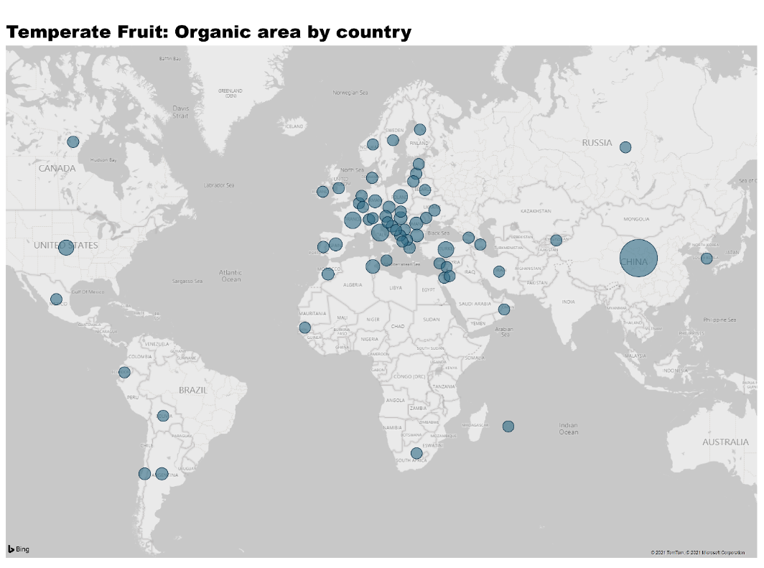
World: Organic temperate fruit: Global distribution 2019

Slide 54

World: Use of the organic temperate fruit area 2019

Slide 55
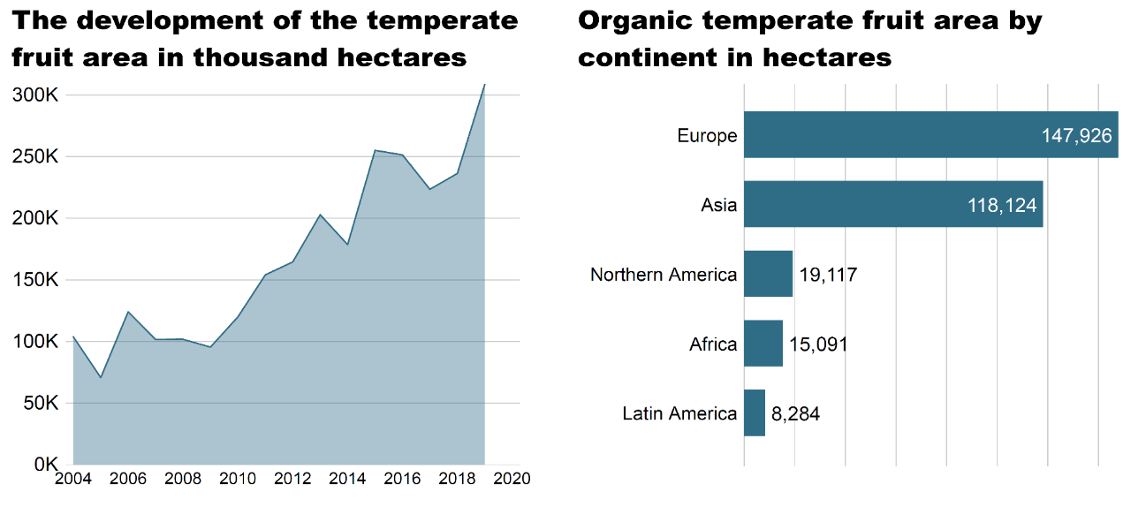
World: Development of the organic temperate fruit area and area by continent 2019

Slide 56

World: Countries with the largest organic temperate fruit area and highest organic temperate fruit area share 2019

Slide 57
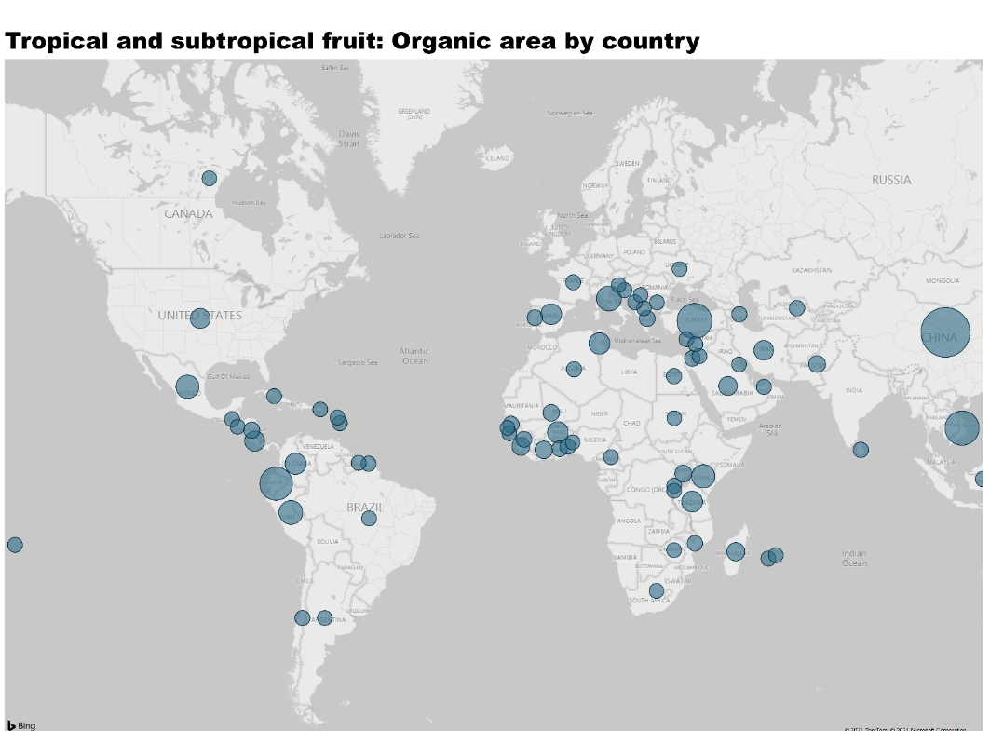
World: Organic tropical and subtropical fruit: Global distribution 2019

Slide 58

World: Distribution of global organic tropical and subtropical area by crop 2019

Slide 59
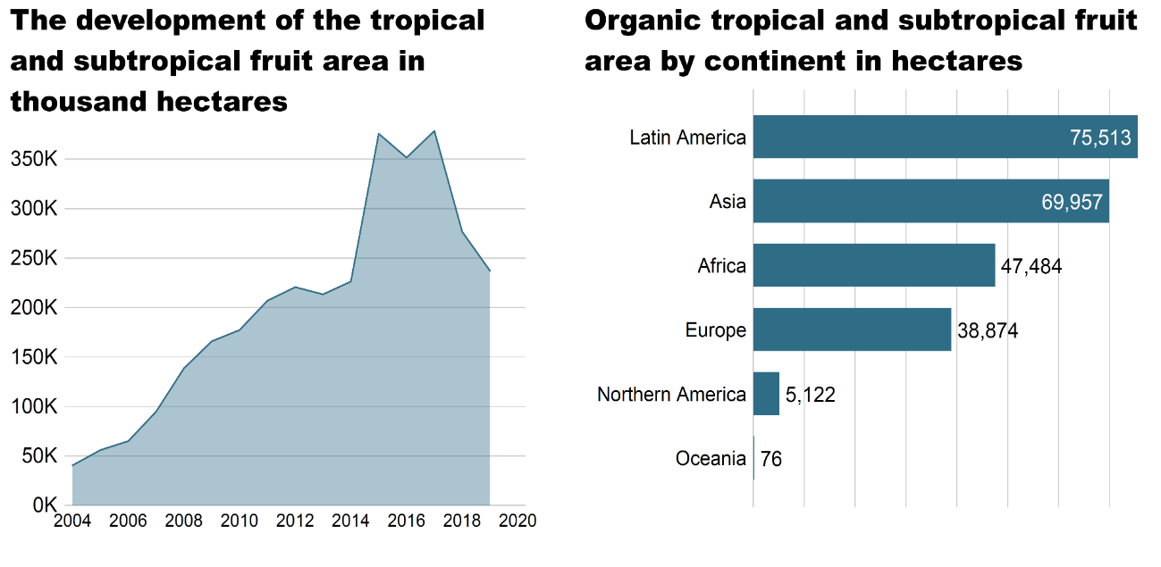
World: Development of the organic tropical and subtropical fruit area and area by continent 2019

Slide 60

World: Countries with the largest organic tropical and subtropical area and highest organic area share 2019

Slide 61
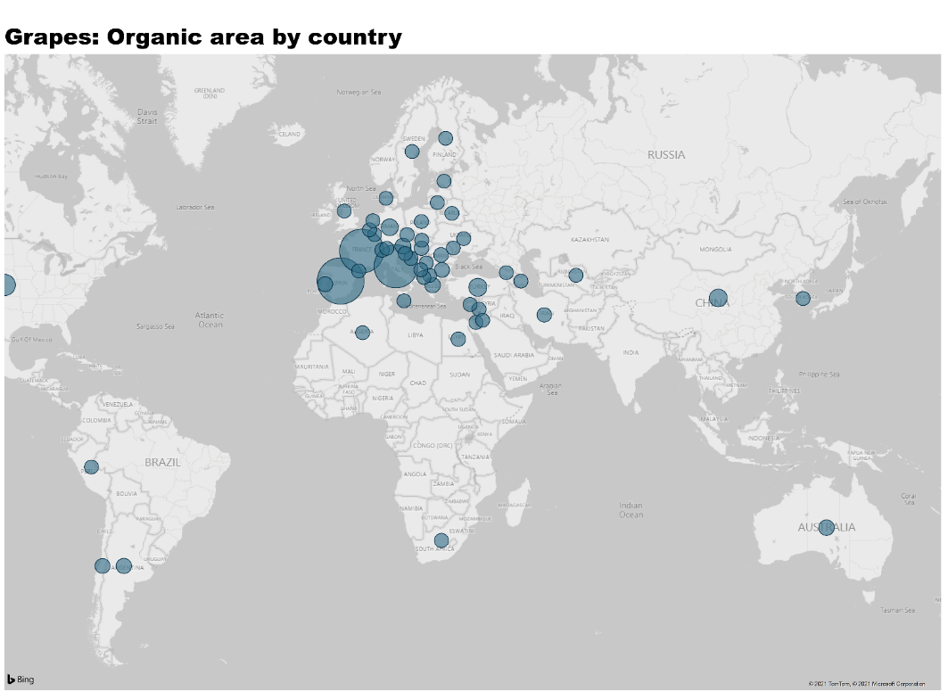
World: Organic grapes: Global distribution 2019

Slide 62
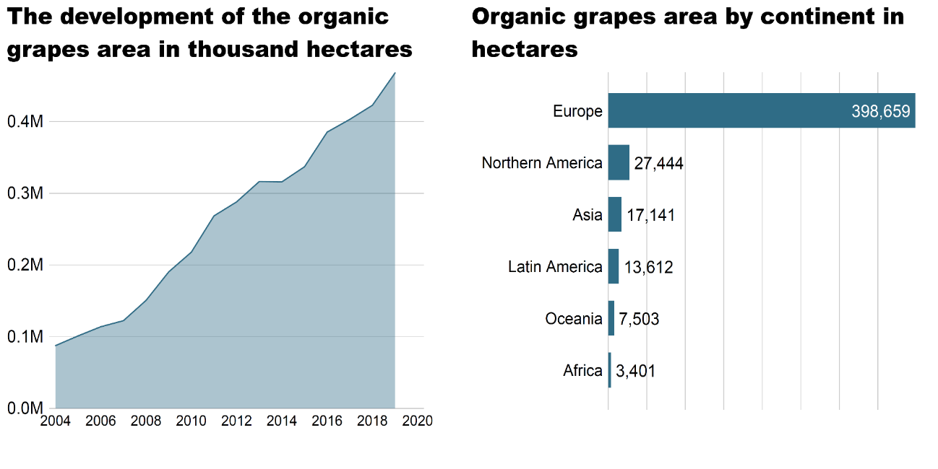
World: Development of the organic grapes area and area by continent 2019

Slide 63

World: Countries with the largest organic grapes area and highest organic grapes area share 2019

Slide 64
Spain: Development of the organic grape area
2000-2019 (including in-conversion areas)

Slide 65
Italy: Development of the organic grape area 2000-2019 (including in-conversion areas)

Slide 66
France: Development of the organic grape area 2000-2019 (including in-conversion areas)

Slide 67
Germany: Development of the organic grape area 2003-2019 (including in-conversion areas)

Slide 68
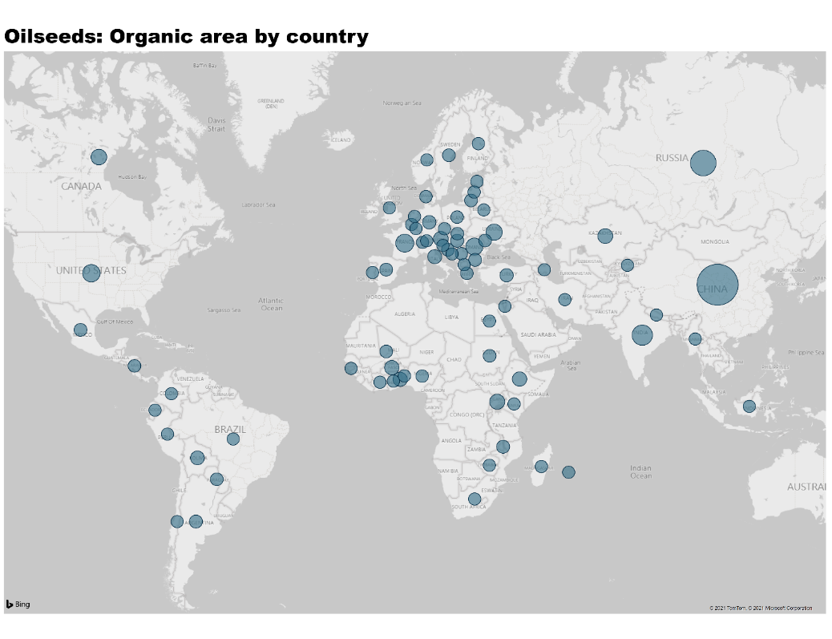
World: Organic oilseeds: Global distribution 2019

Slide 69
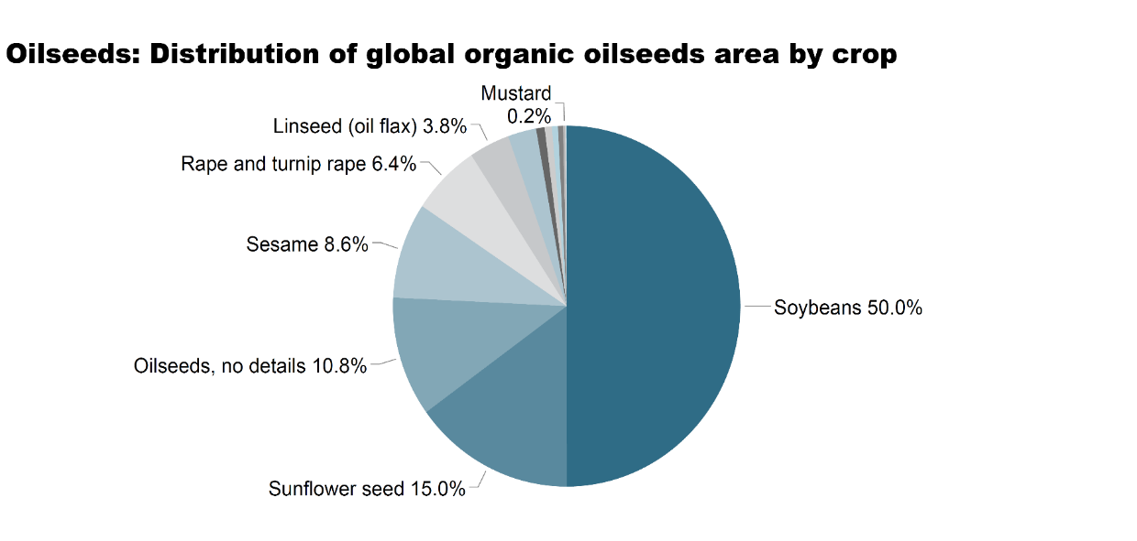
World: Distribution of the global organic oilseeds area by oilseed type 2019

Slide 70
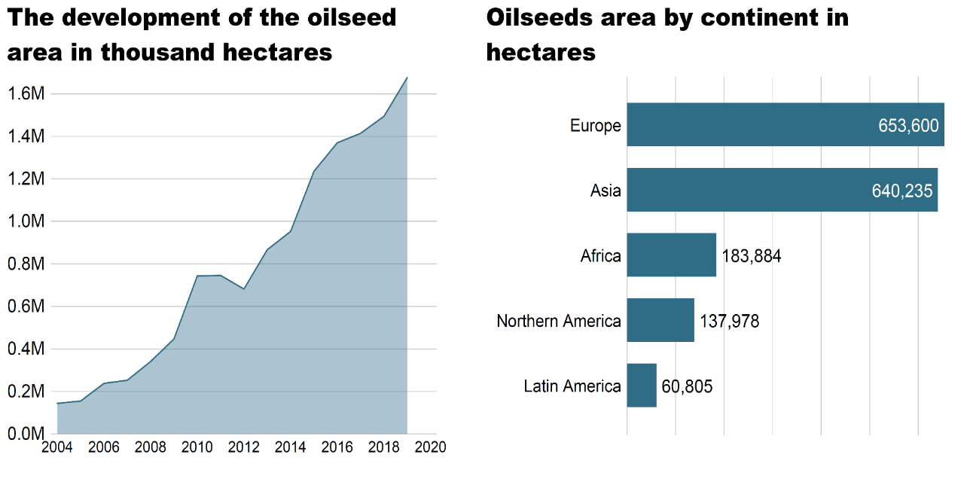
World: Development of the organic oilseeds area and area by continent 2019

Slide 71

World: Countries with the largest organic oilseeds area and highest organic oilseeds area share 2019

Slide 72
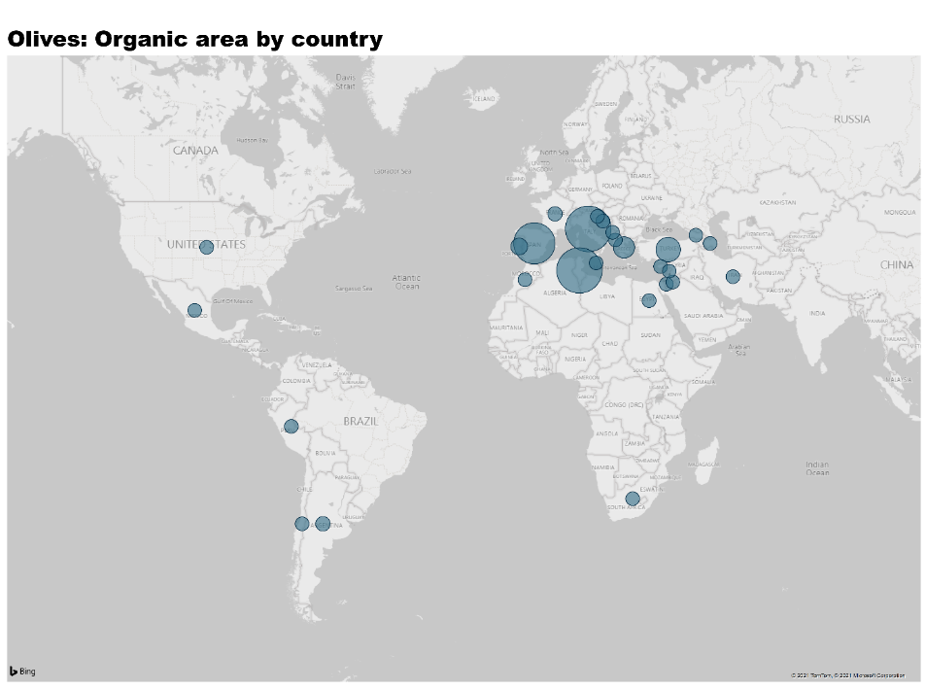
World: Organic olives: Global distribution 2019

Slide 73
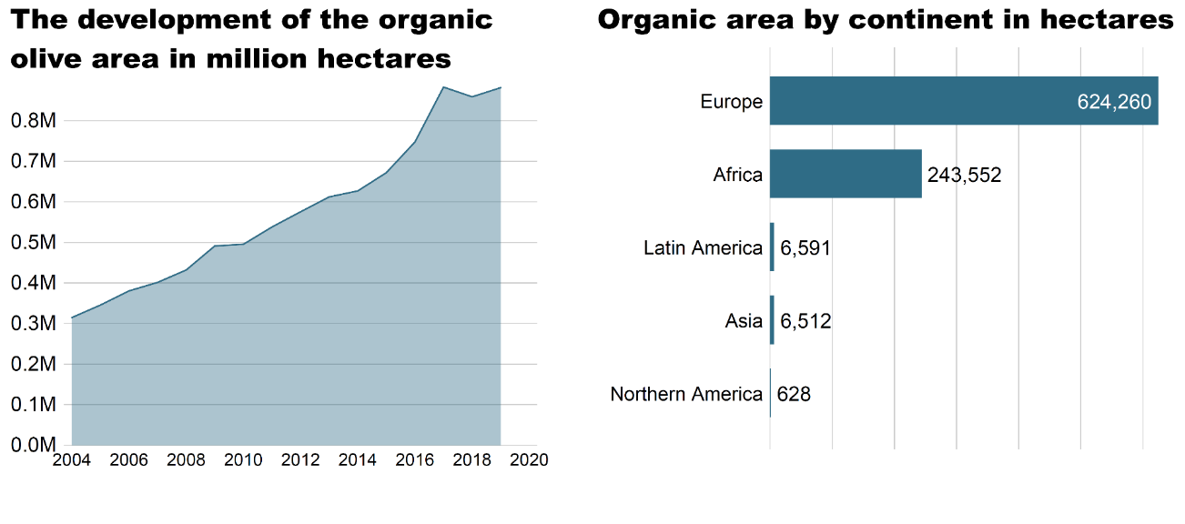
World: Development of the organic olives area and area by continent 2019

Slide 74

World: Countries with the largest organic olives area and highest organic olives area share 2019

Slide 75
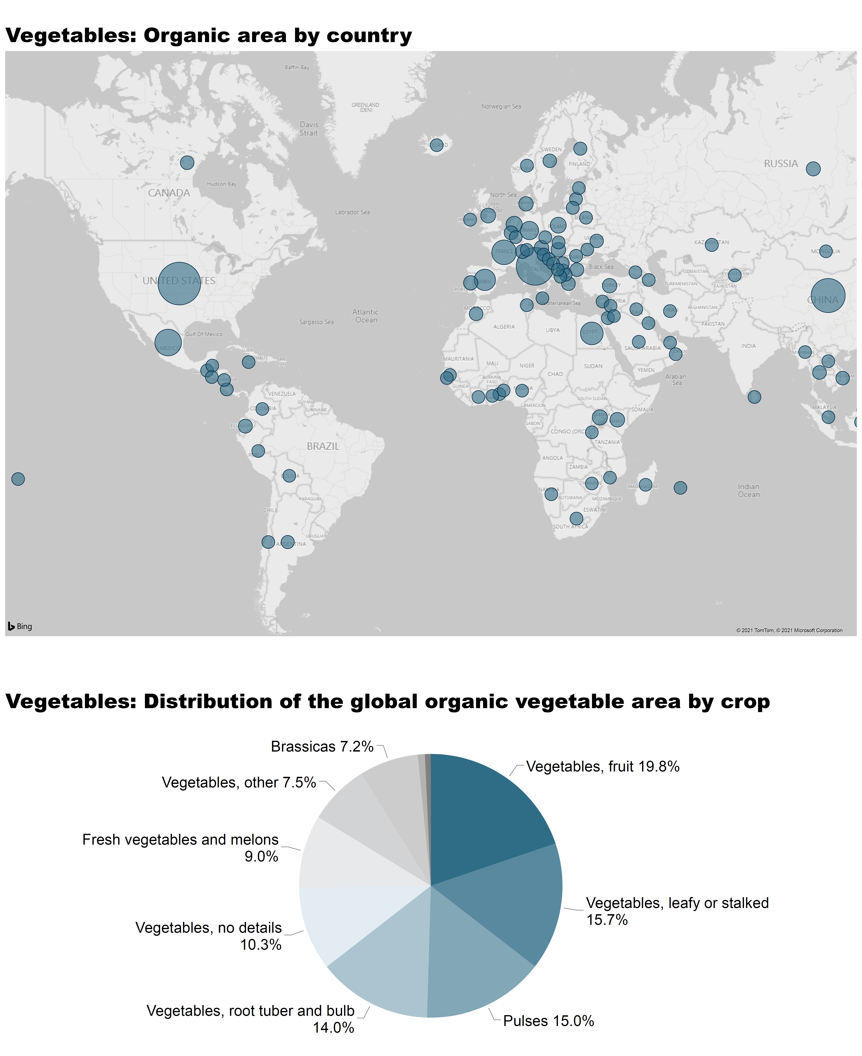
World: Organic vegetables: Global distribution 2019

Slide 76
World: Distribution of the global organic vegetable area by crop 2019

Slide 77
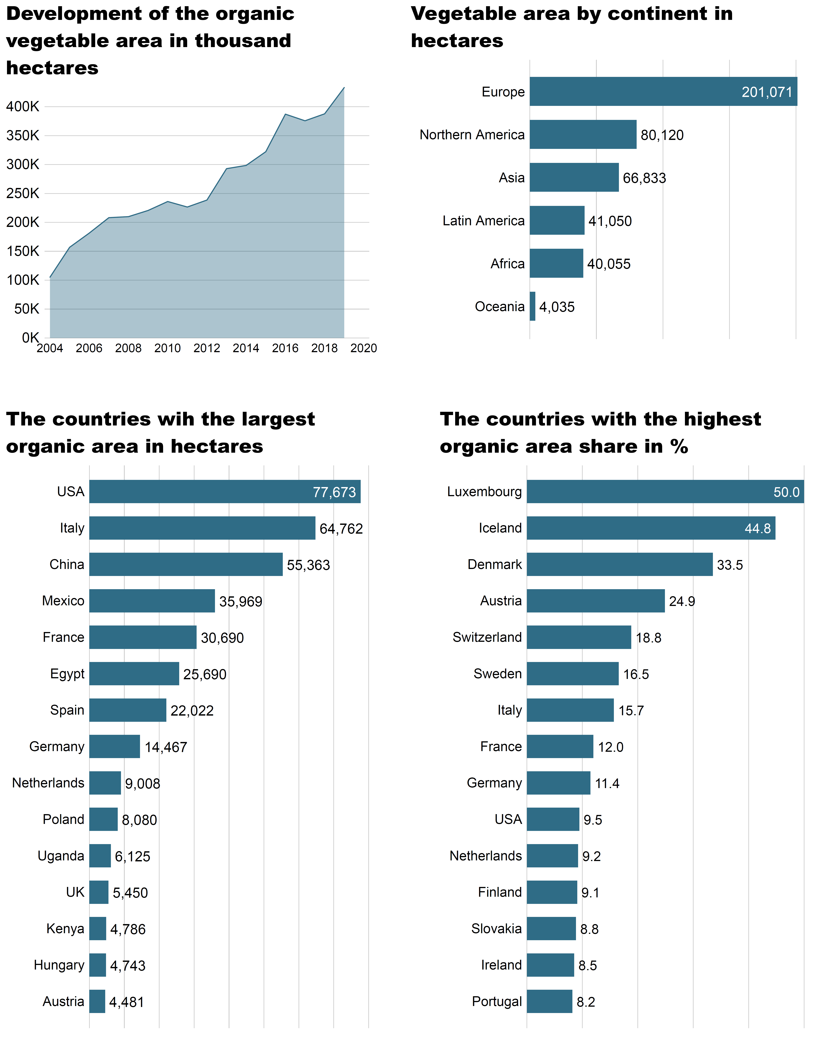
World: Development of the organic vegetable area and area by continent 2019

Slide 78
World: Countries with the largest organic vegetable area and highest organic vegetable area share 2019

Slide 79
More information
More information (PDF, data sources, graphs) at http://www.organic-world.net/yearbook/yearbook-2021.html
Contact
Helga Willer
Research Institute of Organic Agriculture (FiBL)
5070 Frick
Switzerland
helga.willer@fibl.org

Slide 80
Disclaimer
All of the results contained in this slide show have been compiled by the Research Institute of Organic Agriculture (FiBL). However, the possibility of mistakes cannot be ruled out entirely. Therefore, FIBL is not subject to any obligation and makes no guarantees whatsoever regarding any of the statements or results in this work; neither does FiBL accept responsibility or liability for any possible mistakes, nor for any consequences of actions taken by readers based on statements or advice contained therein.
This document has been produced with the support of the Swiss State Secretariat for Economic Affairs (SECO), the International Trade Centre (ITC), the Sustainability Fund of Coop Switzerland, NürnbergMesse, IFOAM – Organics International. The views expressed herein can in no way be taken to reflect the official opinions of SECO, ITC, Coop, NürnbergMesse or IFOAM – Organics International.

