Slide 1
Organic Agriculture Worldwide:
Key results from the FiBL survey on organic agriculture worldwide 2021
Part 1: Global data and survey background
Jan Trávníček,, Bernhard Schlatter, Claudia Meier nad Helga Willer
Research Institute of Organic Agriculture (FIBL), Frick, Switzerland
© FiBL 2021

Slide 2
Organic Agriculture Worldwide: Key results from the FiBL survey on organic agriculture worldwide 2021
Part 1: Global data and survey background
Data compiled by the Research Institute of Organic Agriculture (FiBL), Frick, Switzerland, based on national data sources and data from certifiers.
Data as published February 2021 in FiBL & IFOAM – Organics International (2021): The World of Organic Agriculture. Statistics and Emerging Trends 2021. Frick and Bonn
For updates, check www.organic-world.net
This presentation is available online at: https://www.organic-world.net/yearbook/yearbook-2021/presentations.html
Texts and graphs: Helga Willer, Bernhard Schlatter, Jan Trávníček, Laura Kemper and Julia Lernoud, Research Institute of Organic Agriculture (FiBL), Frick, Switzerland
Contact: Helga Willer, helga.willer@fibl.org, Research Institute of Organic Agriculture (FiBL), Frick, Switzerland
© Research Institute of Organic Agriculture (FiBL), Frick, Switzerland, February 2021
Notes:
FiBL
17.02.2021
www.fibl.org
2

Slide 3
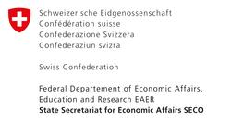

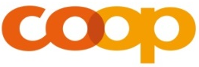
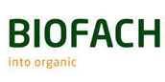
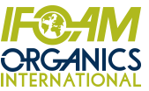
Acknowledgements*
The Swiss State Secretariat of
Economic Affairs (SECO), Berne
International Trade Centre (ITC)
Sustainability Fund of Coop Switzerland
Nürnberg Messe, the organizers of the
BioFach World Organic Trade Fair
IFOAM – Organics International
200 experts from all parts of the world contributed to the FiBL survey 2021
* See also disclaimer on last page of this slide show

Slide 4
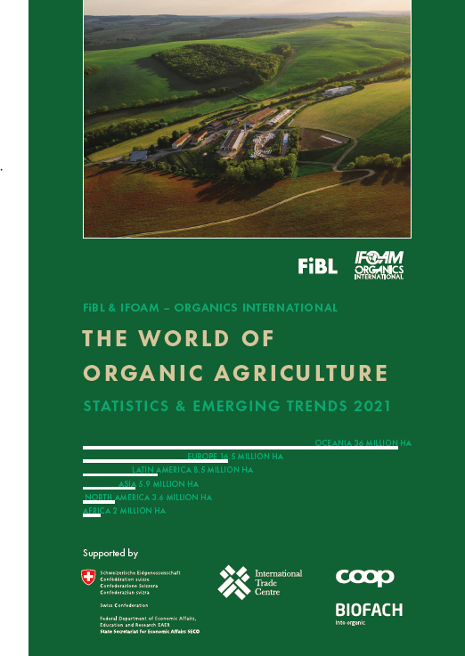
The World of Organic Agriculture 2021
The 22nd edition of “The World of Organic Agriculture”, was published by FiBL and IFOAM in February 2021.*
Contents:
      Results of the survey on organic agriculture worldwide.
      Numerous graphs, tables, maps and infographics.
      Organic agriculture in the regions and reports from Australia, Canada, the Pacific Islands, and The United States of America.
      Chapters on the global market, standards & legislations, PGS, policy support, the European market, etc.
      The book can be ordered via IFOAM.bio and shop.FiBL.org.
* Willer, Helga, Jan Trávníček, Claudia Meier and Bernhard Schlatter (Eds.) (2021): The World of Organic Agriculture. Statistics and Emerging Trends 2021. Research Institute of Organic Agriculture FiBL, Frick, and IFOAM – Organics International, Bonn

Slide 5
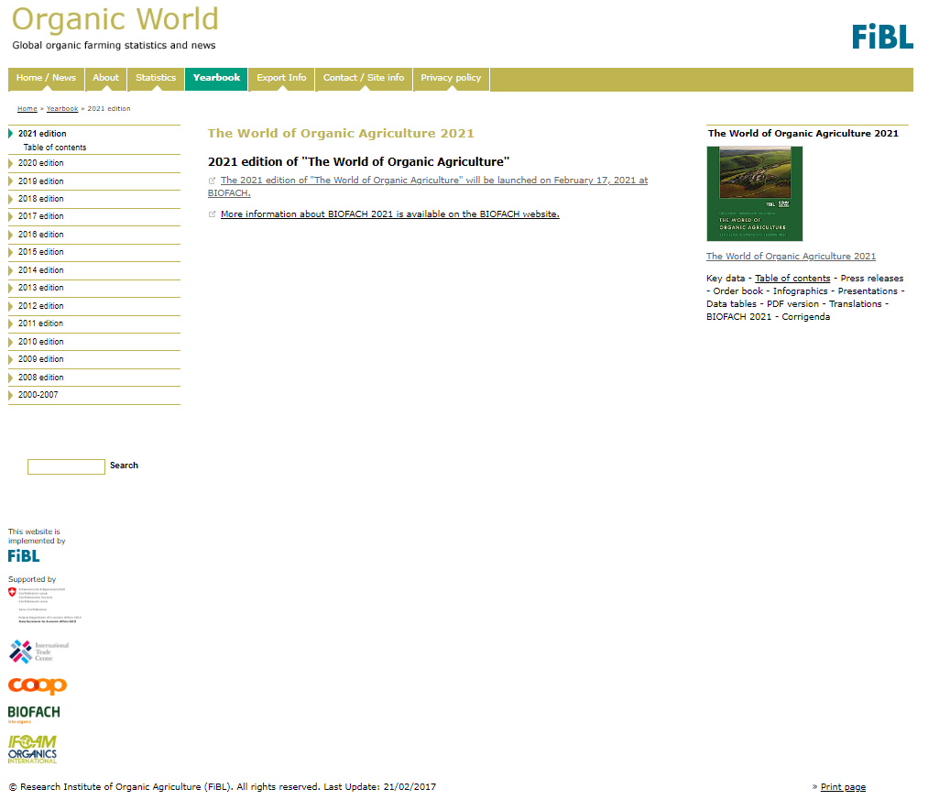
Website www.organic-world.net
Detailed statistics
in excel format
Graphs & Maps
Data revisions
News and
background
information

Slide 6
About this presentation
There are 3 presentations summarizing the key results of the FiBL survey on organic agriculture worldwide 2021(data 2019). Apart from the global data, key results on crop and on regional data are presented.
More information is available at www.organic-world.net
The following three presentations are available at https://www.organic-world.net/yearbook/yearbook-2021/presentations.html:
  Part 1: Global data 2019 and survey background
  Part 2: Land use and key crops in organic agriculture 2019
  Part 3: Organic agriculture in the regions 2019

Slide 7
The 22nd survey on organic agriculture world-wide
The 22nd survey on organic agriculture worldwide was carried out by the Research Institute of Organic Agriculture FiBL in cooperation with partners from all around the world. The results were published jointly by FiBL and IFOAM – Organics International.
The survey was carried out between July 2020 and February 2021.
Data were received from 187 countries.
Updated data on area and producers were available for 142 countries.
Data was provided by over 200 country experts (representatives from NGOs, certification bodies, governments, researchers).
The following data was collected: area data (including land use and crop details); producers, other operator types; domestic market values; export and import data; and livestock data (animal heads and production in metric tons);
The results are published in the yearbook “The World of Organic Agriculture 2021” and at www.organic-world.net.

Slide 8
Countries covered by the survey on organic agriculture 2019
World: Organic agricultural land (including in-conversion areas) and regions’ shares of the global organic agricultural land 2019
Region | Organic agricultural land [hectares] | Regions’ shares of the global organic agricultural land
Africa | 2’030’830 | 2.8%
Asia | 5’911’622 | 8.2%
Europe | 16’528’677 | 22.9%
Latin America | 8’292’139 | 11.5%
Northern America | 3’647’623 | 5.0%
Oceania | 35’881’053 | 49.6%
World* | 72’285’656 | 100.0%
Source: FiBL survey 2021. Note: Agricultural land includes in-conversion areas and excludes wild collection, aquaculture, forest, and non-agricultural grazing areas.
*Includes correction value for French overseas departments.

Slide 9
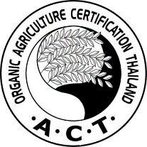
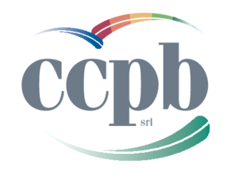

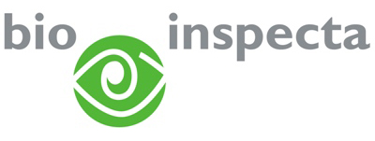

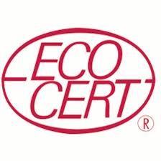
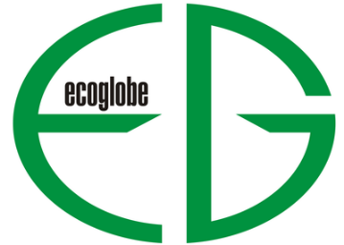

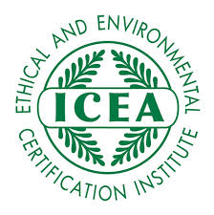
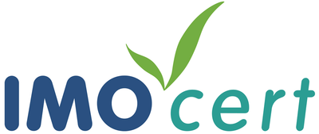
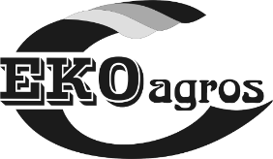
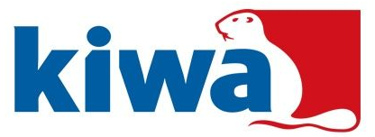

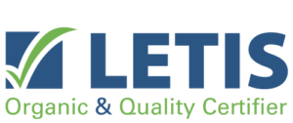
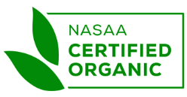
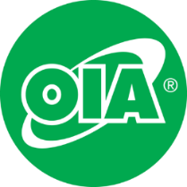
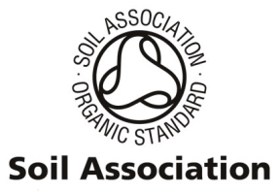

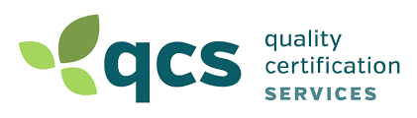
International certifiers that provided data for several countries

Slide 10
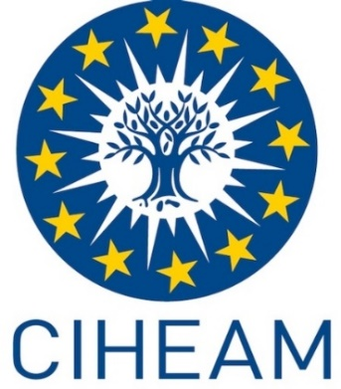
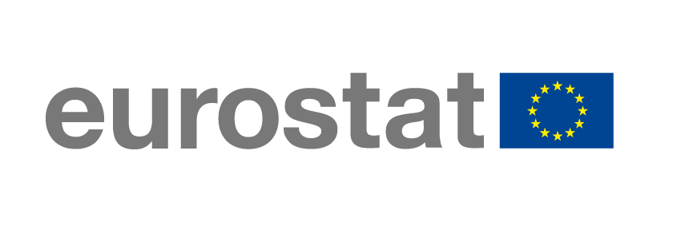
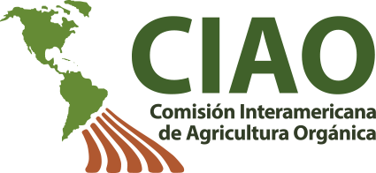
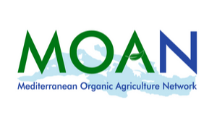
Networks, transnational data collection efforts

Slide 11
General notes on the data
Data sources: For data sources see annex of The World of Organic Agriculture 2021 or www.organic-world.net/statistics-data-sources.html
Countries: For countries and territories, the FAO country list is used. Where the designation "country" appears in this report, it covers countries or territories. For the countries’ grouping by region, the Standard Country and Area Classifications as defined by the United Nations Statistics Division, is used in most cases.
Term organic: In the tables, the term organic refers to the fully converted and in-conversion areas.
Organic share: In some cases, the calculation of the organic share of the total agricultural land or that of individual crops, based on FAOSTAT and in some cases the Eurostat data, might differ from the organic shares obtained from ministries or local experts.
Producers: Some countries report the number of smallholders while others only report the number of companies, projects, or grower groups, which may each comprise a number of producers. This applies in particular to many African countries. The number of producers is, therefore, probably higher than the number communicated in this report.
Data revisions: Should data revisions and correction become necessary these are communicated at the data revision pages of Organic-World.net: http://www.organic-world.net/statistics/statistics-data-revisions.html?L=2.

Slide 12
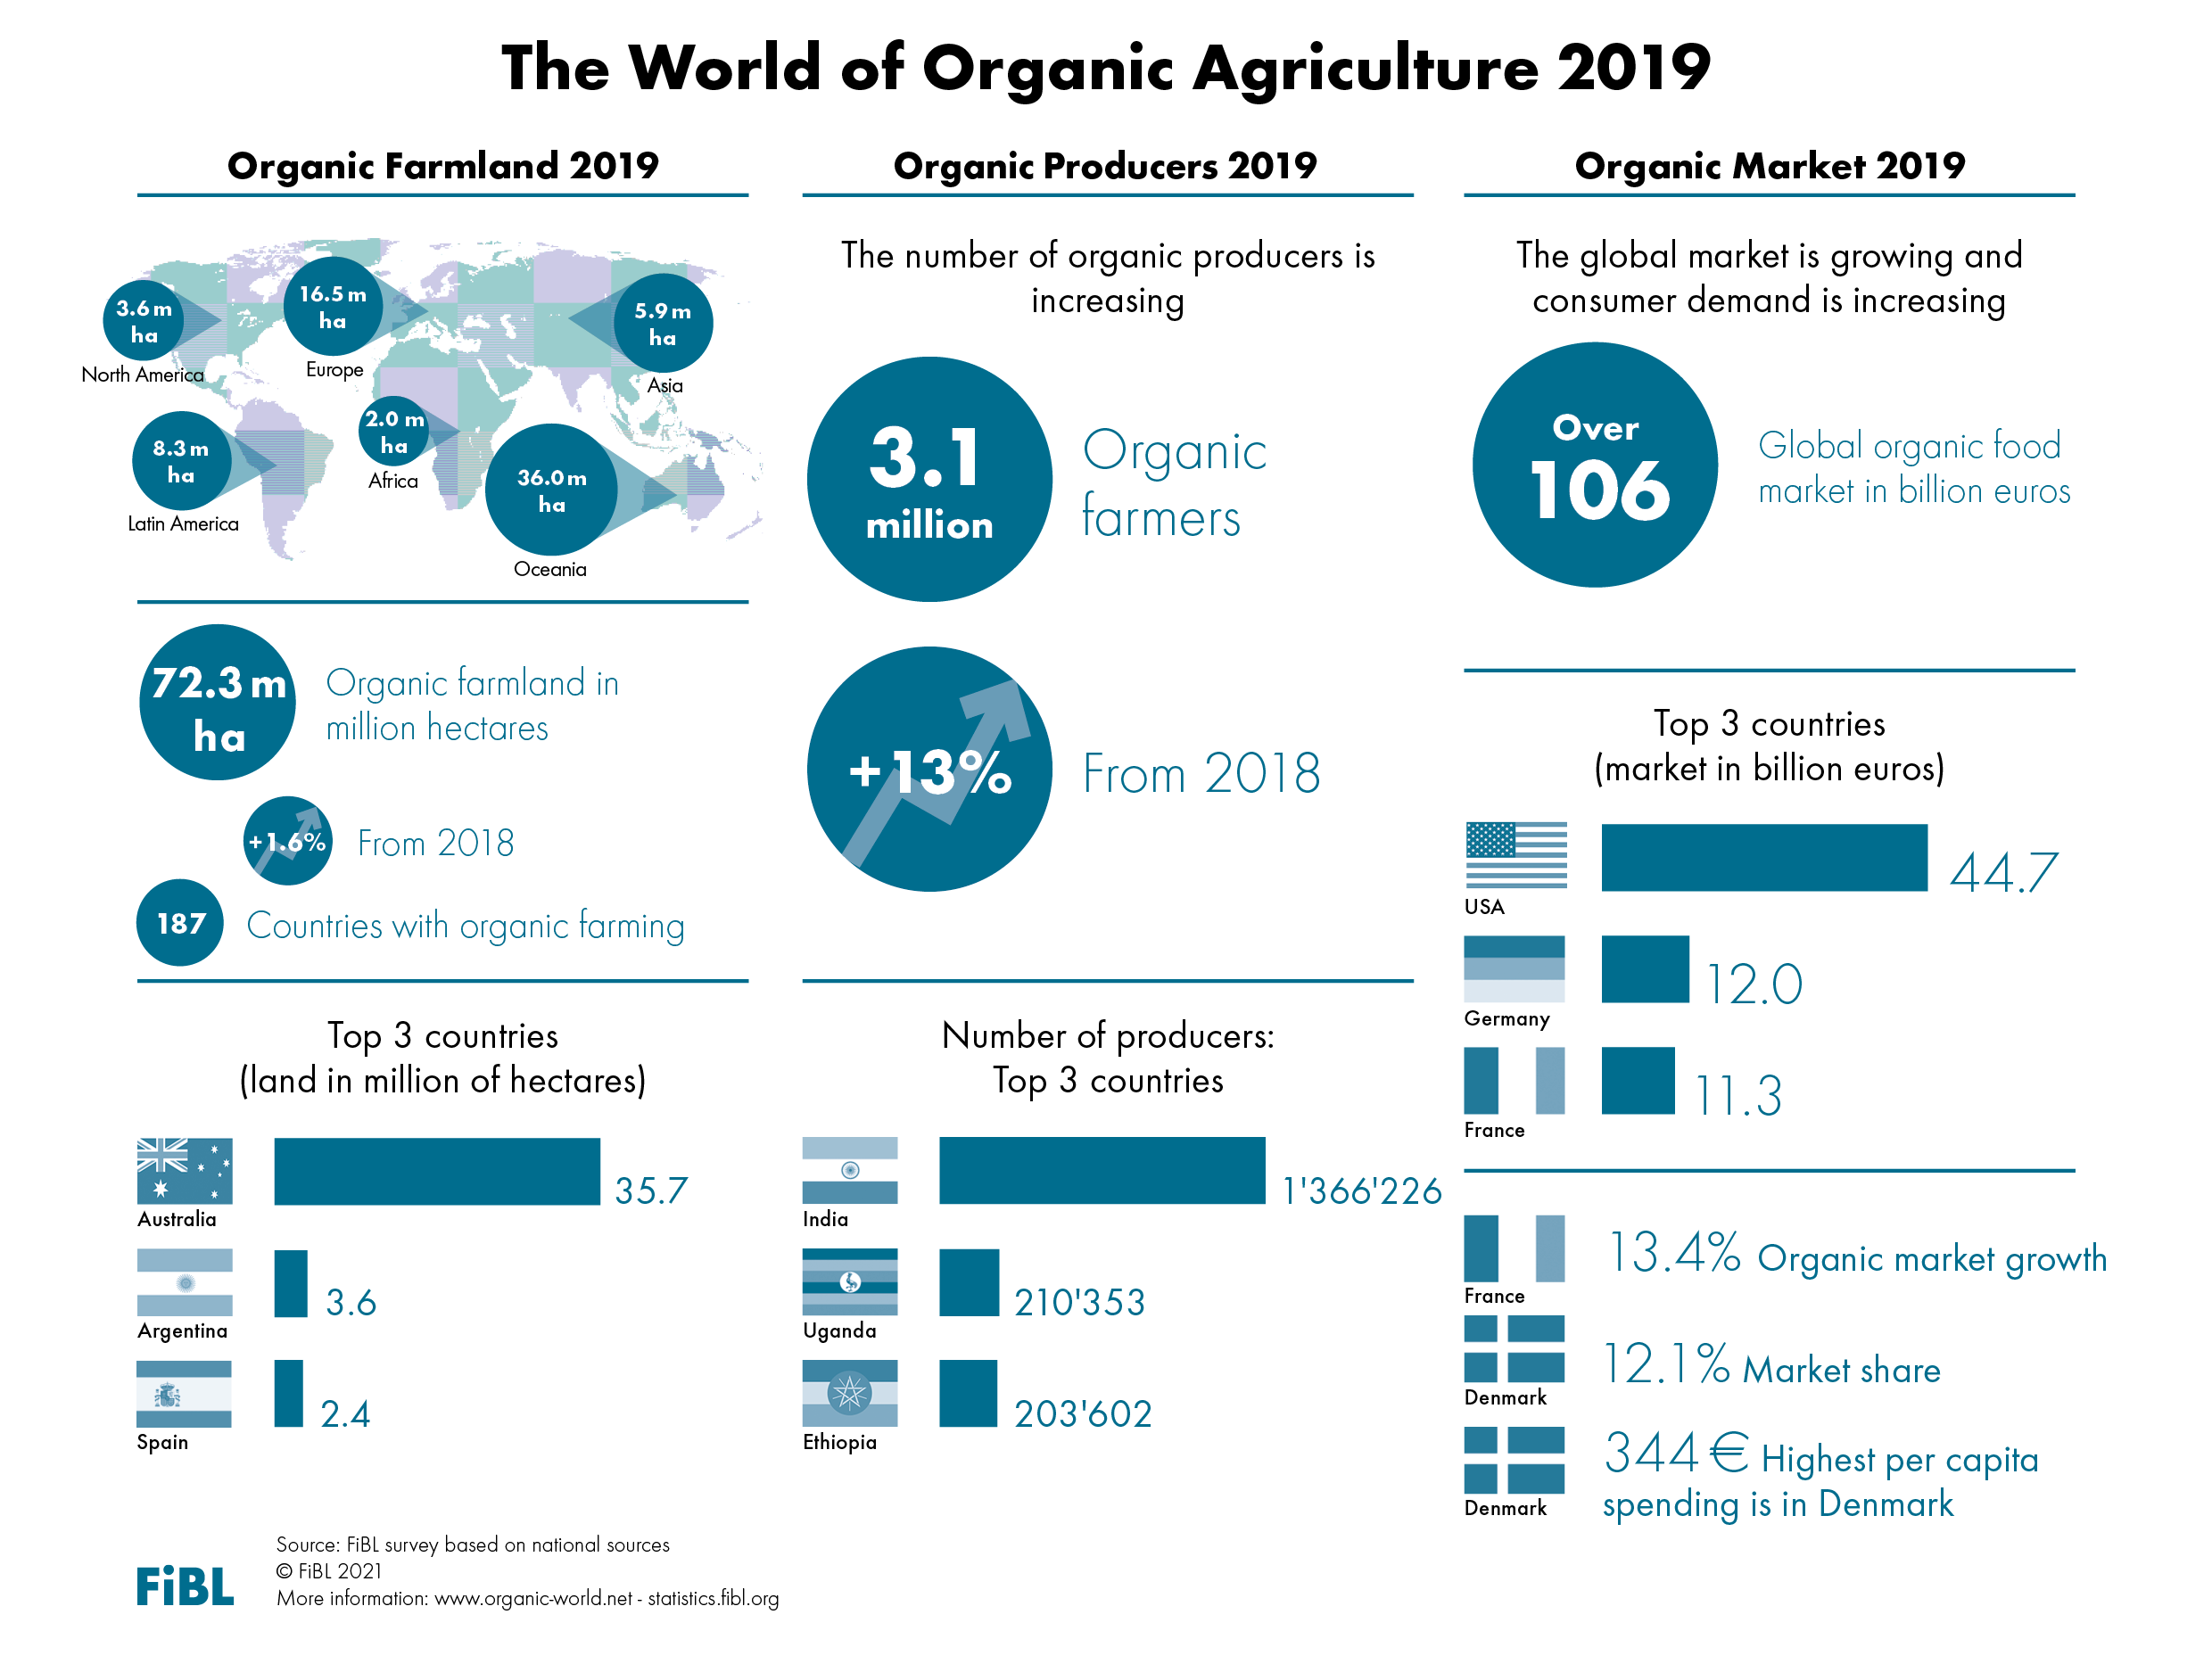

Slide 13
Key data/indicators on organic agriculture worldwide 2019
187 countries have data on organic agriculture.
72.3 million hectares of agricultural land are organic (including in-conversion areas).
16 countries have ten percent organic agricultural land or more, and 15 countries have between 5 and 10 percent organic agricultural land.
There are almost 35 million hectares of further organic non-agricultural areas.
3.1 million producers were reported.
Global organic market reached over106 billion euros.

Slide 14
World: Distribution of organic areas 2019
Agricultural land (72.3 million hectares in 2019)
  Cropland
    Arable land (cereals, green fodders, oilseeds, etc.)
    Permanent crops (olives, nuts, coffee, etc.)
    Cropland, no details (arable land and permanent crops with no further details)
    Permanent grassland
    Other agricultural land
Non-agricultural areas (34.8 million hectares in 2019)
    Wild collection/Bee keeping (34.8 million hectares)
    Forest
    Aquaculture
    Grazing areas on non-agricultural land

Slide 15
World: Organic agricultural land by region 2019
Currently 72.3 million hectares are under organic agricultural management (end of 2019 for most data).
The distribution of the organic agricultural land is as follows:
  Oceania (35.9 million hectares);
  Europe (16.5 million hectares);
  Latin America (8.3 million hectares);
  Asia (5.9 million hectares);
  North America (3.6 million hectares);
  Africa (2.0 million hectares).
Oceania has half of the global organic agricultural land. Europe, a region that has had a very constant growth of organic land over the years, has over 23 percent of the world’s organic agricultural land followed by Latin America with 12 percent.
Apart from the organic agricultural land, there are further organic areas such as wild collection areas. These areas constitute more than 34.8 million hectares.
Source: FiBL survey 2021

Slide 16
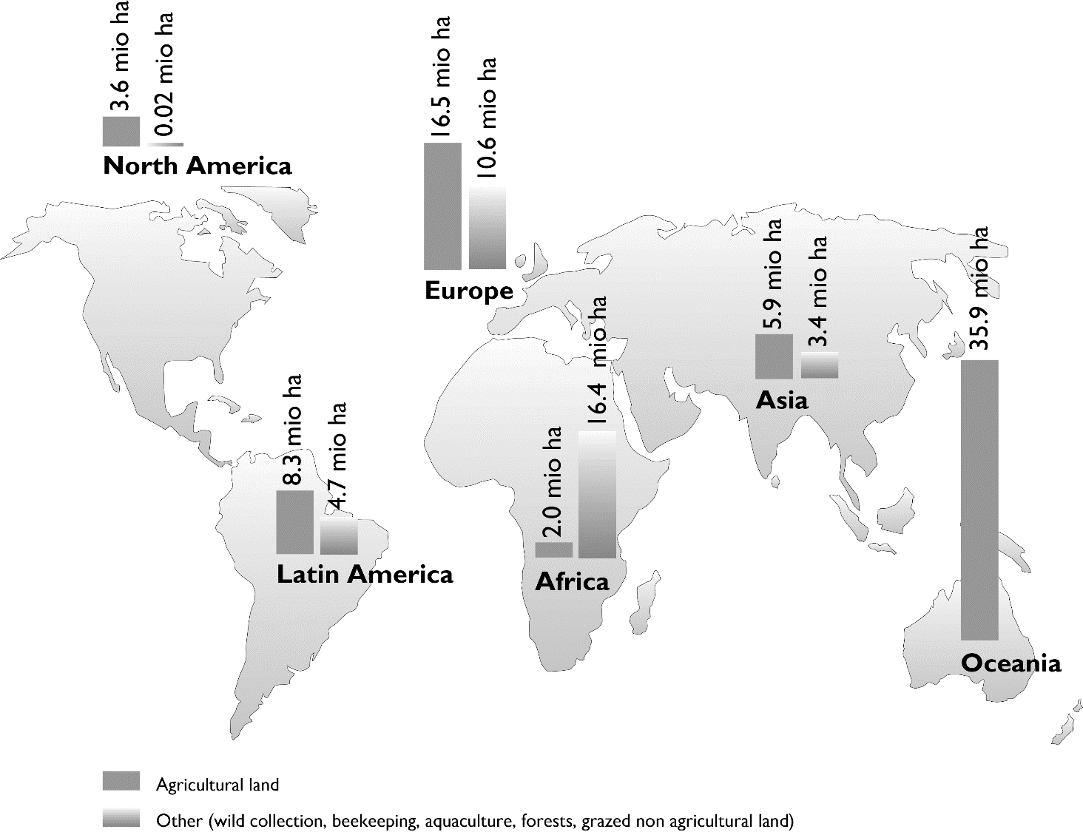
World: Organic agricultural land and other organic areas 2019
Source: FiBL survey 2021

Slide 17



ORGANIC FARMLAND 2019
World
72.3
million
ha
Australia 35.69
million
ha
1.5 % of the world’s farmland is organic
+555 %
since 1999
In Oceania there were 35.9 Mio ha, in Europe 16.5 Mio ha, and in Latin America 8.3 Mio ha.
The ten countries with the largest organic agricultural areas represent 78% of the world’s organic agricultural land.
16 countries have 10% or more of their agricultural land under organic management.
In 2019, over 1.1 million hectares more were reported compared with 2018.
Percentage
Distribution of organic
agricultural land by region 2019
The five countries with
the largest areas of organic agricultural land 2019
Top 5 countries with more than
10 percent of organic agricultural land 2019
Growth of the organic
agricultural land 1999-2019
Source: FiBL survey 2021 www.organic-world.net – statistics.fibl.org

Slide 18
Distribution of organic agricultural land by region 2013

Slide 19
World: The countries with the most organic agricultural land 2019
Australia is the country with the most organic agricultural land, 97 percent of which is estimated to be extensive grazing area.
Argentina is second, followed by Spain in third place.
The ten countries with the most organically managed agricultural land have a combined total of 56.5 million hectares and constitute three-quarters of the world’s organic agricultural land.
Source: FiBL survey 2021

Slide 20
The ten countries with the largest organic agricultural land 2013

Slide 21
World: Share of organic land of total agricultural area 2019
1.5 percent of the global agricultural land is organic.
By region, the share is highest in Oceania (9.6 percent), followed by Europe with 3.3 percent and Latin America with 1.2 percent.
In the European Union, the share of organically managed land is 8.1 percent. In the other regions, the share of organically managed land is less than one percent.
Sixteeen countries have 10 percent organic land or more, and 15 countries have between 5 and 10 percent organic land.
However, almost 58 percent of the countries for which data are available have less than one percent organic agricultural land.
The country with the highest share is Liechtenstein (41.0 percent), followed by Austria (24.7 percent), and Sao Tome and Principe (24.9 percent).
Source: FiBL survey 2021

Slide 22
World: Shares of organic agricultural land by region 2019
World: Organic agricultural land (including in-conversion areas) and organic share of total agricultural land by region 2019
Region | Organic agri. land [ha] | Share of total agri. land
Africa | 2’030’830 | 0.2%
Asia | 5’911’622 | 0.4%
Europe | 16’528’677 | 3.3%
Latin America | 8’292’139 | 1.2%
North America | 3’647’623 | 0.8%
Oceania | 35’881’053 | 9.6%
World* | 72’285’656 | 1.5%
Source: FiBL survey 2021.
* Total includes correction value for French overseas departments.
Source: FiBL survey 2021

Slide 23
The eleven countries with the highest shares of organic agricultural land 2013

Slide 24
Distribution of the shares of organic agricultural land country 2013

Slide 25
World: Growth of the organic agricultural land 2019
Organic agriculture land increased by 1.6% (1.1 million hectares) between 2018 and 2019.
Many countries reported a significant increase, for instance, India (18.6 percent increase; over 0.36 million hectares more) and France (10.1 percent increase; almost 0.21 million hectares more). In addition, Ukraine (51.4 percent increase; almost 0.16 million hectares more) and Mexico (almost 0.12 million hectares more) reported significant increases.
Compared with 1999, when 11 million hectares were organic, organic agricultural land has increased more than six-fold.
Ninety countries experienced an increase in the area of their organic agricultural land, while a decrease was reported in 48 countries. In 41 countries, the organic agricultural area either did not change, or no new data was received.
Source: FiBL survey 2021

Slide 26
World: Growth of the organic agricultural land by region
World: Organic agricultural land (including in-conversion areas) by region: growth 2018-2019 and 10 years growth
Region | Organic agri. land 2018 [ha] | Organic agri. land 2019 [ha] | 1 year growth [ha] | 1 year growth [%] | 10 years growth [ha] | 10 years growth [%]
Africa | 1’854’646 | 2’030’830 | 176’184 | 9.5% | 958’706 | 89.4%
Asia | 6’364’778 | 5’911’622 | -453’156 | -7.1% | 3’453’707 | 140.5%
Europe | 15’607’636 | 16’528’677 | 921’042 | 5.9% | 6’499’896 | 64.8%
Latin America | 8’008’581 | 8’292’139 | 283’559 | 3.5% | 752’496 | 10.0%
North America | 3’342’849 | 3’647’623 | 304’774 | 9.1% | 1’174’944 | 47.5%
Oceania | 35’999’373 | 35’881’053 | -118’320 | -0.3% | 23’735’998 | 195.4%
World* | 71’172’783 | 72’285’656 | 1’112’873 | 1.6% | 36’571’729 | 102.4%
Source: FiBL survey 2021, based on data from government bodies, the private sector, and certifiers. For detailed data sources see annex, page 317
* Total includes correction value for French Overseas Departments.
Source: FiBL survey 2021

Slide 27
Growth of the organic agricultural land 1999-2013

Slide 28
Growth of the organic agricultural land by continent 2005-2013

Slide 29
World: Growth of organic agricultural land by region 2019

Slide 30
The ten countries with highest growth of organic land 2013

Slide 31
World: Further organic areas
Apart from the organic agricultural land there are further organic areas; the largest part of these are wild collection areas and areas for beekeeping.
Further areas are aquaculture, forest and grazing areas on non-agricultural land.
It should be noted, that many countries do not report these areas, as they only communicate the agricultural land.
The total area for these areas was more than 34.8 million hectares.
In total, 107.6 million hectares – agricultural land and other areas – were organic in 2019.
Source: FiBL survey 2021

Slide 32
World: Wild collection and beekeeping areas
Over 34.8 million hectares of wild collection and beekeeping areas were reported for 2019.
The wild collection / beekeeping areas are distributed over four regions: Europe, Africa, Asia, and Latin America, reflecting quite a different pattern than that for agricultural land.
The collection of wild harvested crops is defined in the IFOAM Basic Standards (IFOAM 2014), and wild collection activities are regulated by organic laws.
Source: FiBL survey 2021

Slide 33
Distribution of organic wild collection areas by region 2013

Slide 34
World: Organic wild collection 2019: Top 10 countries

Slide 35
World: Organic producers 2019
For the current survey, a total of 3.1 million organic producers was reported,
According to the data obtained, over 91 percent of the producers are located in Asia, Africa, and Europe.
The country with the most producers is India (1’366’226), followed by Uganda (210’353) and Ethiopia (203’602).
There was an increase of more than 353’000 producers compared to 2018, or 12.7 percent.
It should be noted that not all certifiers reported the number of producers; the number is probably higher than 3.1 million.
Source: FiBL survey 2021

Slide 36
ORGANIC PRODUCERS 2019
World
3.1 million producers
51%
in Asia
+1ꞌ432% since 1999
The country with the most organic producers is India, followed by Uganda and Ethiopia.
More than 91% of the producers are in Asia, Africa, and Europe.
There has been an increase in the number of producers by 1'564‚524 or over 100% over the past decade.
The five countries with the most
organic producers 2019
Distribution of organic producers
by region 2019
Development of the number of organic
producers 1999-2019
Source: FiBL survey 2021 www.organic-world.net – statistics.fibl.org
Notes:
Development doesn´t match 2017 numbers

Slide 37
The ten countries with the largest numbers of organic producers 2013
Notes:
What data year should be mentioned?

Slide 38
Organic producers by region 2013

Slide 39
Development of the number of organic producers 1999-2013
Notes:
Numbers doesn´t match with the database

Slide 40
World: The global market for organic food and beverages 2019
In 2019, the global market for certified organic food and drink was reached over106 billion euros.
The turnover with organic products has increased more than eight fold since 2000.
Almost ninety percent of the organic product revenues is made in the North America and Europe.
In 2019, the largest market by far was the United States with 44.7 billion euros of organic food sales, followed by Germany with 12.0 billion euros and France with 11.3 billion euros.
The highest annual per capita consumption was in Denmark (344 euros) and Switzerland (338 euros).
Denmark, Switzerland, and Austria have the highest share of organic food sales. In 2019 total food market value was not available for most of the countries, and it was therefore not possible to calculate the organic share for most countries.
Source: FiBL survey 2021

Slide 41
ORGANIC RETAIL SALES 2019
World
over
106 billion €
North America
48 billion €
344 €
are spent per person in Denmark,
338 € in Switzerland
12.1 %
of the
food market
in Denmark is organic
The largest single market is the USA (44.7 billion €) followed by the EU (41.4 billion €) and China. By region, North America has the lead (48.2 billion €), followed by Europe (45 billion €) and Asia.
The countries with the largest markets for organic food are the United States (44.7 billion €), Germany (11.9 billion €), France (11.3 billion €) and China (8.5 billion €).
Denmark and Switzerland have the highest per capita consumption worldwide, followed by Luxembourg, Austria, and Sweden.
The highest organic share of the total market is in Denmark, followed by Switzerland, Austria, Luxembourg and Sweden.
Distribution of retail sales value
by country 2019
The five countries with the largest
markets for organic food 2019
The five countries with the highest
per capita consumption 2019
The five countries with
the highest organic shares of the total market 2019
Source: FiBL survey 2021 www.organic-world.net – statistics.fibl.org

Slide 42
World: Global market: Distribution of retail sales by single market 2019

Slide 43
World: Distribution of organic retail sales 2019

Slide 45
Growth of organic retail sales worldwide

Slide 46
United States of America: Growth of retail sales 2002-2019

Slide 47
Germany: Growth of retail sales 2000-2019

Slide 48
France: Growth of retail sales 2000-2019

Slide 49
The ten countries with the largest per capita consumption for 2013
Notes:
Per capita not complete

Slide 50
World: Organic farming in the DAC countries 2019
Almost a quarter of the world’s organic agricultural land, 15.1 million hectares, is located in countries listed on the developing/transition countries and in emerging markets.* Almost half is located in Latin American countries (almost 6.1 million hectares), with Asia (5.8 million) and Africa (2.0 million) in second and third place.
2.7 million producers are in these countries.
*Countries listed in the List of Recipients of Official Development Assistance (ODA) of the Development Assistance Committee (DAC) of the Organization for Economic Cooperation and Development (OECD). The list is available at:
http://www.oecd.org/dac/financing-sustainable-development/development-finance-standards/DAC_List_ODA_Recipients2018to2020_flows_En.pdf
Source: FiBL survey 2021

Slide 51
World: DAC list: The top 10 countries with the largest areas of organic agricultural land 2019

Slide 52
World: DAC list: The top 10 countries with the highest shares of organic agricultural land 2019

Slide 53
More information
More information (PDF, data sources, graphs) at:
http://www.organic-world.net/yearbook/yearbook-2021.html
Contact
Helga Willer
Research Institute of Organic Agriculture (FiBL)
5070 Frick
Switzerland
helga.willer@fibl.org

Slide 54
Disclaimer
All of the results contained in this slide show have been compiled by the Research Institute of Organic Agriculture (FiBL). However, the possibility of mistakes cannot be ruled out entirely. Therefore, FIBL is not subject to any obligation and makes no guarantees whatsoever regarding any of the statements or results in this work; neither does FiBL accept responsibility or liability for any possible mistakes, nor for any consequences of actions taken by readers based on statements or advice contained therein.
This document has been produced with the support of the Swiss State Secretariat for Economic Affairs (SECO), the International Trade Centre (ITC), the Sustainability Fund of Coop Switzerland, NürnbergMesse, IFOAM – Organics International. The views expressed herein can in no way be taken to reflect the official opinions of SECO, ITC, Coop, NürnbergMesse or IFOAM – Organics International.

