Slide 1
Organic Agriculture Worldwide: Key results from the FiBL survey on organic agriculture worldwide 2021
Part 3: Organic agriculture in the regions 2019
Jan Trávníček, Bernhard Schlatter, Claudia Meier and Helga Willer
Research Institute of Organic Agriculture (FIBL), Frick, Switzerland
© FiBL 2021

Slide 2
Organic Agriculture Worldwide: Key results from the FiBL survey on organic agriculture worldwide 2021 Part 3: Organic agriculture in the regions 2021
Data compiled by the Research Institute of Organic Agriculture FiBL, Frick, Switzerland, based on national data sources and data from certifiers.
Data as published February 2021 in FiBL & IFOAM – Organics International (2021): The World of Organic Agriculture. Statistics and Emerging Trends 2021. Frick and Bonn
For updates check www.organic-world.net
This presentation is available online at: http://www.organic-world.net/yearbook/yearbook2021/slide-presentations.html
Texts and graphs: Jan Trávníček, Bernhard Schlatter, Claudia Meier and Helga Willer, Research Institute of Organic Agriculture, FiBL, Frick, Switzerland
Contact: Helga Willer, helga.willer@fibl.org, Research Institute of Organic Agriculture, FiBL, Frick, Switzerland
© Research Institute of Organic Agriculture (FiBL), Frick, Switzerland, February, 2021
Notes:
FiBL
17.02.2021
www.fibl.org
2

Slide 3
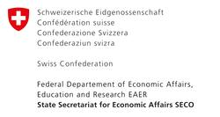
Acknowledgements*
The Swiss State Secretariat of Economic Affairs (SECO), Berne
International Trade Centre (ITC)
Sustainability Fund of Coop Switzerland
Nürnberg Messe, the organizers of the BioFach World Organic Trade Fair
IFOAM – Organics International
200 experts from all parts of the world contributed to the FiBL survey 2021
* See also disclaimer on last page of this slide show

Slide 4
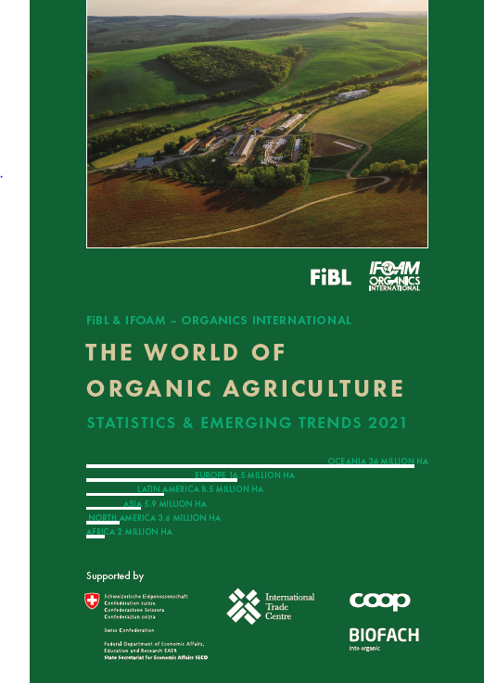
The World of Organic Agriculture 2021
The 22nd edition of “The World of Organic Agriculture”, was published by FiBL and IFOAM in February 2021.*
Contents:
Results of the survey on organic agriculture worldwide.
Numerous graphs, tables, maps and infographics.
Organic agriculture in the regions and reports from Australia, Canada, the Pacific Islands, and The United States of America.
Chapters on the global market, standards & legislations, PGS, policy support, the European market, etc.
The book can be ordered via IFOAM.bio and shop.FiBL.org.
* Willer, Helga, Jan Trávníček, Claudia Meier and Bernhard Schlatter (Eds.) (2021): The World of Organic Agriculture. Statistics and Emerging Trends 2021. Research Institute of Organic Agriculture FiBL, Frick, and IFOAM – Organics International, Bonn

Slide 5
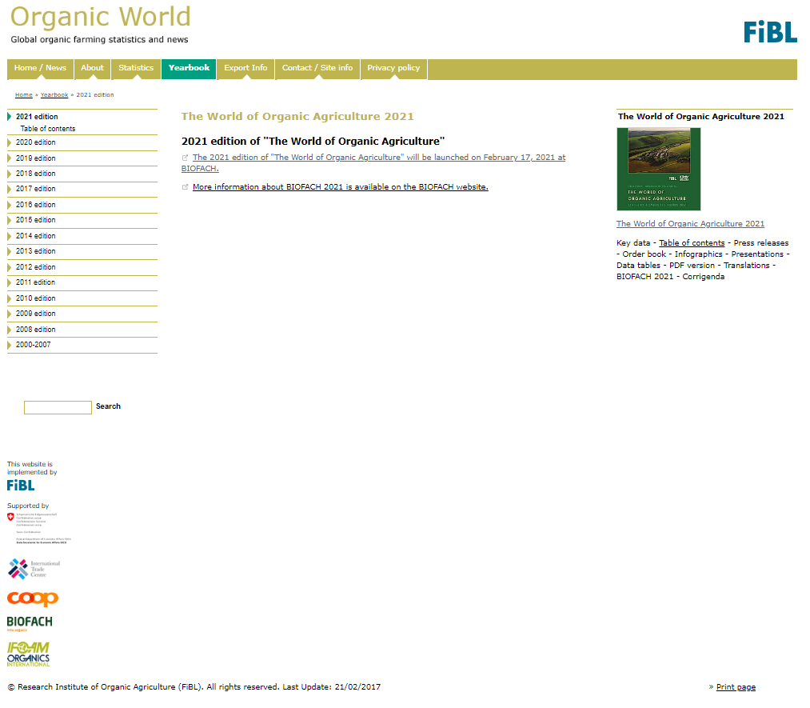
Website www.organic-world.net
Detailed statistics in excel format
Graphs & Maps
Data revisions
News and background information

Slide 6
About this presentation
There are 3 presentations summarizing the key results of the FiBL survey on organic agriculture worldwide 2021(data 2019). Apart from the global data, key results on crop and on regional data are presented.
More information is available at www.organic-world.net
The following three presentations are available at http://www.organic-world.net/yearbook/yearbook2021/slide-presentations.html:
Part 1: Global data 2019 and survey background
Part 2: Land use and key crops in organic agriculture 2019
Part 3: Organic agriculture in the regions 2019

Slide 7
The 22nd survey on organic agriculture world-wide
The 22nd survey on organic agriculture worldwide was carried out by the Research Institute of Organic Agriculture FiBL in cooperation with partners from all around the world. The results were published jointly by FiBL and IFOAM – Organics International.
The survey was carried out between July 2020 and February 2021.
Data were received from 187 countries.
Updated data on area and producers were available for 142 countries.
Data was provided by over 200 country experts (representatives from NGOs, certification bodies, governments, researchers).
The following data was collected: area data (including land use and crop details); producers, other operator types; domestic market values; export and import data; and livestock data (animal heads and production in metric tons);
The results are published in the yearbook “The World of Organic Agriculture 2021” and at www.organic-world.net.

Slide 8
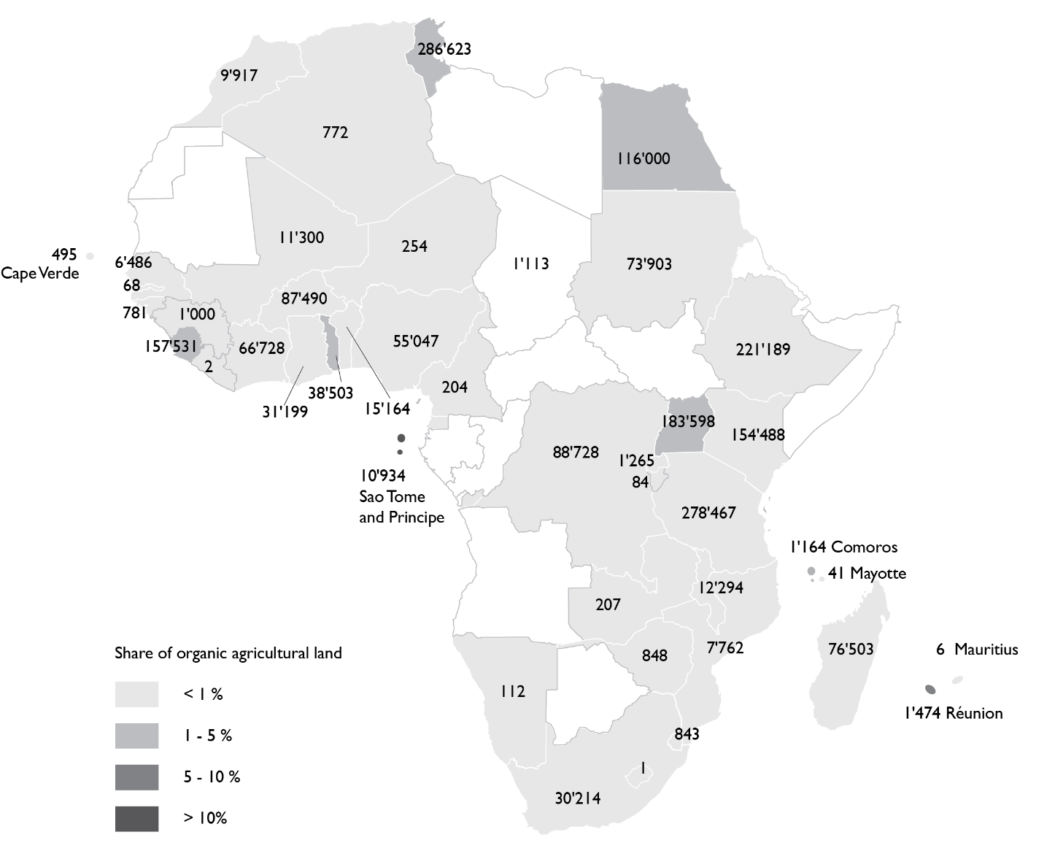
Africa: Organic agricultural land by country 2019
Source: FiBL survey 2021, based on national sources and data from certifiers.

Slide 9
Africa: Organic agriculture in Africa 2019
In Africa, there 2.0 million hectares of certified organic agricultural land (data 2019).
This constitutes about three percent of the world’s organic agricultural land and 0.2 percent of the total agricultural area in the region.
850´000 producers were reported.
The countries with the most organic land are Tunisia (286’623 hectares), Tanzania (278’467 hectares), and Ethiopia(221’189 hectares).
The highest shares of organic land are in Sao Tome and Prince (24.9 percent), Sierra Leone (4.0 percent), and Réunion (3.1 percent).
The majority of certified organic produce in Africa is destined for export markets.
The European Union, as the major recipient of these exports, is Africa’s largest market for agricultural produce.
Source: FiBL survey 2021

Slide 10
Africa: Development of organic agricultural land 2019

Slide 11
Africa: The ten countries with the largest organic area 2013

Slide 12
Africa: Distribution of organically managed agricultural land by country 2019

Slide 13
Africa: The countries with the highest share of organic agricultural land 2012

Slide 14
Africa: Use of agricultural organic land 2012
Notes:
Where to find the data?

Slide 15
Africa: The ten countries with the largest number of organic producers 2013

Slide 16
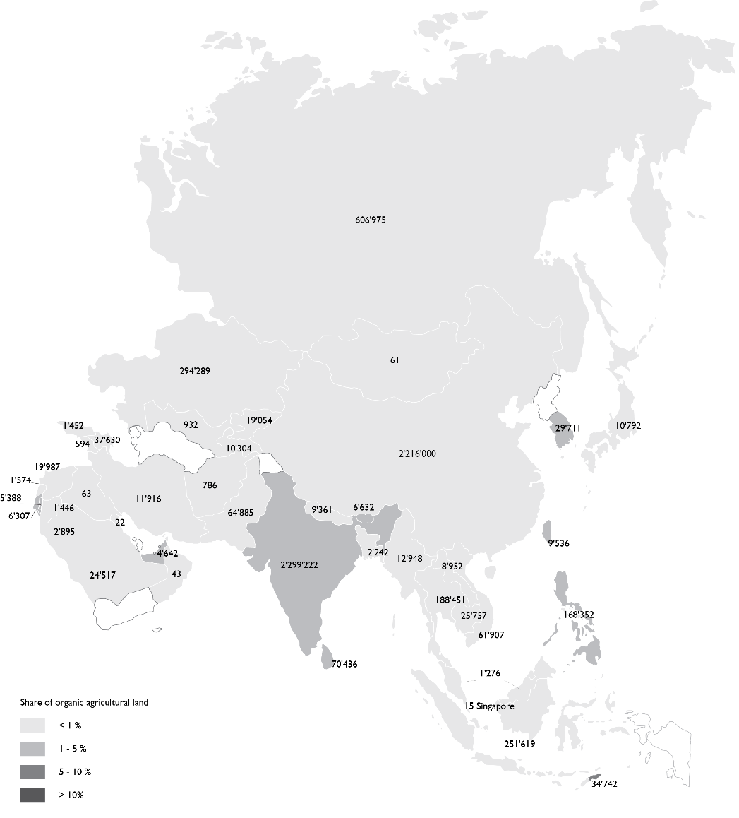
Asia: Organic agricultural land by country 2019
Source: FiBL survey 2021, based on national sources and data from certifiers.

Slide 17
Asia: Organic Agriculture in Asia – Key Figures 2021
The total organic agricultural area in Asia was 5.9 million hectares in 2018.
This constitutes nine percent of the world’s organic agricultural land, and 0.4 percent of the total agricultural area in the region.
There were nearly1.6 million producers reported.
The leading countries by organic agricultural land are China (2.3 million hectares) and India (2.2 million hectares).
Timor-Leste has the most organic agricultural area as a proportion of total agricultural land (8.5 percent).
Source: FiBL survey 2021

Slide 18
Asia: Development of organic agricultural land 2000 to 2013

Slide 19
Asia: The ten countries with the largest organic area 2013

Slide 20
Asia: Distribution of organic agricultural land by country 2019 (total 5.9 million hectares)

Slide 21
Asia: The countries with the highest share of organic agricultural land 2013

Slide 22
Africa: Use of agricultural organic land 2012
Notes:
Land use asia!!!!! China – no permanent grassland – all moved to plants harvested green – arable land

Slide 23
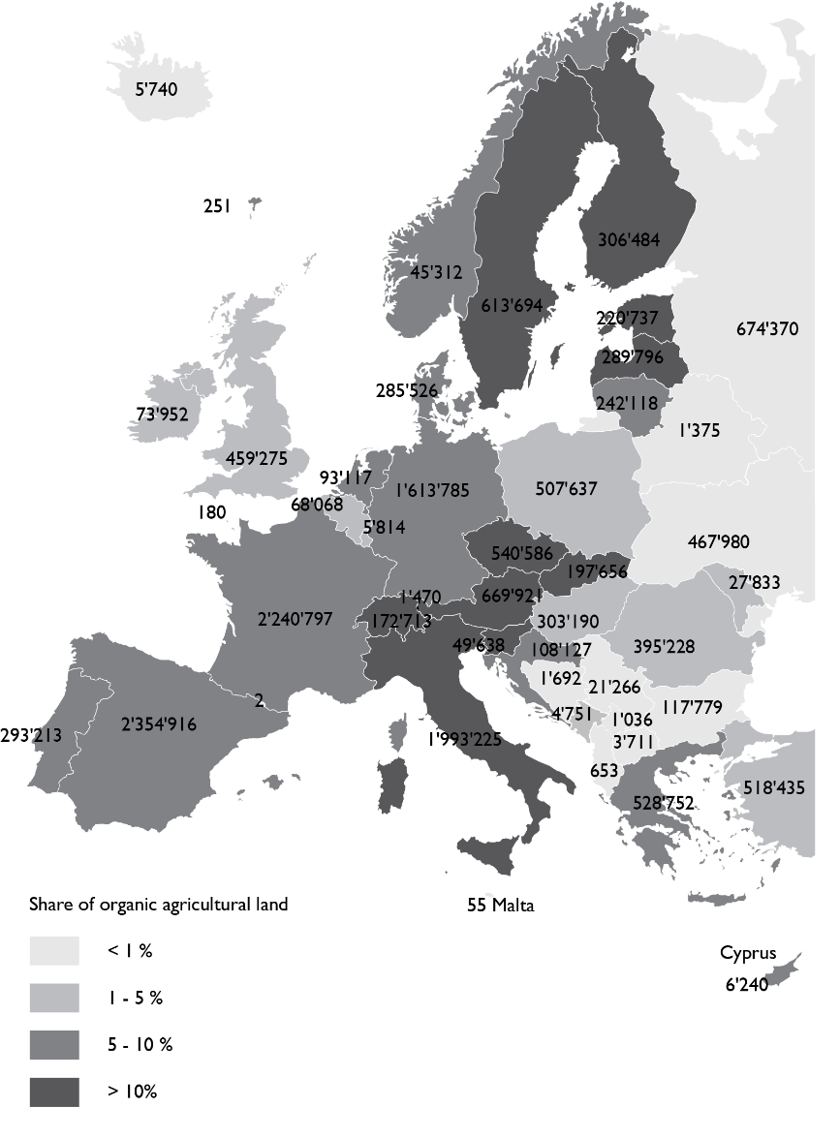
Europe: Organic agricultural land by country 2019
Source: FiBL survey 2021, based on national sources and Eurostat.

Slide 24
Organic agriculture in Europe: Key data/indicators 2019
16.5 million hectares of agricultural land are organic (including in conversion areas).
This constitutes 3.3 percent of the agricultural land in Europe.
The organic agricultural land increased by 0.92 million hectares or 5.9 percent in 2019.
More than 430’000 producers were reported.
The organic retail sales reached 45.0 billion euros in Europe.
Source: FiBL survey 2021, based on national sources and Eurostat.

Slide 25
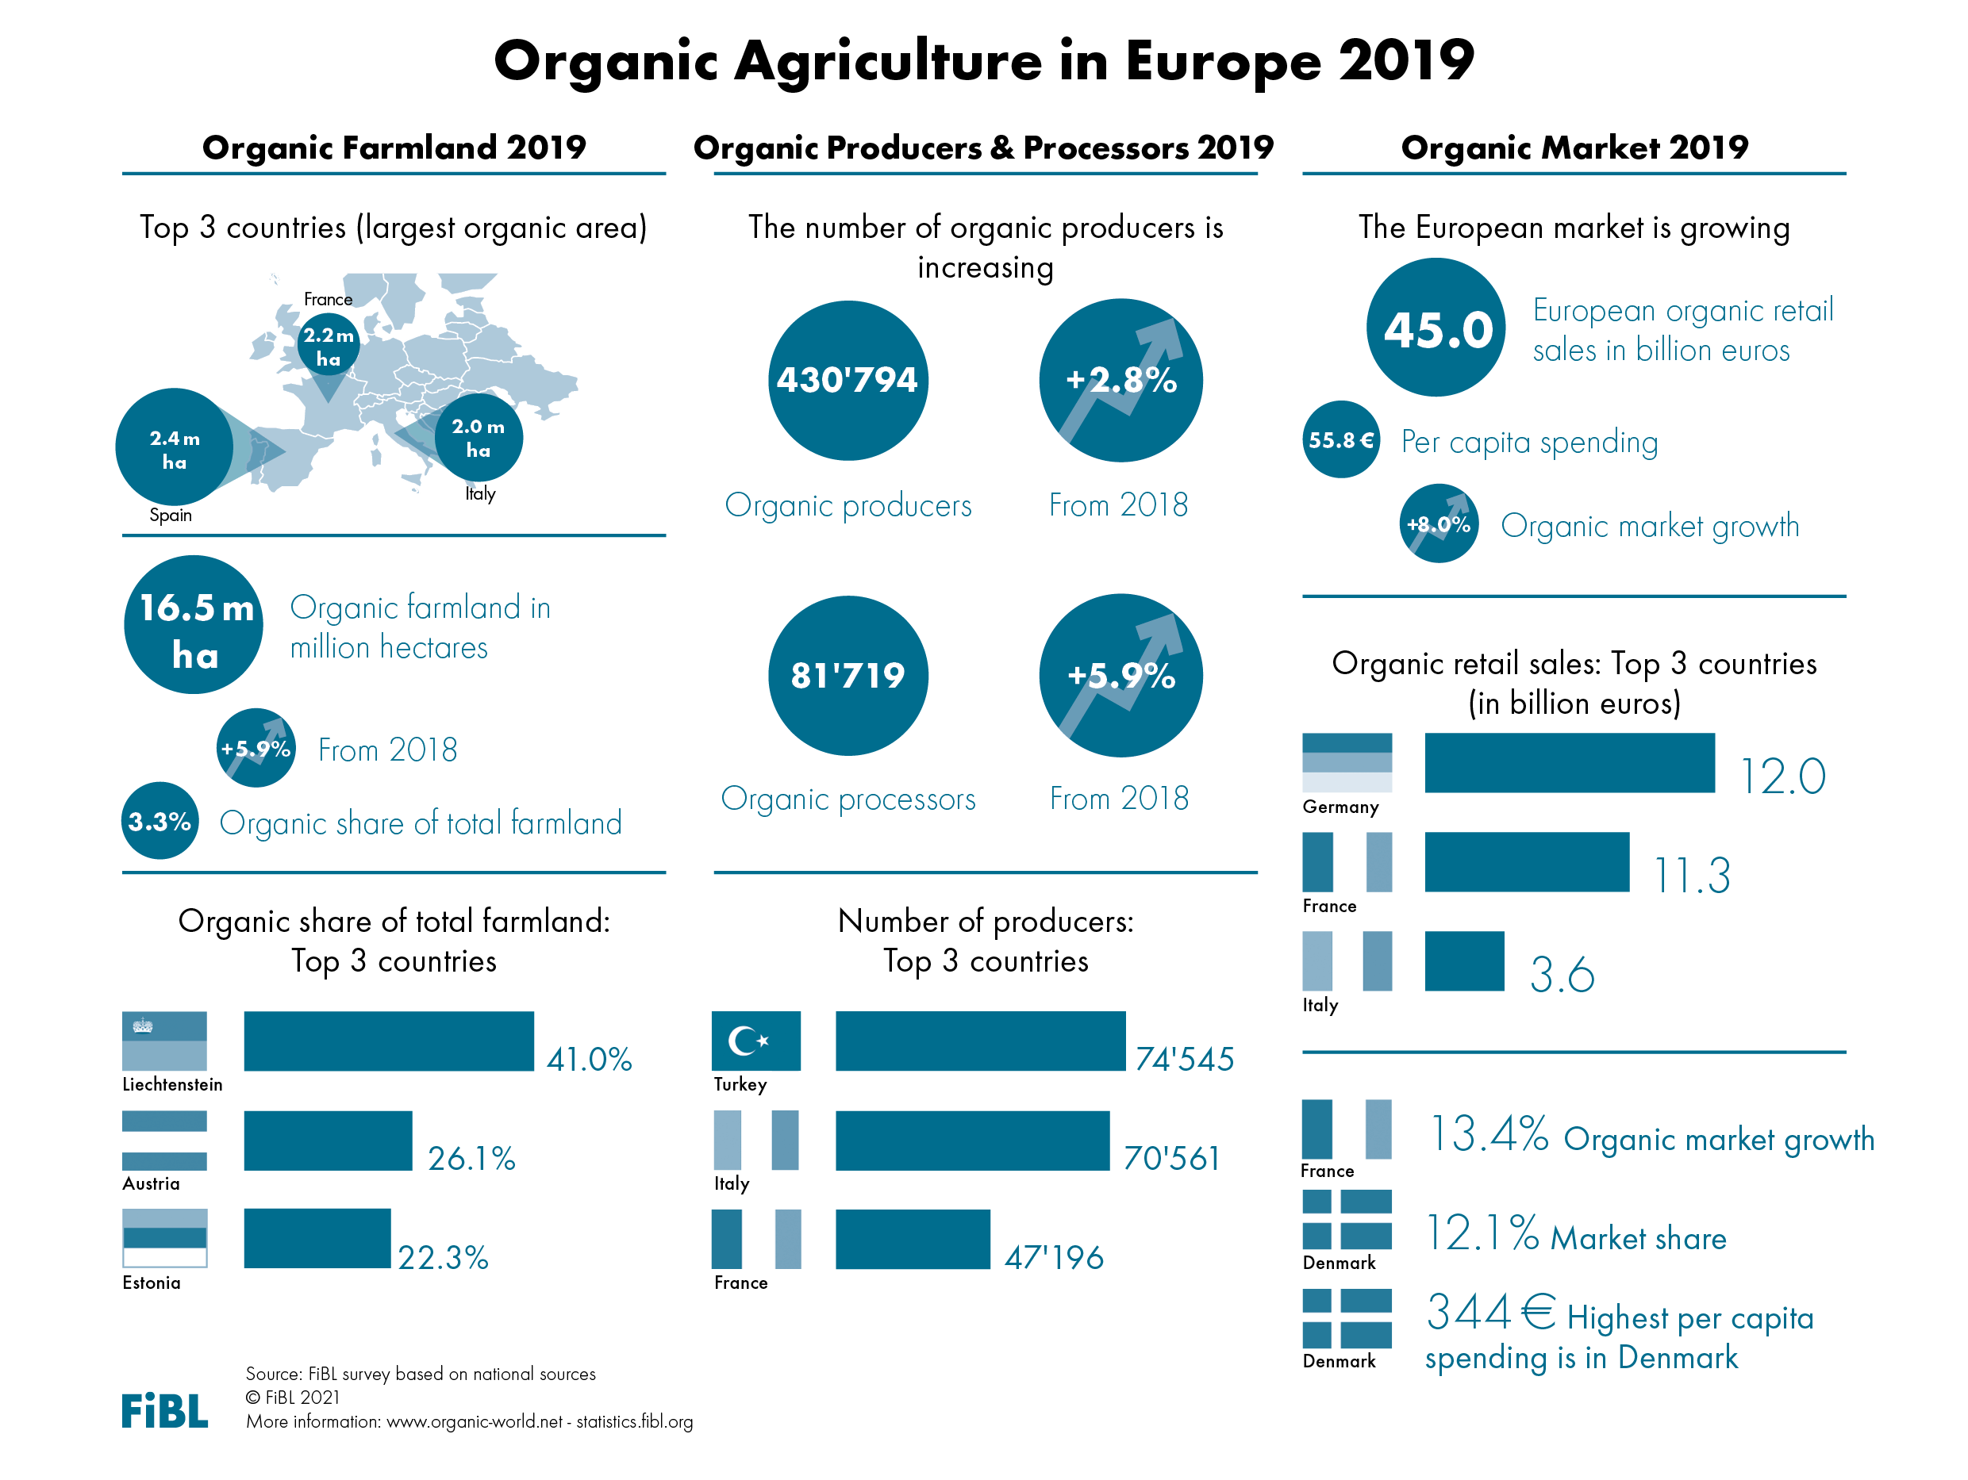

Slide 26
Organic agriculture in the European Union: Key data/indicators 2019
14.6 million hectares of agricultural land are organic (including in conversion areas).
This constitutes 8.1 percent of the agricultural land in the European Union.
The organic agricultural land increased by 0.82 million hectares or 5.9 percent in 2019.
More than 343´000 producers were reported.
The organic retail sales reached 41.4 billion euros in the EU.
Source: FiBL survey 2021, based on national sources and Eurostat.

Slide 27
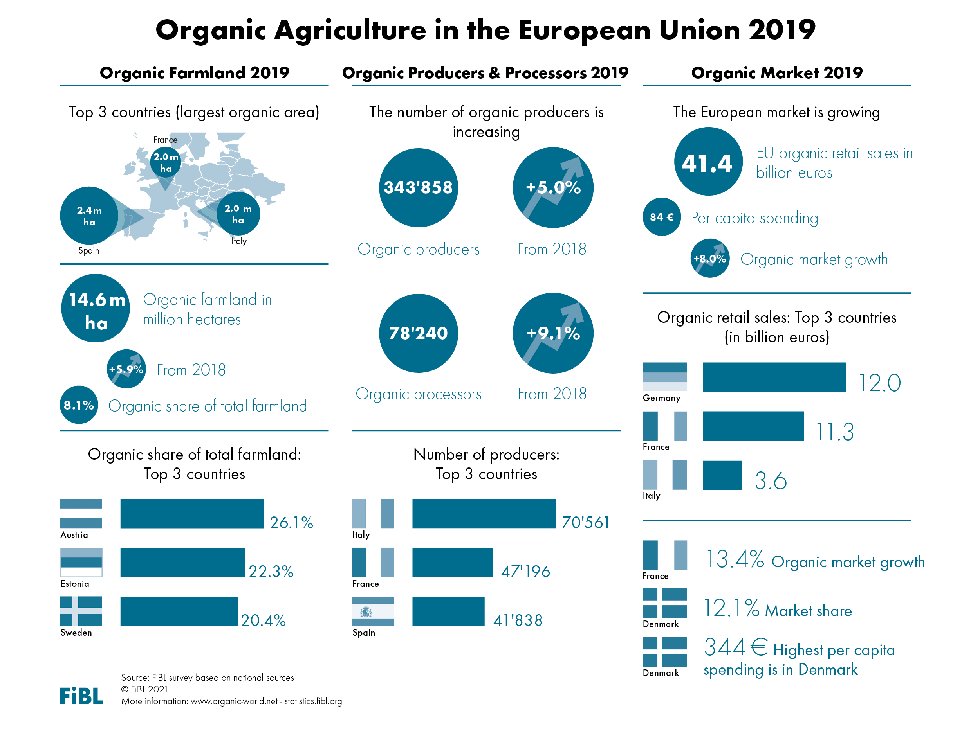

Slide 28
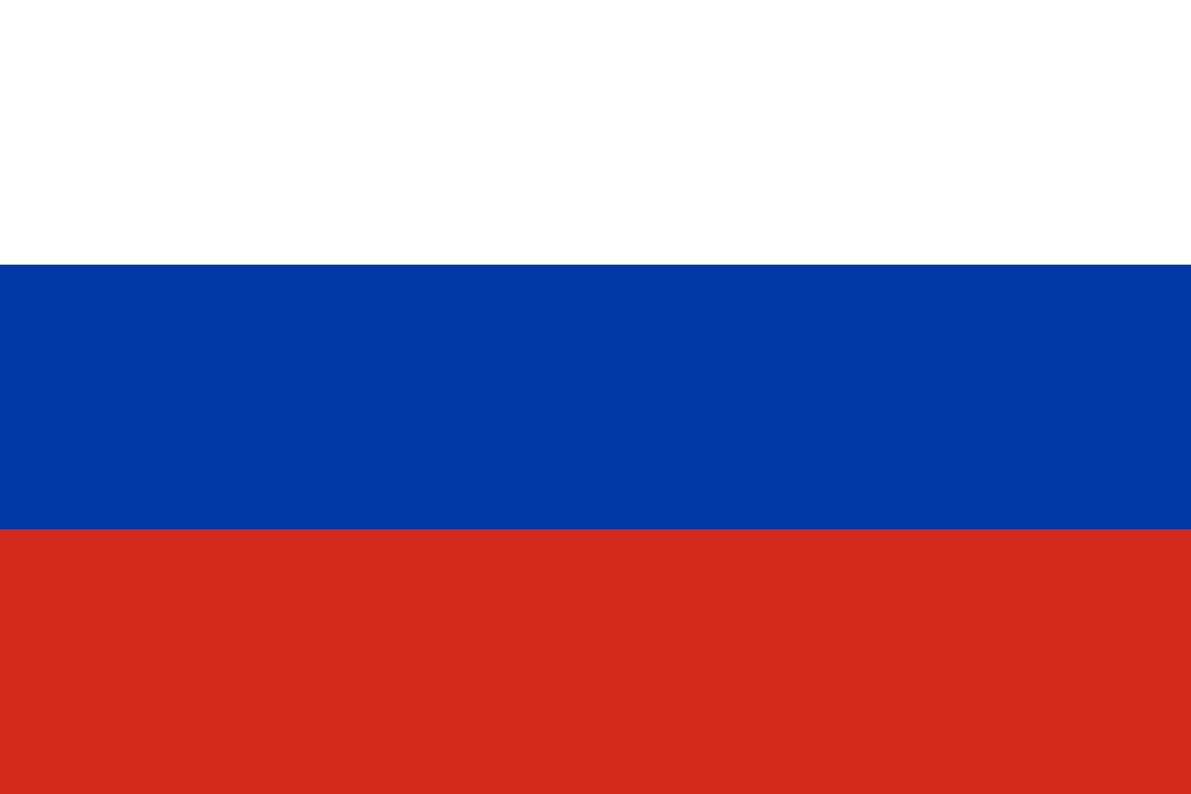
EUROPE: ORGANIC FARMLAND 2019
Europe 16.5 Million ha
Spain 2.4 Million ha
3.3% of Europe’s farmland is organic (EU 8.1%)
+65% in the decade 2010-2019
(EU +61%)
Half of Europe´s organic farmland is in 4 countries.
The country with the largest area of organic farmland is in Spain, followed by France and Italy.
Twelve countries have 10% or more of their agricultural land under organic management.
From 2018 to 2019 the organic agricultural land grew by 0.9 Million hectares (+5.9%).
Spain
Liechtenstein
France
Austria
Italy
Estonia
Germany
Sweden
Russia
Switzerland
Percentage
Distribution of organic
agricultural land by country 2019
Top 5 countries with the largest areas of organic agricultural land 2019
Top 5 countries, where more than 10 percent of the farmland is organic 2019
Growth of the organic
agricultural land 1985–2019
Source: FiBL-AMI survey 2021, www.organic-world.net

Slide 29
Europe: The ten countries with the most organic agricultural land 2019

Slide 30
Europe: Distribution of organic farmland by country 2019

Slide 31
Europe: Distribution of shares of organic land 2019

Slide 32
Europe: The ten countries with the most organic agricultural land 2019

Slide 33
Europe: Growth of organic area and retails sales 2000-2019

Slide 34
Europe and European Union: Development of organic farmland 1985 to 2019

Slide 35
Europe: The 10 countries with the highest growth of organic agricultural land in 2019

Slide 36
Europe: Use of organic agricultural land 2019

Slide 37
Europe : Distribution of organic producers and processors in 2019

Slide 38
Europe and European Union: Development of organic producers 2000 to 2019

Slide 39
Organic market in Europe: Key data/indicators 2019
The European market was 45.0 billion euros; 8.0 percent more than in 2018.
The largest market for organic products in 2019 was Germany with a turnover of over 12.0 billion euros, followed by France (11.3 billion euros) and Italy (3.6 billion euros).
As a portion of the total market share, the highest levels have been reached in Denmark, Switzerland, and Austria with nine percent or more for organic products. The highest per capita spending is In Denmark, followed by Switzerland, Luxewmbourg, and Austria
Source: FiBL survey 2021, based on national sources and Eurostat.

Slide 40
EUROPE: ORGANIC RETAIL SALES 2019
Europe 45.0 billion €
Germany 12.0 billion €
344 € are spent per person in Denmark
12.1 % of the food market in Denmark is organic
The European Union (41.4 billion €) is the second largest single market after the US (44.7 billion €) and China (8.5 billion €). By region, North America has the lead (48.2 billion €), followed by Europe and Asia (10.9 billion €).
The European countries with the largest markets for organic food are Germany, France (11.3 billion €), Italy (3.6 billion €), and Switzerland (2.9 billion €).
Denmark and Switzerland have the highest per capita consumption worldwide, followed by Luxembourg, Austria, and Sweden.
The country with the highest organic market share is Denmark, followed by Switzerland, Austria, Sweden, and Luxembourg.
Germany
Denmark
Denmark
France
Switzerland
Switzerland
Italy
Luxembourg
Austria
Switzerland
Austria
Sweden
UK
Sweden
Luxembourg
Distribution of retail sales value worldwide by country 2019
The countries with the largest markets for organic food 2019
The countries with the highest
per capita consumption of organic food 2019 in Europe (and world)
The countries with the highest organic shares of the total market 2019 in Europe (and world)
Source: FiBL-AMI survey 2021. www.organic-world.net

Slide 41
Europe:growth of organic area and retails sales 2000-2019

Slide 42
Europe and European Union: Development of retail sales 2000-2019

Slide 43
European Union: Growth of the per capita consumption 2005-2019

Slide 44
European Union: Development of the organic market in selected European countries 2004-2019

Slide 45
Germany: Development of the organic market 1997-2019

Slide 46
France: Growth of retail sales 200-2019

Slide 47
United Kingdom: Development of the organic market 1995-2019

Slide 48
Europe: Distribution of sales of organic food and drink by country 2019

Slide 49
Figure: Distribution of retail sales in Europe and worldwide

Slide 50
The European market for organic food and drink: The countries with the highest sales 2019

Slide 51
Europe: The countries with the highest per-capita consumption 2019

Slide 52
Europe: The countries with the highest growth of the organic market 2018-2019

Slide 53
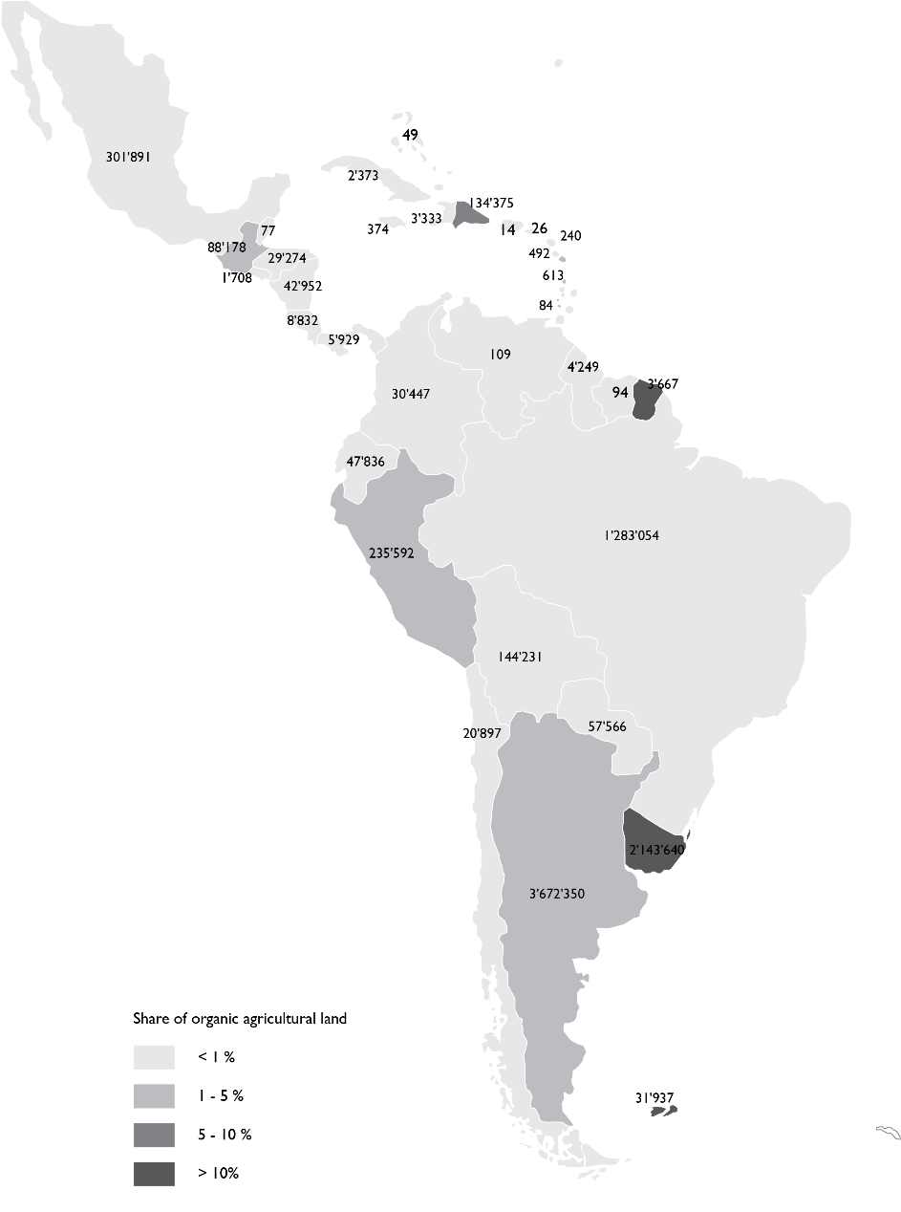
Latin America/Caribbean: Organic agricultural land by country 2019
Source: FiBL survey 2021, based on national sources and data from certifiers.

Slide 54
Latin America and Caribbean: Key figures 2019
In Latin America, almost 227'609 producers managed over 8 million hectares of agricultural land organically in 2018.
This constitutes 11 percent of the world’s organic land and 0.9 percent of the regions agricultural land.
The leading countries are Argentina (3.6 million hectares), Uruguay (2.1 million hectares), and Brazil (1.9 million hectares).
The highest shares of organic agricultural land are in Uruguay (14.9 percent), French Guiana (10.1 percent), and the Dominican Republic (7.2 percent).
Source: FiBL survey 2021

Slide 55
Latin America and Caribbean: Organic agricultural overview
Most organic products from Latin American countries are sold on the European, North American or Japanese markets. Popular goods are especially those that cannot be produced in those regions, as well as off-season products.
Many Latin American countries remain important exporters of organic products such as bananas, cocoa and coffee; in countries such as Argentina and Uruguay, temperate fruit and meat are key export commodities. At the same time, domestic markets are trending positively in the region.
Important crops are tropical fruits, grains and cereals, coffee, cocoa, sugar, and meats. Most organic food sales in the domestic markets of the countries occur in major cities.

Slide 56
Latin America and Caribbean: Development of organic agricultural land 2000 to 2013

Slide 57
Latin America and Caribbean: The ten countries with the largest organic area 2013

Slide 58
Latin America/Caribbean: Distribution of organic agricultural land by country 2019

Slide 59
Latin America and Caribbean: The countries with the highest share of organic agricultural land 2013

Slide 60
Africa: Use of agricultural organic land 2012

Slide 61
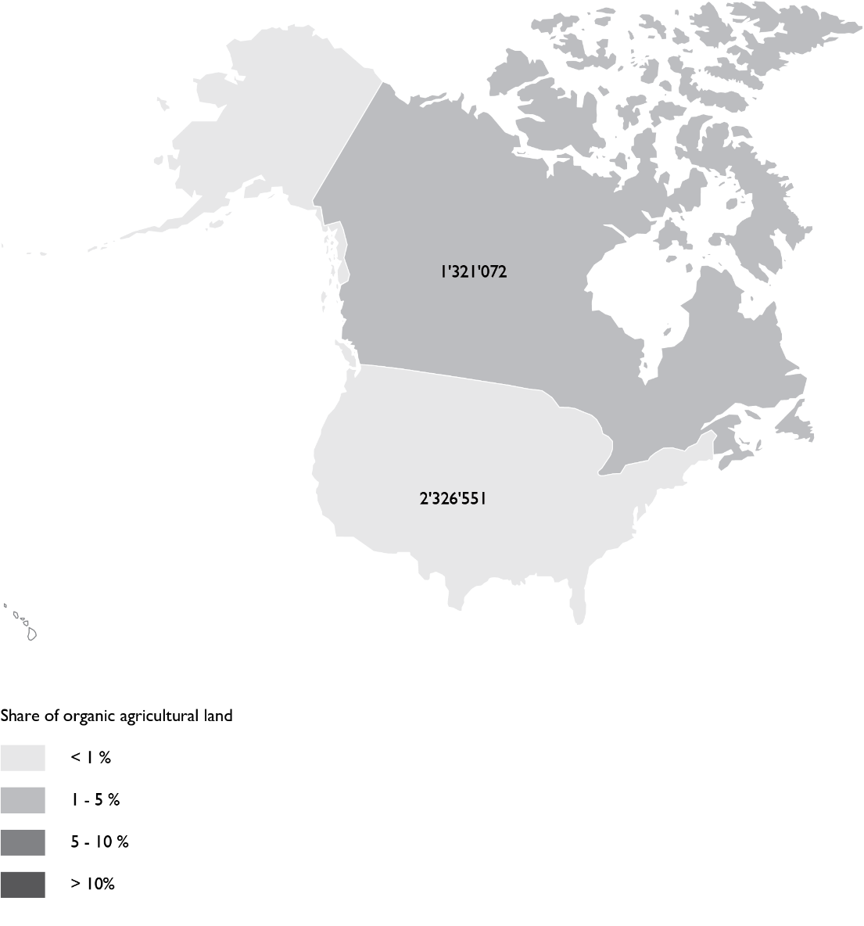
North America: Organic agricultural land by country 2019
Source: USDA and COTA 2021

Slide 62
Organic Agriculture in North America: Key figures 2019
In North America, 3.6 million hectares are managed organically, of these are 2.3 in the United States and more than 1.3 million in Canada.
This represents 0.8 percent of the total agricultural area in the region and 5 percent of the world’s organic agricultural land.
In 2019, the organic market continued to grow in North America, reaching more than 48.2 billion euros. In Canada, the organic market grew by over 12 percent in 2019, and in the United States the organic market grew by 10 percent.
The United States is the largest single organic market in the world, and North America continues to be the continent with the largest organic market.
Source: USDA and COTA 2021

Slide 63
North America: Development of organic agricultural land 2000-2013

Slide 64
Organic Agriculture in North America 2013

Slide 65
North America: Distribution of organic agricultural land by country 2019

Slide 66
North America: Organic share of total organic agricultural Land 2013

Slide 67
Africa: Use of agricultural organic land 2012

Slide 68
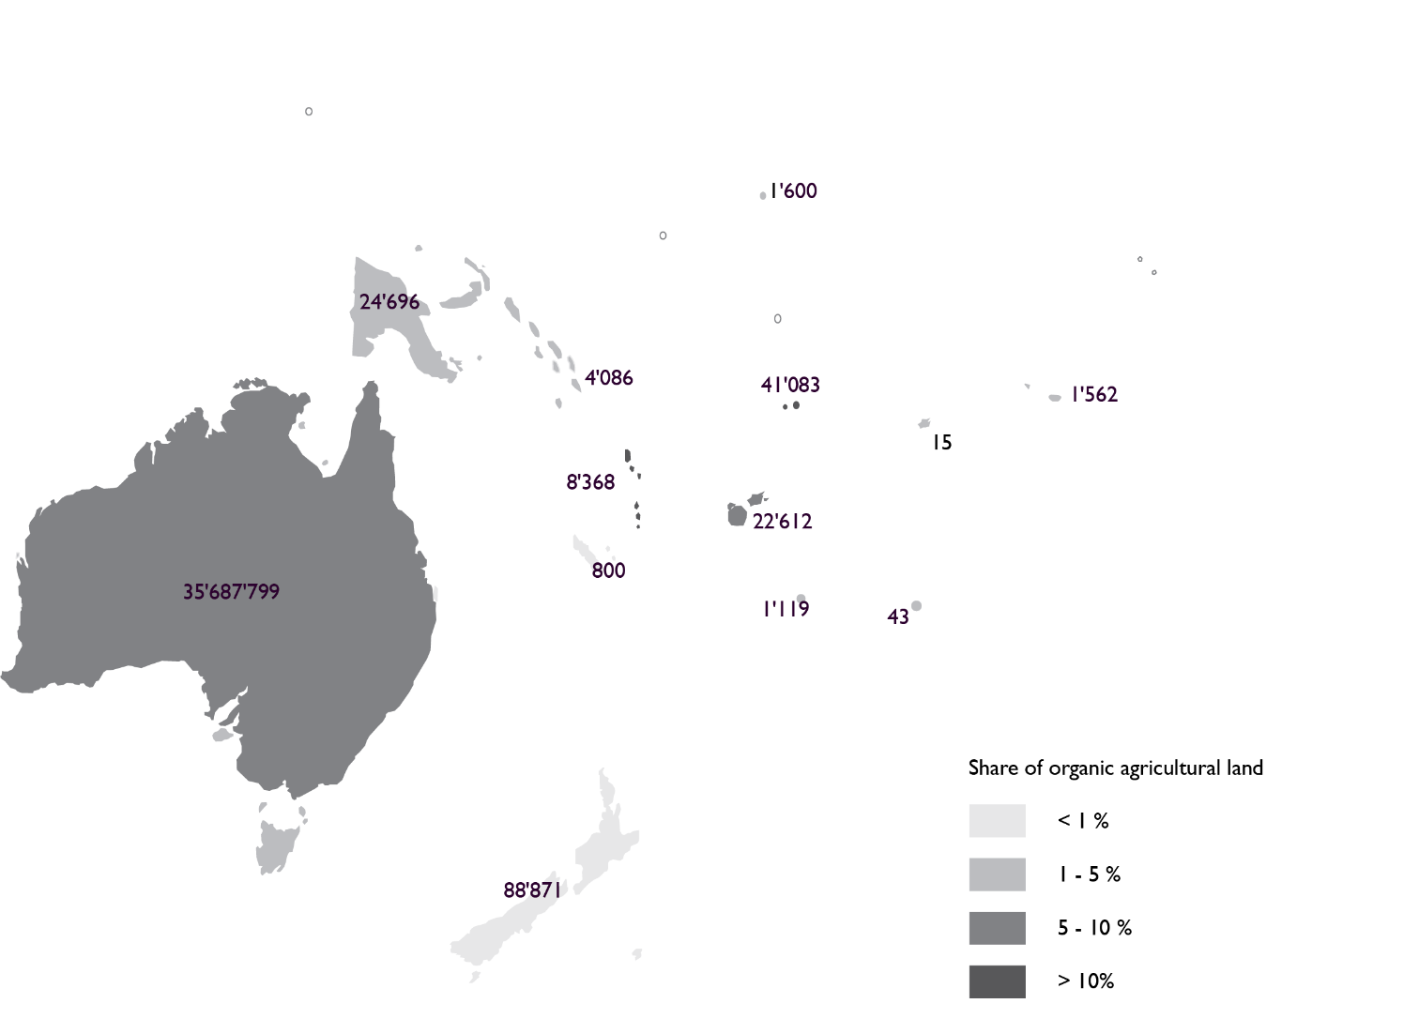
Oceania: Organic agricultural land by country 2019
FiBL survey 2021, based on national sources and data from certifiers.

Slide 69
Organic agriculture in Oceania: Key figures 2019
This region includes Australia, New Zealand, and the Pacific Islands.
Altogether, there are almost 18´000 producers, managing 35.9 million hectares.
This constitutes 9.6 percent of the agricultural land in the area and half of the world’s organic land.
Ninety-nine percent of the organic land in the region is in Australia (35.7 million hectares, 97 percent of which is estimated to be extensive grazing land), followed by New Zealand (88´871 hectares), and Samoa (41´093hectares).
The highest shares of all agricultural land are in Samoa (14.5 percent), followed by Australia (9.9 percent), Fiji (5.3 percent), and Vanuatu (4.5 percent).
FiBL survey 2021

Slide 70
Oceania: Development of organic agricultural land 2000-2013

Slide 71
Oceania: Organic agricultural land by country 2013

Slide 72
Oceania: Distribution of organic agricultural land by country 2019

Slide 73
Oceania: Share of organic agricultural land 2013

Slide 74
Oceania: Use of organic agricultural land 2019

Slide 75
More information
More information (PDF, data sources, graphs) at http://www.organic-world.net/yearbook/yearbook-2021.html
Contact Helga Willer Research Institute of Organic Agriculture (FiBL) 5070 Frick Switzerland helga.willer@fibl.org

Slide 76
Disclaimer
All of the results contained in this slide show have been compiled by the Research Institute of Organic Agriculture (FiBL). However, the possibility of mistakes cannot be ruled out entirely. Therefore, FIBL is not subject to any obligation and makes no guarantees whatsoever regarding any of the statements or results in this work; neither does FiBL accept responsibility or liability for any possible mistakes, nor for any consequences of actions taken by readers based on statements or advice contained therein.
This document has been produced with the support of the Swiss State Secretariat for Economic Affairs (SECO), the International Trade Centre (ITC), the Sustainability Fund of Coop Switzerland, NürnbergMesse, IFOAM – Organics International. The views expressed herein can in no way be taken to reflect the official opinions of SECO, ITC, Coop, NürnbergMesse or IFOAM – Organics International.

